Slide 1
Parallelization of GPUs based on Horovod – A Scaling and Performance Analysis based on an Application from Material Sciences
Zwischenpräsentation Bachelorarbeit
Paul Orlob

Slide 2
Structure
Introduction
Model- & Data Parallelism
Horovod
Example from Material Sciences
Speedup & Efficiency
Performance Analysis
Optimization
Next Steps

Slide 3
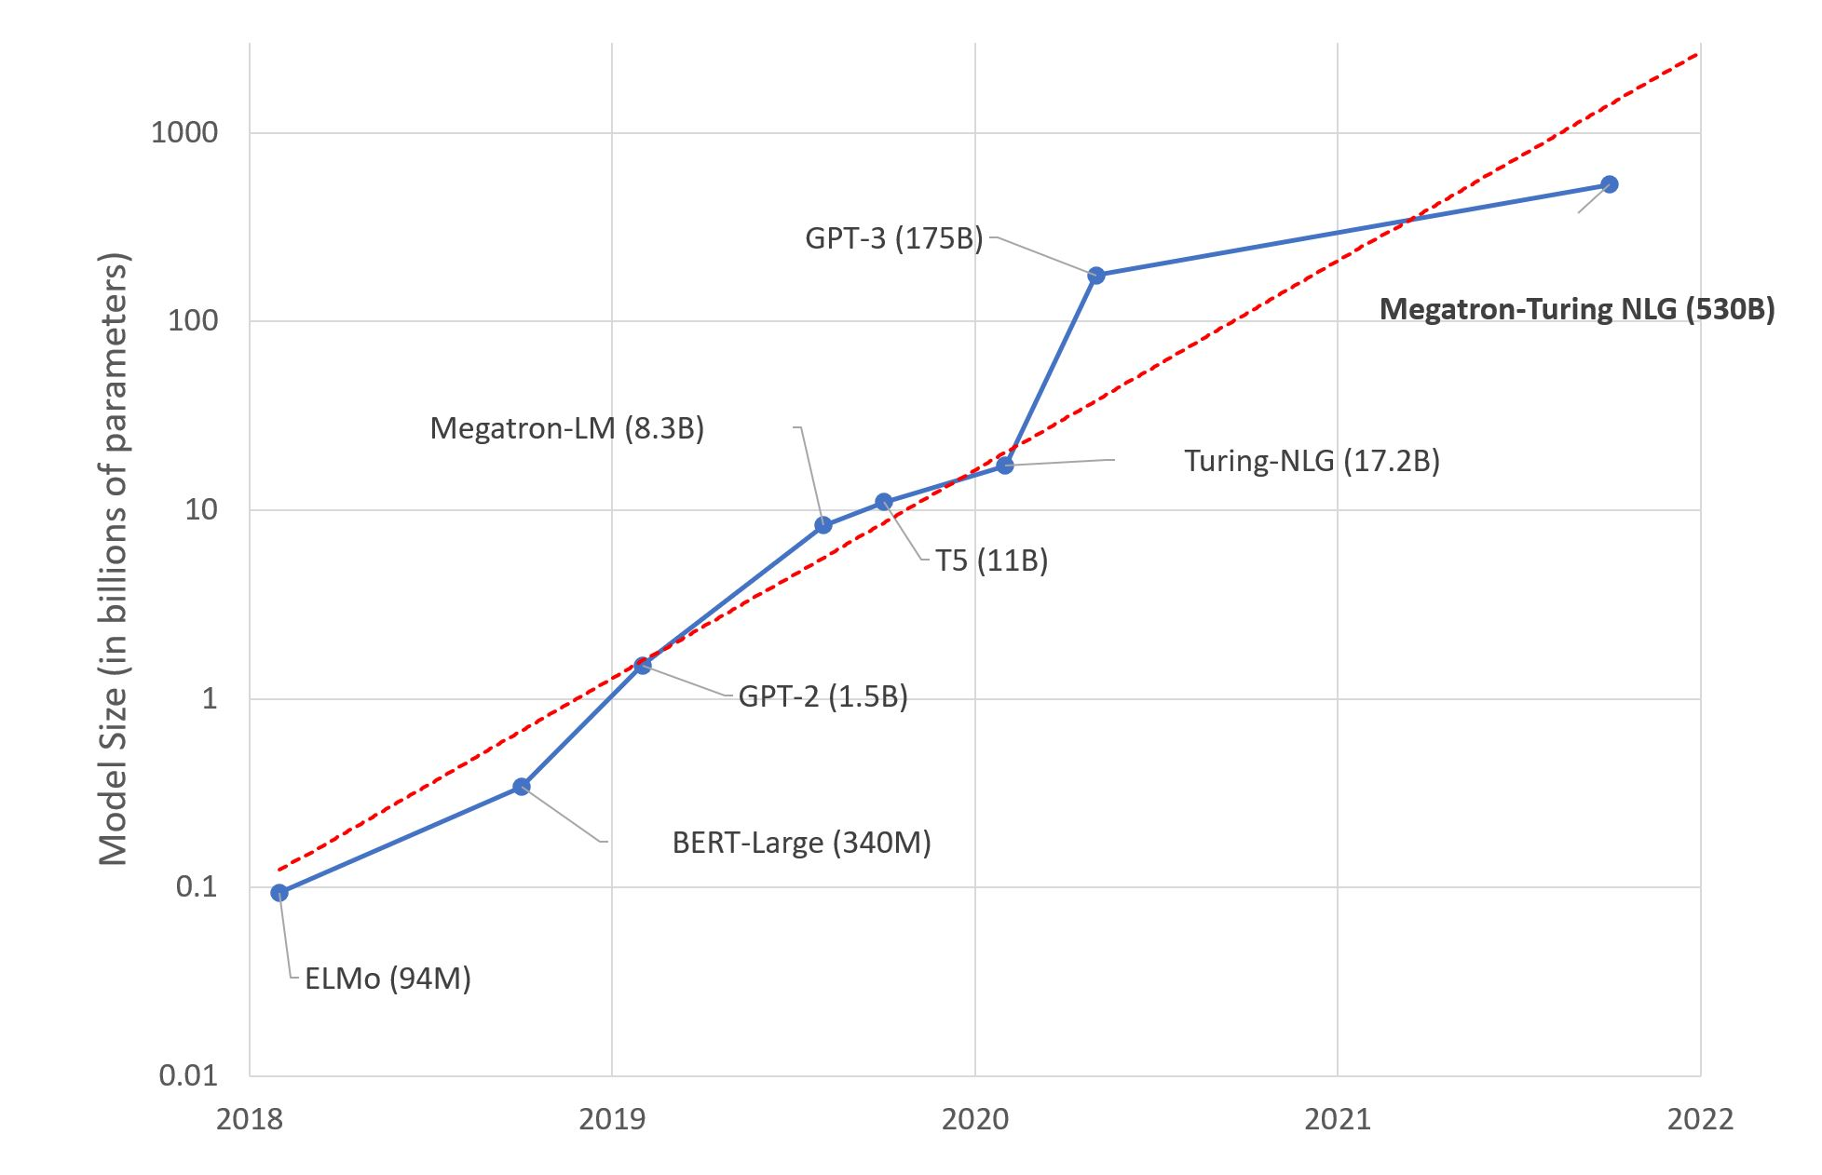
Motivation
Problem: increasingly large networks + large amounts of data
  Increased training time
  Especially problematic when tuning hyperparameters
Solution: GPU-Parallelization, multiple GPUs and Nodes used for training
Image: A. Alvi, P. Kharya. „Using DeepSpeed and Megatron to Train Megatron-Turing NLG 530B, the World’s Largest and Most Powerful Generative Language Model“. microsoft.com. 2020 [Online] Available: https://www.microsoft.com/en-us/research/blog/using-deepspeed-and-megatron-to-train-megatron-turing-nlg-530b-the-worlds-largest-and-most-powerful-generative-language-model/

Slide 4
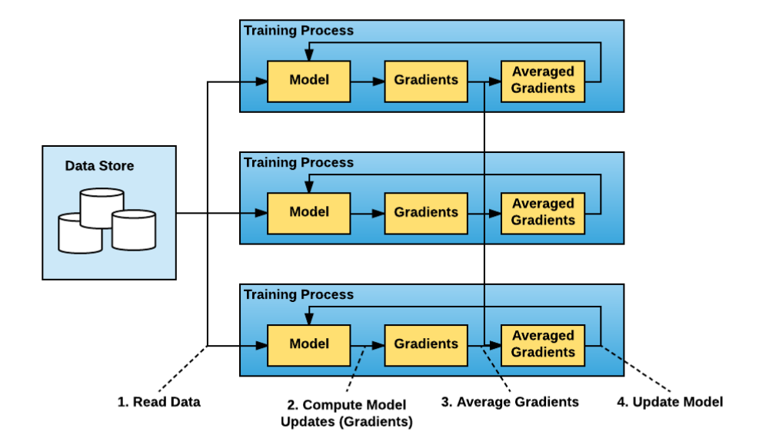
Data Parallelism [1, 2, 4]
N workers
Each Worker has a copy of the network
Split data into N partitions
Parallel computation of forward- and backward pass
→ Synchronization of N groups of parameter-gradients at the end of each backward pass
→ # of synchronizations = # of batches
Figure 1: Data parallel training [3]

Slide 5
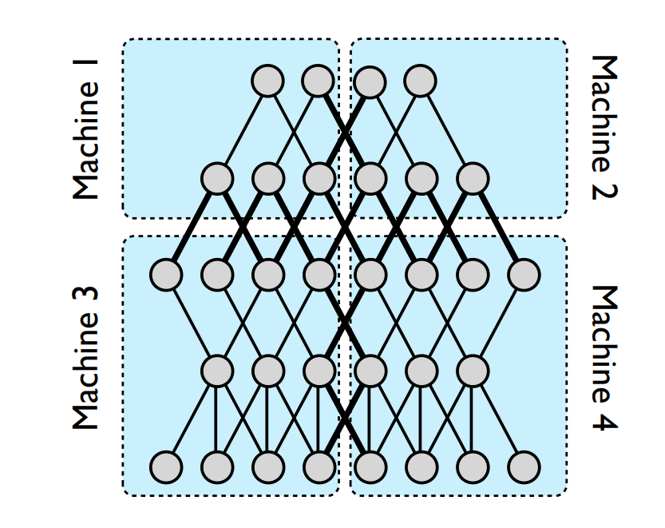
Model Parallelism [1, 2, 4]
N workers
Each Worker has a copy of all data
Split network into M partitions
Parallel computation of (some) network layers
→ Synchronization every time results are needed by another worker
  Layers can only be computed sequentially
Image : J. Dean et al., “Large scale distributed deep networks,” Advances in neural information processing systems, vol. 25, 2012.

Slide 6
Data vs. Model Parallelism [1,2,3,4]
Data Parallelism | Model Parallelism
Efficient if amount of computation per parameter is high | Efficient if amount of computation per neuron output is high
Number of synchronizations dependant on number of batches | Number of synchronizations dependant on network topology
Reduces size of data per worker | Reduces size of network per worker
Parallel, except gradient synchronization | Parallelism highly dependant on network topology, interconnected sequential layers can not be computed in parallel

Slide 7

Horovod [3]
Library created by Uber, published 2017, Apache 2.0 license
Motivation:
  TensorFlow Distributed used parameter servers (at time of creation) [7]
  Complicated software development: Number of Parameter Servers; Boilerplate Code
Supports major DL frameworks (Tensorflow, Keras, PyTorch, MXNet)
Supports Data Parallelism out-of-the-box
Uses „ring-allreduce“ algorithm, bandwith-optimal [5, 6]
„ring-allreduce“ implemented in MPI & NCCL (NVIDIA Collective Communication Library)
→ 88% efficient scaling when training Inception V3, ResNet-101

Slide 8
Example from Material-Sciences: Dataset [8]
Prediction of material parameters from strain-stress curves
1M labelled datapoints → 75% training, 25% validation
1 point → (200 points {strain, stress, flag}; 2 parameters)

Slide 9
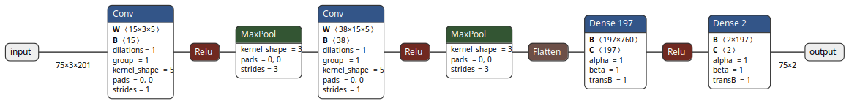
Example from Material-Sciences: Network [8]
Using Hyperparameteroptimization:
  Batch Size 75, Learning Rate: 4.7331*10⁻⁴
  153,441 parameters → 0.61MB parameter size
→ „large“ dataset, „small“ network → data parallelism preffered
Topology generated using: L. Roeder. „Netron“ netron.app (accessed Aug. 1, 2022)

Slide 10
Training on Taurus
Partitions: Alpha, GPU2, HPDLF
Using NCCL and MPI
NCCL Advantages: [9]
  Intra-Node: uses aggregated NVLinks, PCIe and shared-memory
  Inter-Node: uses aggregated network interfaces (TCP und RDMA)
  Automatic topology detection
  Compatible with MPI

Slide 11
Computing Resources
Runs executed in SLURM exclusive mode
#CPUs = (maxCPUs / maxGPUs) * #GPUs
Memory: all available Memory on the Node
#GPUs: variable
Default: NCCL

Slide 12
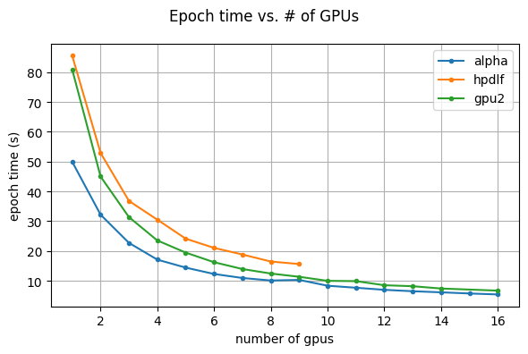
Speedup und Efficiency, sequential Distribution of GPUs
Sequential distribution: All GPUs of a node are used, before allocating another node

Slide 13
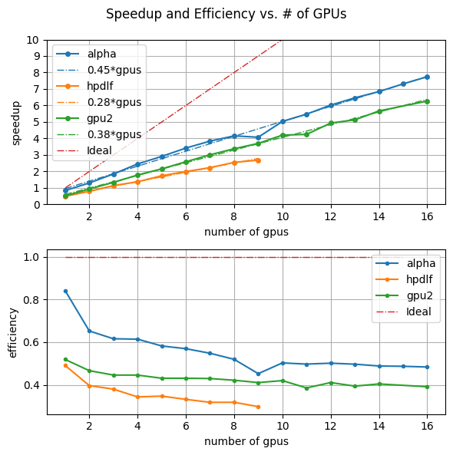
Speedup and Efficiency, sequential
Baseline: Alpha, 1 GPU, without Horovod
Speedup ~linear, Speedup per GPU:
  Alpha: 0.45 (MPI: 0.44)
  HPDLF: 0.28 (MPI: 0.26)
  GPU2: 0.38
MPI scales marginally worse than NCCL
Horovod on 1 GPU imposes overhead, ~17%
Why does scaling not come close to the promised 88%?

Slide 14
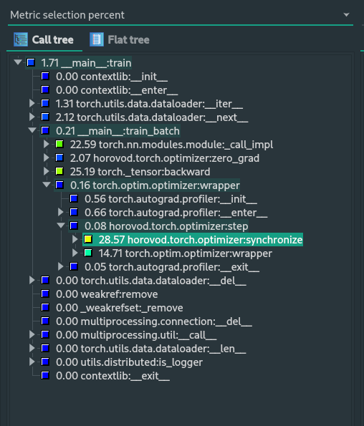
Profiling
2 Nodes, 6 GPUs, HPDLF
28% of training runtime used by gradient synchronization
Loading data only takes 2% → data already in RAM

Slide 15
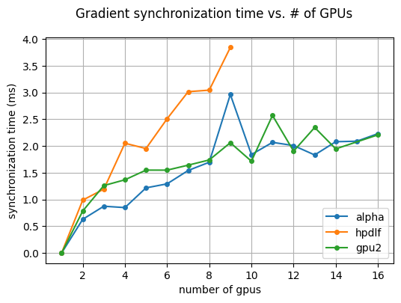
Horovod Communication Overhead
Synchronization of gradients before updating parameters
„synchronization time“ = time for synchronizing gradients
Observations:
Time increases w.r.t. number of gpus
Steeper gradient for HPDLF
Curve flattens for GPU2 und Alpha

Slide 16
Horovod Communication Overhead
Number of Synchronizations per epoch equal to number of batches per epoch
  Small batch size, large dataset → many synchronizations
  10 000 batches per epoch for full dataset
  On 2 workers:
    Data partitioned into 2
    5 000 batches * 1ms = 5s per epoch

Slide 17
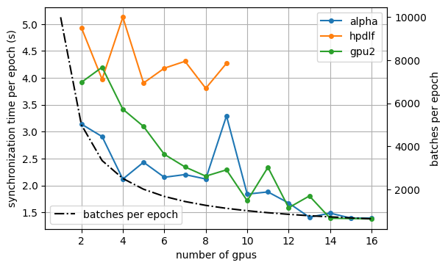
Horovod Communication Overhead
Number of Synchronizations per epoch equal to number of batches per epoch
  Number of Batches per epoch descreases due to data split
  Less synchronizations
  Number of synchronizations decreases faster than duration per synchronization increases → overall decrease

Slide 18
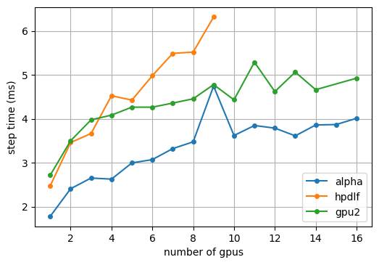
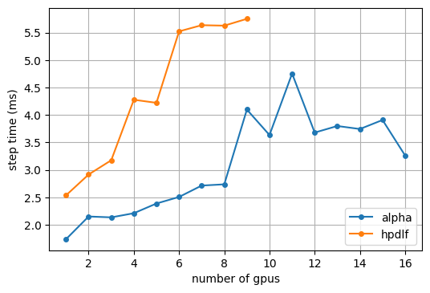
NCCL MPI
MPI more efficient intra-node
NCCL more efficient inter-node
Counterintuitive, NCCL should use intra-GPU links (NVLink) → MPI is more efficient for small tensors [11]

Slide 19
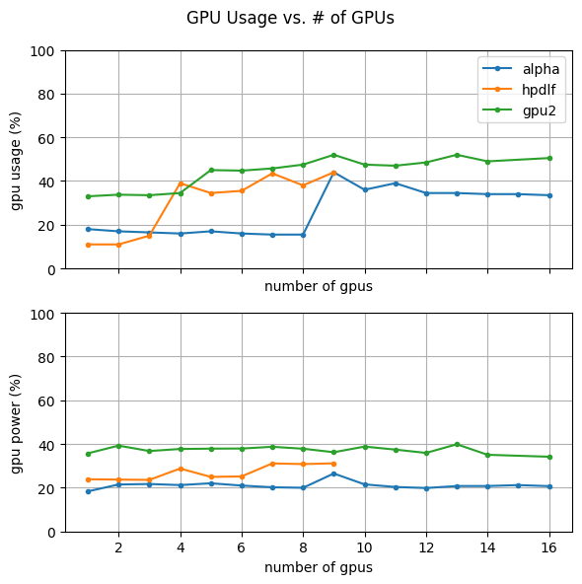
System Usage
Usage suddenly increases for Alpha/HPDLF when first, additional Node is allocated
  No impact on speedup
  NCCL?
Low overall GPU usage due to:
  small Batch Size
  small Netzwerk
  → Overhead CPU-GPU communication

Slide 20
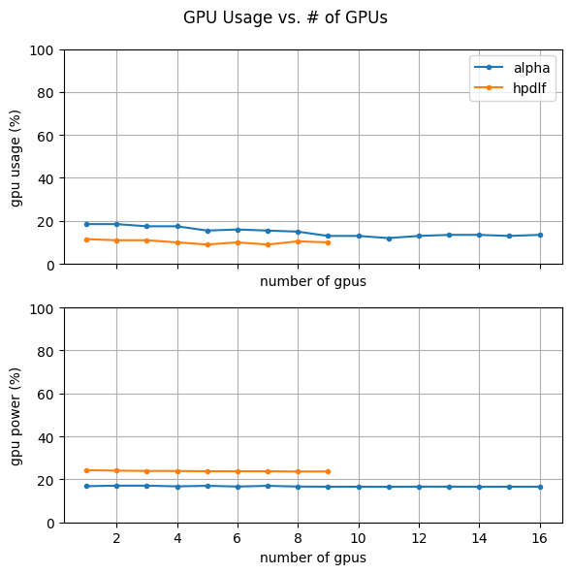
Comparison with MPI
No sudden increase in GPU Usage
Similar low GPU usage

Slide 21
Optimizations
Increasing Batch Size
  + Less synchronizations per Epoch
  + Higher GPU usage
  - Worse accuracy with found hyperparameters (new HP search)
  - Possibly generalization-gap with large Batch-Sizes [10]
Move dataset into GPU-Memory
  Dataset only ~4GB, enough memory available on each partition
  Decrease in data-loading time

Slide 22
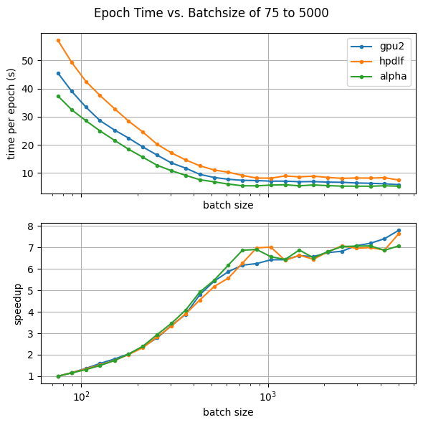
Optimizations – Batch Size
Test on one GPU
  7x Speedup for Batch Size 1000

Slide 23
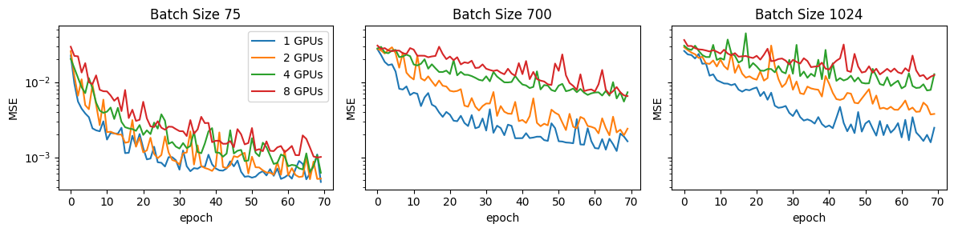
Optimizations – Batch Size
Worse Accuracy with same number of epochs
effective_batch_size = batch_size * n_workers
Less gradient updates per epoch

Slide 24
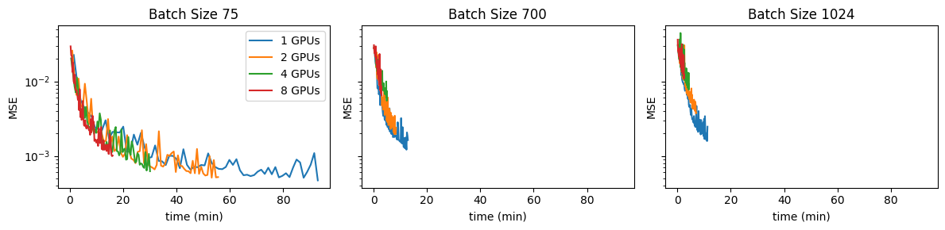
Optimizations – Batch Size
Accuracy w.r.t. Time
  Don’t use epochs but training time as metric for ending training
  Increase LR by sqrt(k), when increasing Batch Size by k [1]

Slide 25
Next Steps
Train for the same time with increased batch size
Scale learning rate
Optimize HPs for larger batches

Slide 26
Thank you for your time.
Any questions?

Slide 27
Literaturverzeichnis
[1] A. Krizhevsky, “One weird trick for parallelizing convolutional neural networks,” arXiv e-prints, p. earXiv:1404.5997, Apr. 2014.
[2] T. Ben-Nun and T. Hoefler, Demystifying Parallel and Distributed Deep Learning: An In-Depth Concurrency Analysis. arXiv, 2018. doi: 10.48550/ARXIV.1802.09941.
[3] A. Sergeev and M. Del Balso, Horovod: fast and easy distributed deep learning in TensorFlow. arXiv, 2018. doi: 10.48550/ARXIV.1802.05799.
[4] J. Dean et al., “Large scale distributed deep networks,” Advances in neural information processing systems, vol. 25, 2012.
[5] P. Patarasuk and X. Yuan, “Bandwidth Optimal All-Reduce Algorithms for Clusters of Workstations,” J. Parallel Distrib. Comput., vol. 69, no. 2, pp. 117–124, Feb. 2009, doi: 10.1016/j.jpdc.2008.09.002.
[6] A. Gibiansky, "Bringing HPC Techniques to Deep Learning - Andrew Gibiansky", andrew.gibiansky.com, 2017. [Online]. Available: https://andrew.gibiansky.com/blog/machine-learning/baidu-allreduce/.
[7] Martín Abadi et al. Tensorflow: Large-scale machine learning on heterogeneous distributed systems, 2016, arXiv:1603.04467.
[8] P. Winkler, N. Koch, A. Hornig, and J. Gerritzen, “OmniOpt – A Tool for Hyperparameter Optimization on HPC,” in High Performance Computing, 2021, pp. 285–296.
[9] S. Jeaugey, „Scaling Deep Learning Training with NCCL“, developer.nvidia.com, 2018. [Online]. Available: https://developer.nvidia.com/blog/scaling-deep-learning-training-nccl
[10] N. S. Keskar, D. Mudigere, J. Nocedal, M. Smelyanskiy, and P. T. P. Tang, “On Large-Batch Training for Deep Learning: Generalization Gap and Sharp Minima,” CoRR, vol. abs/1609.04836, 2016, [Online]. Available: http://arxiv.org/abs/1609.04836
[11] E. Hölzl. „Communication Backends, Raw performance benchmarking“, mlbench.github.io, 2020. [Online]. Available: https://mlbench.github.io/2020/09/08/communication-backend-comparison/

Slide 28
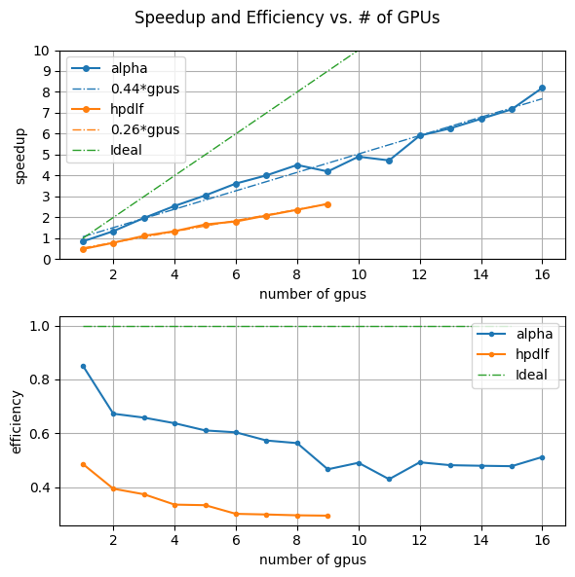
Speedup und Efficiency, MPI

Slide 29
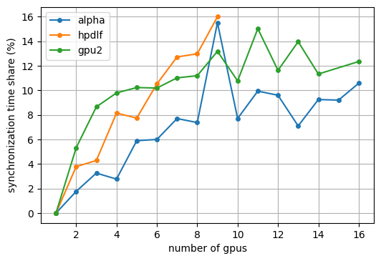
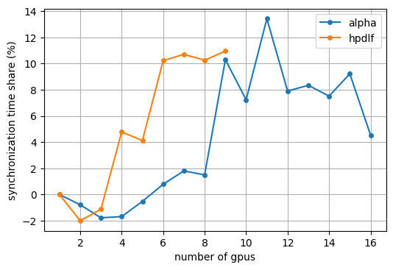
Gradient Synchronization Time NCCL vs MPI

