Slide 1

US Police Shootings
Alexander Senatorov
Danil Sheremetyev
Yasakova Polina
Timofey Orlov

Slide 2
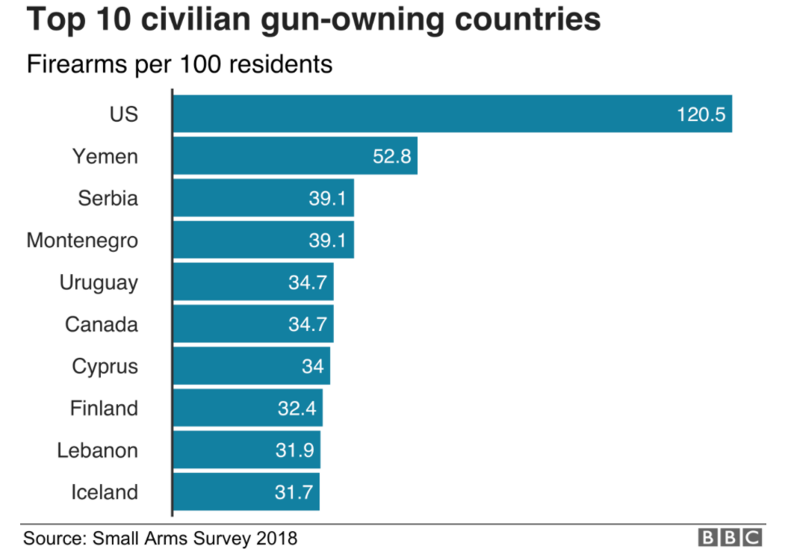
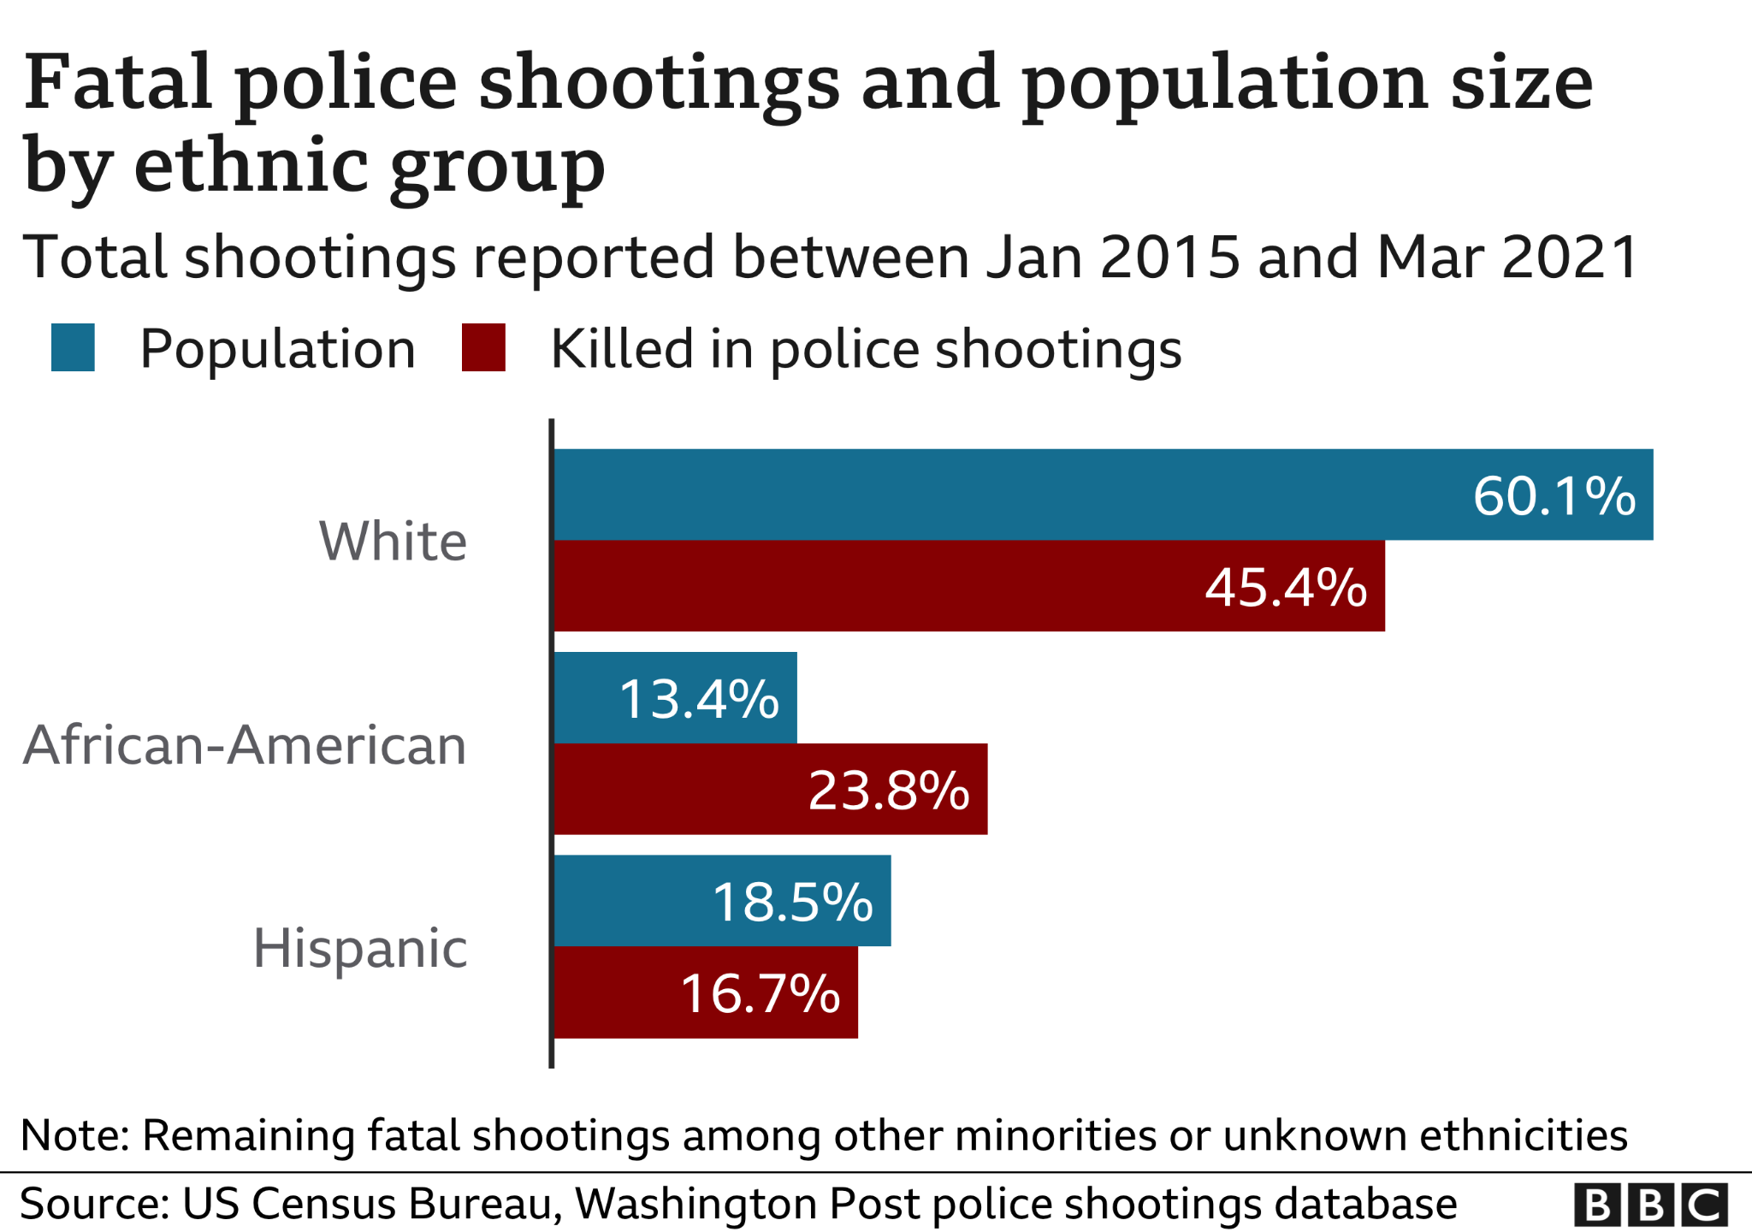
Problem
Data
Statistical model
Random Forest
Adaboosting
KNN
Summary
Logit
Context

Slide 3






Problem
Data
Statistical model
Random Forest
Adaboosting
KNN
Summary
Logit
Problem
Firearms legislation
?
?
Systemic racism
937 people have been shot and killed by police in the past year Washington Post
Some lives could be saved
Policemen psychological problems
Public protests
Police Department is interested in a better understanding of the suspect's threat level for the use of weapons

Slide 4
Problem
Data
Statistical model
Random Forest
Adaboosting
KNN
Summary
Logit
Research question
Are there factors that are related to whether a suspect will attack a police officer or not to use firearm?
Policy recommendation
Additional expertise
Weak points

Slide 5
Problem
Data
Statistical model
Random Forest
Adaboosting
KNN
Summary
Logit
Original dataset
4896 observations
Each observations is a suspect killed by police officer
2015-2020 years
For years data of police shootings with a fatal outcome
14 variables in the dataset
6 of them were used in extended model and 2 was created by us

Slide 6
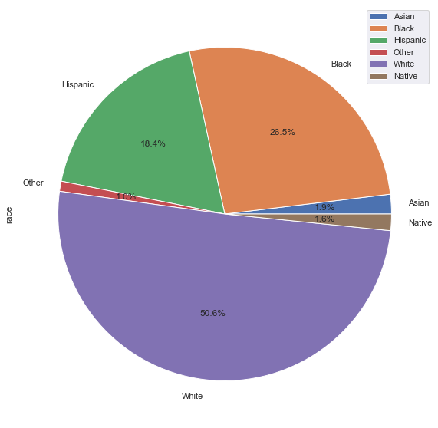
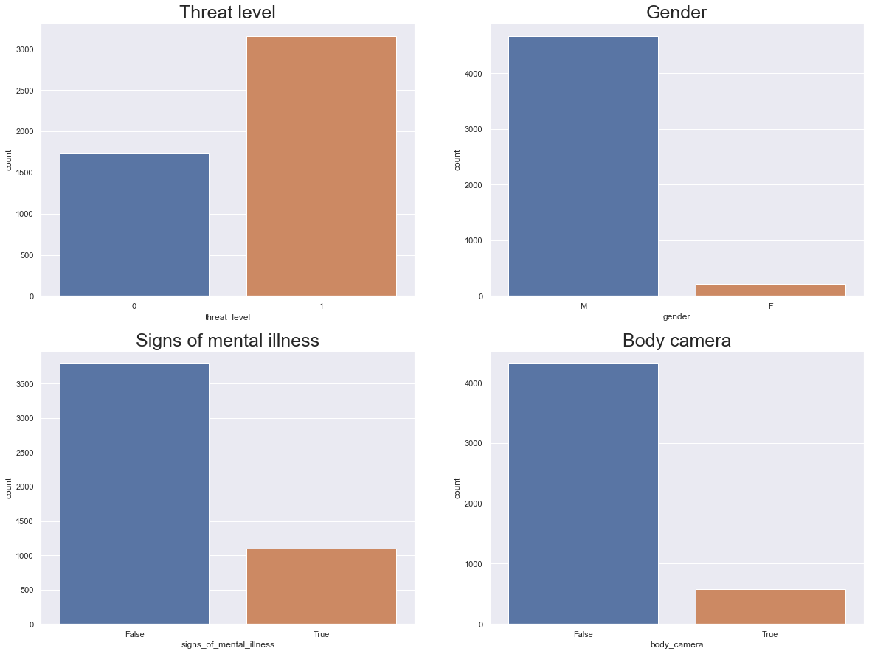
Problem
Data
Statistical model
Random Forest
Adaboosting
KNN
Summary
Logit
Descriptive analysis

Slide 7
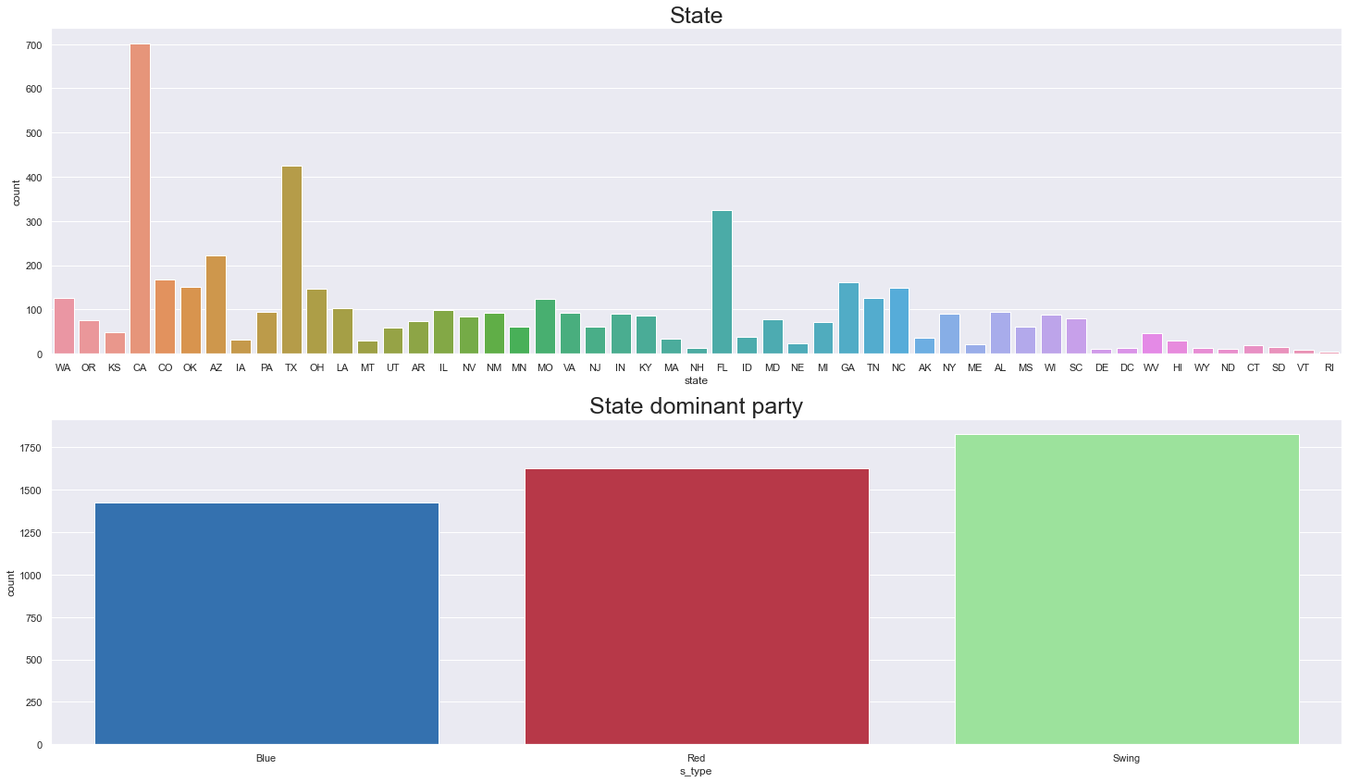
Problem
Data
Statistical model
Random Forest
Adaboosting
KNN
Summary
Logit
Descriptive analysis

Slide 8

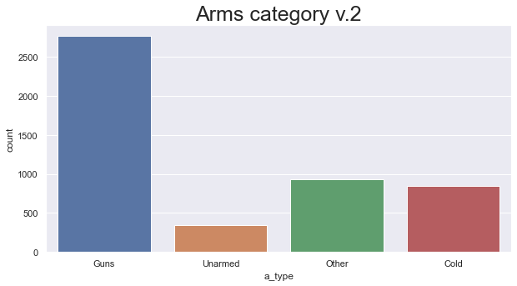
Problem
Data
Statistical model
Random Forest
Adaboosting
KNN
Summary
Logit
Descriptive analysis

Slide 9
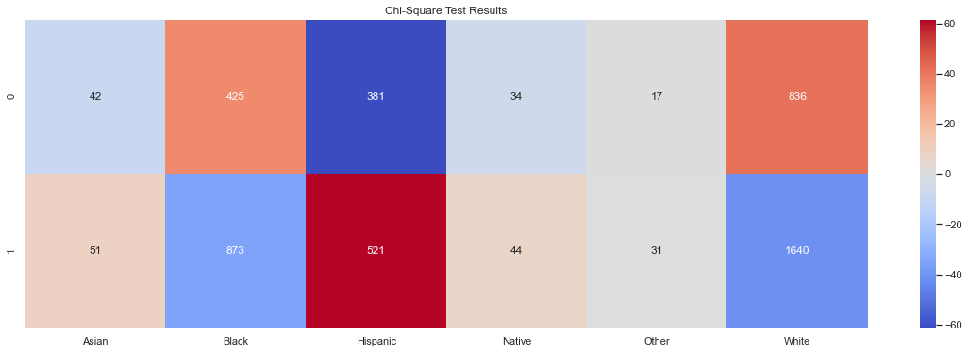
Problem
Data
Statistical model
Random Forest
Adaboosting
KNN
Summary
Logit
Anomaly
Chi-Square Test Results

Slide 10
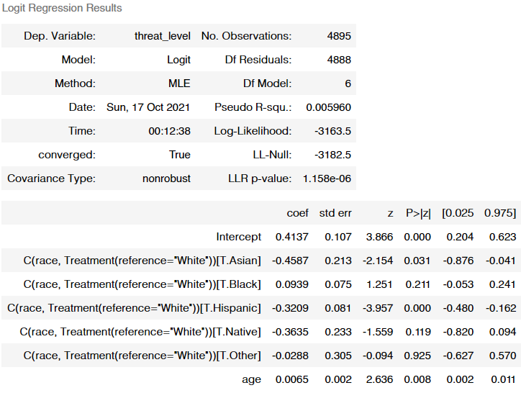
Data
Statistical model
Random Forest
Adaboosting
KNN
Summary
Problem
Logit
Base model
Threat Level
0 – suspect not definitely attacks
1 – suspect attacks
threat_level ~ age + race (base cat: white)

Slide 11
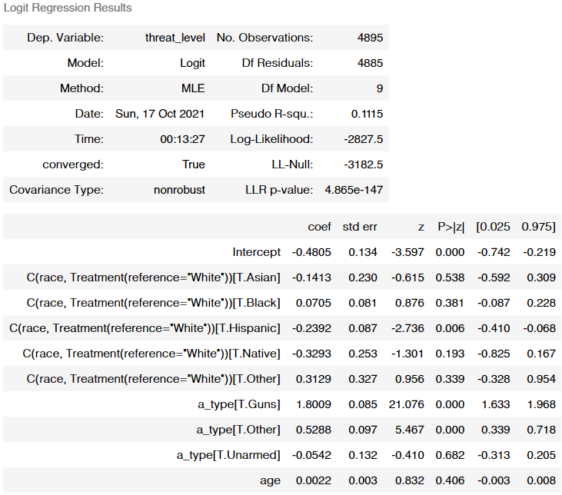
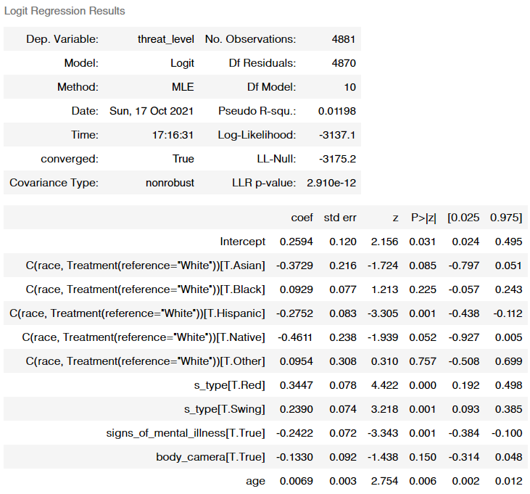
Statistical model
Random Forest
Problem
Data
Logit
Adaboosting
KNN
Summary
Extended model
threat_level ~ age + race (white) + a_type
threat_level ~ age + race (white) + s_type + mental_illness + body_camera

Slide 12
Data
Statistical model
Random Forest
Adaboosting
KNN
Summary
Problem
Logit
Logit
 | L1 | L2 | ELASTIC NET
ROC_ AUC | 0.62384 | 0.62681 | 0.62384
Accuracy | 0.63574 | 0.64467 | 0.63574
Precision | 0.77765 | 0.77714 | 0.77765
Recall | 0.65597 | 0.67503 | 0.65597

Slide 13
Statistical model
Random Forest
Adaboosting
Problem
Data
Logit
KNN
Summary
RandomForestClassifier
 | default | Grid
ROC_ AUC | 0.60349 | 0.62695
Accuracy | 0.65154 | 0.66185
Precision | 0.75205 | 0.77063
Recall | 0.73319 | 0.72116

Slide 14
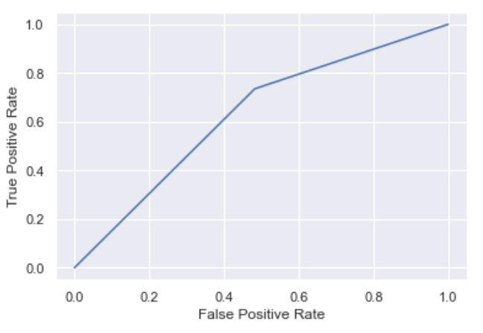
Problem
Data
Statistical model
Logit
Random Forest
Adaboosting
KNN
Summary
AdaBoosting
 | default
ROC_ AUC | 0.62633
Accuracy | 0.66666
Precision | 0.76834
Recall | 0.73520

Slide 15
Problem
Data
Statistical model
Logit
Random Forest
Adaboosting
KNN
Summary
KNeighborsClassifier or Nearest Neighbors classifier
 | default | Grid
ROC_ AUC | 0.59715 | 0.60234
Accuracy | 0.66872 | 0.67422
Precision | 0.74269 | 0.74553
Recall | 0.79037 | 0. 79638

Slide 16
Problem
Data
Statistical model
Logit
Random Forest
Adaboosting
KNN
Summary
 | Logit | Random forest | Adaboosting | KNN_grid
ROC_ AUC | 0.62681 | 0.62695 | 0.62633 | 0.60234
Accuracy | 0.64467 | 0.66185 | 0.66666 | 0.67422
Precision | 0.77714 | 0.77063 | 0.76834 | 0.74553
Recall | 0.67503 | 0.72116 | 0.73520 | 0. 79638

