Slide 1

Semantic Versioning at Scale
by Sergei Orlov

Slide 2




Sergei Orlov
@priestine

Slide 3


Slide 4
Agenda
We’ll discuss versioning in general and dive into SemVer
STEP 01
We’ll then find out what changelogs are and what their purpose is
STEP 02
Then, we’ll look at commit conventions that help us version and log
STEP 03
Finally, we’ll define the right time to bump and how to have parallel versions
STEP 04

Slide 5
What is a version?
Software upgrade versioning is the process of assigning either unique version names or unique version numbers to unique states of computer software.
- Wikipedia
A version is an unique human-readable pointer to a specific state of computer software.

Slide 6
Which one happened first?
v3
v4
4c879e0c3d477fb0bfd5f975e17bf03590a9c9bf
ef5503d3293f09a31dab2a5dc717b2f8c09f1600

Slide 7
Where to Store Versions?
VCS
Tags
NOT a branch: they are mutable
NOT a commit: they are not human-readable

Slide 8
Versioning Schemes
Date of Release
Sequence-based
Wine 20040505
macOS 10.16
Ubuntu 19.10
Node.js 12.10.0
WebStorm 2019.3*
TypeScript 3.6
Microsoft Windows 95
Windows 10
Microsoft Office 2007
Angular 8

Slide 9

Semantic Versioning
Under this scheme, version numbers and the way they change convey meaning about the underlying code and what has been modified from one version to the next.
- semver.org
X . Y . Z
MAJOR . MINOR . PATCH

Slide 10
SemVer PATCH
MUST bump: only backward compatible bug fixes are introduced
X . Y . Z
MAJOR . MINOR . PATCH

Slide 11
SemVer MINOR
MUST bump: new, backward compatible functionality is introduced to the public API
MUST bump: any public API functionality is marked as deprecated
MAY bump: substantial new functionality/improvements introduced in the private code
MUST reset PATCH version to 0
MAY include patch level changes
X . Y . 0
MAJOR . MINOR . PATCH

Slide 12
SemVer MAJOR
MUST bump: any backward-incompatible changes are introduced to the public API
MUST reset PATCH and MINOR versions to 0
MAY include minor and patch level changes
X . 0 . 0
MAJOR . MINOR . PATCH

Slide 13

Keep a Changelog
What is a changelog?
A changelog is a file which contains a curated, chronologically ordered list of notable changes for each version of a project.
Why keep a changelog?
To make it easier for users and contributors to see precisely what notable changes have been made between each release (or version) of the project.
Who needs a changelog?
People do. Whether consumers or developers, the end users of software are human beings who care about what's in the software. When the software changes, people want to know why and how.

Slide 14
Simple: Keep a Changelog
What is a changelog?
A changelog is a PLACE which contains a curated, chronologically ordered list of notable changes for each version of a project.
Why keep a changelog?
To make it easier for contributors to see WHAT IS GOING ON.
To be able to inform users about changes.
To reflect on the progress.
Who needs a changelog?
PEOPLE DO.

Slide 15
Changelog:
Source of Truth
Jira Tickets
Changes in PRs
Changes in commits
Commit messages

Slide 16

Jira release 1.293 go brr
- Someone on the project

Slide 17
Changelog: Alternative
Source of Truth
Commit messages
Changes in PRs
Changes in commits
Jira Tickets

Slide 18
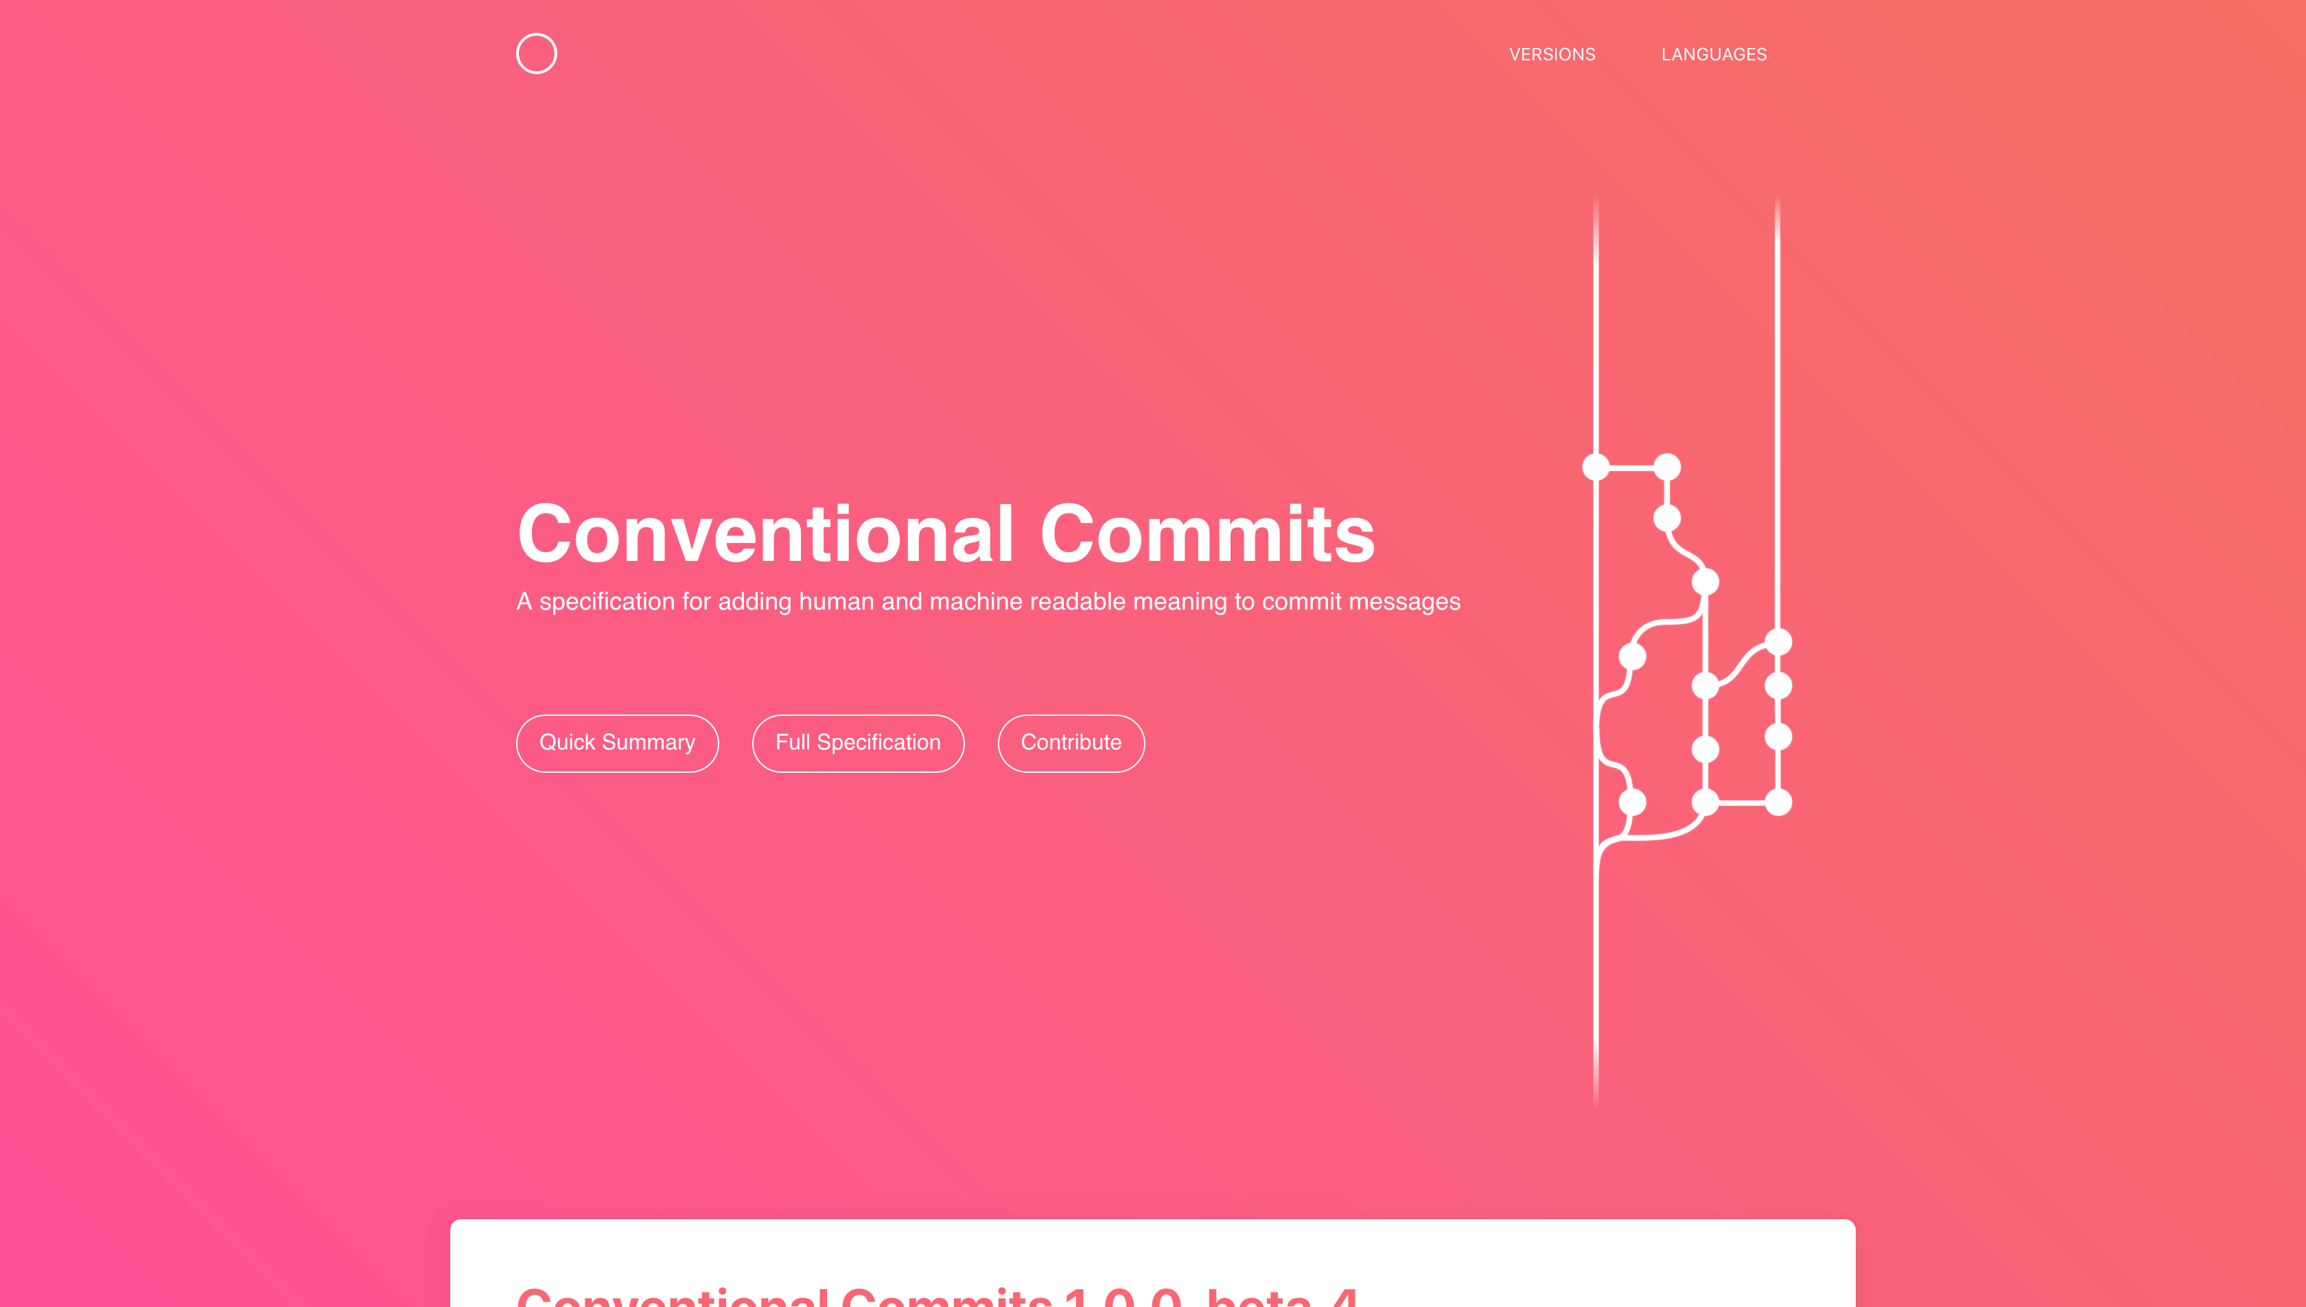
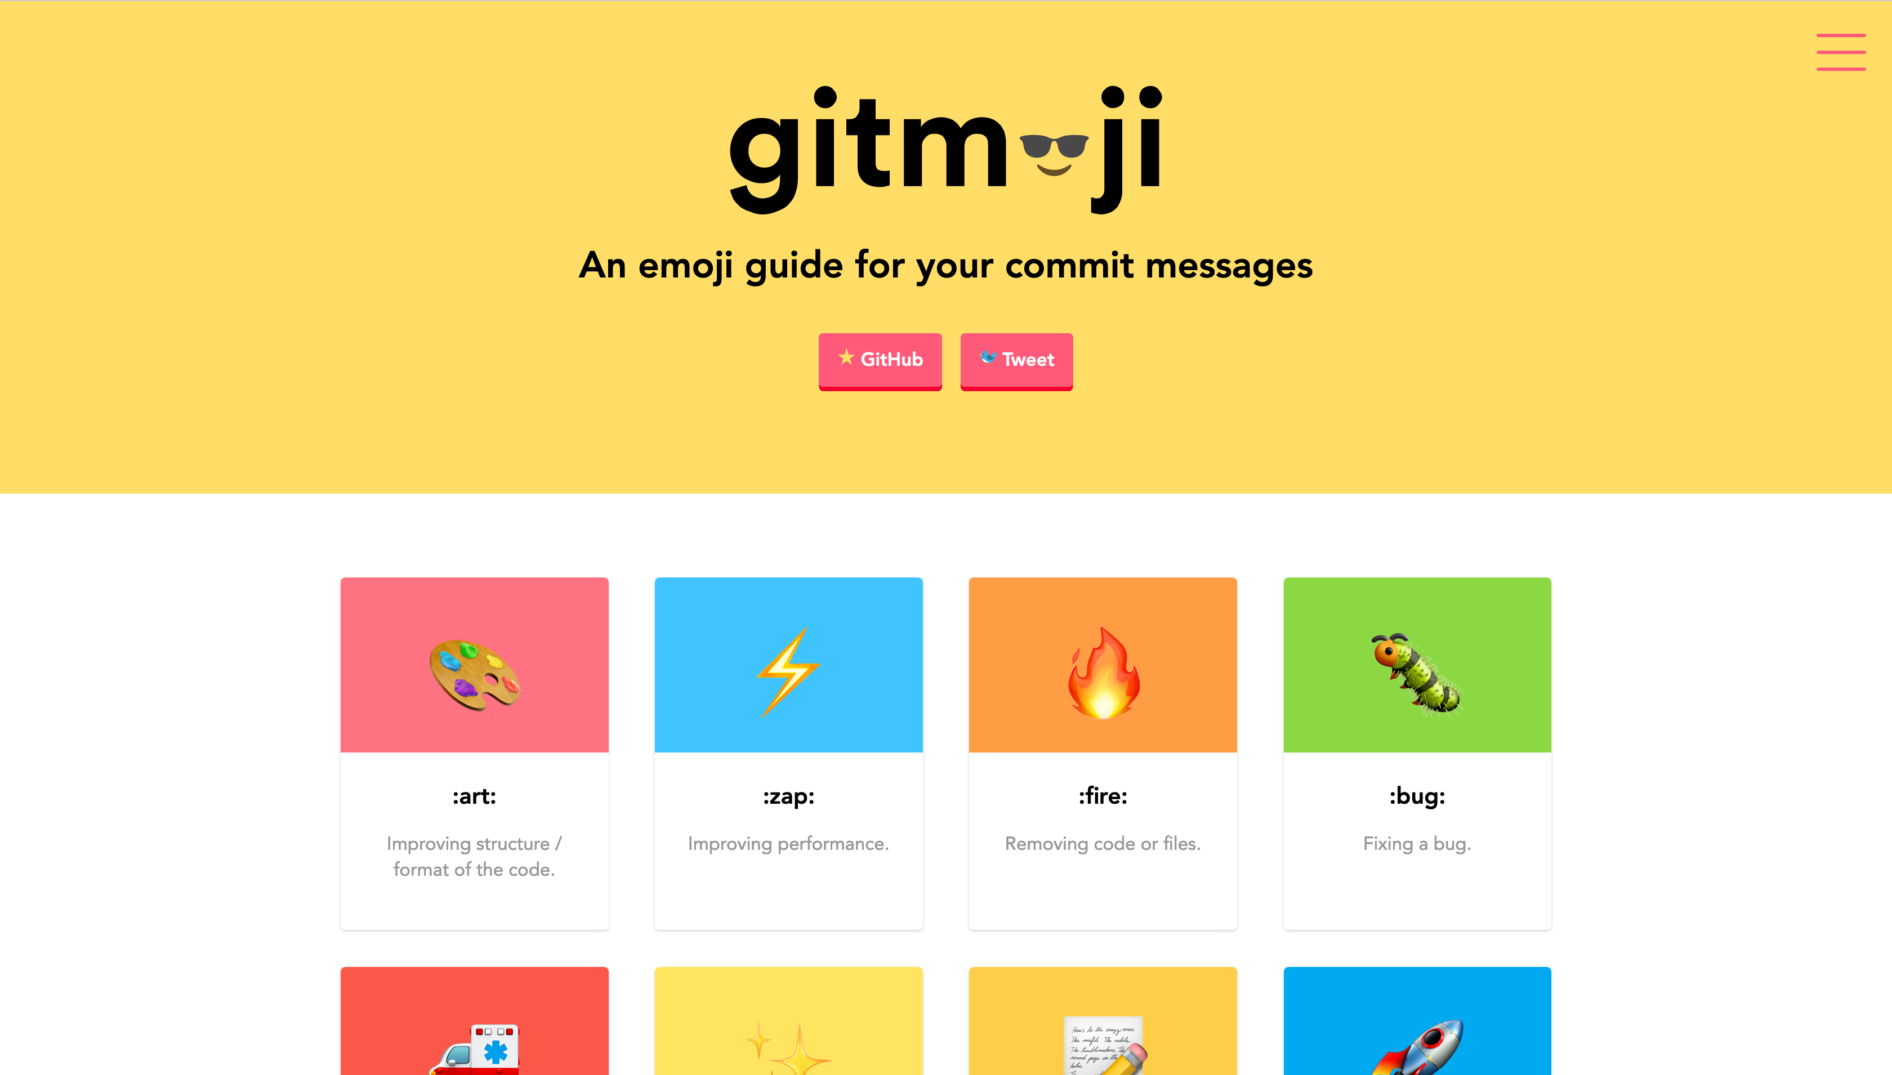
Widely Adopted Conventions

Slide 19
Distilled: Type is for Versioning
Commit MAY have a type
Type MAY be ANY string that is adopted
Commit type MUST be one of the adopted types
Adopted types MUST cover
Fixes
Features
Deprecations
Breaking changes
[OPTIONAL] Substantial internal updates
X . Y . Z
MAJOR . MINOR . PATCH

Slide 20
Distilled: Rest is for Changelog
Commit MUST have a short description
Commit MAY provide additional long description in the body
Commit MAY reference an issue at the bottom line (this is widely supported)
X . Y . Z
MAJOR . MINOR . PATCH

Slide 21
Code Maturity Funnel
In Development
Dev Artifact
In Testing
RC
Deliverable
Release

Slide 22
Semantic Versioning
Under this scheme, version numbers and the way they change convey meaning about the underlying code and what has been modified from one version to the next.
- Tom Preston-Werner
X . Y . Z
MAJOR . MINOR . PATCH

Slide 23
SemVer Pre-Releases → RCs
MAY be denoted by appending a hyphen and a series of dot separated identifiers
MUST - comprise only ASCII alphanumeric characters or hyphen [0-9A-Za-z-]+
MUST - follow PATCH version number
MUST NOT - be empty if specified
MUST NOT - include leading zeroes
X . Y . Z [- a]
MAJOR . MINOR . PATCH [PRE-RELEASE]

Slide 24
SemVer Builds → Dev Artifacts
MAY be denoted by appending a plus sign and a series of dot separated identifiers
MUST - comprise only ASCII alphanumeric characters or hyphen [0-9A-Za-z-]+
MUST - follow Pre-Release definition if it is denoted
MUST - be ignored when determining version precedence
MUST NOT - be empty if specified
MUST NOT - include leading zeroes
X . Y . Z [+ b]
MAJOR . MINOR . PATCH [BUILD NUMBER]

Slide 25
Example Version Flow
1.0.1+011a110
1
1.0.1-rc.1
2
1.1.0+1def11a
3
1.1.0-rc.1
4
1.1.0
5

Slide 26
Recap: Proper Versioning
IMPROVES
COMMUNICATION
ADAPTABLE
PROVIDES
TRANSPARENCY
SIMPLE
GIVES MORE SPACE
FOR AUTOMATION
EASY TO INTEGRATE

Slide 27

Code time
http://tiny.cc/raini-cphwsvac

Slide 28
Recovery Point
git checkout
0-1-exec-with

Slide 29
Recovery Point
git checkout
0-2-pipe

Slide 30
Recovery Point
git checkout
1-get-latest-version

Slide 31
Recovery Point
git checkout
2-make-new-version

Slide 32
Recovery Point
git checkout
3-exit-if-no-version

Slide 33
Recovery Point
git checkout
4-get-version-commit

Slide 34
Recovery Point
git checkout
5-get-changes

Slide 35
Recovery Point
git checkout
6-force-bump

Slide 36
Recovery Point
git checkout
7-make-changelog

Slide 37
Recovery Point
git checkout
8-log

Slide 38

Q & A

