Slide 1
Semantic Versioning at Scale
by Sergei Orlov

Slide 2





Sergei Orlov

Slide 3
Agenda
We’ll discuss versioning in general and dive into SemVer
STEP 01
We’ll then find out what changelogs are and what their purpose is
STEP 02
Then, we’ll look at commit conventions that help us version and log
STEP 03
Finally, we’ll define the right time to bump and how to have parallel versions
STEP 04

Slide 4
What is Versioning
Software upgrade versioning is the process of assigning either unique version names or unique version numbers to unique states of computer software.
- Wikipedia
A version is a human-readable unique immutable pointer to a specific unique state of the computer software.

Slide 5
Where to Store Versions?
VCS
NOT in branches: they are mutable
NOT in commits: they are not human-readable

Slide 6
Which one happened first?
v3
v4
4c879e0c3d477fb0bfd5f975e17bf03590a9c9bf
ef5503d3293f09a31dab2a5dc717b2f8c09f1600

Slide 7
Where to Store Versions?
VCS
Tags
NOT in branches: they are mutable
NOT in commits: they are not human-readable

Slide 8
Versioning Schemes
Date of Release
Sequence-based
Wine 20040505
macOS 10.16
Ubuntu 19.10
Node.js 12.10.0
WebStorm 2019.3*
TypeScript 3.6
Microsoft Windows 95
Windows 10
Microsoft Office 2007
Angular 8

Slide 9

Semantic Versioning
Under this scheme, version numbers and the way they change convey meaning about the underlying code and what has been modified from one version to the next.
- semver.org
X . Y . Z
MAJOR . MINOR . PATCH

Slide 10
SemVer PATCH
MUST bump: only backward compatible bug fixes are introduced
X . Y . Z
MAJOR . MINOR . PATCH

Slide 11
SemVer MINOR
MUST bump: new, backward compatible functionality is introduced to the public API
MUST bump: any public API functionality is marked as deprecated
MAY bump: substantial new functionality/improvements introduced in the private code
MUST reset PATCH version to 0
MAY include patch level changes
X . Y . 0
MAJOR . MINOR . PATCH

Slide 12
SemVer MAJOR
MUST bump: any backward-incompatible changes are introduced to the public API
MUST reset PATCH and MINOR versions to 0
MAY include minor and patch level changes
X . 0 . 0
MAJOR . MINOR . PATCH

Slide 13
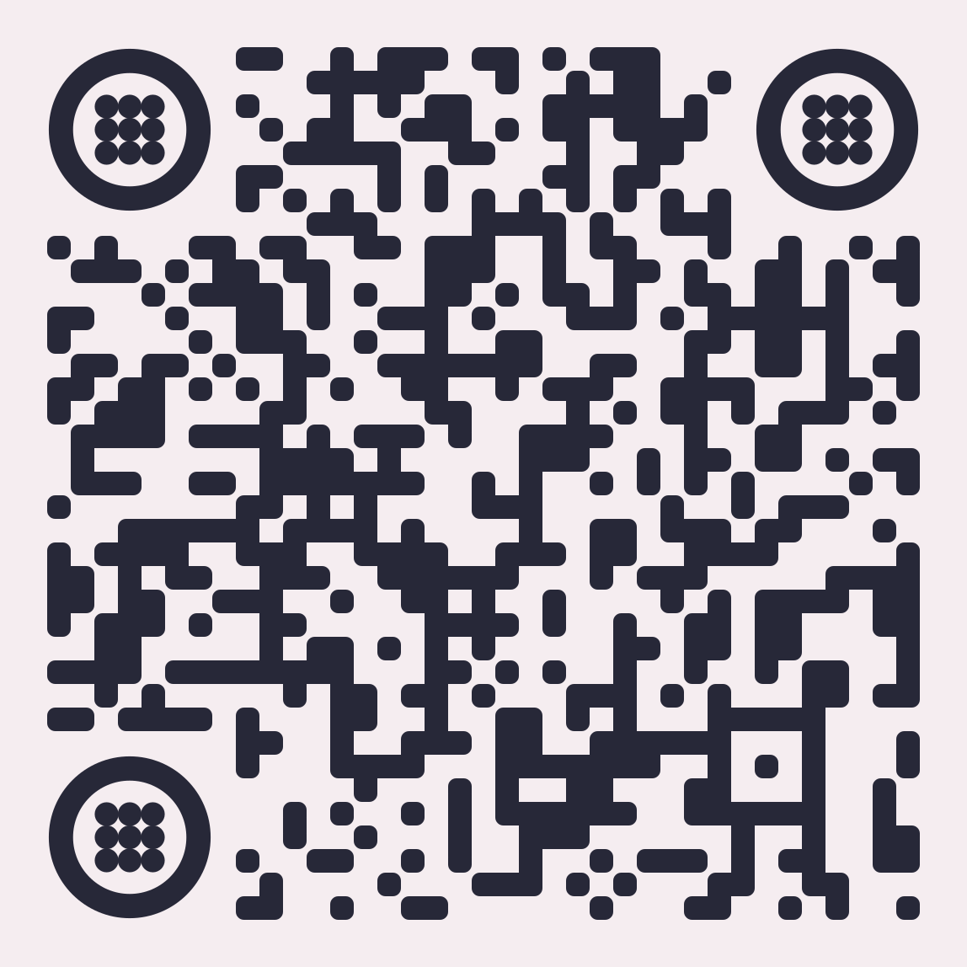
Code time
https://tiny.cc/raini-svas

Slide 14
Recovery Point
git checkout
01-current-commit-command

Slide 15
Recovery Point
git checkout
02-latest-version-command

Slide 16
Recovery Point
git checkout
03-new-version-command

Slide 17
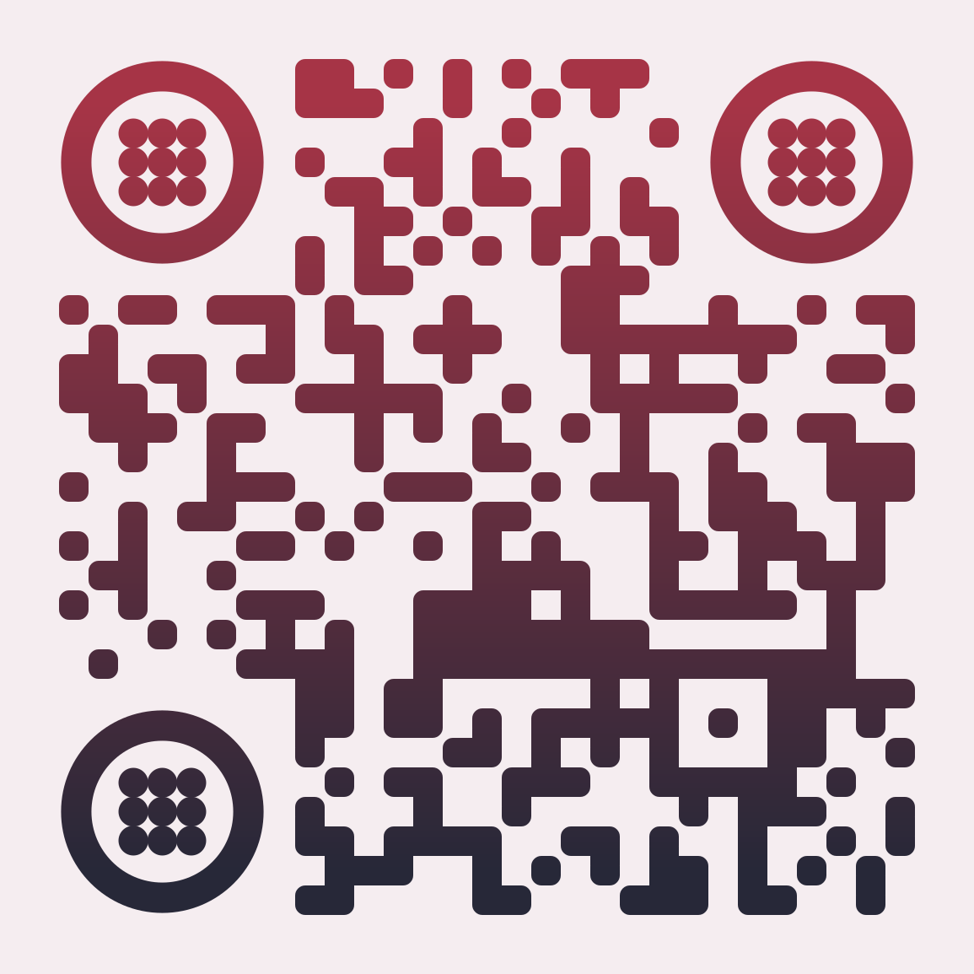
Keep a Changelog
What is a changelog?
A changelog is a file which contains a curated, chronologically ordered list of notable changes for each version of a project.
Why keep a changelog?
To make it easier for users and contributors to see precisely what notable changes have been made between each release (or version) of the project.
Who needs a changelog?
People do. Whether consumers or developers, the end users of software are human beings who care about what's in the software. When the software changes, people want to know why and how.

Slide 18
Keep a Changelog Alternatively
What is a changelog?
A changelog is a PLACE which contains a curated, chronologically ordered list of notable changes for each version of a project.
Why keep a changelog?
To make it easier for users and contributors to see WHAT IS GOING ON.
Who needs a changelog?
PEOPLE DO.

Slide 19
Changelog:
Source of Truth
Jira Tickets
Changes in PRs
Changes in commits
Commit messages

Slide 20

Jira release 1.293 go brr
- Executioner

Slide 21
Changelog: Alternative
Source of Truth
Commit messages
Changes in PRs
Changes in commits
Jira Tickets

Slide 22
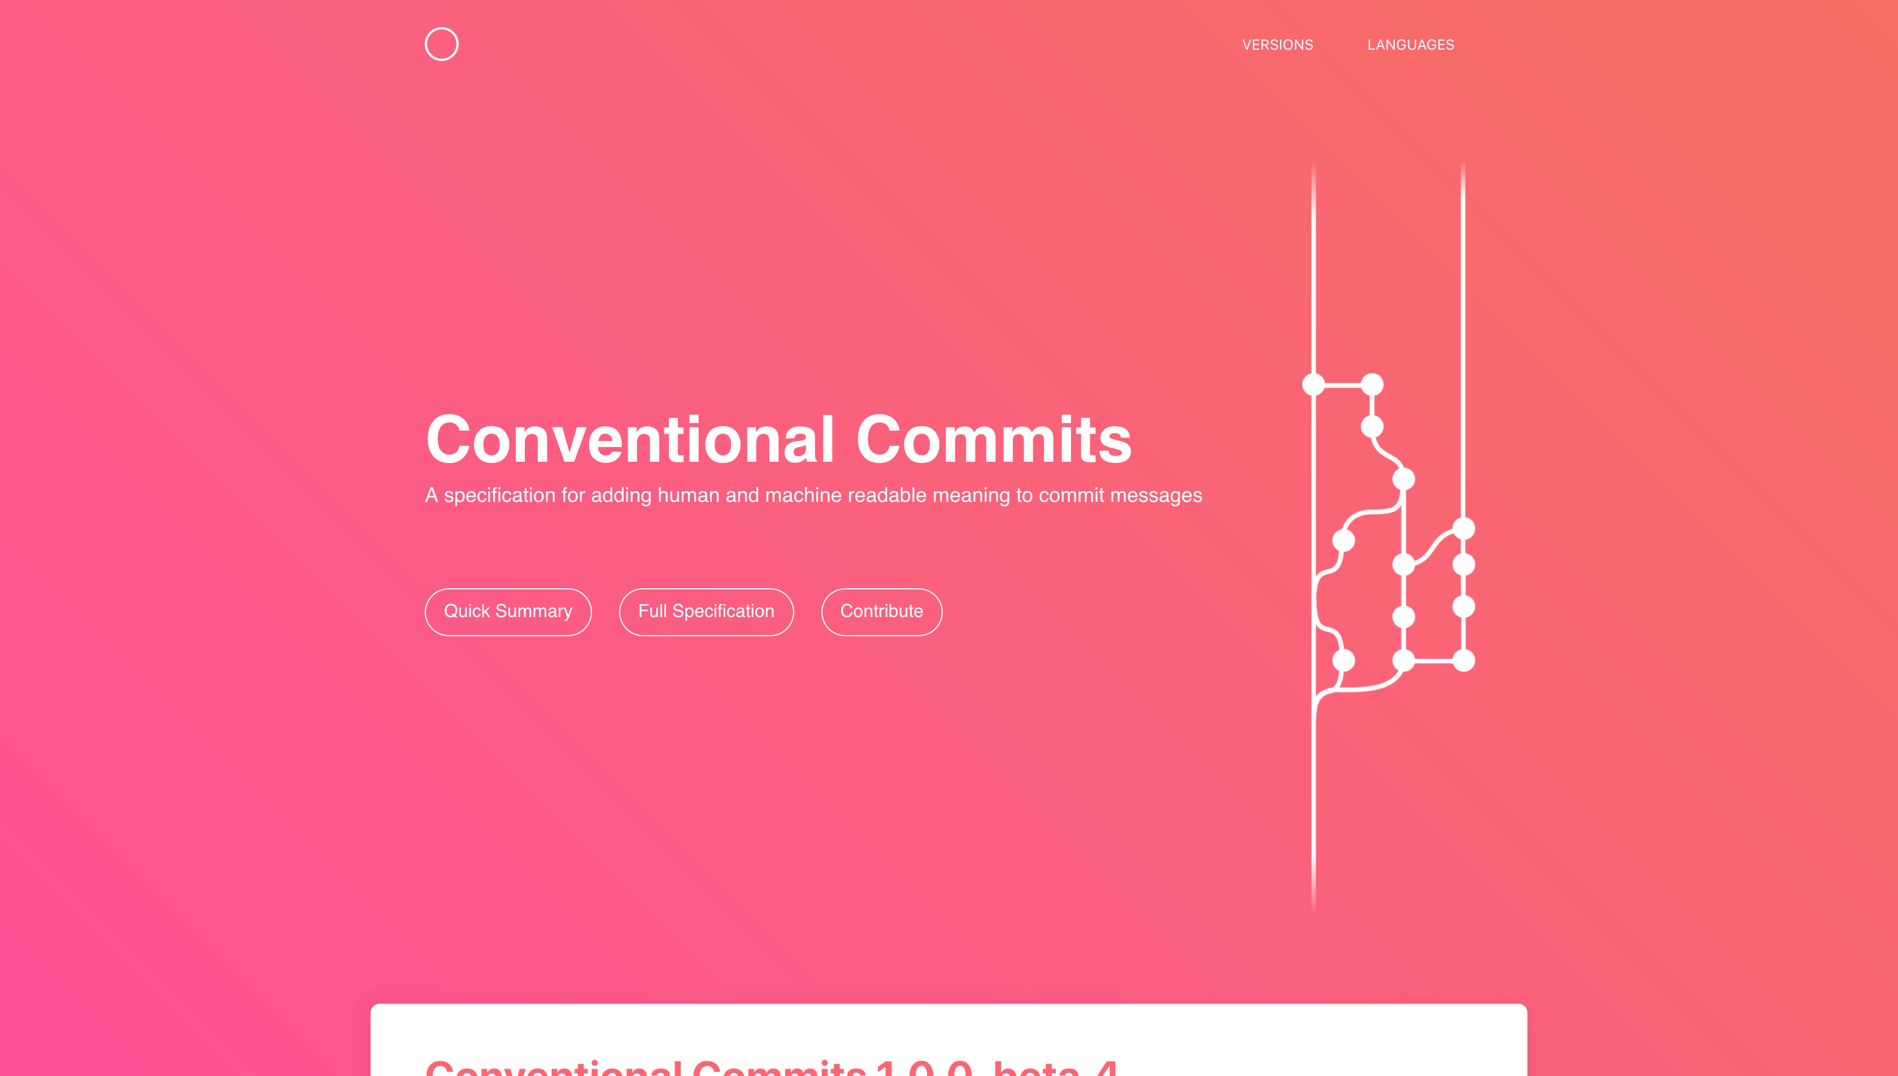
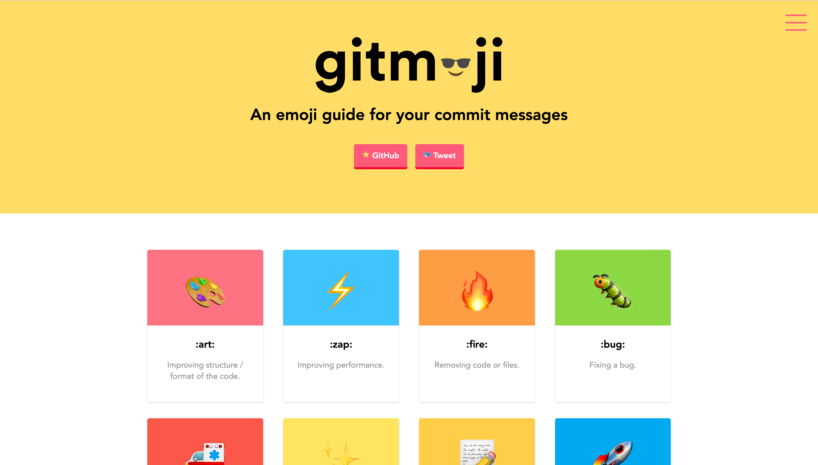
Widely Adopted Conventions

Slide 23
Distilled: Type is for Versioning
Commit MAY have a type
Type MAY be ANY string that is adopted
Commit type MUST be one of the adopted types
Adopted types MUST cover
Fixes
Features
Deprecations
Breaking changes
[OPTIONAL] Substantial internal updates
X . Y . Z
MAJOR . MINOR . PATCH

Slide 24
Distilled: Rest is for Changelog
Commit MUST have a short description
Commit MAY provide additional long description in the body
Commit MAY reference an issue at the bottom line (this is widely supported)
X . Y . Z
MAJOR . MINOR . PATCH

Slide 25
Code time
https://tiny.cc/raini-svas

Slide 26
Recovery Point
git checkout
03-new-version-command

Slide 27
Recovery Point
git checkout
04-auto-version-command

Slide 28
Recovery Point
git checkout
05-changelog-command

Slide 29
Code Maturity Funnel
In Development
Dev Artifact
In Testing
RC
Deliverable
Release

Slide 30
Semantic Versioning
Under this scheme, version numbers and the way they change convey meaning about the underlying code and what has been modified from one version to the next.
- Tom Preston-Werner
X . Y . Z
MAJOR . MINOR . PATCH

Slide 31
SemVer Pre-Releases → RCs
MAY be denoted by appending a hyphen and a series of dot separated identifiers
MUST - comprise only ASCII alphanumeric characters or hyphen [0-9A-Za-z-]+
MUST - follow PATCH version number
MUST NOT - be empty if specified
MUST NOT - include leading zeroes
X . Y . Z [- a]
MAJOR . MINOR . PATCH [PRE-RELEASE]

Slide 32
SemVer Builds → Dev Artifacts
MAY be denoted by appending a plus sign and a series of dot separated identifiers
MUST - comprise only ASCII alphanumeric characters or hyphen [0-9A-Za-z-]+
MUST - follow Pre-Release definition if it is denoted
MUST - be ignored when determining version precedence
MUST NOT - be empty if specified
MUST NOT - include leading zeroes
X . Y . Z [+ b]
MAJOR . MINOR . PATCH [BUILD NUMBER]

Slide 33
Code time
https://tiny.cc/raini-svas

Slide 34
Example Version Flow
1.0.1+011a110
1
1.0.1-rc.1
2
1.1.0+1def11a
3
1.1.0-rc.1
4
1.1.0
5

Slide 35
Recap: Proper Versioning
IMPROVES
COMMUNICATION
ADAPTABLE
PROVIDES
TRANSPARENCY
SIMPLE
GIVES MORE SPACE
FOR AUTOMATION
EASY TO INTEGRATE

Slide 36
Q & A

