Slide 1
CSS Hero

Slide 2
Admin Work

Slide 3
Homework Assignment
Also, at this point everyone should have access to the class repository in GitLab.
Homework Assignment #1 is Due IN ONE WEEK

Slide 4
Homework Assignment
Really, work hard on this assignment! This assignment introduces you to fundamental concepts that we’ll be building the entire course-long.
Review In Class Material, especially Exercises (On GitLab)
Work with your peers! It’s much better than screaming at your computer alone.
Ask Questions on Slack! Your peers, TAs, and Instructors are all here to help when they can.

Slide 5
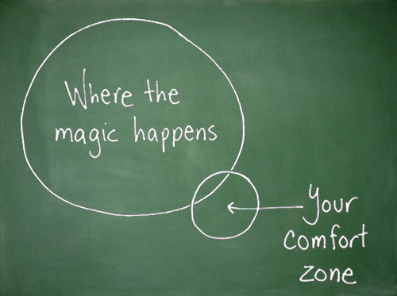
Most Important of All….
Just Submit SOMETHING (even if it seems pretty crummy)!

Slide 6
Warning!

Slide 7
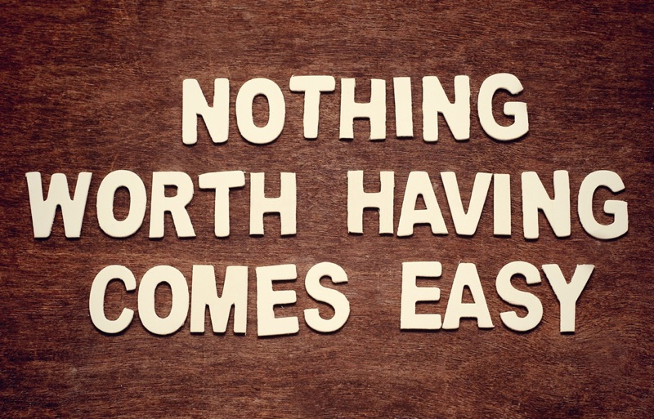
Brace Yourselves
Today is going to be a bit tough.
But trust us!
It will all look easy a few weeks from now.

Slide 8
Brace Yourselves
Don’t expect to understand EVERYTHING at once.
Today is all about getting immersed.

Slide 9
CSS Recap

Slide 10
Critical Question
What is “CSS?”

Slide 11
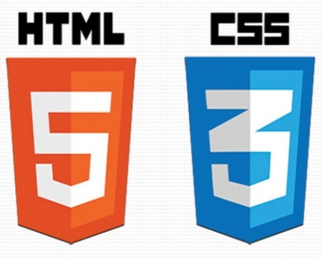

HTML / CSS Definitions (*yawn* unimportant)
HTML: Hypertext Markup Language – (Content)
CSS: Cascading Style Sheets – (Appearance)
HTML/CSS are the “languages of the web.” Together they define both the content and the aesthetics of a webpage – handling everything from the layouts, colors, fonts, and content placement. (JavaScript is the third – handling logic, animation, etc.)

Slide 12


HTML / CSS Analogy
HTML Alone
Like writing papers in “Notepad.”
Can only write unformatted text.
HTML / CSS
Like writing papers in Microsoft Word.
Can format text, page settings, alignment, etc. based on “highlighting” and menu options.

Slide 13
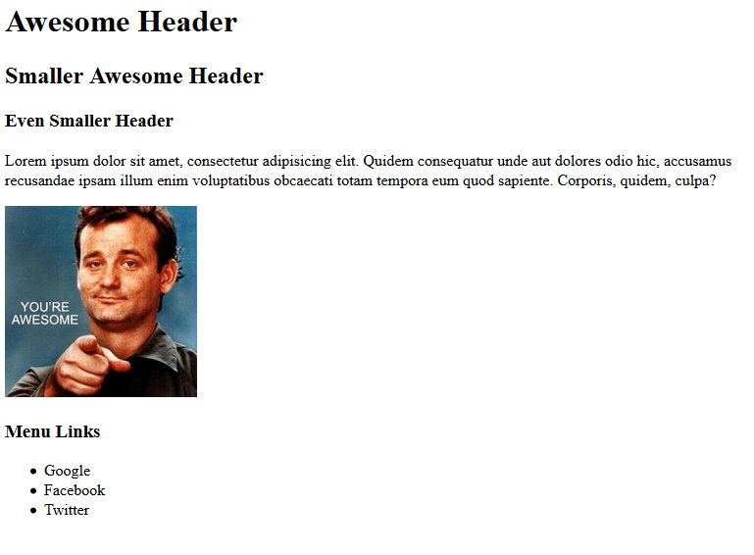
Basic HTML Page - Result

Slide 14
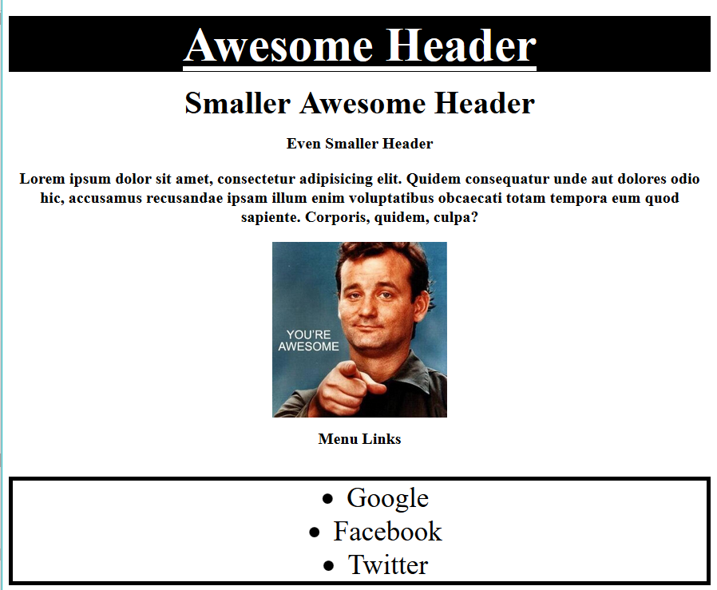
Enter CSS - Result

Slide 15
Critical Question
How do we style HTML…
Elements?
Classes?
IDs?

Slide 16
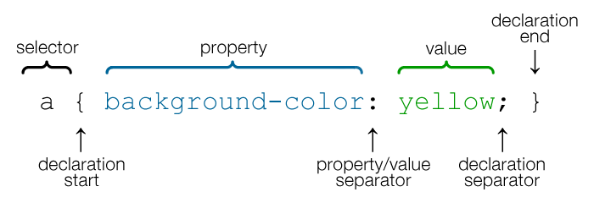
CSS Syntax
CSS works by hooking onto selectors added into HTML using classes and identifiers.
Classes use .classname, IDs use #idname, and elements use just their name.
Once hooked, we apply styles to those HTML elements using CSS.

Slide 17
Selectors
Element selector
Applies to all <p> elements
p {
background-color: blue;
}
Applies to all elements with class=“classItem"
.classItem {
background-color: orange;
}
Applies to all elements with id=“idItem"
#idItem {
background-color: green;
}
Element name
(p, a, div, span, etc)
Class Selector
Period (.) + variable name
(.myDiv, .phoneNumber, etc.)
ID Selector
Hash (#) + variable name
(#myDiv, #phoneNumber)

Slide 18
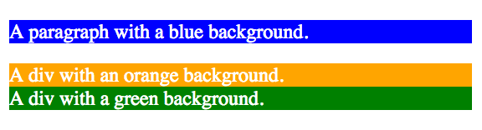
CSS Selectors
p {
background-color: blue;
}
.classItem {
background-color: orange;
}
#idItem {
background-color: green;
}
<p>
A paragraph with a blue background.
</p>
<div class=“classItem">
A div with an orange background.
</div>
<div id=“idItem">
A div with a green background.
</div>
+

Slide 19
Lingering Questions
Questions so far?

Slide 20
Relative File Paths

Slide 21
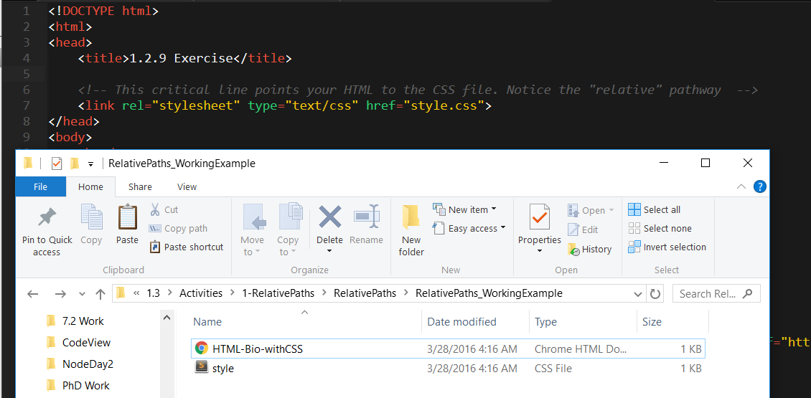
Relative File Paths
Relative file paths connect us with other files in our working directory. In this case, style.css is in the same folder as our html document.

Slide 22
Quick Demo
Instructor: Demo
(RelativePaths_DEMO | 1-RelativePaths)

Slide 23
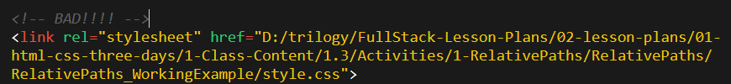

Absolutely No Absolute Paths
VERY VERY BAD
ALWAYS USE RELATIVE FILE PATHS.
If you deploy your sites without them, all of your links will fail.
  The same will happen if you move your project from one folder to another.
Remember, there is no such thing as a “C:” drive on the internet.

Slide 24
> YOUR TURN!!
Activity: 1-RelativePaths| Suggested Time: 10 min
Assignment
1. Unzip the folder sent to you via Slack.
2. Edit the HTML files in all of the “RelativePaths” folders. You need to write relative paths that link the HTML documents with CSS stylesheets.
Tip: Check out the “RelativePaths_WorkingExample” folder.

Slide 25
CSS Selectors

Slide 26
Box Model

Slide 27
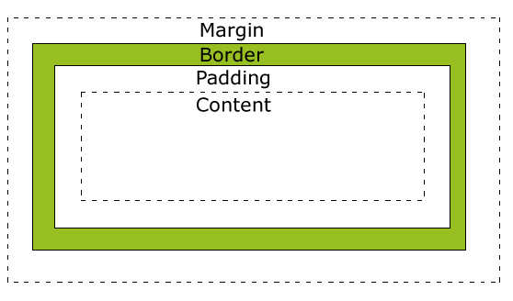
Boxes Upon Boxes
In CSS, every element rests within a series of boxes.
Each box has customizable space properties:
margin, border, and padding.
Typical spacing value: 20px 10px 10px 20px (top, right, bottom, left)

Slide 28
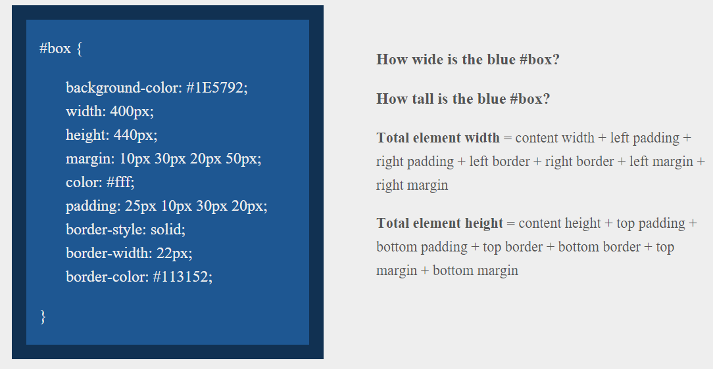
> YOUR TURN!!
Suggested Time: 10 min

Slide 29
> YOUR TURN!!
Answer
Width: 474 px (no margin), 554 px (with margin)
Height: 539 px (no margin), 569 px (with margin)

Slide 30
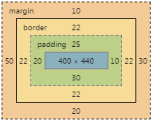
> YOUR TURN!!
Answer
Width: 474 px (no margin), 554 px (with margin)
Height: 539 px (no margin), 569 px (with margin)

Slide 31
We Be Floatin’

Slide 32
Take a Facebook Break…
Warning!
These next topics are fairly “tricky”… but VERY IMPORTANT.
Time to channel that inner genius.

Slide 33
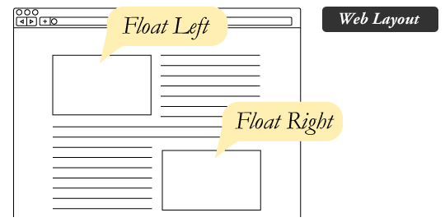
The Concept of “Flow”
By default, every HTML element displayed in the browser is governed by a concept called flow.
This means that HTML elements force their adjacent elements to flow around them.

Slide 34
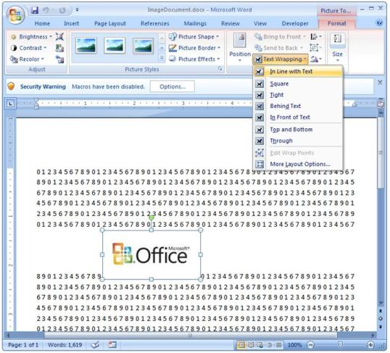
Flow Analogy to MS Word
This concept of “flow” is very similar to the wrap-text options you may be familiar with in Microsoft Word.
Just as in MS Word, you can have images in-line with text, on-top of text, etc.

Slide 35
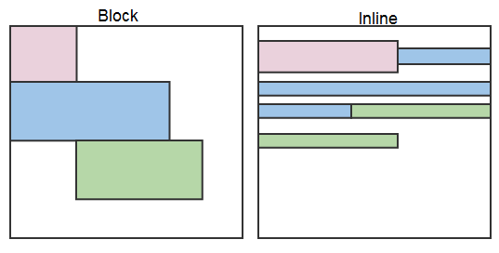
Block Elements
By default, web clients render many HTML elements as block elements. Paragraphs, headers, divs and more receive this treatment.
A block element will take up an entire line of space—unless you intervene with CSS properties.

Slide 36
Block Elements vs. Inline Elements
Now contrast the block elements with inline elements.
By using float CSS properties, we can command our website to display multiple HTML elements adjacently.

Slide 37
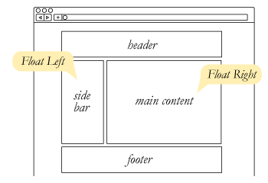
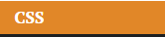
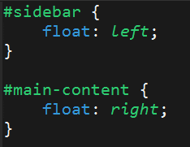
Floating
To make inline elements “flow” around block elements, we use float
Floats are necessary for things like pull quotes or illustrations

Slide 38
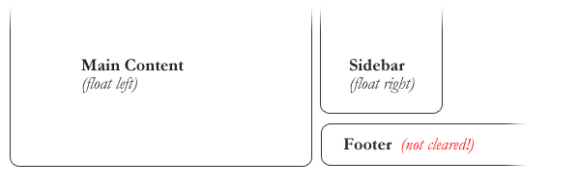
Clearing the Float
Floats often get in the way of our layouts.
Sometimes we don’t want to give each element the “inline” treatment.

Slide 39
ONE MORE THING
How to reset floats
.selector { clear: both; }

Slide 40
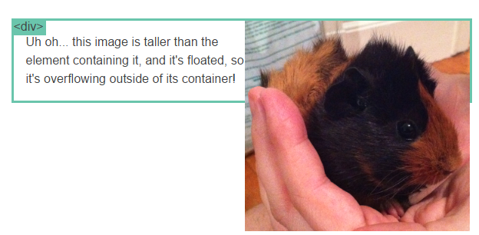
Clearfix Hack
Sometimes when elements don’t match up in size, we get situations like the above…

Slide 41
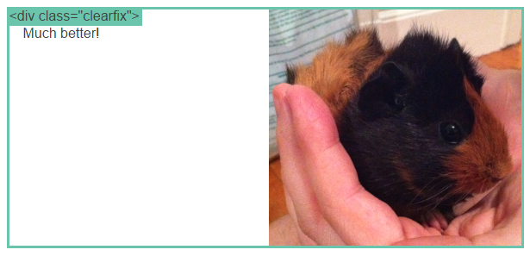
Clearfix Hack
We can get around this by using “the clearfix hack.”

Slide 42
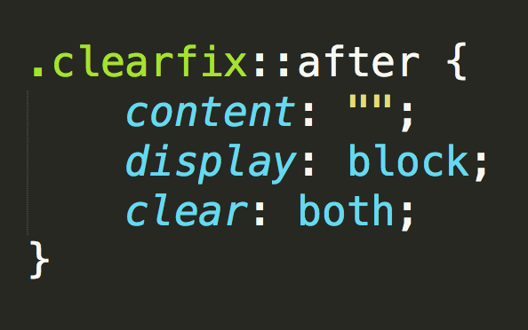
Clearfix Hack
::after is what we call a pseudo-element. We use it to style specific parts of an element.
This will add an HTML element, hidden from view, after the content of the “.clearfix” element. This clears the float.

Slide 43
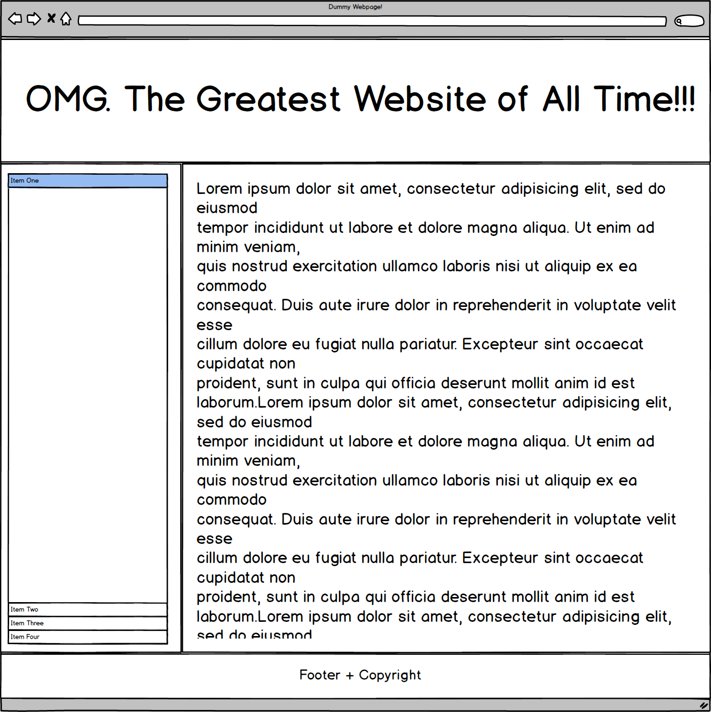
Quick Demo!

Slide 44
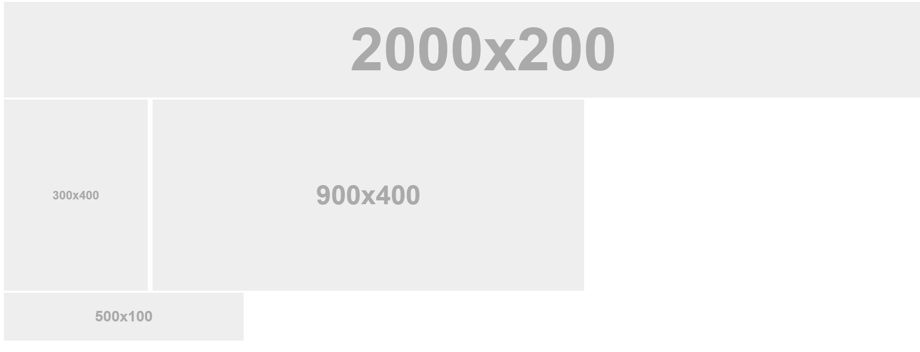
Quick Demo!

Slide 45
Quick Demo
Instructor: Demo
(2-FloatExamples)

Slide 46

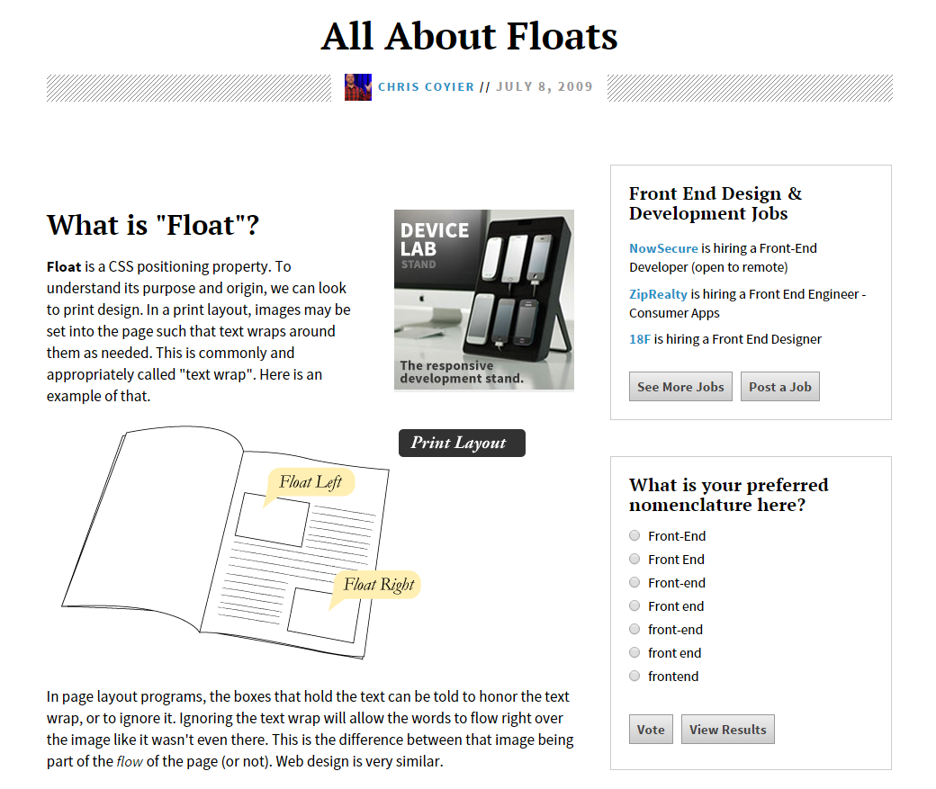
Fantastic Guide on Floats ****
To all serious front-end developers (this is a necessary read):
https://css-tricks.com/all-about-floats/

Slide 47
> YOUR TURN!!
Activity: 3-FloatLayout-Activity | Suggested Time: 30 min
Assignment
In this activity, you’ll flex your newfound floating skills by creating a conceptual layout. Eyeball the design to your best ability.
Check your Slack for more instructions.

Slide 48
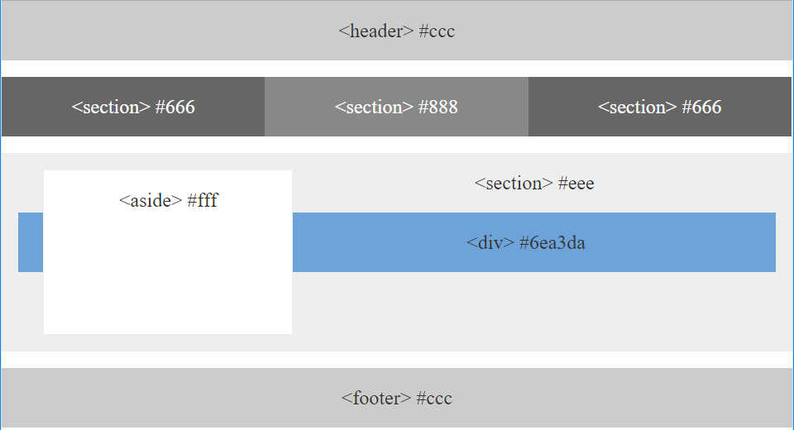
> YOUR TURN!!

Slide 49

Good work!
Your brain may rest now…

Slide 50
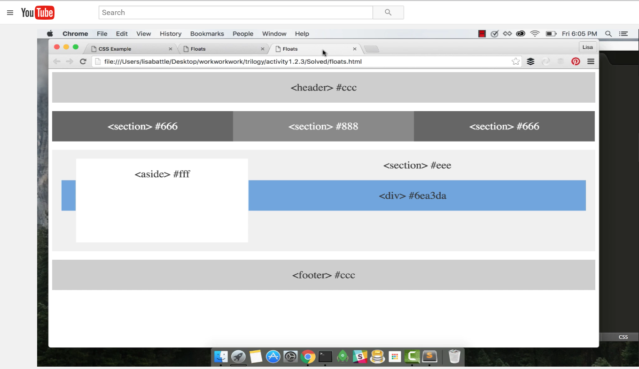
Video Walkthrough! (Highly, HIGHLY Recommend!!!)
Video Link: https://youtu.be/0lpxKw6E90Y

Slide 51
BREAK!

Slide 52
CSS Positioning

Slide 53
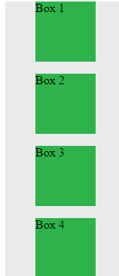
Position: Static (Default)
Four boxes placed statically (default)

Slide 54
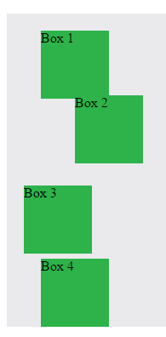
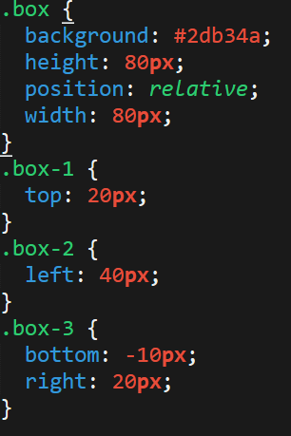
Position: Relative
Switching the boxes to relative will nudge the boxes in relation to their “original” location.

Slide 55
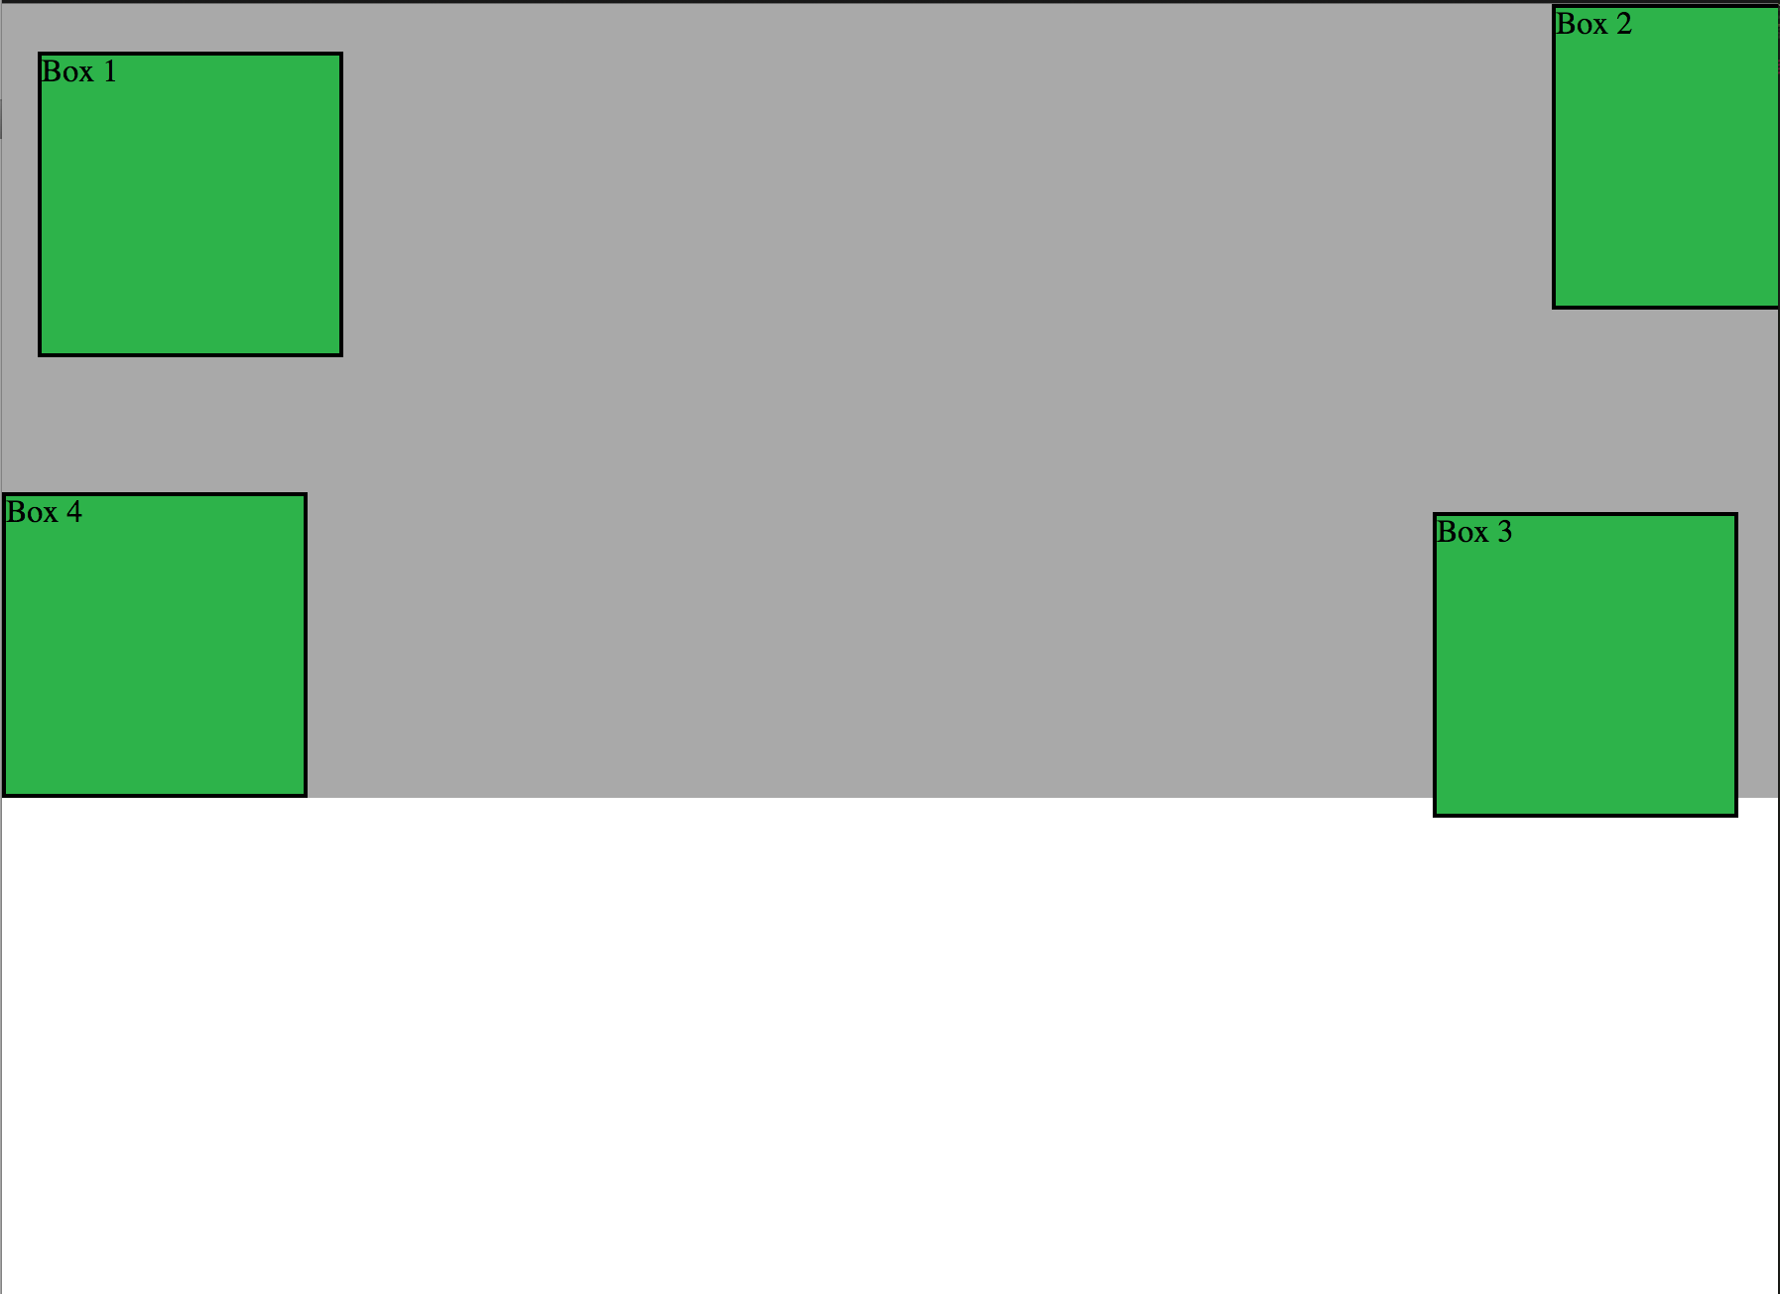
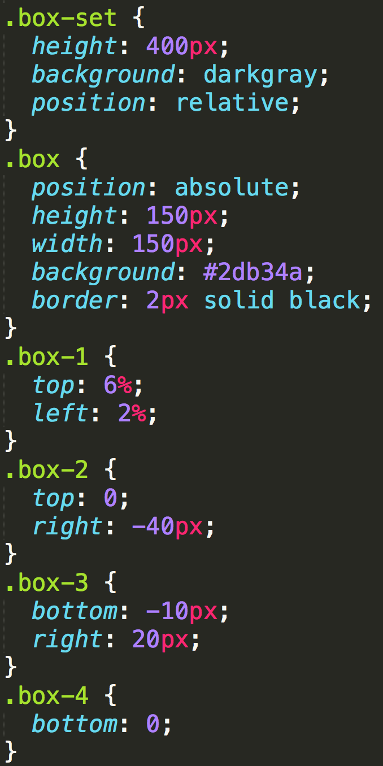
Position: Absolute
Positioned relative to nearest positioned ancestor
Notes:
An element that is positioned absolutely is taken out of the flow and thus takes up no space when placing other elements.
The absolutely positioned element is positioned relative to nearest positioned ancestor (non-static).
If a positioned ancestor doesn't exist, the initial container (body) is used.

Slide 56
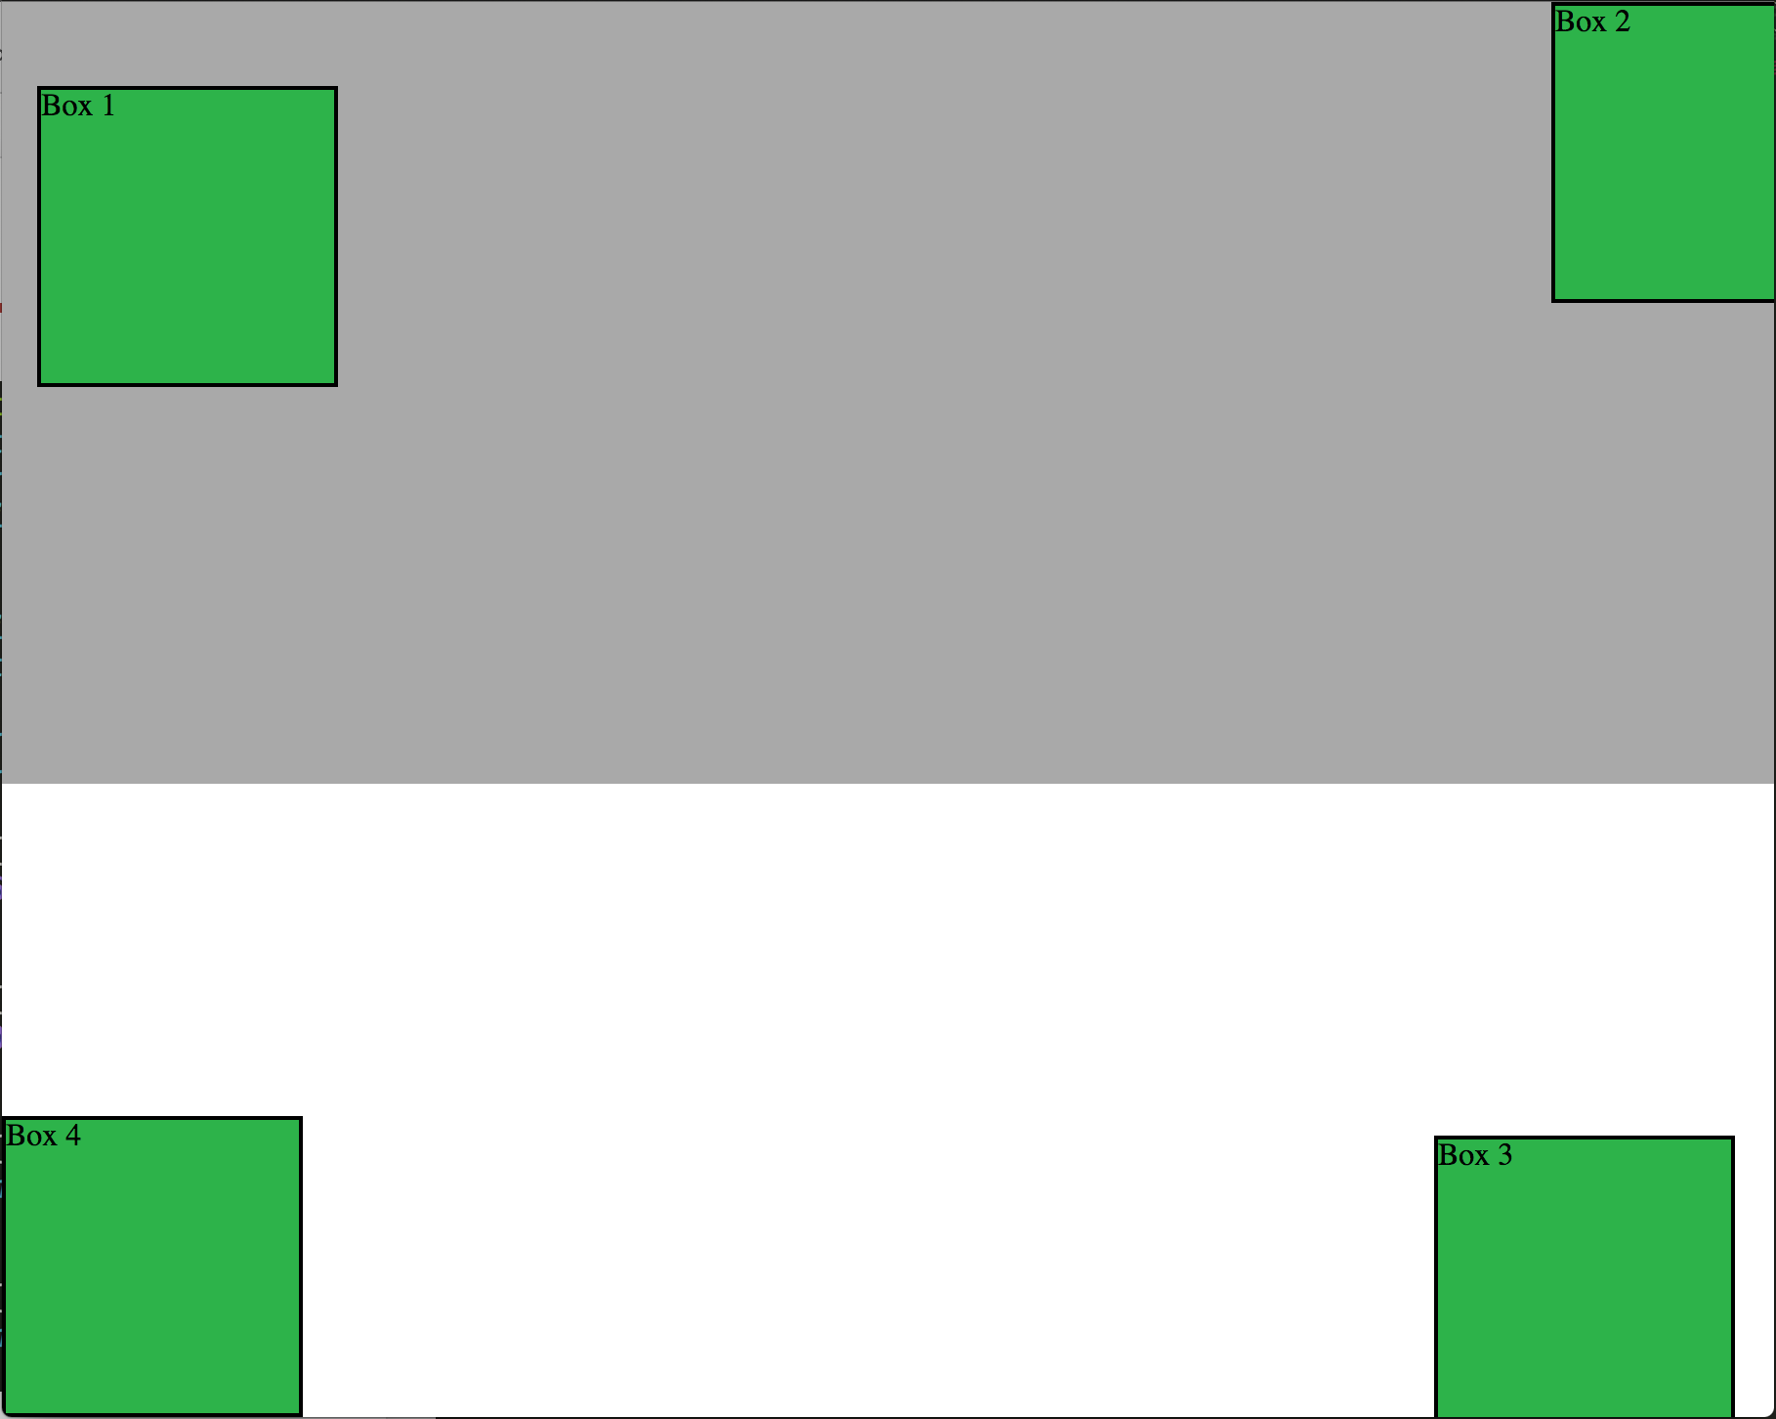
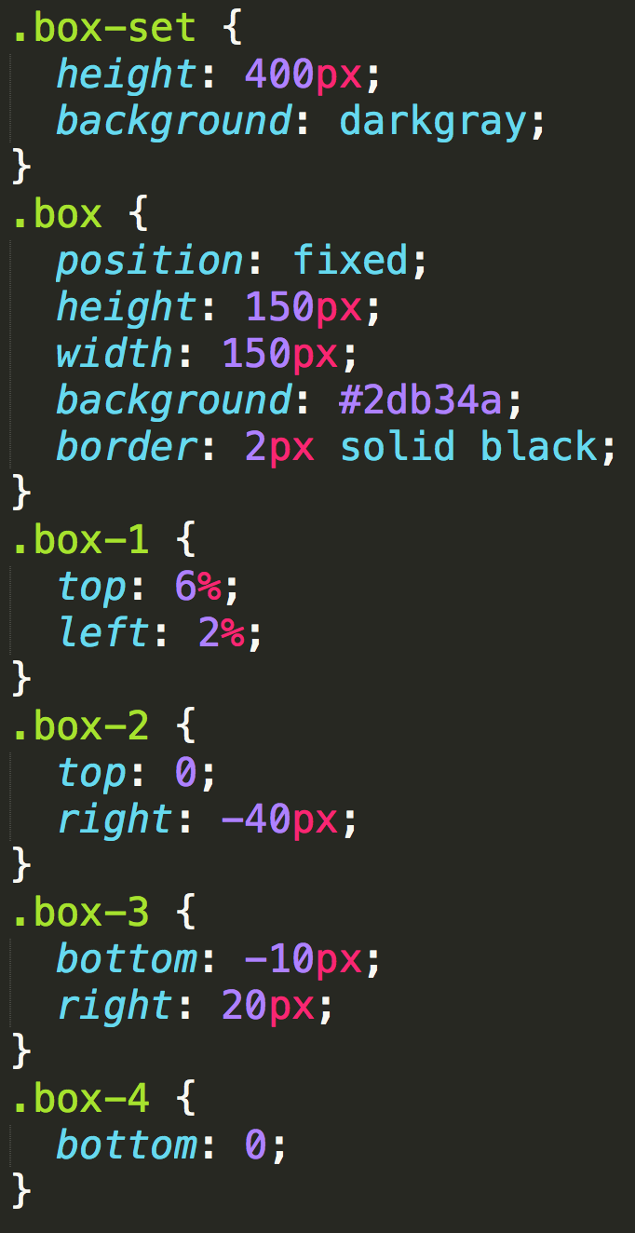
Position: Fixed
Position with exact coordinates to the browser window

Slide 57
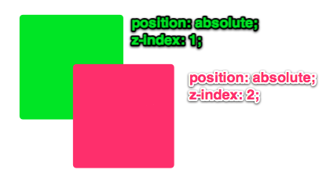
Layering with Z-Index
Z-Index allows you to layer elements on top of each other when they’re positioned.
Notes:
The elements must be positioned (any position other than static)

Slide 58
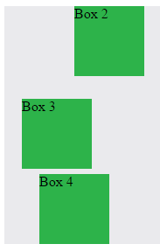
Hiding Things
“Display: none” allows us to hide elements from view.
This will become useful in later sections, when we’ll be hiding and revealing specific HTML elements of our choice.

Slide 59
Quick Demo
Instructor: Demo
(5-CSS_PositionedLayout)

Slide 60
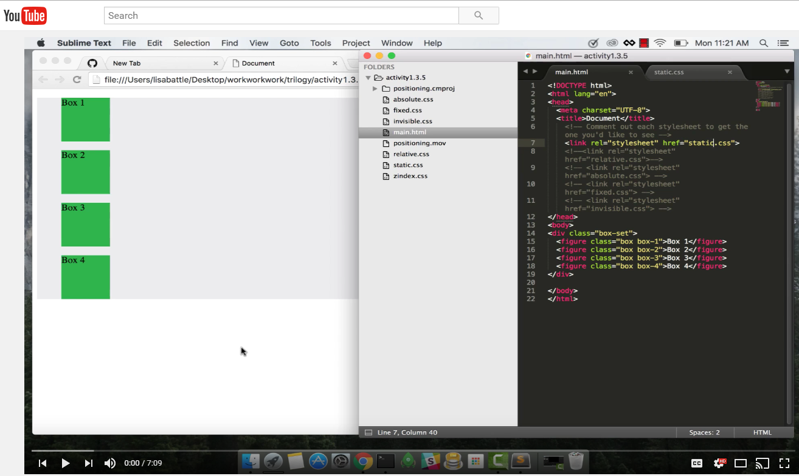
Video Walkthrough!
Video Link: https://youtu.be/sHfJn0jqBro

Slide 61
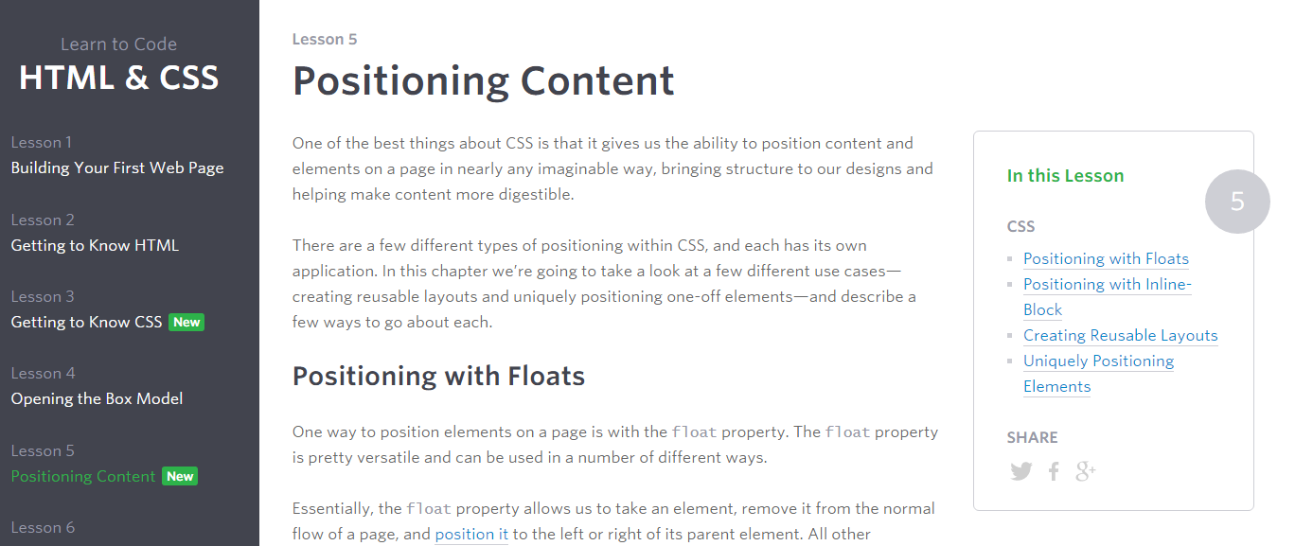
Great Resource
Another great read for front-end developers:
http://learn.shayhowe.com/html-css/positioning-content/

Slide 62
> YOUR TURN!!
6-CSS_Positioned_Activity | Suggested Time: 30 min
Assignment
In this activity, you’ll flex your newfound positioning skills by creating another conceptual layout. Eyeball the design to your best ability.
Check your Slack for additional instructions.

Slide 63
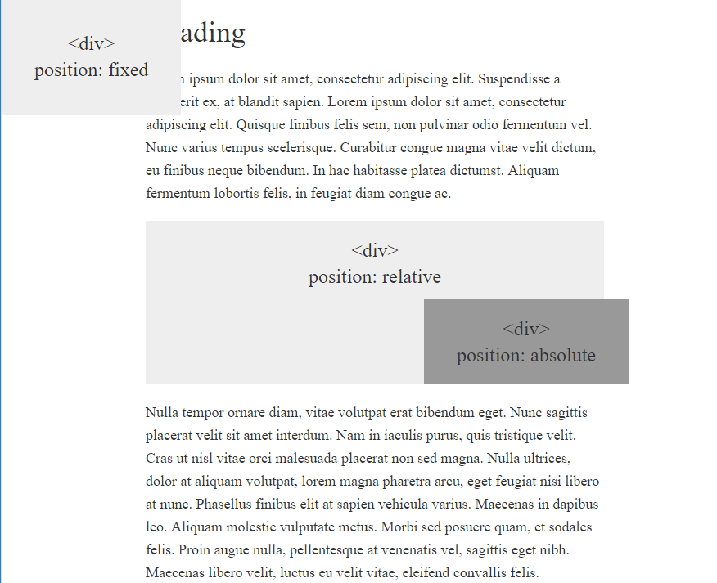
> YOUR TURN!!

Slide 64
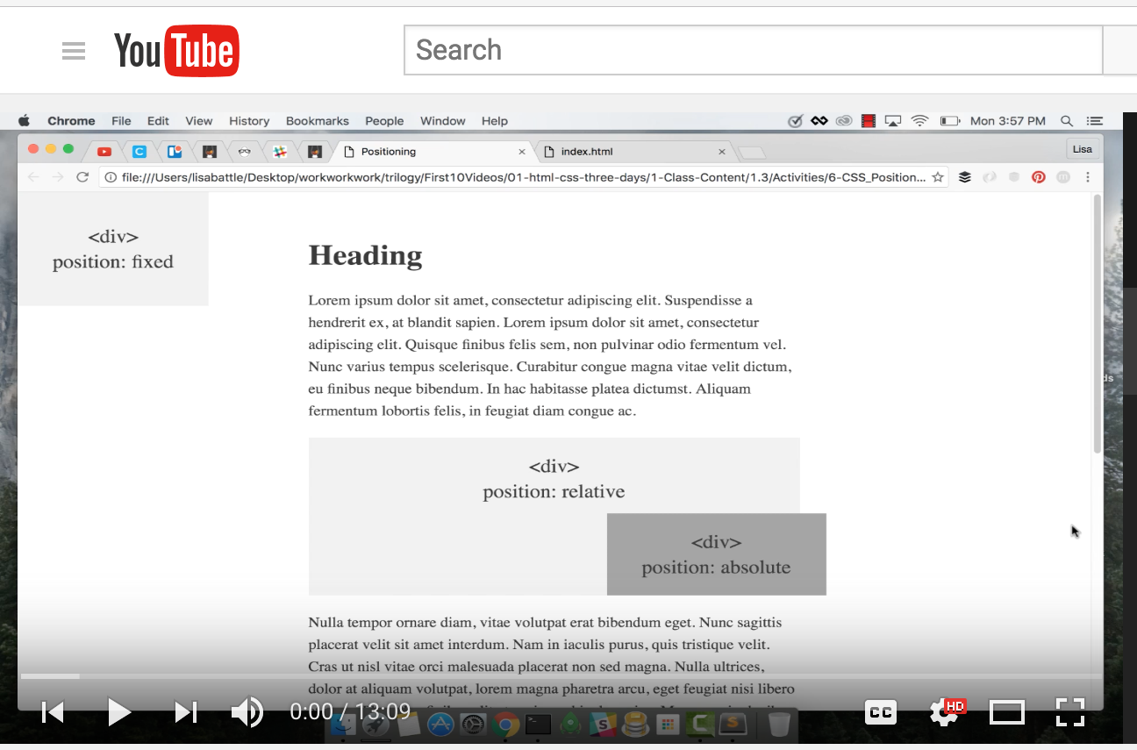
Video Walkthrough!
Video Link: https://youtu.be/yWXgnQaWSW0

Slide 65
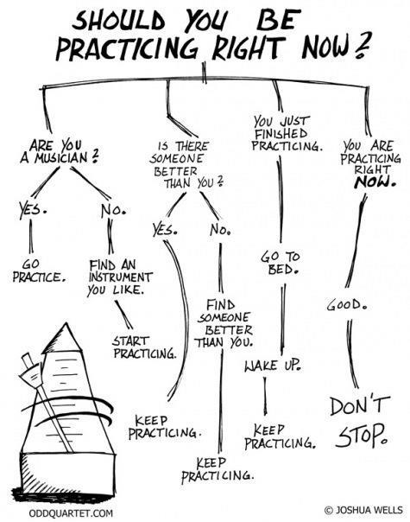
Advice
Re-do this at home.
We designed this exercise
to firm up your HTML/CSS skills.
REMEMBER:
The best way to learn
web development
is to PRACTICE!

Slide 66
Chrome Inspector

Slide 67
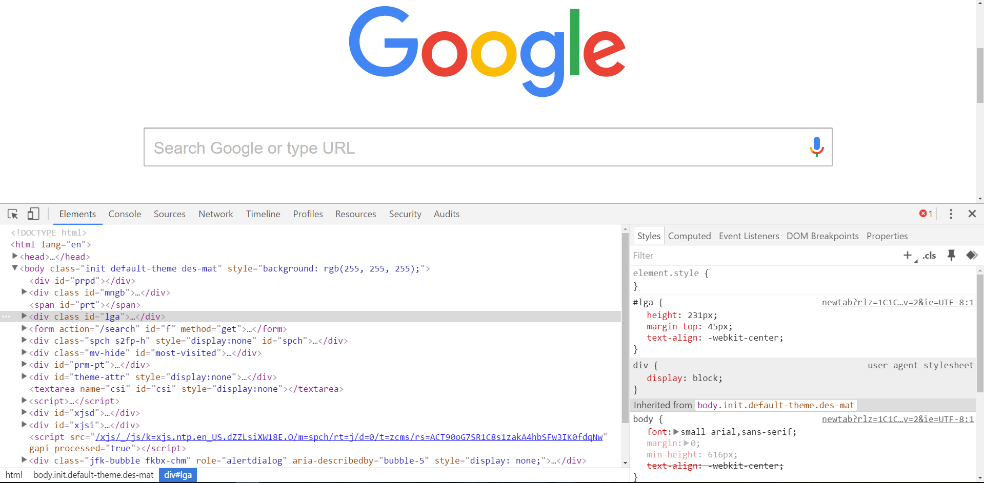
Chrome Inspector is Your Friend
To access chrome inspector, right click on a page. Then hit “Inspect.”
It will allow you to inspect the HTML, CSS and more!

Slide 68
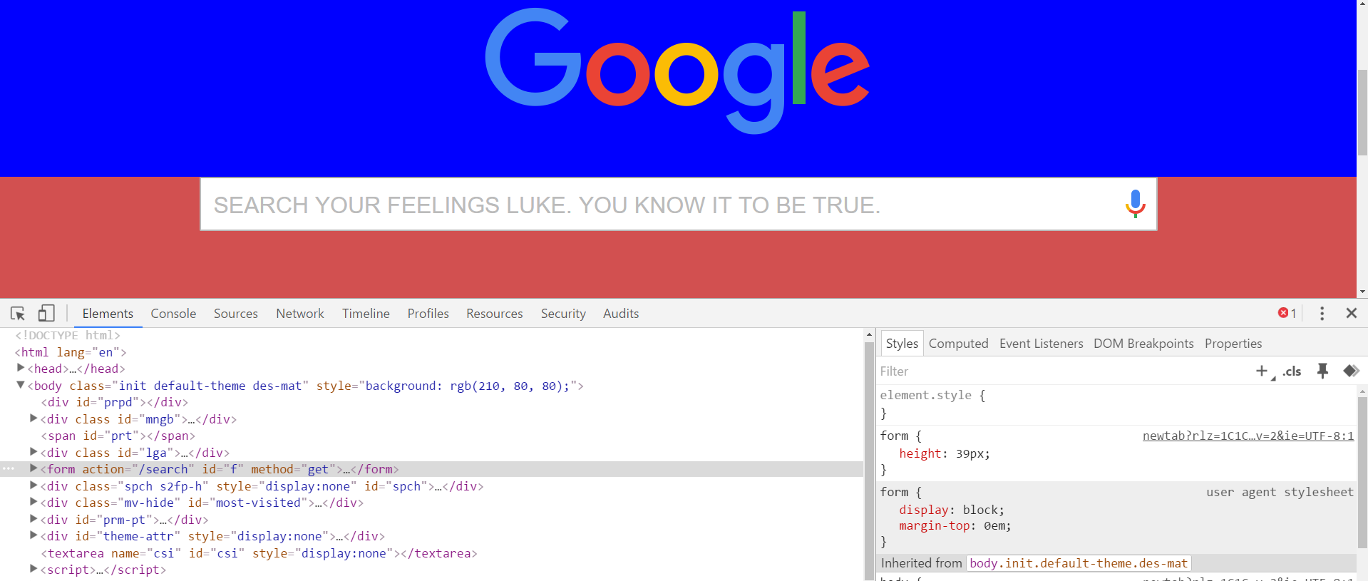
Chrome Inspector is Your Friend
You can even edit the HTML/CSS of a webpage and instantly view your changes in the browser!
This works on any website, whether yours or not.

Slide 69
Next Class!
We’ll be coming back to this
in our next class.

Slide 70
Recap + Reassurances

Slide 71


Slide 72
Questions?

Slide 73
EXTRA MATERIAL

Slide 74
> YOUR TURN!!
Assignment
Take a website you commonly visit (Amazon, Google, Huff Po, etc.) and heavily modify it with Google Developer Tools.
You have 15 minutes to test Chrome Inspector. Try modifying:
Content (change words).
Colors.
Spacing.
Any other CSS style rules.
When you’re done, send a screenshot to your class’s Slack.

Slide 75
CSS Resets

Slide 76
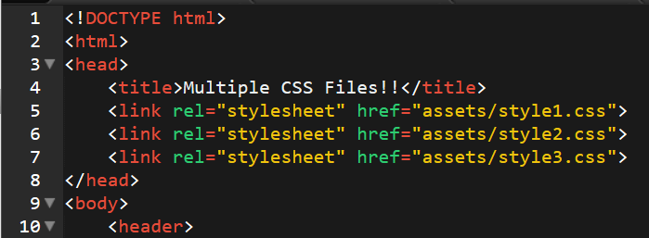
Loading Multiple CSS Files ***(Very Important!!!)***
We can link our documents to more than one stylesheet at a time—one of the most powerful features of CSS/HTML.
By tapping into different stylesheets simultaneously, we can create complex layouts with plenty of design rules.
Just remember: the loading order matters!!!

Slide 77
What Browser?
By a show of hands…
Which browser do you use?

Slide 78

Battle of the Browsers
Under the hood, web browsers often render webpages differently than their competition.
These disparities could mean HTML/CSS displaying differently in each web client.
Because of these potential divergences, web developers need to make their websites cross-browser compatible.

Slide 79
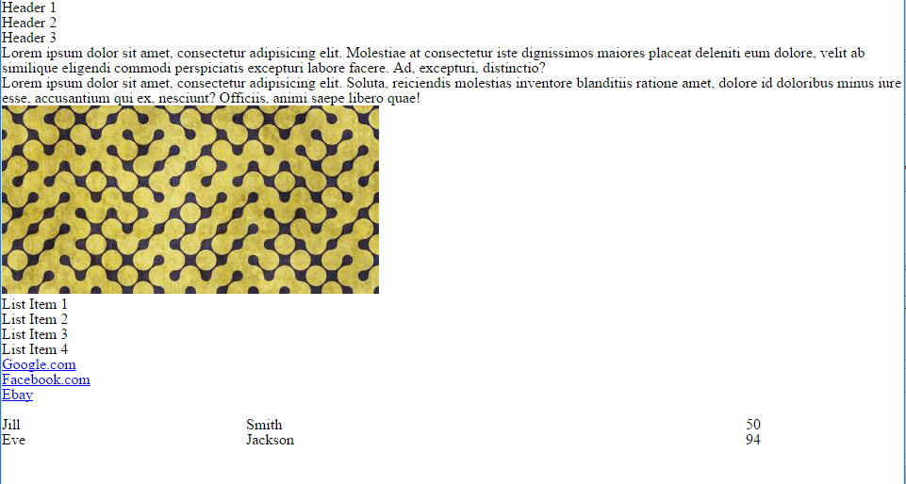
Reset.css (or Normalize.css)
Reset.css will “reset” all browser-specific CSS. This means your site will appear the same in all browsers.
However, you will have to re-style everything yourself.

Slide 80
Why CSS Resets Matter
It’s important for creating browser-compatible websites.
It’s an example of using someone else’s CSS in your website!!!
It’s a common Front-End Developer Interview question.

Slide 81
> YOUR TURN!!
Assignment
Follow the instructions given via Slack to incorporate a reset.css file in a basic HTML file.
Note the impact of the reset file makes after you include it.

