Slide 1
In Unit 7, we learnt to use Verb complements: ---ing or to + verb
…….. + verb + ing | ……. + to + verb
consider finish imagine miss mind spend mind appreciate enjoy suggest avoid complain discuss end up keep on think about give up put off | agree decide happen offer seem intend expect demand hope learn plan prepare promise
With different meanings remember stop try forget regret
With the same meaning Begin bother continue start Like love hate

Slide 2
Complete the sentences:
Even in winter, he keeps on _______________ (run) every morning.
I cannot imagine ______________ (live) in another country.
How did you end up ___________ (study) here?
That guy seems _____________ (be) very nice.
We´ve decided _____________ (buy) a new car.
I feel very hot. I´m going to stop _________ (buy) an ice-cream.
I´m planning __________ (give up) __________ (smoke). I´m going to stop ___________ (buy) cigarretes.
I really hate __________ (get up) early.
The man offered ______ (help) me

Slide 3
LMS: Before you begin, page 2: Listen
Unit 2
Tastes
http://www.youtube.com/watch?v=kAUVXngifzE

Slide 4
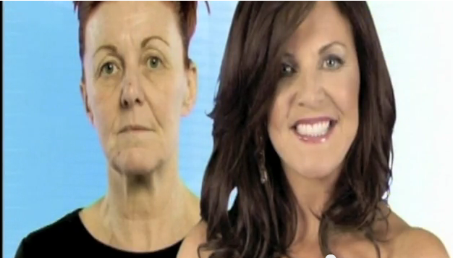
What do you think about this makeover?
How did she feel at the beginning? How did she change?

Slide 5
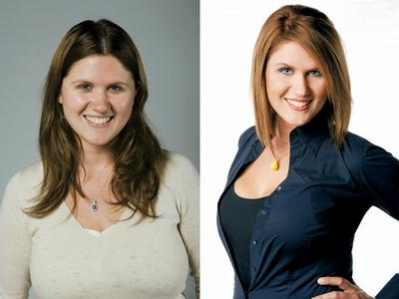
Makeover
Have you ever wanted to change your hairstyle or buy new clothes to better suit your personality? Would you let a friend to give you a makeover?

Slide 6
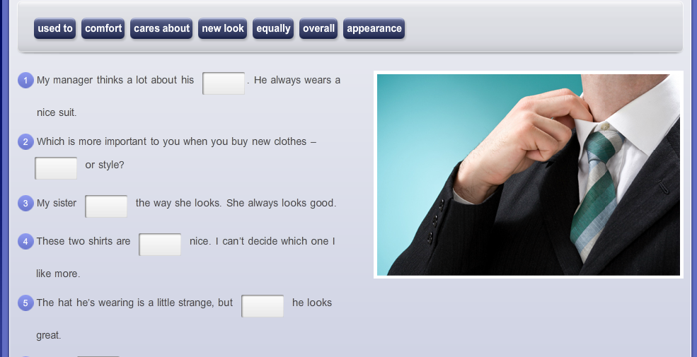
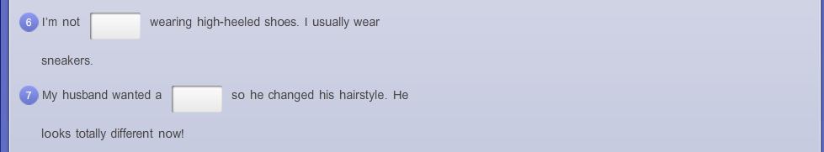
Preview: vocabulary

Slide 7
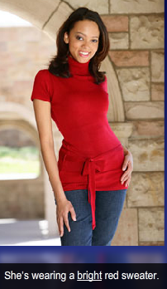
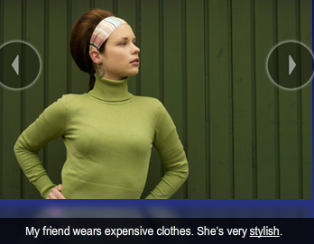
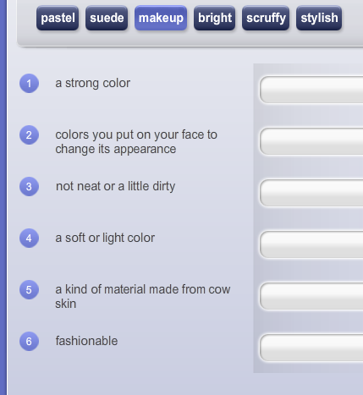
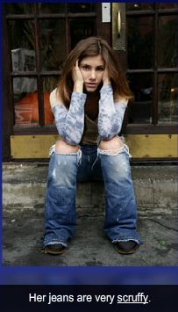
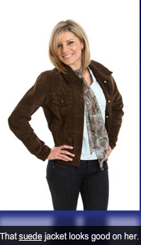
She always looks good
BRIGHT
MAKE UP
SCRUFFY
PASTEL
SUEDE
STYLISH

Slide 8
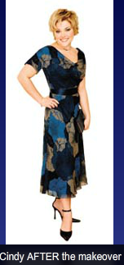
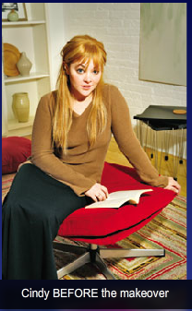
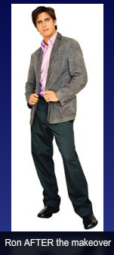
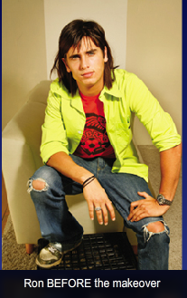
Now look at the pictures of Cindy and Ron before and after their makeovers. Do you think they look better or worse with their new looks?

Slide 9
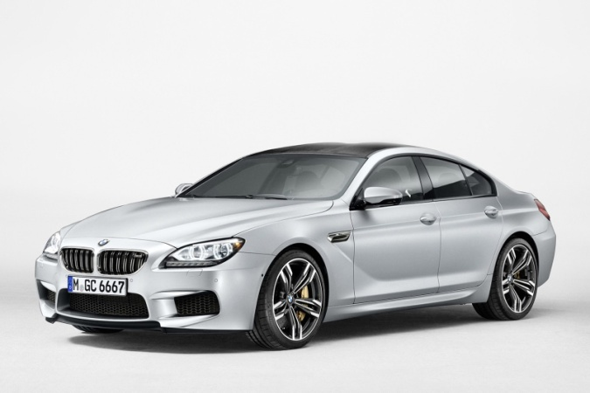
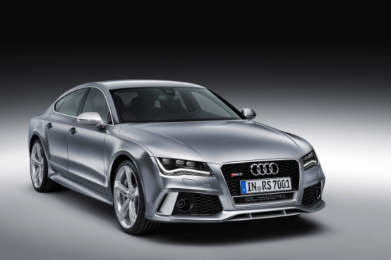
You can use: as …. as…. to make comparisons
(not) as + adjective + as…
The BMW is as expensive as the Audi
$80,000 $80,000

Slide 10
Examples:
The pants are just as comfortable as my jeans.
I don´t look as scruffy as I did.
Which are the adjectives?
Notice: We use JUST to emphasize that the two parts are the same. It comes before the first “as”

Slide 11
Henry made five mistakes on the test. Vivian made five mistakes on the test.
Henry made as many mistakes as Vivian
Mistakes: Countable noun
You use: Many
Jerry lost $200 at the casino. Tim lost $200 at the casino.
Jerry lost as much money as Tim did
Money: Uncountable noun
You use: Much

Slide 12
If you have the same number or quantity of something, use:
(not) as + quantifiers + nouns + as….
With Countable nouns | With Uncountable nouns
Many | Much
A few | A little

Slide 13
Examples:
I spend as ________________ time as you do.
He has as _________________ good friends as his brother does.
He doesn´t pay as _________________ money as I do.
I don´t read as ___________________ books as I should
Little / much
many
Little / much
many

Slide 14
as + adverb + as…
I tried as hard as I could to find the right style for her.
I don´t like short hair as much as long hair.

Slide 15
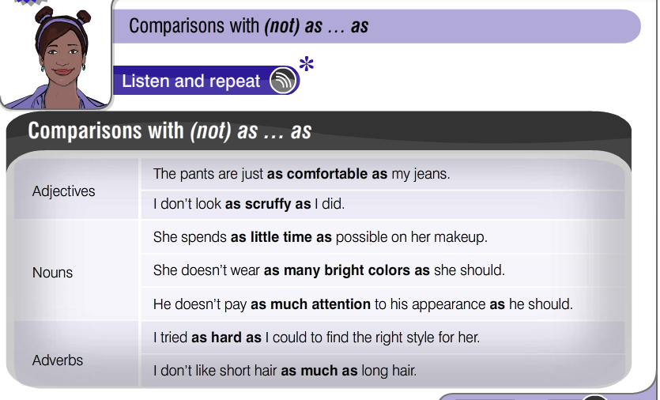

Slide 16
Are the underlined words adjectives, nouns or adverbs?
I tried as hard as I could to find a style that would fit her personality.
These pants are just as comfortable as my jeans.
I don´t look as scruffy as I did before.
I usually don´t like short hair as much as long hair.
He doesn´t pay as much attention to his appearance as he should

Slide 17
Make comparisons using (not) as… as
Young people are more interested in fashion than old people.
The jeans and pants are both equeally comfortable.
I like short hair less than long hair.
She spends as little time as possible on her makeup.
She doesn´t wear as many bright colors as she should.

Slide 18
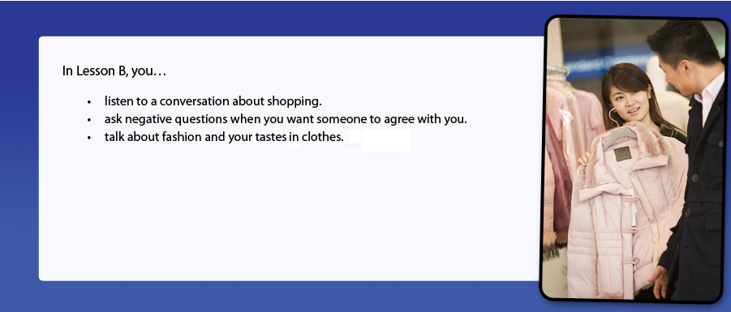
Today we are going to:

Slide 19
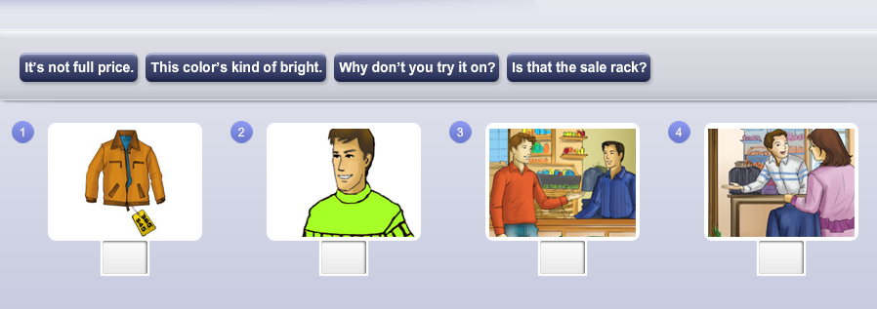
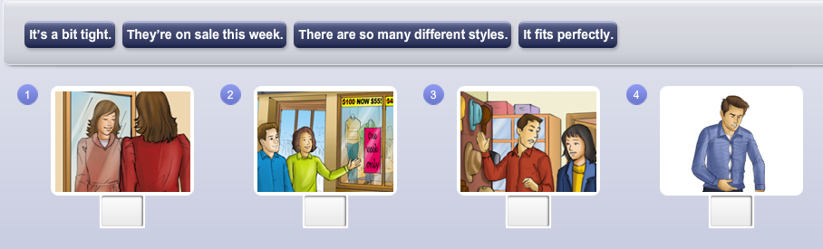
Vocabulary Preview: Shopping Expressions
It´s not full price
This color is kind of brigh
Is that the sale rack?
Why don´t you try it on?
It fits perfectly
They´re on sale this week
There are so many different styles
It´s a bit tight

Slide 20
Read along: Check True or False
Ben thinks the jacket is a nice color.
Yoko thinks the jacket would look good on Ben
Ben is going to try the jacket on
The jacket is not on sale
Ben doesn´t want to look at other jackets.
Book: Exercise 1 B

Slide 21
Look at these negative questions. Choose the senteces with the same meaning:
Don´t you love this jacket?
I don´t like this jacket
I love this jacket.
Don´t you like it?
It´d look good on you. Don´t you think?
Don´t you want to try it on?
I´m surprised you like it
I´m surprised you don´t like it
I think it would look good on you.
I don´t think it would look good on you
I don´t think you should try it on
I think you should try it on

Slide 22
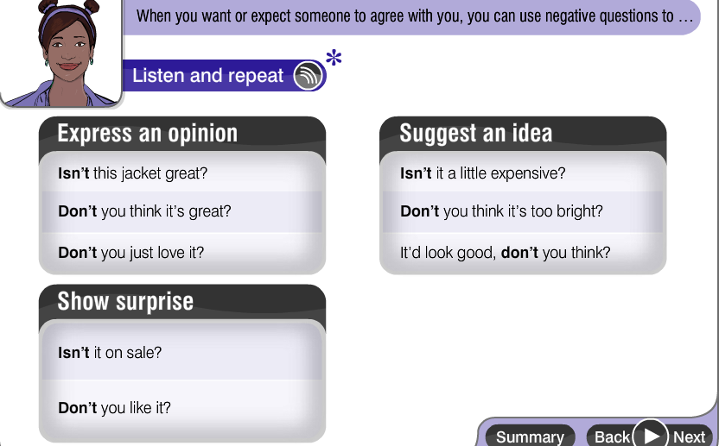
Negative Questions

Slide 23
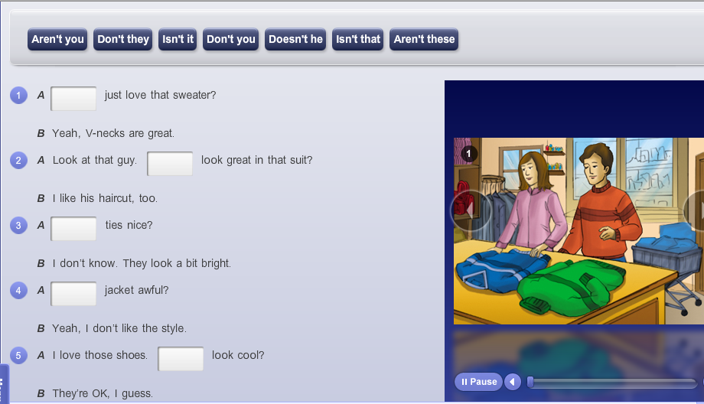
Don´t you
Doesn´t he
Aren´t these
Isnt that
Don´t they

Slide 24
Vocabulary on clothing
5°
ana maria rodrigo prado

Slide 25
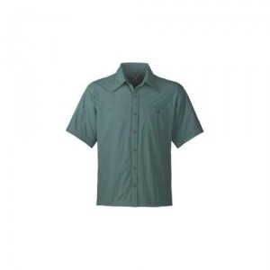


Describing appearence
Styles + Color + Pattern

Slide 26

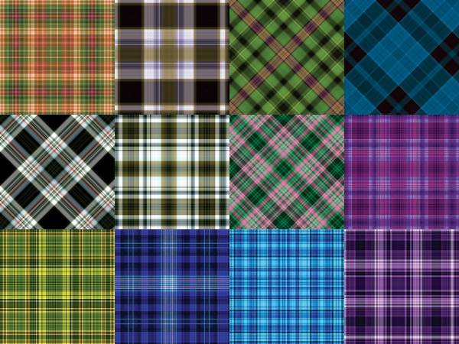
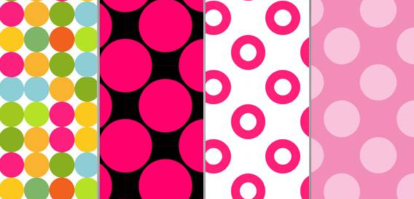


Patterns
Floral print
Plaid
Polka - dots
Animal print
striped

Slide 27





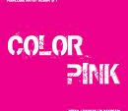














maroon
neon orange
purple
mauve
violet
beige
almond
neon green

Slide 28
Styles
elegant
Ankle-lenght
V-neck
fitted
short
long
flared
Boot-cut
old-fashioned
tight
casual

Slide 29
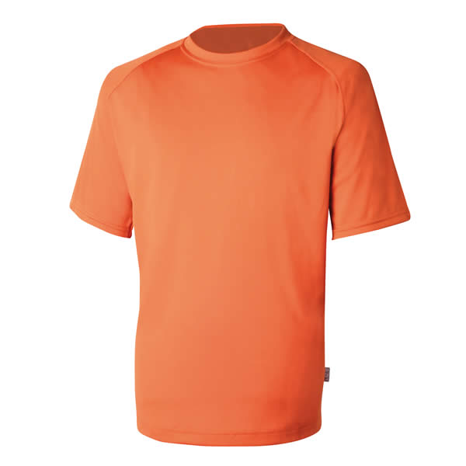

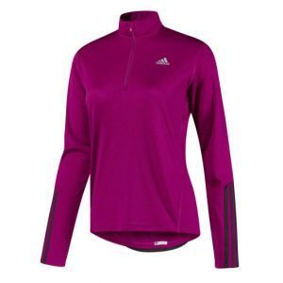
Styles
Short- sleeved
Sleeveless
Large -sleeved

Slide 30
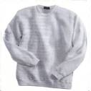
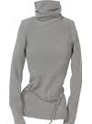
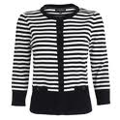
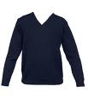
turtleneck
crewneck
round neck
v- neck

Slide 31
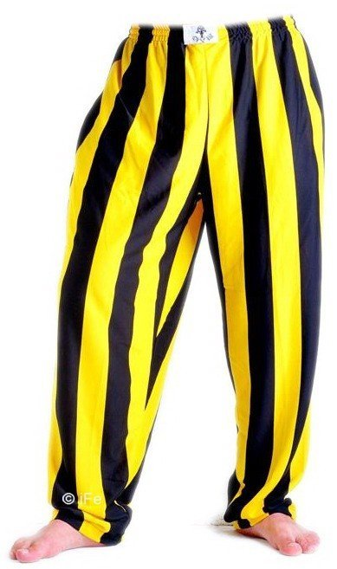
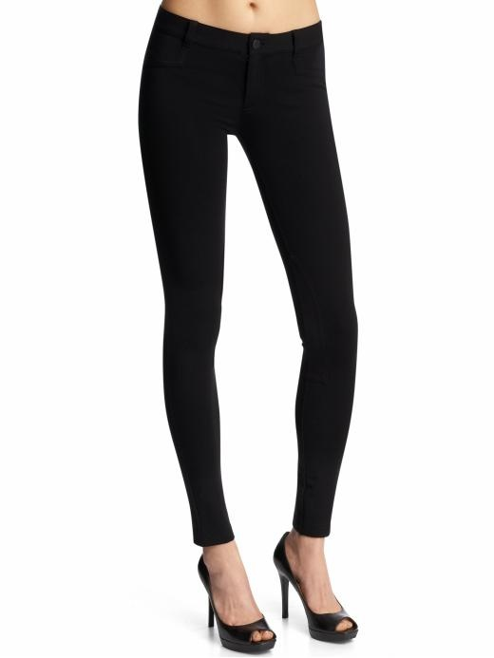
.
Baggy
Fitted

Slide 32
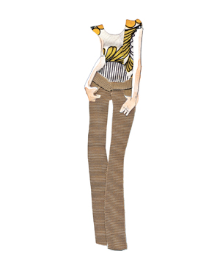
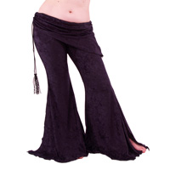
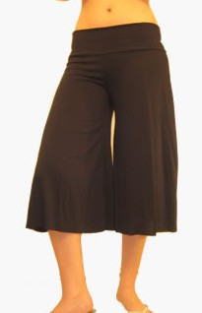
boot-cut
FLARED

Slide 33
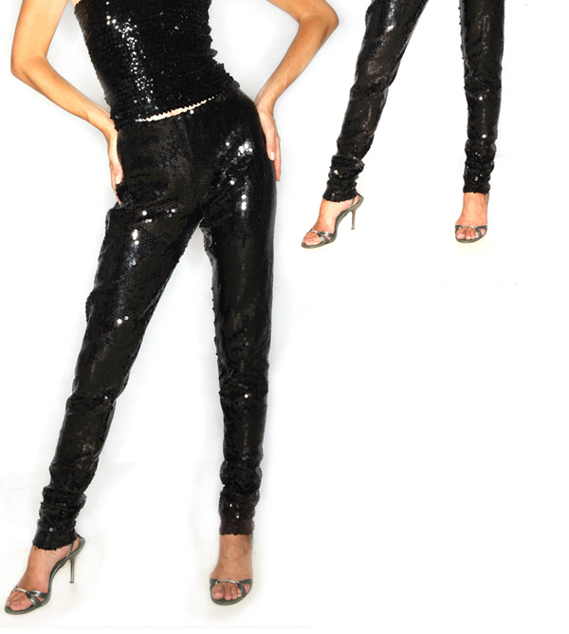
Tight

Slide 34



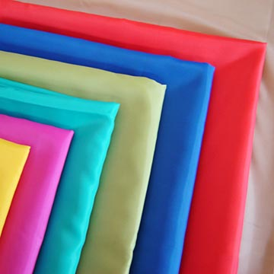
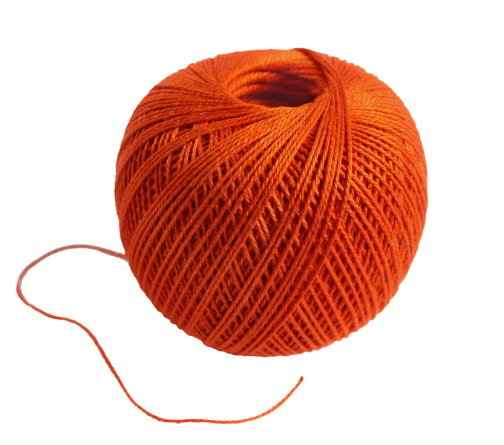
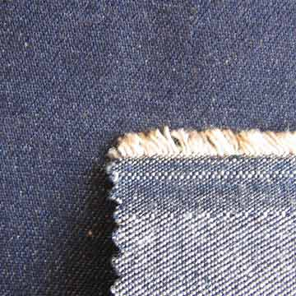

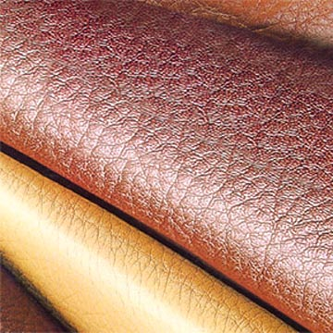
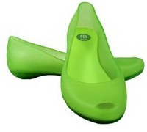
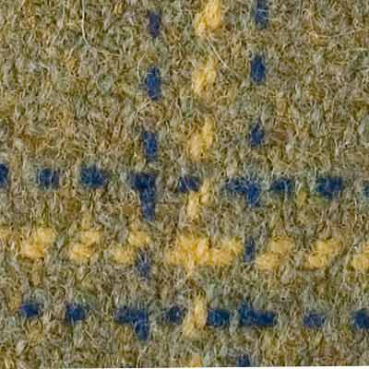
Material
velvet
suede
silk
polyester
wool
denim
satin
leather
tweed
plastic

Slide 35
Pairs write a conversation in which
a mother and a daugher
mother and son
Boyfriend and girlfriend
husband and wife
Are shopping for clothes. They each choose an item that the other really dislikes.
Remember to use negative questions and as…as…

Slide 36
