Slide 1
Bayes-UCB Bandit Policy
Yuyan Zhao, Bérénice Jaulmes

Slide 2
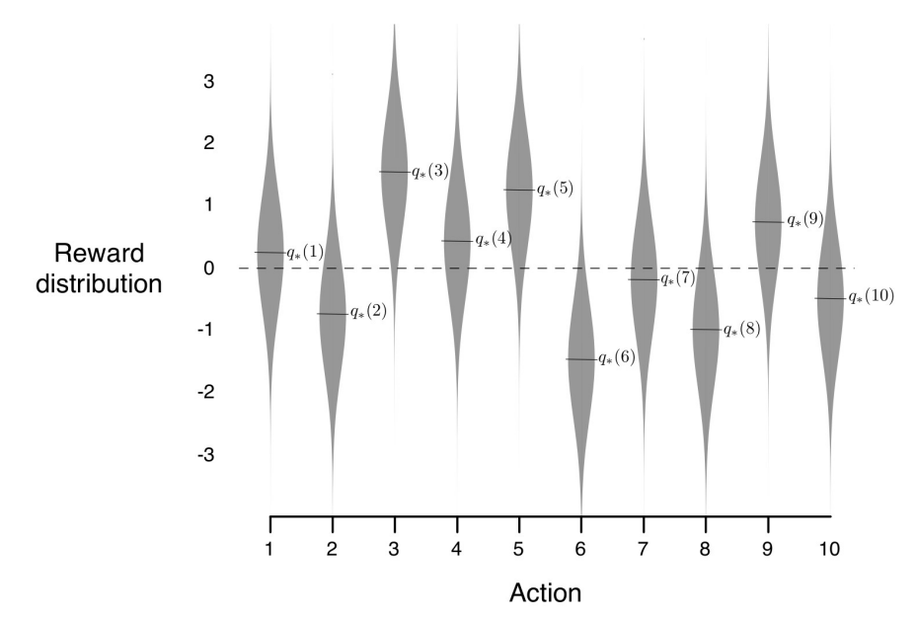
Introduction
Multi-armed bandit problem
A bandit with k arms
The reward given by each arm follows an unknown Gaussian distribution
Their distributions are invariant
Find a policy to maximize the cumulative reward with a limited number of timesteps

Slide 3
Introduction
Bayes-UCB Algorithm
Bayes-UCB is a Bayesian algorithm for the multi-armed bandit problem
The generality of the Bayesian approach makes it possible to address more challenging multi-armed bandit problem, e.g. with variant distributions
Compute the posterior distribution of the reward for each arm,
Compute an upper confidence bound (UCB) on the expected reward for each arm,
Pull the arm with the highest UCB. Update its posterior distribution after each pull
Reference
On Bayesian upper confidence bounds for bandit problems (Kaufmann et Al.)
-> Bayes-UCB for binary reward, Bernoulli distribution

Slide 4
Algorithm
Assume the posterior of reward given by each arm follows a Beta distribution
Initialized the distributions with Beta(1, 1)
For each timestep:
For each arm:
Compute the p-th quantile of its Beta distribution, where p = 1 - 1 / (n_timestep + 1)
Use the p-th quantile as the UCB for this arm
Pull the arm with the highest UCB
Update the beta distribution for the pulled arm

Slide 5
Results
Metrics
Cumulative reward
The sum of rewards obtained at the current and previous time steps
-> goal
Mean reward
The average of rewards obtained at the current and previous time steps
-> performance and stability
Environments
CandyCaneContest, provided by River
A bandit with 100 arms. The value of the reward is 0 or 1
The probability of getting a reward for each arm decays with the number of pulls
The reward given by each arm follows an unknown Beta distribution

Slide 6
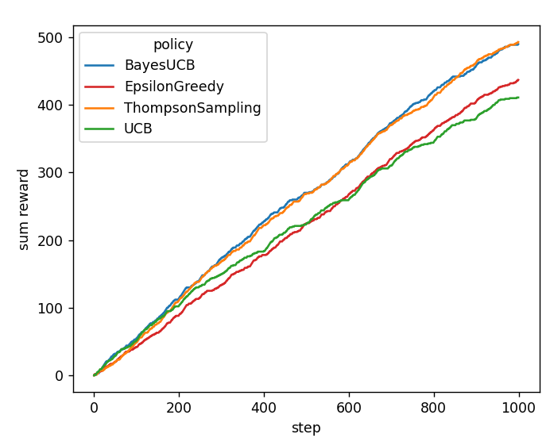
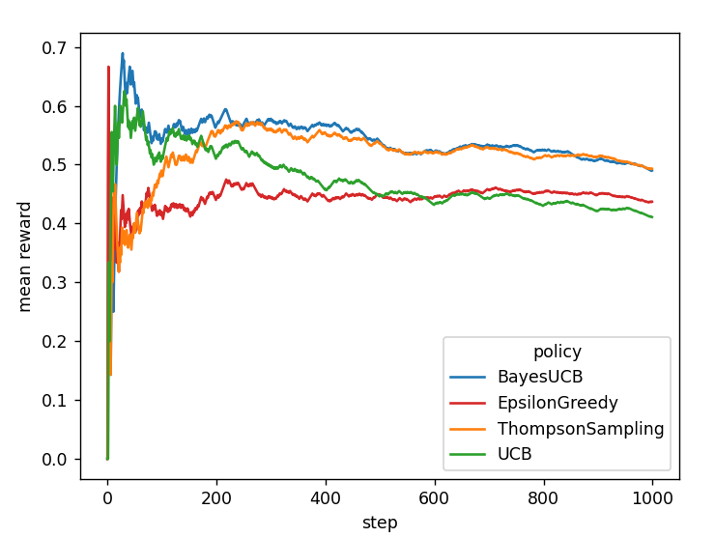
Results
Cumulative reward
Mean reward

Slide 7
Conclusion
Discussion
Implemented Bayes-UCB algorithm for bandit problem in River
Evaluated it with the evaluation method in River
Compared it with the existing bandit algorithms in River
This work could be extended to include other distributions, such as the Gaussian distribution

Slide 8
Quick overview
Code in River
https://github.com/ormarv/Project/blob/master/bayes_ucb.py
Documentation
https://github.com/ormarv/Project/tree/master
Code run

