Slide 1
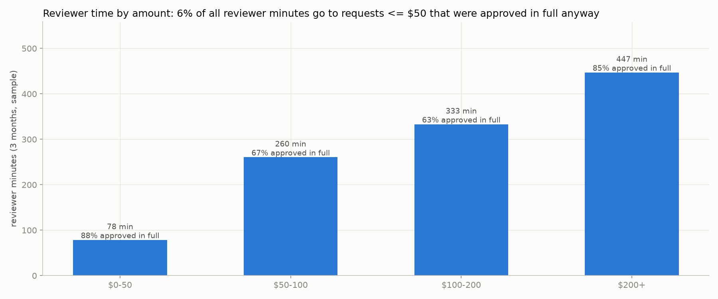
Refund requests: let rules take the easy ones
What happens today, from 3 months of real decisions (248 requests)
45%
8 min
of requests were approved by an old automatic rule nobody remembers. Only 14% of the money.
is what a person spends per request. 1,119 minutes in the sample, 4 reviewers.
8
22
chargebacks: the bank took the money back after we refunded. About $2,519 lost.
small, clean requests went to a person only because the account was new. 21 were approved anyway.
Where reviewer time goes. The tiny approvals under $50 are only 6% of it. Most time goes to $50–200 requests, where the answer sits in a note: was there a photo, did the warehouse confirm a mistake.
Before: one queue for everything. A $20 shirt in the wrong size waits behind a $495 fraud case.
After: written rules approve the safe cases. People get the rest, with the reason and the evidence. The manager changes the rules herself, and sees the effect before it goes live.
Notes:
111 of 248 requests were decided automatically, 137 by people. Mean 8.2 minutes per human decision.

Slide 2
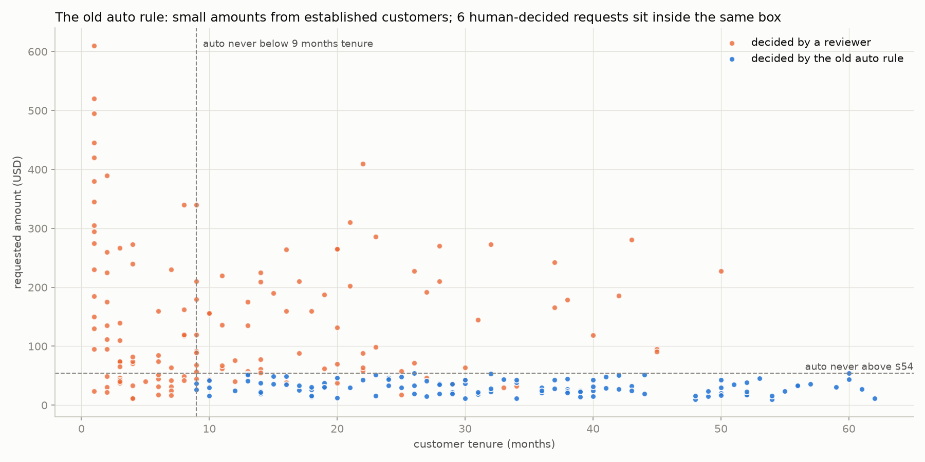
Today's line, read off the data
What we read off it
• Nobody wrote the old rule down, so we found it in 248 past decisions: every automatic approval is $54 or less, from an account 9 months or older, with no earlier refund.
• It reads nothing: not the reason, not the notes, not the fraud flag beyond 'not yes'.
• 6 requests inside that box were still decided by a person (3 approved, 3 rejected). Most carry a note, so the rule probably skips anything with free text.
• 22 small, clean requests fell just outside it because the account was under 9 months old. A person approved 21 of them: the 'two minutes clicking approve'.
• 111 of 248 requests (45%), but only $3,377, 14% of the money. One of its approvals charged back: $49, with no note to read.
Where it breaks
Everything the rule does not take sits in one queue: the $495 fraud case next to the $20 shirt. 3 fraud-flagged requests were approved without asking the fraud team; 2 of them charged back. 10 decisions went against the manager's own notes. 3 rejections were overturned on appeal; one of those customers closed the account.
Notes:
Figure and numbers from docs/eda/findings.md sections 3 to 6; scripts/eda.py reverse-engineers the old rule as the tightest box around every auto-decided request.

Slide 3
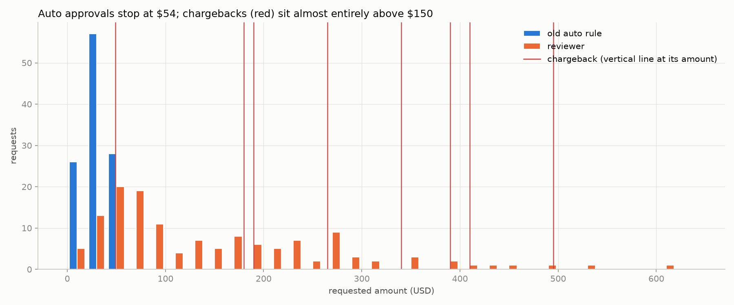
The new line: her notes set the rules, the data sets the numbers
the manager wrote | what the rules do
1. small stuff from good customers goes through | up to $200 with no red flag: approve (numbers on the right)
2. change of mind: 14 days, no exceptions | within 14 days: approve; after: a person (the system never rejects)
3. damage: a photo for anything over $50 | $50 or less: approve; over: only if the note says the photo shows damage
4. never arrived: signature means reject | always a person; a rejection is a person's call
5. fraud flag goes to the fraud team | fraud queue, always; a blank flag is unreadable: a person
6. our mistake: full refund; partials are the reviewer's call | picking error confirmed in the note: approve; late delivery: a person
Numbers from the data: the cap
cap | approved alone | reviewer minutes saved | bad approvals a note could catch
$54 (old) | 104 (42%) | 48 | 0
$100 | 111 (45%) | 86 | 0
$150 | 115 (46%) | 104 | 0
$200 (chosen) | 120 (48%) | 156 | 0
Four of the six turn on what the note says
A photo, carrier proof, a stolen card, a confirmed picking error. Those became five yes/no questions a model answers, each with the quote it relied on; 'unknown' never approves.
The replay corrected us once: the first question was 'photo attached', and it approved two claims where the photo showed the item was fine. It became 'does the photo show damage'.
$200 is the highest cap with zero catchable bad approvals, and the chargebacks sit above $150. Above $150 there are only 5 past cases, so the evidence is thin; the manager can lower it with one change. Also from the data: accounts under 3 months (both fraud-flagged chargebacks were 1 to 2 months old) and customers with two earlier refunds go to a person.
Notes:
Rules: policies/v1.json, each with the policy note it comes from. Cap table and chargeback figure: docs/eda/findings.md section 8 and refund-agent backtest.

Slide 4
What we added: rules, a note reader, two screens, and a test
A request
From the web form or the support desk, as a CSV.
Clean the file
Fix dates, amounts, Y/N flags and reason spellings. Hide card numbers. Flag duplicate ids.
Written rules decide
An ordered list in a versioned file: 7 'send to a person' rules first, 4 'approve' rules after. First match wins. Unknown never approves.
Approve
120 of 248 (48%); rule and quote recorded.
Two queues
The reviewer queue, oldest first. The fraud queue for flagged cases.
To a person
128 of 248, with the reason in plain words.
The same path on the command line and in the app.
refund-agent decide any.csv writes one line per request: the outcome, the rule that fired, the facts it used, the rules version. Nothing in the app is a mock.
A model reads the note, only when a rule asks
Five yes/no questions, each with the quote it relied on. Answers are saved. No key means 'unknown', which goes to a person.
Two outcomes only.
Approve, or send to a person. The system never rejects: a wrong rejection costs an appeal and maybe the customer. Rejecting stays with people.
The reviewer's screen
The manager's screen
The replay, as a test
Why the request is here, in plain words; what the model read, with the exact quote; the customer's history; the manager's note that applies.
Approve, approve part, reject, or send to the fraud team. Each goes to the log with the reviewer's name and the rules version.
She types a sentence ('anything over $300 comes to us'); the model turns it into a rule, or says why it cannot.
A dry run replays old and new rules on the 248 past requests; then she publishes a new version. Rollback is one click.
Every version is run on the 248 decided requests, where we know what happened next.
If it would approve a past bad case that a note or flag could have caught, the test fails and blocks publishing.
Notes:
The flow is src/data/normalize.py -> src/policy/engine.py -> src/queue.py; the model is only called from the extractor. Screens are app/pages; the test is refund-agent backtest.

Slide 5
What changes: today and with the system, side by side
 | today | with the system
who decides the money | an old rule nobody remembers, then four reviewers | written rules in a versioned file; first matching rule wins; people take the rest
approved without a person | 111 of 248 (45%), $3,377: $54 or less, no earlier refunds, account 9 months or older | 120 of 248 (48%), $5,015: safe cases up to $200, with the notes read; 100% agreed with the final human decision
reviewer time | 1,119 minutes over 137 requests | 963 minutes: 156 saved, and the small clean cases no longer wait
why a request was approved | not recorded | the rule that fired and the quote from the note, in the decision log
what the reviewer sees | the raw request, in one queue with no order | why it is here, what the model read, the customer's history, the policy note that applies; oldest first
fraud-flagged cases | same queue; 3 approved without the fraud team, 2 charged back | their own queue; the rules never approve a fraud flag
changing a rule | find whoever set it up at IT; no way to test it first | the manager types a sentence, sees the dry run on 248 past cases, publishes a version; rollback in one click
catching a bad rule | a chargeback, weeks later | the replay before publishing; five weekly numbers and two rollback levels after
rejecting a customer | the reviewer's call | unchanged: the system never rejects
+$1,638
156 minutes
0
approved without a person on the same 248 requests: 120 instead of 111, $5,015 instead of $3,377.
of reviewer time saved out of 1,119, and no small clean request waits behind a fraud case.
bad approvals a note or flag could have caught, in the replay. The one it cannot catch is a $49 case with no note.
Notes:
Left column from findings.md sections 2 to 6; right column from the backtest ('The line') and the two screens. Slides 5 to 7 give the detail behind each row.

Slide 6
How we would know it is wrong: before switch-on, and after
Before: the replay is a test
After: five numbers, checked weekly
• Every version is replayed on the 248 past requests. 'Bad' means approved, then a chargeback, a fraud flag the fraud team never confirmed, or a reviewer's no. If a note or flag could have caught it, the test fails and the change cannot be published.
• The model's reading of notes is checked separately on 205 notes labelled by hand (slide 7).
number | good looks like
share approved automatically | about 48%, and stable
chargebacks on automatic approvals | zero; below the human rate of 3.7%
dollars approved automatically per week | about $450; never above 1.5×
oldest request waiting for a person | under one working day
appeals on reviewer rejections | fewer than today's 3 of 24
Rollback, two levels
Honest note: 248 past requests is a small sample. The replay proves we did not repeat a known mistake; the weekly numbers are the real test.
• One bad case: a chargeback on something the system approved. The manager switches off the one rule that approved it. No engineer needed.
• A pattern over 4 weeks: more chargebacks on automatic approvals than people had (3.7%), or one week paying out 1.5 times the usual. She publishes a rule that sends everything to people. Same day.
Notes:
Baselines come from the replay: about $450 per week approved automatically over 11 weeks of history.

Slide 7
Where the AI is used, where it is not, and why
Used, for two narrow jobs
Model, cost, and how well it reads
• Reading notes: five yes/no questions per note, with the quote it relied on. Only when a rule needs it. Answers are saved, so a note is read once.
• Turning the manager's sentence into a rule. The code checks that the rule only uses things the system can measure.
• Claude Haiku 5.5, the small fast model. About $0.0002 per note read; most requests need no call, so under $0.0001 per decision.
• No API key: the answers are 'unknown' and those requests go to a person. It never approves blindly.
question the model answers | when it says yes, it is right | finds the yes cases
photo shows the damage | 100% | 97%
carrier has proof of delivery | 100% | 100%
carrier opened an investigation | 100% | 76%
card confirmed stolen | 100% | 91%
our mistake confirmed | 100% | 100%
Deliberately not used
• Deciding money. A rule gives the same answer every time and can be tested; a model does neither.
• Rejecting anyone. Rejections stay with people.
• A 'risk score' model: 248 rows is too few, and a line you can explain is worth more.
A wrong 'yes' could approve money, so that is the number that must be perfect. A missed 'yes' only sends the case to a person.
Notes:
Checked on 205 notes labelled by hand; details and every mismatch in docs/eda/extractor_eval.md.

Slide 8
What was left out, and what comes next
Left out on purpose
Next
• Login, hosting, real payments, a real fraud-team workflow, a database, notifications.
• Editing an existing rule in place: today it is done by sentence, or by switching one rule off and adding another.
• Approval rules sit below the guard rules by default; moving one up is possible, and the red list in the dry run is the safety net.
• A monitoring page fed by the decision logs: the five weekly numbers, with the rollback lines drawn on.
• Re-check a sample of the model's answers every week; alert if a question's accuracy drops.
• Make the engine always run guard rules before approval rules, and let one sentence become several changes ('stolen-card cases go straight through' really means: narrow the fraud guard, then add an approval).
• Real carrier data for signatures and traces, instead of reading support shorthand.
• When a reviewer overrides a routed case, suggest the rule change that would have automated it.
Notes:
Scope was 4-6 hours; a narrow thing that runs plus a clear list of what was cut.

