Slide 1
Docker
https://github.com/ormico/AtlCodeCampDocker
Zack Moore
z@ormi.co
@ormico

Slide 2
Who am I?
Zack Moore
Senior Software Engineer at LBA Ware in Macon, GA
We are hiring for C#, ASP.NET, JavaScript, Angular, SQL Server.
https://github.com/ormico
https://bitbucket.org/ormico/
https://twitter.com/ormico

Slide 3
What is Docker? What is a Container?
Docker is the leading Container Platform
Containers are like Virtual Machines… but Not.
Containers are sort of like Phone Apps in that you can install and remove w/o affecting the host.
VMs have their own OS. Containers rely on Host OS.

Slide 4
Getting Docker
Windows 10 – get the Community Edition (CE)
https://www.docker.com/docker-windows
Which takes you to
https://store.docker.com/editions/community/docker-ce-desktop-windows

Slide 5
Getting Docker
Windows Server 2016
Enterprise Edition (EE)
https://store.docker.com/editions/enterprise/docker-ee-server-windows
https://docs.docker.com/engine/installation/windows/docker-ee/

Slide 6
Things are changing quickly
Some of the things I say might already be out of date.
Windows 10 supports Windows and Linux containers.
Windows Server 2016 supports Windows containers. Linux containers coming this year.
A fix for having to switch between Linux and Windows mode is supposed to be coming this year, I think.

Slide 7
Cheatsheet
Version | docker version
List installed images | docker images
Remove an image | docker rmi <image name>
Remove a container | docker rm <container>
Show running containers | docker ps
Show all containers | docker ps -a
Run a command in a NEW container | docker run <container> <command> Interactive mode docker run -i <container> <command>
Run a command in an EXISTING container | docker exec <container> <command> Interactive mode docker exec -i <container> <command>
Connect to a container's console | docker attach <container>
Get a Windows container's IP address | docker inspect --format '{{ .NetworkSettings.Networks.nat.IPAddress }}' <container>
Build an image | docker build <folder> -t <image name> Example: docker build . -t ormico/helloworld Image names are often prefixed with a namespace. In the example above "ormico" is used as the namespace prefix and "/" is used as a separator.

Slide 8
Docker cli
The current command line interface has to switch between Windows containers and Linux containers.
If you get a weird error, make sure you are in the correct mode.
Containers don’t stop when you switch modes, so if you start a Linux container and switch to Windows mode, that Linux container is still running.

Slide 9
Dockerfile reference
Dockerfile
https://docs.docker.com/engine/reference/builder/

Slide 10
Windows and Linux containers
Networking is different
Linux containers need to map to a port on Host.
Windows containers use a private IP and have their own ports.

Slide 11
Windows and Linux containers
Windows containers
Loopback container doesn't work. If you try to do http://localhost:<mapped-port> Instead you have to use the internal local container IP address.
But, the forwarded port does work if you don't go through the loopback. So if you do http://192.168.1.9:47506/ where http://<address>:<mapped-port> where <address> is a public ip address or domain name.
https://blog.sixeyed.com/published-ports-on-windows-containers-dont-do-loopback/
Linux containers
Work differently. The loopback address works. Mapped ports are available

Slide 12
Docker Hello World Example
There is a linux and nanoserver version.
https://store.docker.com/images/hello-world

Slide 13
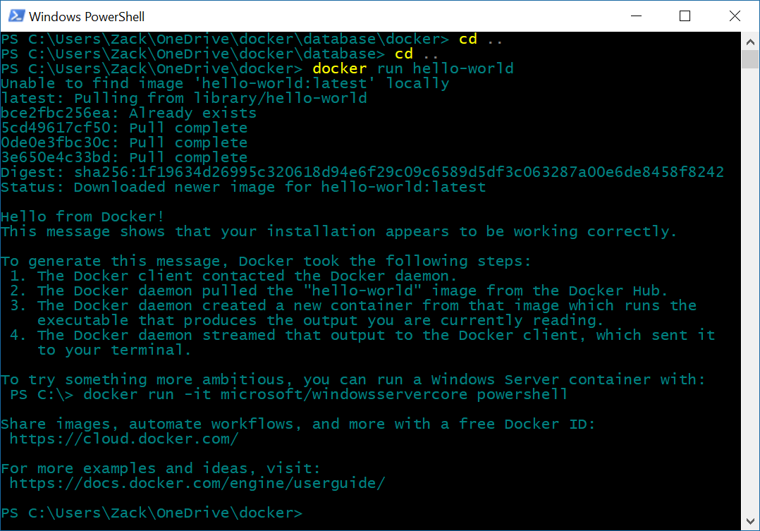
Docker Windows Hello World

Slide 14
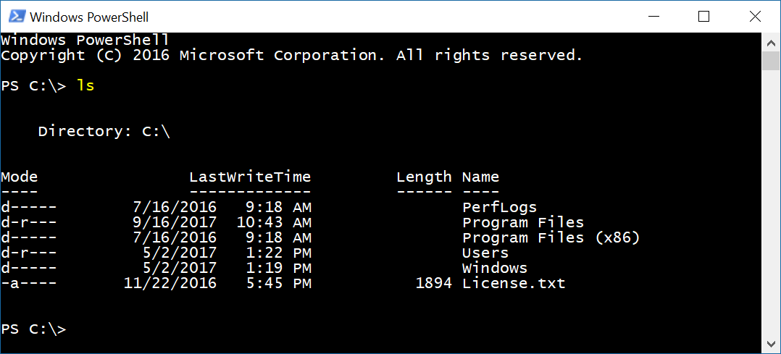
Get a PowerShell prompt in container
docker run -it microsoft/windowsservercore powershell

Slide 15
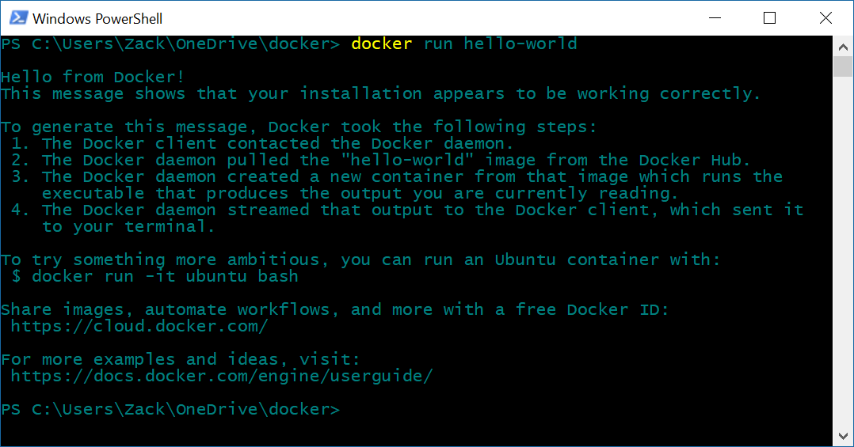
Docker Linux Hello World

Slide 16
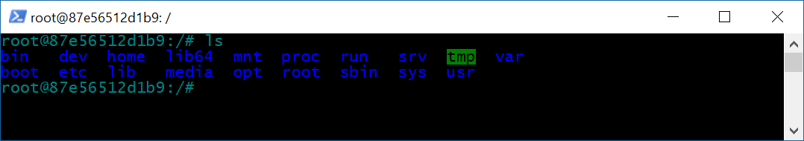
Get a Bash prompt in a Linux container
docker run -it ubuntu bash

Slide 17
My Hello, World! Example
Build image from a dockerfile
docker build . -t ormico/helloworld:nanoserver
Create container and run default action.
docker run ormico/helloworld:nanoserver

Slide 18
My Hello, World! Example
Dockerfile
FROM microsoft/nanoserver
COPY helloworld.txt .
CMD ["powershell", "cat", "helloworld.txt"]

Slide 19
Dockerfile tips
Dockerfiles for windows should start with
# escape=`
This changes the default from \ to ` which is a better escape on windows since it won’t conflict with the folder separator.

Slide 20
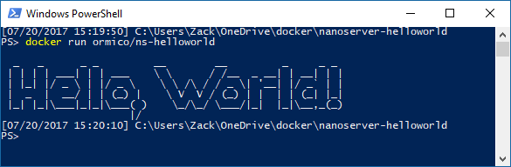
My Hello, World! Example

Slide 21
Installing dependencies Example
Install SQL Management Objects MSI
Microsoft® SQL Server® 2016 Feature Pack
https://www.microsoft.com/en-us/download/details.aspx?id=52676

Slide 22
Install SQL Management Objects MSI
Use a COPY command to get msi into container.
The trailing backslash tells COPY that msi is a directory, not a filename.
COPY SQLSysClrTypes.msi msi\

Slide 23
Install SQL Management Objects MSI
Use a RUN statement to execute commands.
Windows Docker containers have no GUI, only a CLI. To install an MSI, RUN msiexec.exe to install MSI in quiet mode.
RUN msiexec.exe /i "C:\MSI\SQLSysClrTypes.msi" /qn
If an MSI is erroring when installing, you can create a container and run msiexec from the shell and turn on logging.
msiexec.exe /i "C:\MSI\SQLSysClrTypes.msi" /qn /l* SQLSysClrTypes-log.txt

Slide 24
SQL Server Developer Ed. Example
Create a container running MS SQL Server Developer Edition, map a local folder into the container, and attach a database.
The image can be found here: https://store.docker.com/community/images/microsoft/mssql-server-windows-developer

Slide 25
SQL Server docker command
docker run -d
-p 1433:1433
-e sa_password=Password1!
-e ACCEPT_EULA=Y -v C:/temp/:C:/temp/
-e attach_dbs="[{'dbName':'PlantOrders','dbFiles':['C:\\temp\\PlantOrders.mdf','C:\\temp\\PlantOrders_log.ldf']}]“
microsoft/mssql-server-windows-developer

Slide 26
VS ASP.NET Core Example
Prerequisites:
Visual Studio 2017
Docker for Windows
Image: https://store.docker.com/images/aspnet

Slide 27
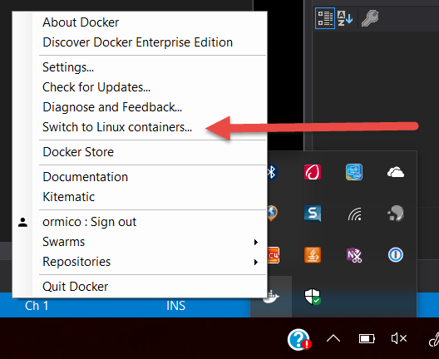
VS ASP.NET Core Example
Set Docker into Linux Container Mode
Open Visual Studio 2017, File->New Project
In the New Project dialog, select ASP.NET Web Application (.NET Core)

Slide 28
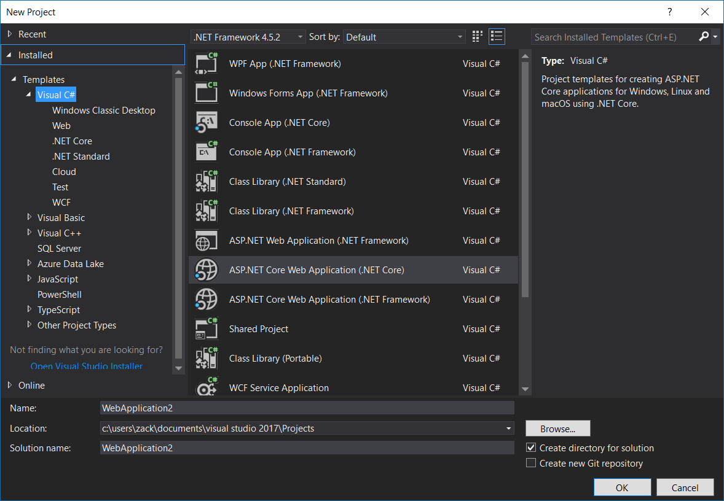
VS ASP.NET Core Example

Slide 29
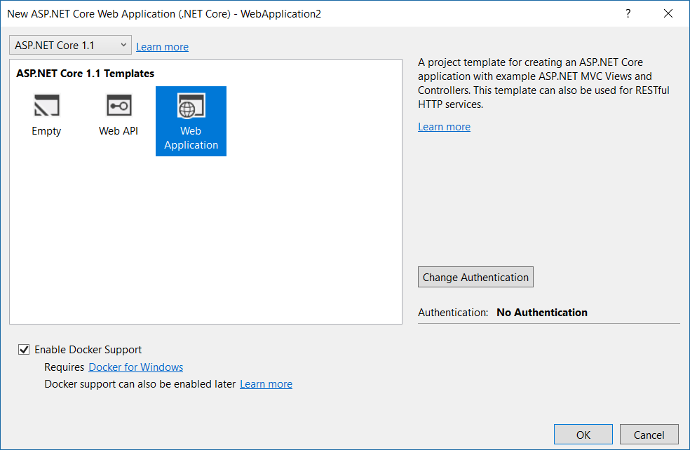
VS ASP.NET Core Example

Slide 30
VS ASP.NET Core Example
4. Give your App and Solution a name and pick a folder.
5. Click OK.
6. On the New ASP.NET Core Web Application dialog, select
Web Application
Enable Docker Support
No Authentication
7. Click OK.
8. When Visual Studio finishes creating the project, it will look like this.

Slide 31
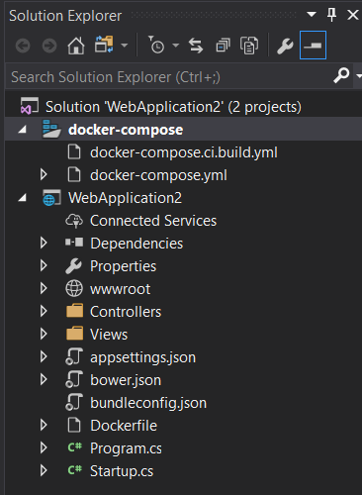
VS ASP.NET Core Example

Slide 32
VS ASP.NET Core Example
4. Give your App and Solution a name and pick a folder.
5. Click OK.
6. On the New ASP.NET Core Web Application dialog, select
Web Application
Enable Docker Support
No Authentication
7. Click OK.
8. When Visual Studio finishes creating the project, it will look like this.

Slide 33
VS ASP.NET Core Example
This creates a solution with a web project and a Docker-Compose project.
The web project contains a dockerfile.
The Docker-Compose project contains 2 yml files. The file docker-compose.yml is the one used when we build and debug in Visual Studio.
A Docker-Compose project is set as the Startup Project.
When you Run the project, it compiles the website and runs dockercompose which runs docker cli. This creates the docker image, copies in the binaries, creates the container, maps the port, and launches the browser.

Slide 34

VS ASP.NET Core Example
Notice the url is localhost with a mapped port.
This is the difference between Linux and Windows containers (at least for now).

Slide 35
Unhelpful Error
If you get this error, you might need to switch from Windows containers back to Linux containers.

Slide 36
VS ASP.NET .NET Framework Example
Create a solution and project from the ASP.NET Web Application (.NET Framework) template.
Right click on the web project and select Add->Docker Support.
This adds a Docker-Compose project and sets it as the Startup Project and adds a Dockerfile to the web project.
One of the difference between this and the ASP.NET Core project with Docker support checkbox is that this project uses a Windows container instead of a Linux container.
Run the project. After the container image is created and the container starts, the web browser should open.

Slide 37
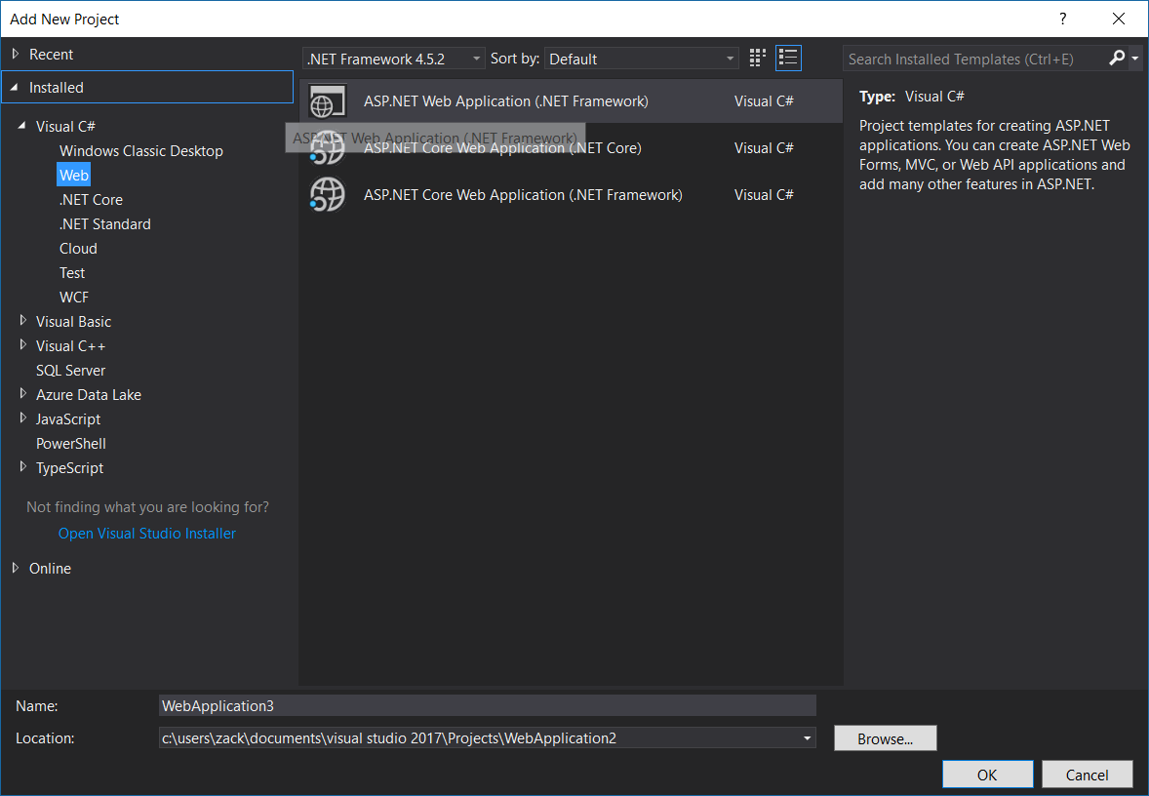
VS ASP.NET .NET Framework Example

Slide 38

VS ASP.NET .NET Framework Example
This site is running in a Windows container.
Because the networking is different, this container gets a private IP address and the site is served on port 80.

Slide 39
Unhelpful Error
Same as before but the reverse. This error might mean you need to switch from Linux to Windows containers.

Slide 40
Using Docker as an App Server
In addition to SQL Server and IIS there are many application servers which have official docker images.
A few examples are RabbitMQ, Redis Cache, ngix, MongoDb, MySQL.
What is nice about using these images is that the software doesn’t have to installed onto the host and you can delete it with no consequenses when you don’t want it anymore.

Slide 41
RabbitMQ Example
Create a container using the official RabbitMQ image and connect to the Management website.
To connect to the Queue, more ports would be required.
Image: https://store.docker.com/images/rabbitmq
Run the image and map the port to a port on the host
docker run -d --hostname my-rabbit --name some-rabbit -p 8080:15672 rabbitmq:3-management
Connect to the management website and login with the default credentials
http://localhost:8080
Default login: guest/guest

Slide 42
Closing
Notes:
In Slide Show mode, click the arrow to enter the PowerPoint Getting Started Center.

