Slide 1
Resilient Applications w/Queues, KEDA, and K8
Zack Moore
https://github.com/ormico
Sep 2022

Slide 2
Introduction
Zack Moore

Slide 3
Resilient Applications w/Queues, KEDA, and K8
Modern Applications receive a lot of different signals but must remain responsive to Users while also not losing track of everything that is going on.
Applications must also deal with real limits on Resources.
Everything can't run at Maximum CPU/RAM and unlimited Replicas.
Applications must stay up and maintain consistency even when parts may be over stressed or go down.
Not only do you not want to lose data but you also don't want to duplicate data if writes are retried or systems go in and out of sync.

Slide 4
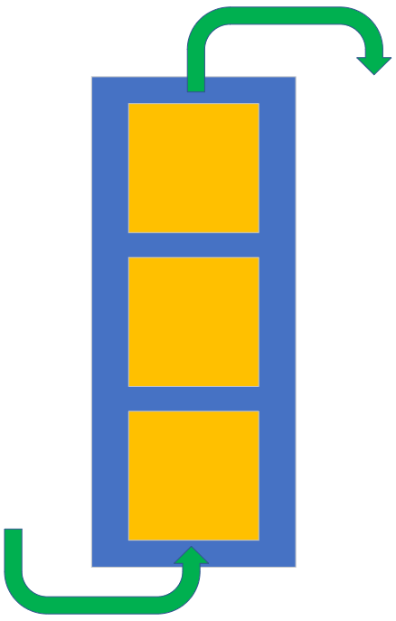
Queues
First in/First out
Allows Applications to decouple Submission of a Task from Handling the Completion of a Job
Can be used to Distribute Work across Multiple Workers
Can be Transactional
Read At Most Once vs At Least Once

Slide 5
A few Use Cases for Queues
Routing Notifications
Triggering Tasks
Recalculation Aggregations when New Data is loaded
Buffer when one system can send tasks in batches faster than workers can handle.
Retry or buffer when a dependent system is down.

Slide 6
Scaling Readers & Writers
How should a Service decide how much resources it should dedicate to handling incoming work?
Will an Application have idle workers wasting resources during low utilization times?

Slide 7
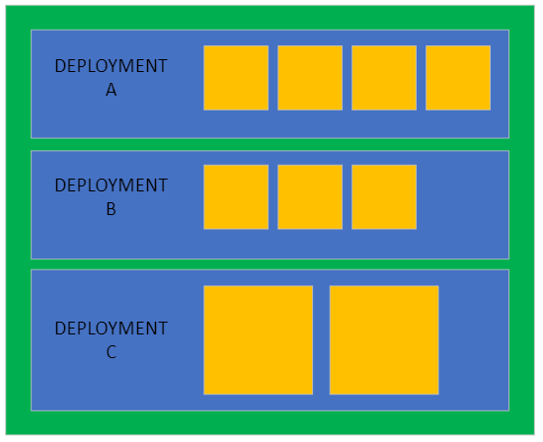
Kubernetes and Resource Balancing
Static Deployment Size
Scaling By Resource CPU/RAM
Better! Scaling By Work.

Slide 8
KEDA
Azure Service Bus
Rabbit MQ
SQL Server
Redis List
...
Kubernetes Event-driven Autoscaling
Scale from Zero to N
Plugins for Scalers
https://keda.sh/docs/2.8/scalers/

Slide 9
KEDA Authentication Providers
Azure AD
Pod Identity
Workload Identity
Azure KeyVault
EKS Pod Identity
Environment Variables
K8 Secrets
Hashicorp Vault
...
Like Scalers, KEDA includes several plugins for Authenticating Scalers
https://keda.sh/docs/2.8/authentication-providers/

Slide 10
Demo Environment
Azure Kubernetes Service (AKS)
Using AKS build in integration to install KEDA
https://learn.microsoft.com/en-us/azure/aks/keda-deploy-add-on-cli

Slide 11
Demo Setup
C#
Microservices
K8
Deployment
Secrets
KEDA
ScaledObject
TriggerAuthentication

Slide 12
Installing KEDA
KEDA has good instructions for installing into your cluster, but Azure has integration with KEDA and it's own set of instructions (preview).
https://learn.microsoft.com/en-us/azure/aks/keda-deploy-add-on-cli
Enable the KEDA Add-in in Azure CLI
az aks create \
--resource-group myResourceGroup \
--name myAKSCluster \
--enable-keda

Slide 13
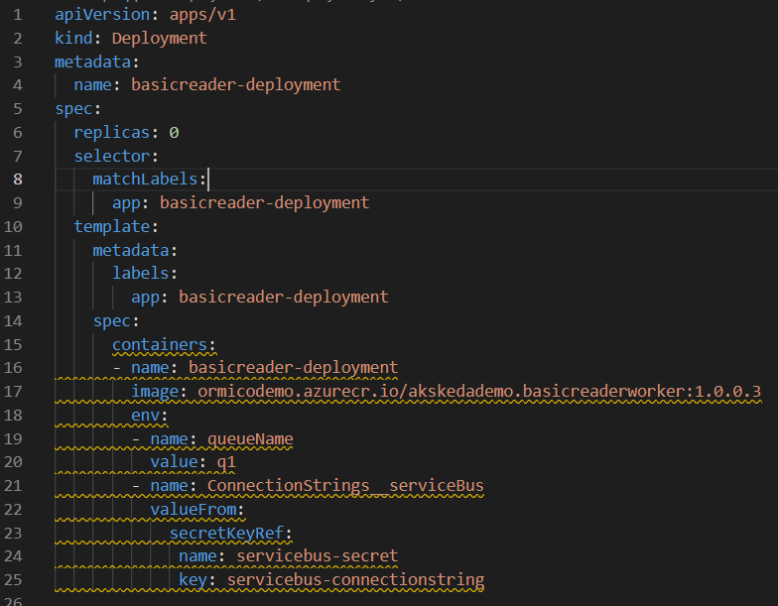
Deployment

Slide 14
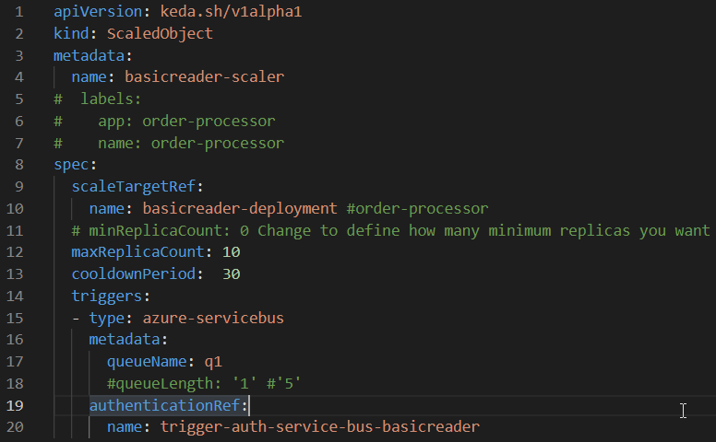
ScaledObject

Slide 15
ScaledObject
MinReplicaCount: Define how many minimum replicas you want
Defaults to Zero but an Application may want to wait until a minimum amount of work is queued before spinning up workers.
MaxReplicaCount: Define the maximum replicas
CooldownPeriod: How long to wait before scaling back down once incoming work items goes to Zero.

Slide 16
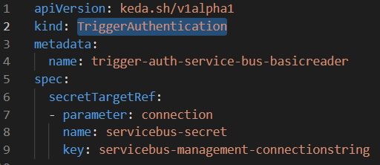
TriggerAuthentication
Connects the Scaler Plugin to the Authentication

Slide 17
Demo

Slide 18
Long Running Tasks
Scenario
Deployment is scaled to Zero.
New Work Comes in for Tasks that take several hours to complete.
KEDA scales deployment up.
Workers take up work items and begin processing.
Time goes by and KEDA sees that the Work Item Queue is empty, so KEDA wants to Scale Deployment back down.
PROBLEM: Workers are still completing their tasks!

Slide 19
Long Running Tasks
K8 Lifecycle Hooks
https://kubernetes.io/docs/concepts/containers/container-lifecycle-hooks/
SIGINT
https://keda.sh/docs/2.8/concepts/scaling-deployments/#leverage-the-container-lifecycle
As Jobs
https://keda.sh/docs/2.8/concepts/scaling-jobs/

Slide 20
Multi-Cluster or Failover Patterns
Message Replication and cross-Region Federation
https://learn.microsoft.com/en-us/azure/service-bus-messaging/service-bus-federation-overview
https://learn.microsoft.com/en-us/azure/service-bus-messaging/service-bus-federation-replicator-functions
Message Replication Task Patterns
https://learn.microsoft.com/en-us/azure/service-bus-messaging/service-bus-federation-patterns

Slide 21
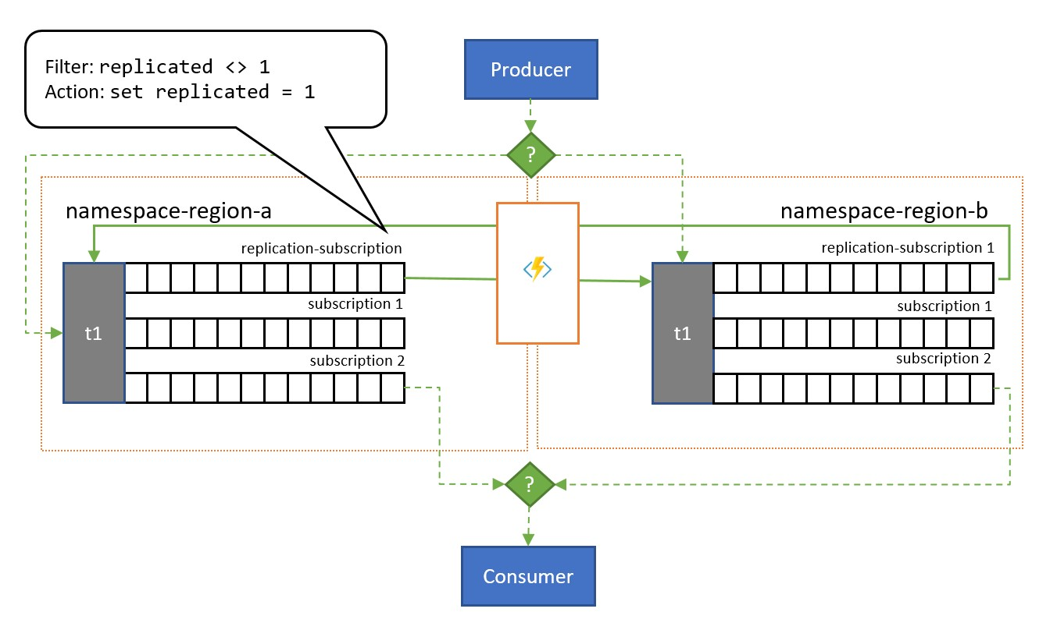
Queue Federation Pattern
Diagram Example from Microsoft(TM)

Slide 22
Links
KEDA - https://keda.sh/
KEDA Service Bus Examples - https://github.com/kedacore/sample-dotnet-worker-servicebus-queue
.NET 6 POSIX Signal Handling - https://learn.microsoft.com/en-us/dotnet/api/system.runtime.interopservices.posixsignalregistration.create?view=net-6.0

Slide 23

Thank-you
Code and Slides can be found here:
https://github.com/ormico/k8aks-keda-testing

