Slide 1






Dataset_from_scanner
Dataset_organized
902145989
participants.tsv
902145989_001.dcm
sub-01
sub-01_ses-01_scans.tsv
902145989_002.dcm
ses-01
902145989_003.dcm
sub-01_ses-01_metadata.tsv
…
mr-anat
ORMIR-MIDS
sub-01_ses-01_T1w.nii
798346781
sub-01_ses-01_T1w.json
ct
798346781_001.dcm
sub-01_ses-01_ct.nii
798346781_002.dcm
sub-01_ses-01_ct.json
798346781_003.dcm
ses-02
…
…
sub-02
sub-02_ses-01_scans.tsv
ses-02

Slide 2
Dataset
Dataset_organized
participants.tsv
Subject
sub-01
sub-01_ses-01_scans.tsv
Session
ses-01
sub-01_ses-01_metadata.tsv
Imaging Method
mr-anat
sub-01_ses-01_T1w.nii
sub-01_ses-01_T1w.json

Slide 3
Dataset_organized
participants.tsv
Participants’ information
sub-01
sub-01_ses-01_scans.tsv
Scans’ information
ses-01
sub-01_ses-01_metadata.tsv
Session information
mr-anat
sub-01_ses-01_T1w.nii
Image volume
sub-01_ses-01_T1w.json
Image information

Slide 4
Folder nomenclature
File nomenclature
Dataset_organized
Dataset_organized
participants.tsv
participants.tsv
sub-01
sub-01
sub-01_ses-01_scans.tsv
sub-01_ses-01_scans.tsv
ses-01
ses-01
sub-01_ses-01_metadata.tsv
sub-01_ses-01_metadata.tsv
mr-anat
mr-anat
sub-01_ses-01_T1w.nii
sub-01_ses-01_T1w.nii
sub-01_ses-01_T1w.json
sub-01_ses-01_T1w.json

Slide 6
Folder nomenclature
File nomenclature
Dataset_organized
Dataset_organized
participants.tsv
participants.tsv
sub-01
sub-01
sub-01_ses-01_scans.tsv
sub-01_ses-01_scans.tsv
ses-01
ses-01
sub-01_ses-01_metadata.tsv
sub-01_ses-01_metadata.tsv
mr-anat
mr-anat
sub-01_ses-01_T1w.nii
sub-01_ses-01_T1w.nii
sub-01_ses-01_T1w.json
sub-01_ses-01_T1w.json
sub-01_ses-01_scans.tsv

Slide 7
Dataset_from_scanner
Dataset_organized
sub-01
902145989
ses-01
902145989_001.dcm
mr-anat
902145989_002.dcm
sub-01_ses-01_T1w.nii
902145989_003.dcm
sub-01_ses-01_T1w.json
ct
…
sub-01_ses-01_ct.nii
ORMIR-MIDS
sub-01_ses-01_ct.json
798346781
ses-02
798346781_001.dcm
mr-anat
798346781_002.dcm
…
sub-02
798346781_003.dcm
ses-01
…
…

Slide 8
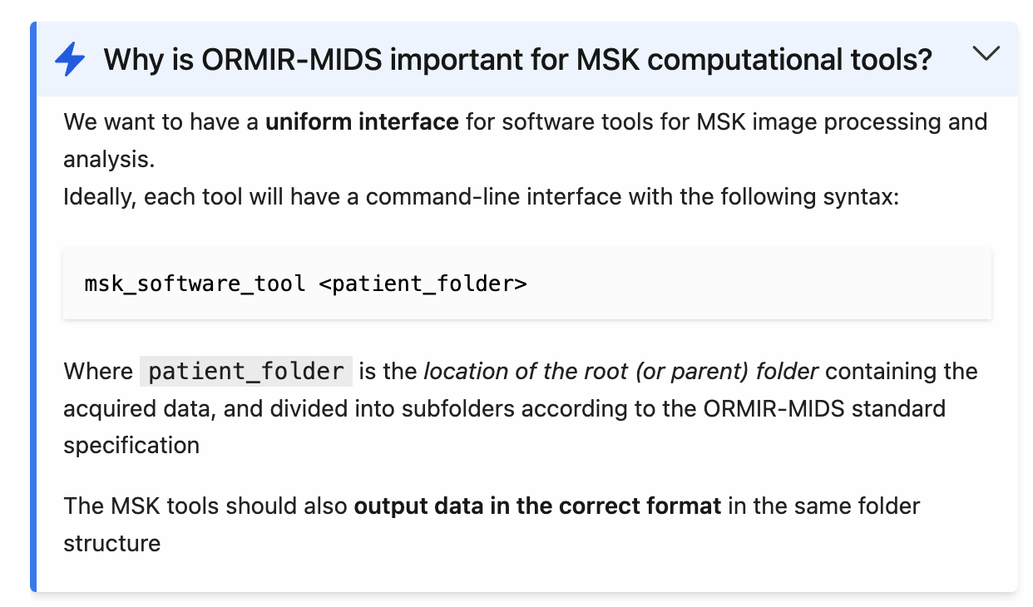
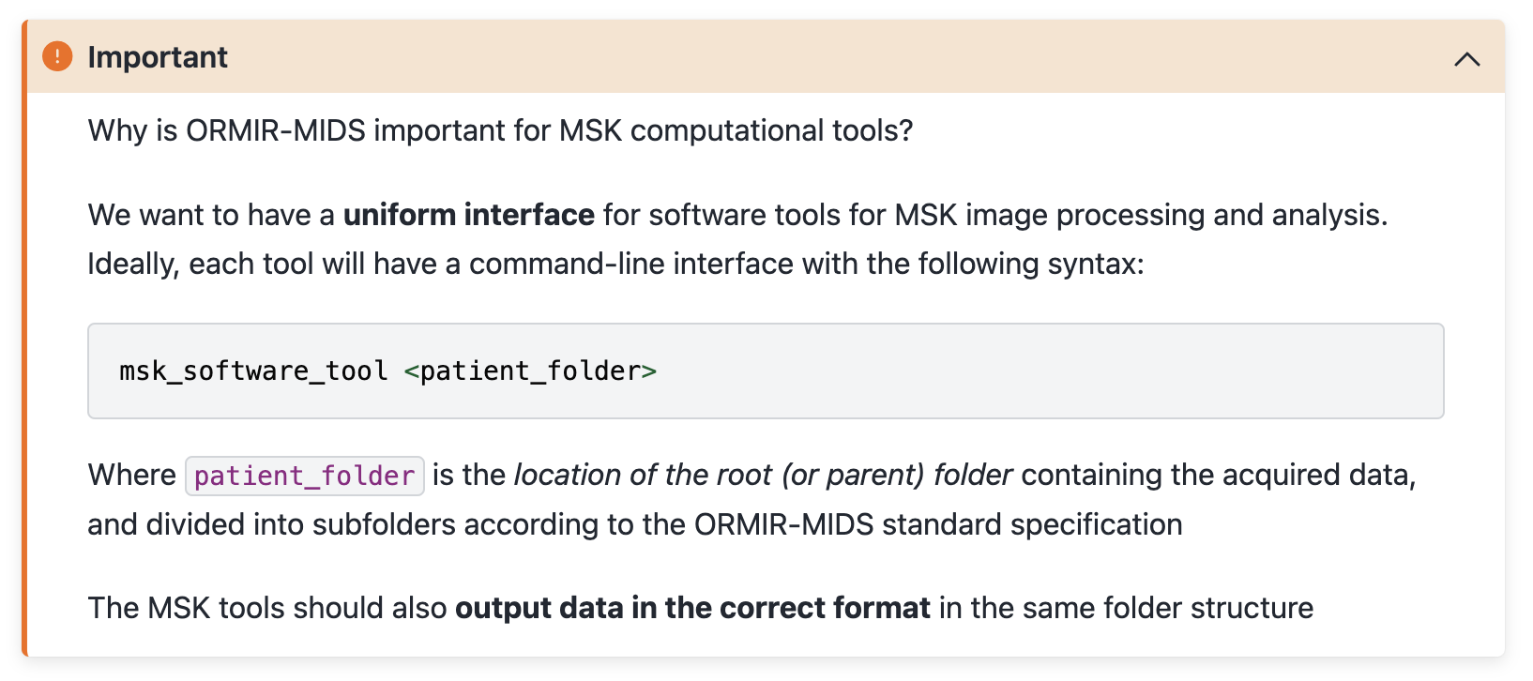
Jupyter notebook written in MyST in JupyterLab
Jupyter Book
?

Slide 9
Dataset
Dataset_organized
participants.tsv
Subject
sub-01
sub-01_ses-01_scans.tsv
Session
ses-01
sub-01_ses-01_metadata.tsv
Imaging Method
mr-anat
sub-01_ses-01_T1w.nii
sub-01_ses-01_T1w.json
Dataset
Dataset_organized
participants.tsv
Subject
sub-01
sub-01_ses-01_scans.tsv
Session
ses-01
sub-01_ses-01_metadata.tsv
Imaging Method
mr-anat
sub-01_ses-01_T1w.nii
sub-01_ses-01_T1w.json

Slide 10
Dataset_organized
participants.tsv
Participants’ information
sub-01
sub-01_ses-01_scans.tsv
Scans’ information
ses-01
sub-01_ses-01_metadata.tsv
Session information
mr-anat
sub-01_ses-01_T1w.nii
Image volume
sub-01_ses-01_T1w.json
Image information
Dataset_organized
participants.tsv
Participants’ information
sub-01
sub-01_ses-01_scans.tsv
Scans’ information
ses-01
sub-01_ses-01_metadata.tsv
Session information
mr-anat
sub-01_ses-01_T1w.nii
Image volume
sub-01_ses-01_T1w.json
Image information

