Slide 1
Wireframes

Slide 2
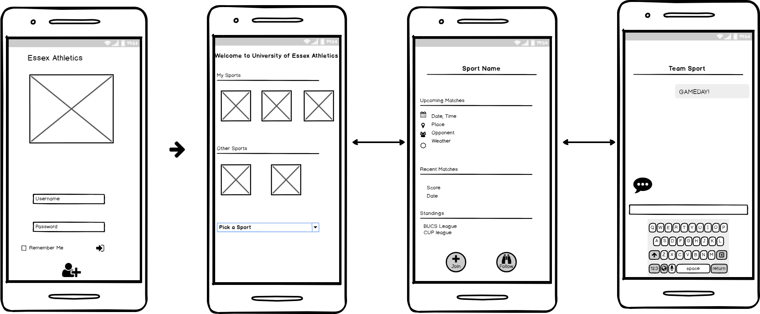
App Map

Slide 3
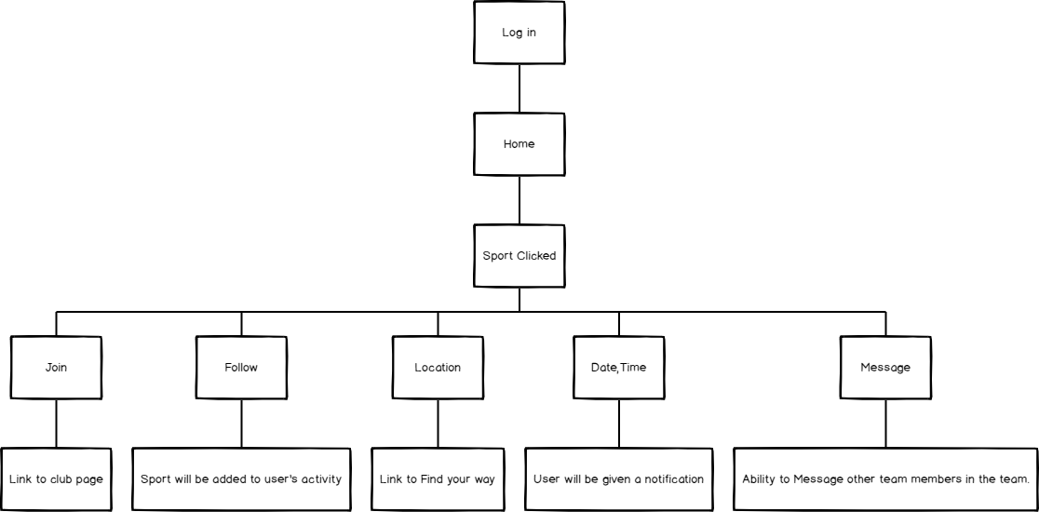
User Journey

Slide 4
Log in
Wireframe #1

Slide 5
Home Page
Wireframe #2

Slide 6
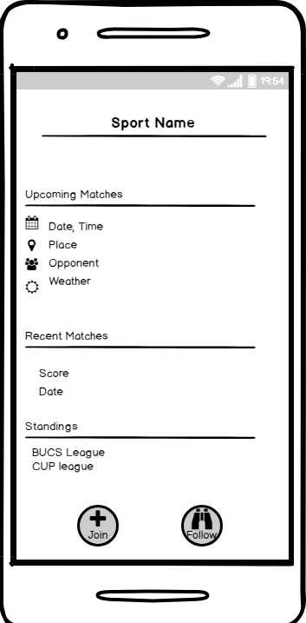
Sport Page
Wireframe #3

Slide 7
Messaging Aspect
Wireframe #4

