Slide 1
Battleship
DESHAUN ORMOND

Slide 2
Introduction
Two player guessing game.
10 x 10 grid
The location of the fleet are concealed from the other player
Player alternate turns until one destroys the opposing fleet.
5 ships
Carrier = 5
Battleship = 4
Cruiser = 3
Submarine = 3
Destroyer = 2

Slide 3

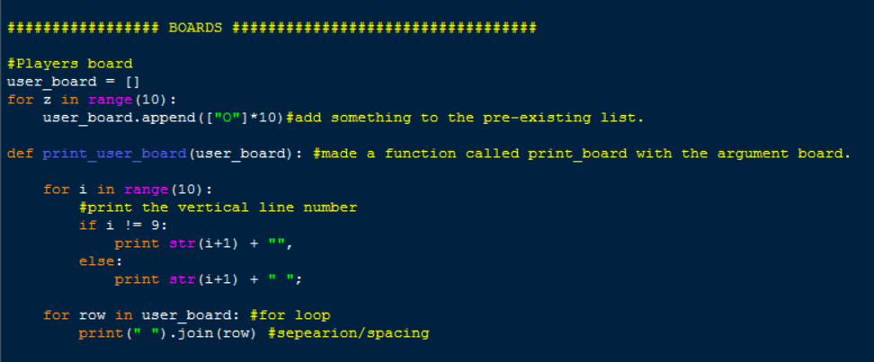
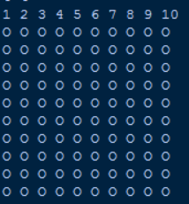
Making the Board

Slide 4
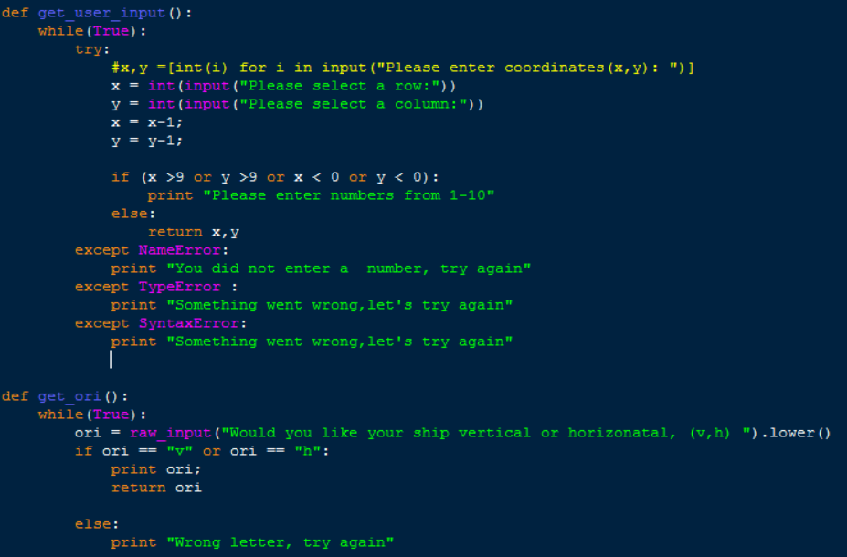
User Input and Orientation

Slide 5
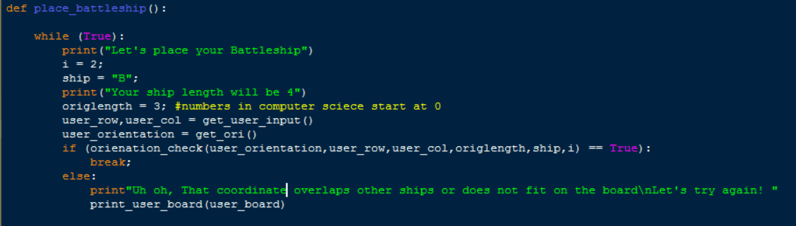
Placing ships

Slide 6
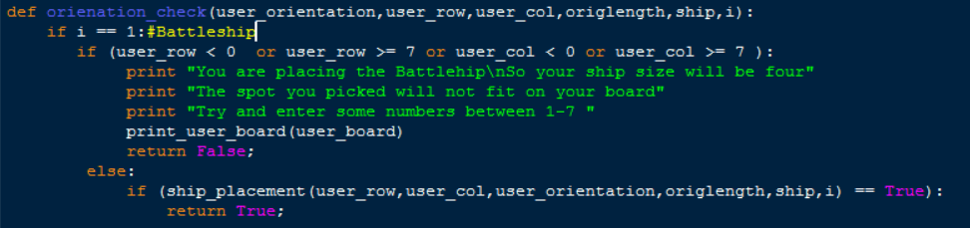
Orientation Check

Slide 7
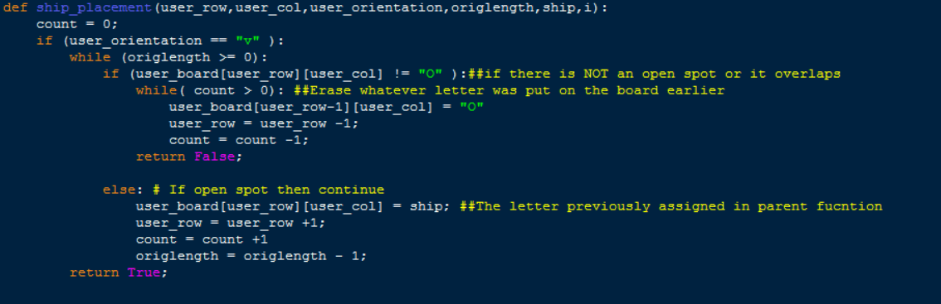
User ship placement

Slide 8
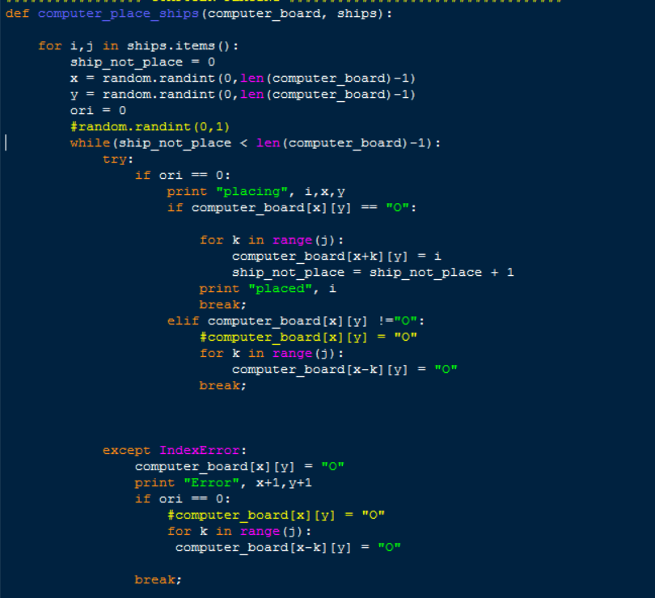
Computer placing ships

Slide 9
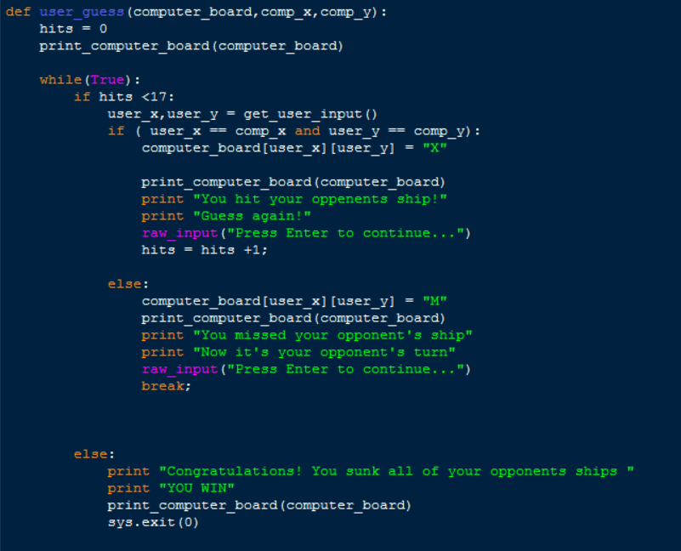
User Guessing

Slide 10
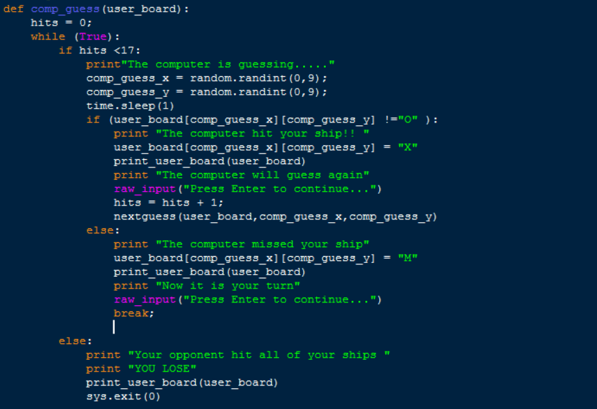
Computer Guessing

Slide 11
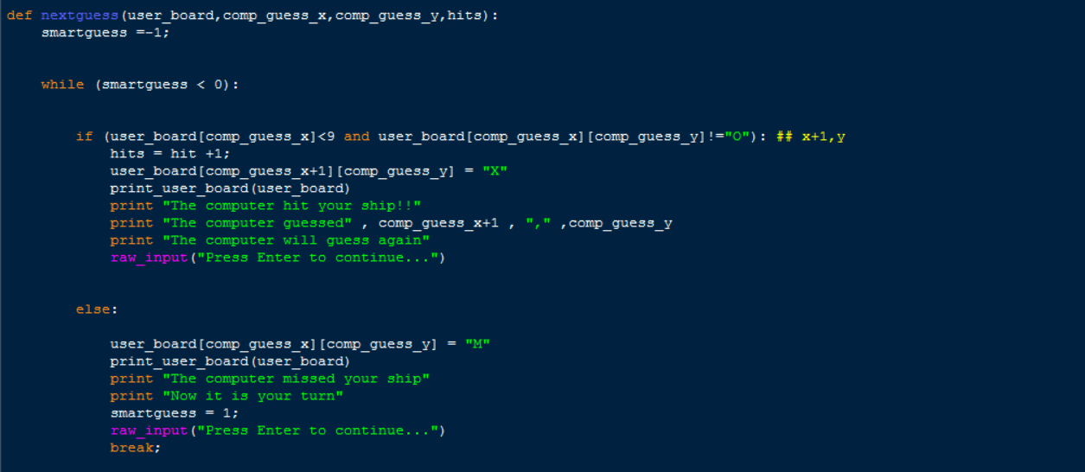
Smart Guess

Slide 12
Battleship Flow Chart
Placing Ships
Computer Placing Ships
User board
Vertical or Horizontal
Randomize ship placements
User Input
Computer board
Orientation check
User guessing
Computer guessing
Ship_placement
Next Guess
User input
Loop until someone’s fleet is destroyed

Slide 13
Display

Slide 14
References
http://effbot.org/zone/stupid-exceptions-keyboardinterrupt.htm
https://docs.python.org/3.1/tutorial/datastructures.html
http://code.activestate.com/recipes/578836-the-game-of-battleships-in-python/
https://www.codecademy.com/courses/learn-python/lessons/python-lists-and-dictionaries/exercises/access-by-index-1
https://stackoverflow.com/questions/27310631/checking-if-input-is-an-integer

