Slide 1
On Developing and Optimizing New Machine Learning Techniques to Analyze Mobility Parameters and Gait Patterns for Healthcare Purposes
Presenter: Donovan Orn

Slide 2
Overall Goal
How can we use mobility parameters collected from wearable sensors to assess health?

Slide 3
Motivation wearable Sensors and health
Widespread use of wearable devices.
Can we utilize the data collected from these devices to remotely predict potential health hazards?
Need for a systematic way to use movement patterns to access health.

Slide 4
Machine Learning
What
Why
Takes in data
Uses pattern analysis
Predicts result
Real time predictions
Can catch the disease early
Can be used to alert Dr. and patient

Slide 5
Project Goal
Improve machine learning models by developing a methodology for finding the best data reduction techniques.

Slide 6
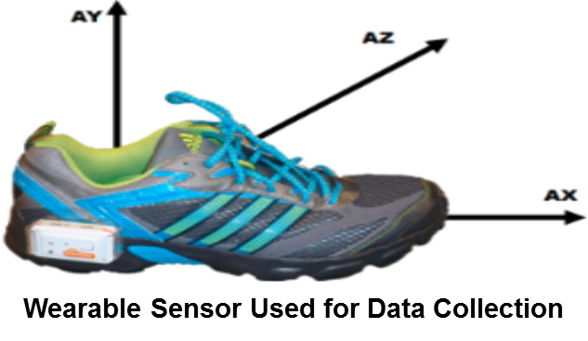
Introducing the data
Groups | Control | Geriatrics
Number of Subjects | 10 | 10
Gender(M/F) | 5:5 | 4:6
Age | 64 ± 8.4 | 81 ± 4.1
UPDRS III
H & Y
PD
10
5:5
63.8 ± 9.3
12.7 ± 6.0
1.7 ± .09
UPDRS and H&Y are from early stages of Parkinson’s disease.
Shimmer R3
(inertial measurement Unit (IMU))
37 Features

Slide 7
Significance of Data Reduction
Too Many Features
Data Reduction
Overfitting
High training accuracy
Less accurate when predicting new individuals
Removes irrelevant and redundant data.
Data Reduction Categories:
Filter Based – MIGMC and MSNR&MC
Wrapper Based – Genetic Algorithm
Dimensionality Reduction – PCA
Embedded methods
Dummy Training Individuals
Dummy New Individuals
Key
Over-fit model
Fit model

Slide 8
Assessment of Data Reduction Techniques
Number of features selected
Classification accuracy
10 random 10-fold cross-validations
Median and standard deviation
Completion time
Compared (PD and HE), (PD and GE), (GE and HE)

Slide 9
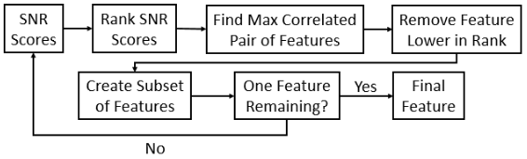
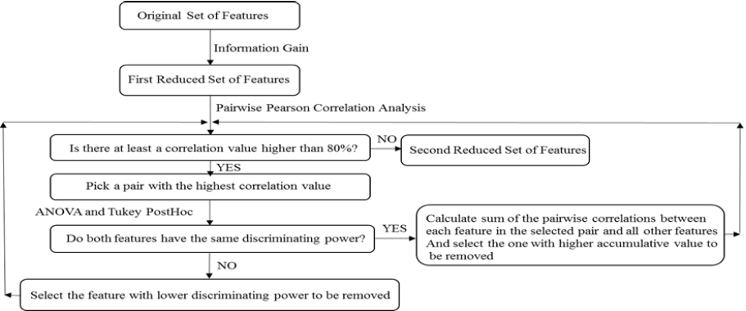
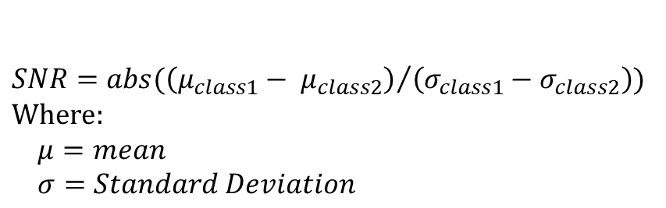
Filter based Methods
Maximum Signal to noise ratio Minimum Correlation (MSNR&MC2)
Maximum Information Gain Minimum Correlation (MIGMC)
$$SNR=abs({\left(μ_{class1}− μ_{class2}\right)}/{\left(σ_{class1}−σ_{class2}\right))}$$
$$Where:$$
$$μ=mean$$
$$σ=Standard Deviation$$

Slide 10
Variations of MIGMC and MSNR&MC
Both MIGMC and MSNR&MC are filter based methods.
MIGMC has a threshold to stop while MSNR&MC2 does not
To have a fair comparison between these two methods:
Variation of MSNR&MC2 with threshold was implemented (MSNR&MC)
Variation of MIGMC without threshold was implemented (MIGMC2)

Slide 11
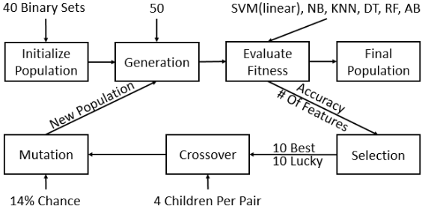
Genetic Algorithm (GA)

Slide 12
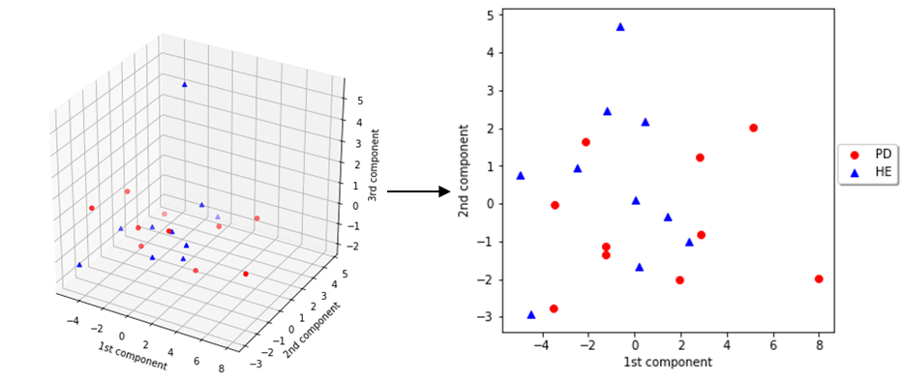
Principal component Analysis (pca)
Dimensionality reduction method
Components are created from the original feature set by projecting them onto lower dimensions called principal components
3 Components are used
Tested Highest Explained Variance (HEV) component, First 2 HEV, and All components
Parkinson’s and healthy elderly, three principal components compared to two principle components.

Slide 13
Results: # Features Selected
# Features Selected
Feature Selection | # Features PD and HE | # Features PD and GE | # Features in GE and HE
GA | 6 | 4 | 1
MIGMC | 1 | 4 | 1
MIGMC2 | 3.6 ± 2.3 | 5.3 ± 3.4 | 2.3 ± 1.8
MSNR&MC | 10 | 9 | 12
MSNR&MC2 | 6.5 ± 5.1 | 6.8 ± 5.8 | 6.4 ± 3.8
PCA | 1 | 2 | 1

Slide 14
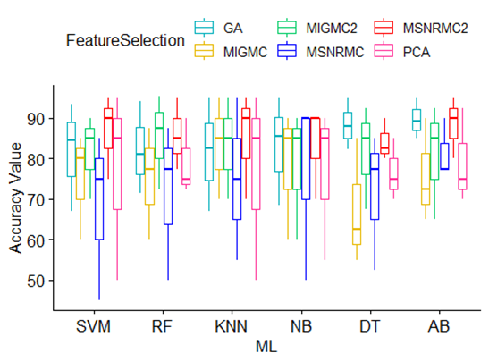
Results: performance
Classification Accuracy
Computation Time
Feature Selection | Average Comp. Time
GA | 8423.5425 or 2h 20m 23.5425s
MIGMC | 0.214s
MIGMC2 | 0.3047s
MSNR&MC | 0.3527s
MSNR&MC2 | 0.3579s
PCA | 0.0078s

Slide 15
Conclusions
Results show that AdaBoost is the most robust machine learning classifier
GA followed by MSNR&MC2 and MIGMC2 showed the highest performance
Computation Time of GA was vastly higher than other feature selection techniques
GA performs the best when computational resources are available
MSNR&MC2 and MIGMC2 are the best when there are limited computational resources

Slide 16
Next Steps
Improve the genetic algorithm feature selection.
Correlation based mutation function
Correlation based crossover function
Goal to improve performance
Accuracy – improving search space
Completion time – reducing search space

Slide 17
Questions and answers

Slide 18
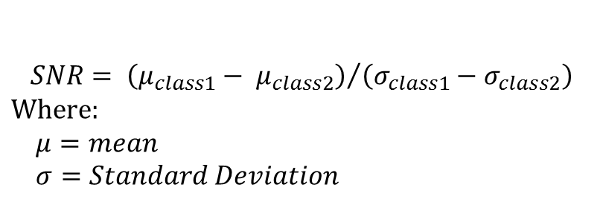
Maximum Signal to noise ratio Minimum Correlation (MSNR&MC2)
MSNR&MC algorithm
Signal to Noise Ratio Rank
SNR Rank
Feature with highest SNR Score
Feature With Lowest SNR Score
Find Highest Correlated Pair
Remove Lowest in rank
$$SNR= {\left(μ_{class1}− μ_{class2}\right)}/{\left(σ_{class1}−σ_{class2}\right)}$$
$$Where:$$
$$μ=mean$$
$$σ=Standard Deviation$$

Slide 19
Maximum Information Gain Minimum Correlation (migmc)

Slide 20

Fitness/Optimization Function
For individual in generation
If #of Features = 0
False
Individual Fitness = 0
True
Features = all positions, True
Scale features
Build Models
$$Individual Fitness=average of models leave one out accuracy$$

