Slide 1

Fundamentals of Data Science
“Logistic Regression”
Trainer: Ulviyya Jafarli
Notes:
1

Slide 2
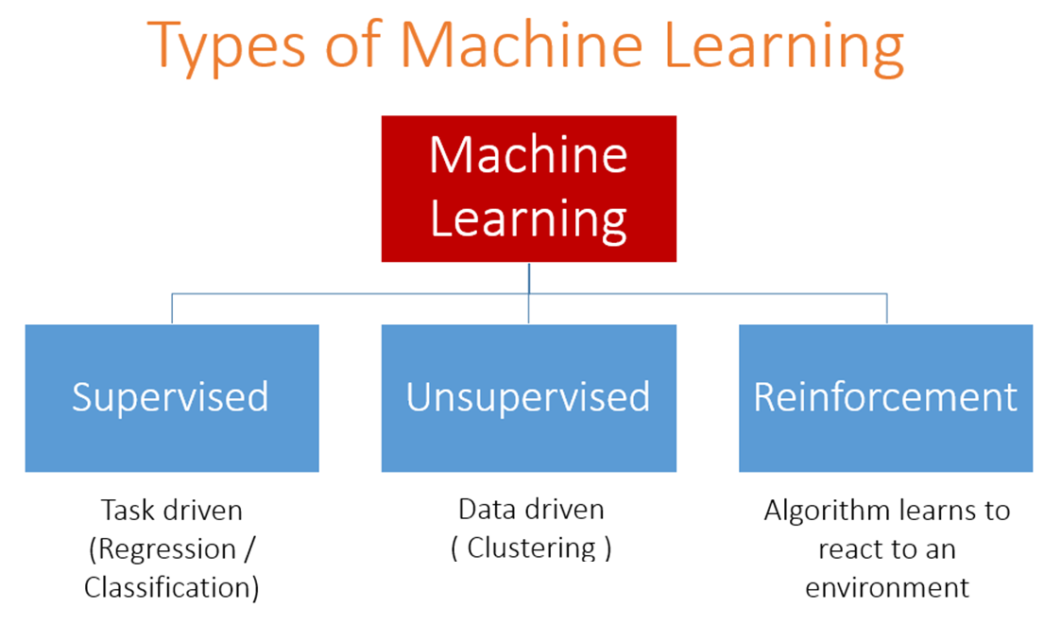

Slide 3
Classification and Regression
Supervised machine learning: Learn to predict target values from labelled data/
Classification (target values are discrete classes)
Regression (target values are continuous values)
Given examples of a function (X, F(X))
Predict function F(X) for new examples X
Discrete F(X): Classification
Continuous F(X): Regression
F(X) = Probability(X): Probability estimation
3
An acquaintance of “Data science”
|
Notes:
3

Slide 4
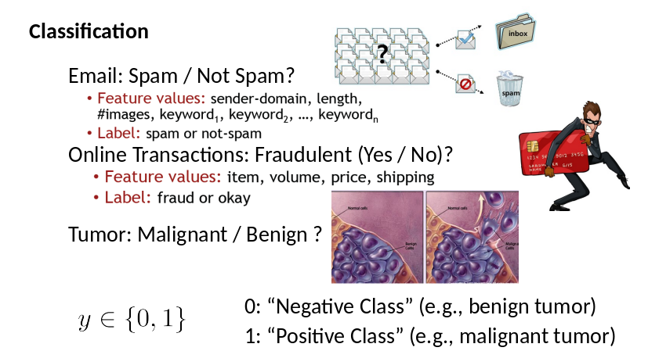
Classification and Regression
4
An acquaintance of “Data science”
|
Notes:
4

Slide 5

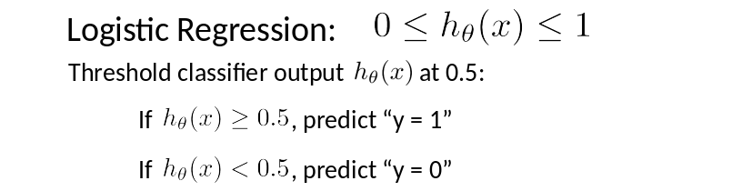
Logistic Regression
Linear regression can be any number
Classification: y = 0 or 1
5
An acquaintance of “Data science”
|
Notes:
5

Slide 6
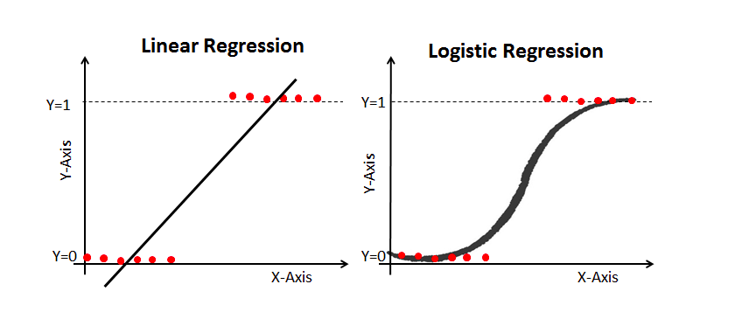
Linear Regression vs Logistic Regression
6
An acquaintance of “Data science”
|
Notes:
6

Slide 7
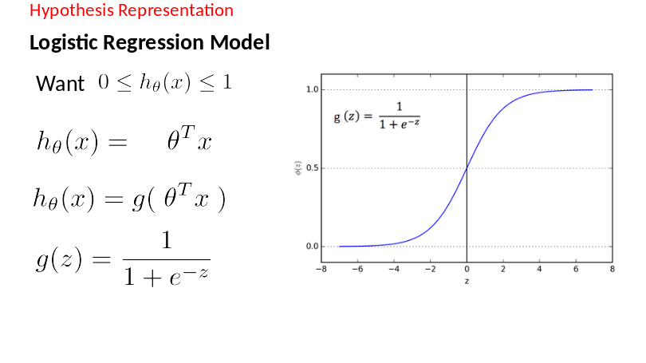
How to Model Logistic Regression?
7
An acquaintance of “Data science”
|
Notes:
7

Slide 8
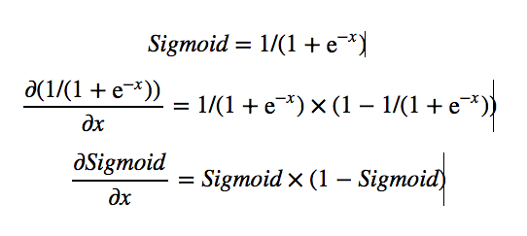
Sigmoid Function
8
An acquaintance of “Data science”
|
Notes:
8

Slide 9
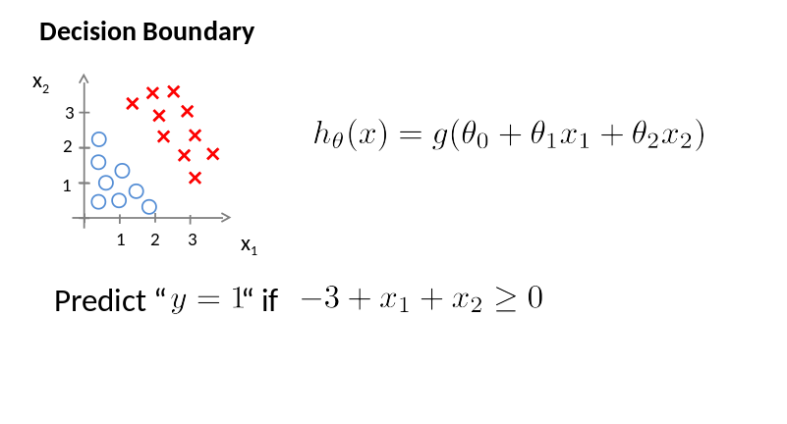
Logistic Regression
9
An acquaintance of “Data science”
|
Notes:
9

Slide 10
Multiclass classification
Email foldering/tagging: Work, Friends, Family, Hobby
Medical diagrams: Not ill, Cold, Flu
Weather: Sunny, Cloudy, Rain, Snow
10
An acquaintance of “Data science”
|
Notes:
10

Slide 11
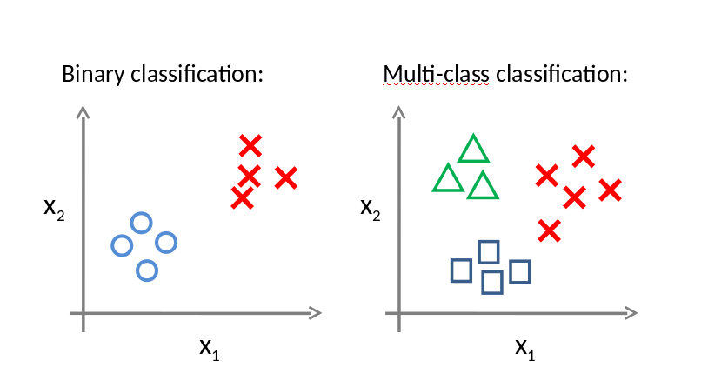
Multiclass classification
11
An acquaintance of “Data science”
|
Notes:
11

Slide 12
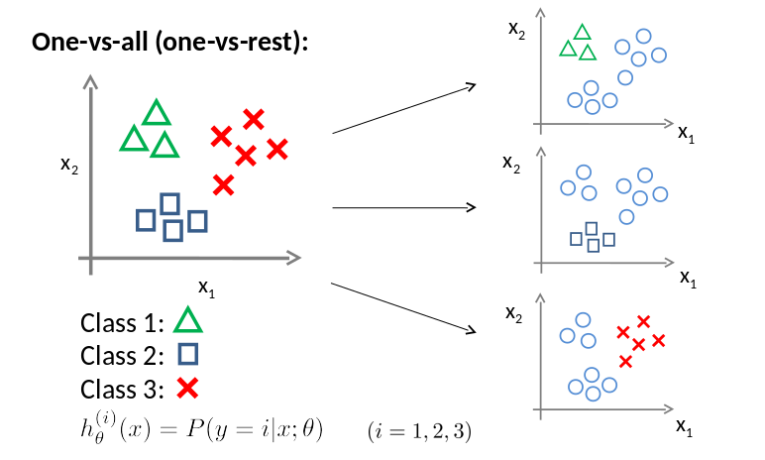
Multiclass classification
12
An acquaintance of “Data science”
|
Notes:
12

Slide 13
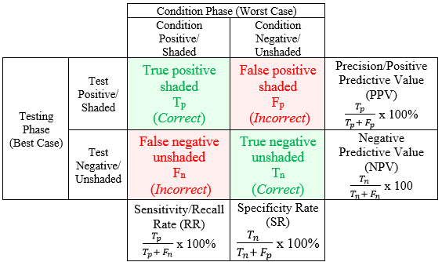

Slide 14
Thank you for your attention!
17
|
Notes:
ou
14

