Slide 1
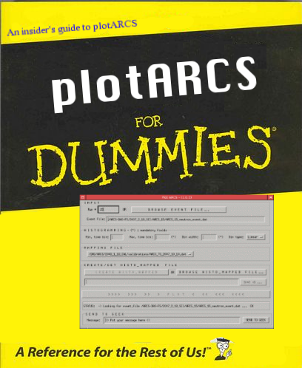

Slide 2
MANUAL
plotARCS
Version 1.0.4

Slide 3
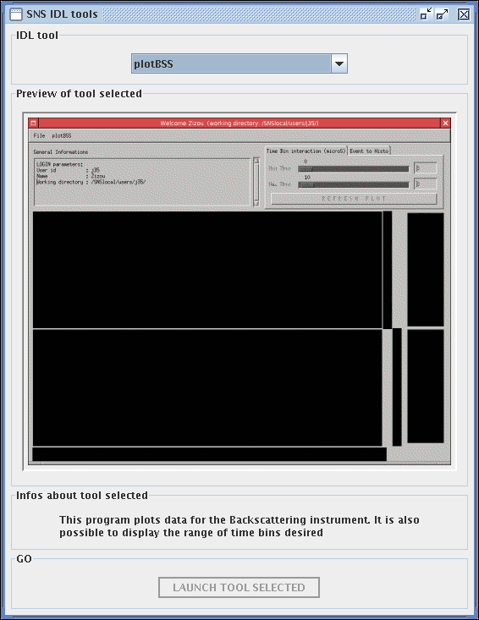
plotARCS is accessible from heater, arcs1 and Arcs2.
To start plotARCS:
> sns_idl_tools

Slide 4
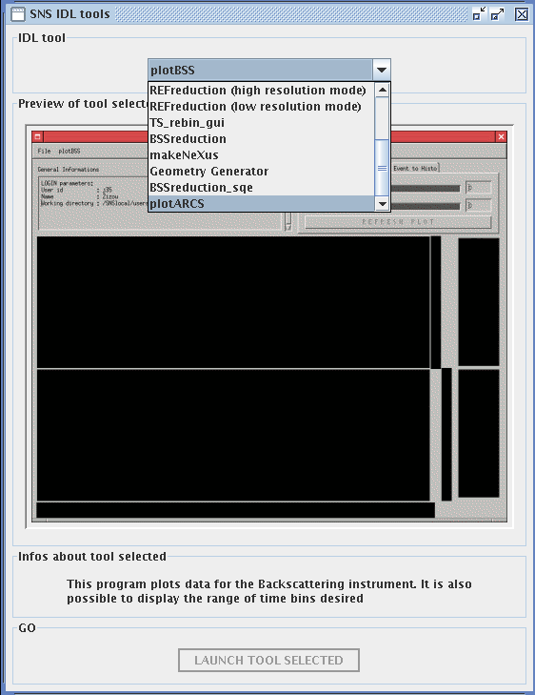
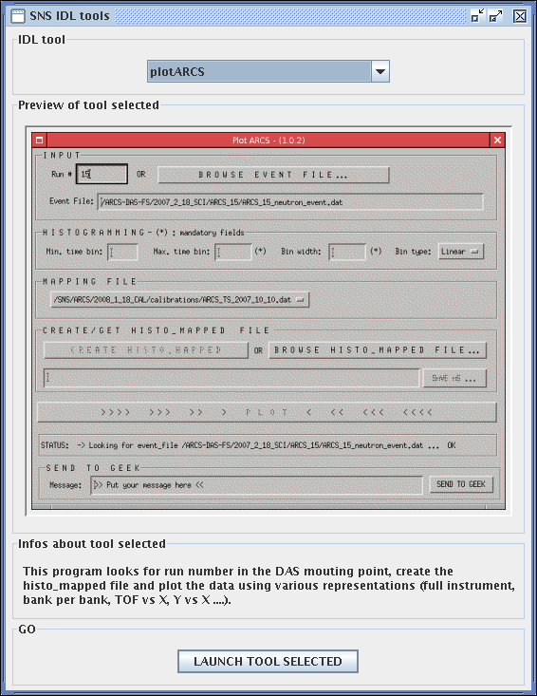
Move the droplist to plotARCS (all way down).
You get a preview of the application.
If you are on heater, arcs1 or 2, the Launch tool selected is enabled and you can start the application.

Slide 5

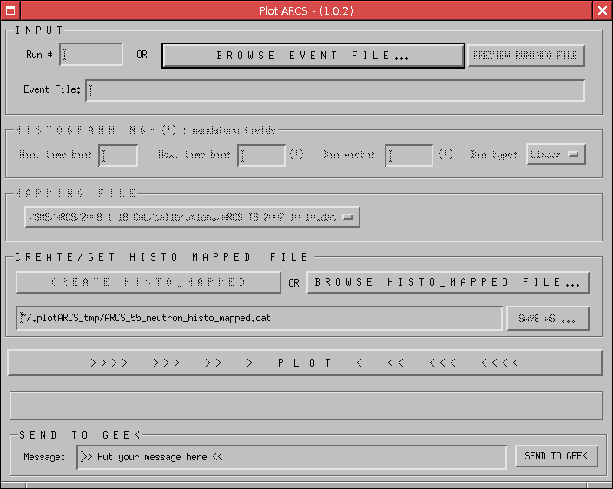
Click the IDL splash window.
Here is what the application looks like when you just started it.

Slide 6
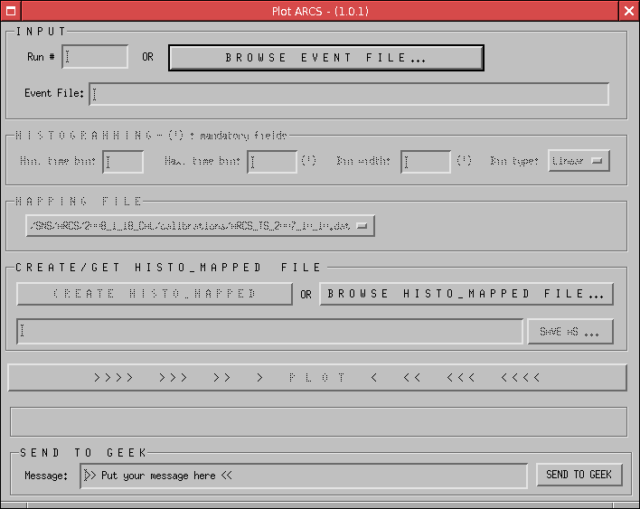
DESCRIPTION OF GUI
Name of application with current version number.
Event input box
Histogram input box
Mapping file selection
Histo_mapped box
Plot button
Status message
Send to Geek box

Slide 7
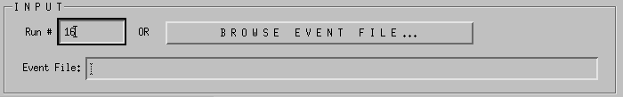
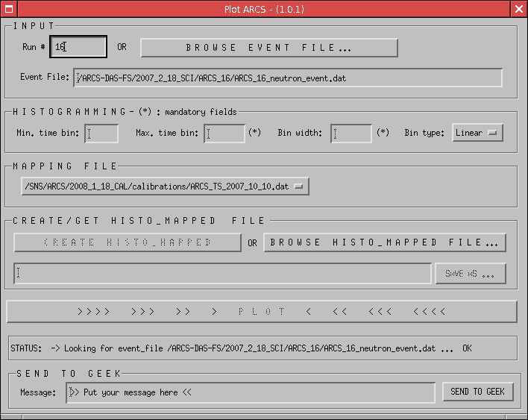

Because there is no ARCS NeXus files yet, plotARCS works on preNeXus files.
To visualize a run, according to what is available to you, you can use any of the following method:
#1: Using a Run number
Enter a run number
And press ENTER to validate your choice.
The program checks if the run number exists and display the full path of the event file (if found) or a failed message in the status box.
If the event file has been found, the histogram box becomes enabled.
Next, goes to HISTOGRAM AN EVENT FILE part

Slide 8
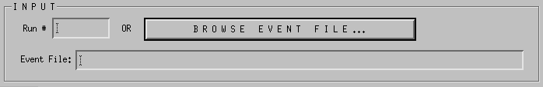
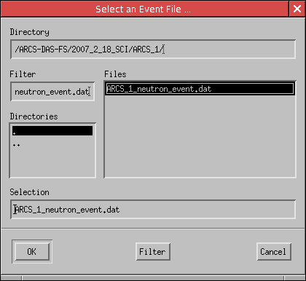
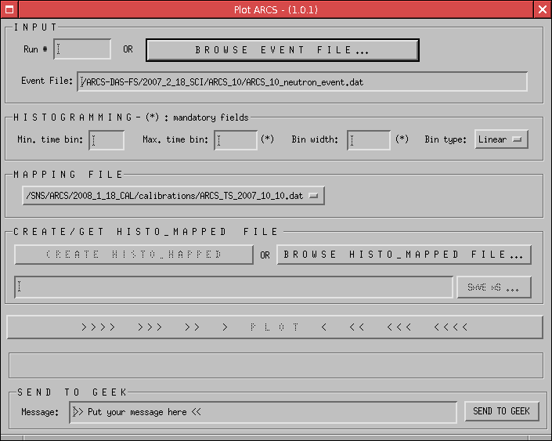
#2: Browsing for an event file
Click the
BROWSE EVENT FILE …
Another window pops-up. Select an event file and click OK
The full path the event file is displayed and the histogram box becomes enabled.
Next, goes to HISTOGRAM AN EVENT FILE part

Slide 9
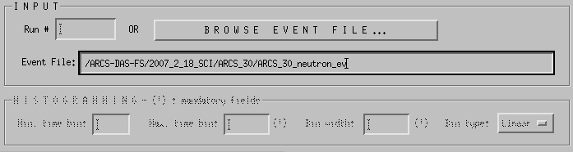
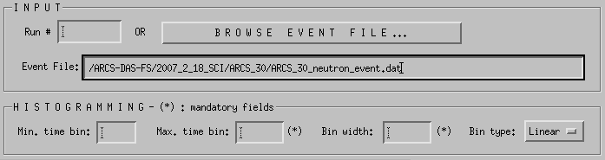
#3: Editing the full name of the event file.
Enter the full name (with absolute path) of the event file name. As long as the file/path edited does not exist, the histogram box is disabled.
…and becomes enabled once the file/path exists.
Next, goes to HISTOGRAM AN EVENT FILE part

Slide 10
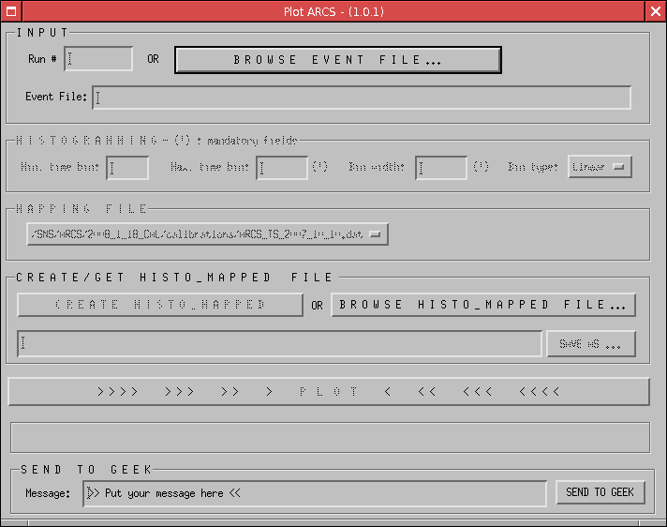
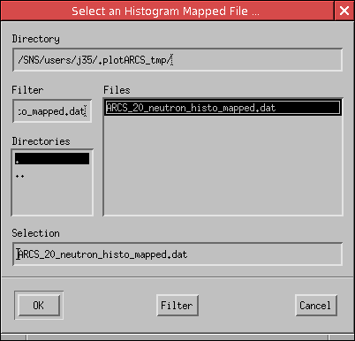
#4: Browsing for a histogram_mapped file
Click the BROWSE HISTO_MAPPED FILE button
Another window pops-up and lets you select a histogram_mapped file.
Then click OK

Slide 11
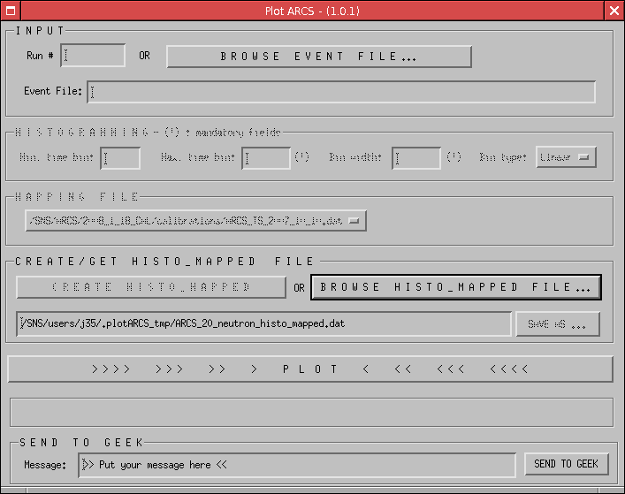
The full path to the histo_mapped file will then be displayed in the histo_mapped text box.
Next, goes to PLOT part

Slide 12
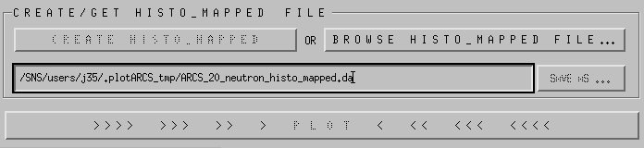
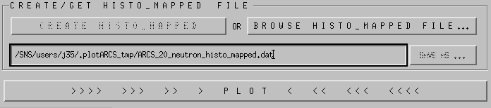
#5: Editing the full file name of the _x0004_ histogram_mapped file
Enter the full name (with absolute path) of the histogram mapped file name. As long as the file/path edited does not exist, the PLOT button is disabled.
…and becomes enabled once the file/path exists.
Next, goes to PLOT part

Slide 13

HISTOGRAMMING
Mininum time bin (time offset) in microSeconds
Maximum time bin in microSeconds
(mandatory)
Time bin type (linear or logarithmic)
Time bin width in microSeconds (mandatory)
Enter a value for Max. time bin and Bin width and select a bin Type. A value for the Min. time bin is optional.

Slide 14

MAPPING FILE
Keep default mapping file or select another mapping file (if this choice is available) - this is not recommended.

Slide 15
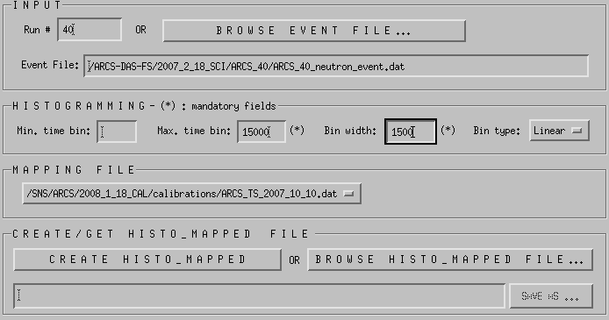
CREATE HISTO_MAPPED
Click CREATE HISTO_MAPPED
The status bar displays an OK once the process is done.

Slide 16
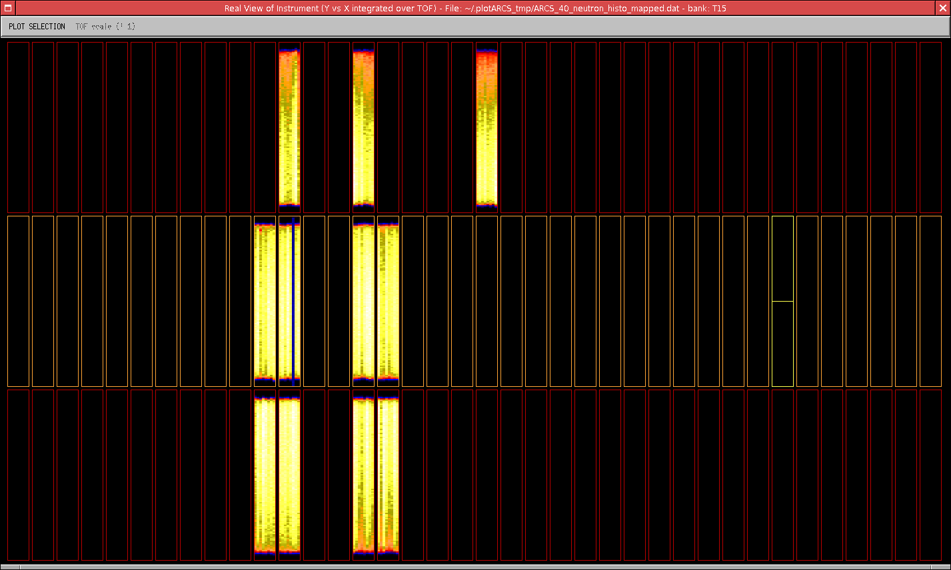
PLOT
Press the PLOT button.
You get a full view of the instrument. The title displays:
- the type of plot displays
- the name of the file
- the position of the mouse (bank#)

Slide 17

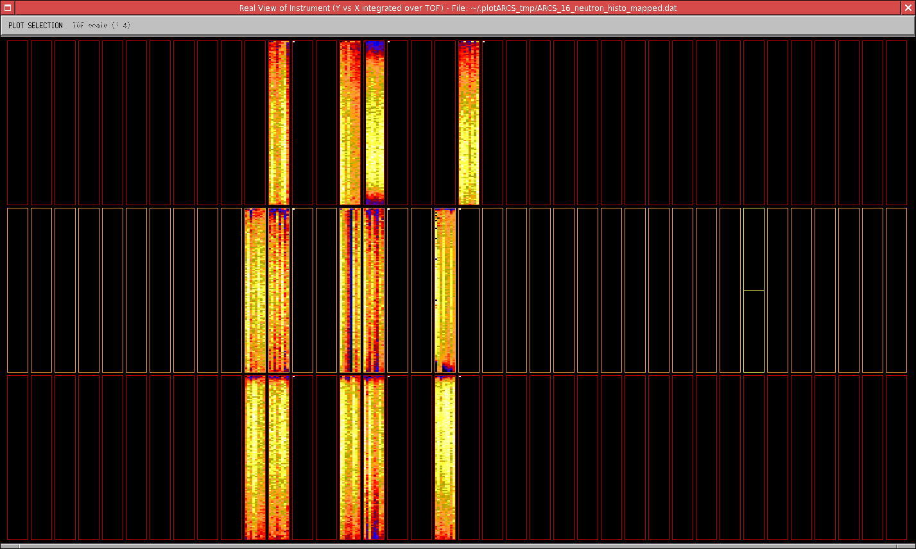
You can either displays the ‘real view of the detector’ (DAS view) or the TOF view.
Select the display desired in the top left corner.
DAS view
The X axis is the horizontal, the Y axis is the vertical and the data are integrated over all the Time Of Flight (TOF). This is the view displayed by the DAS instrument.

Slide 18
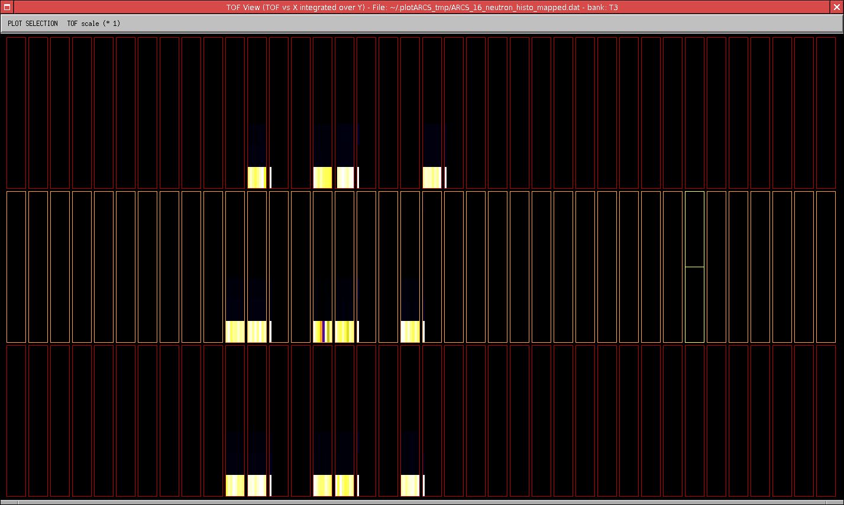

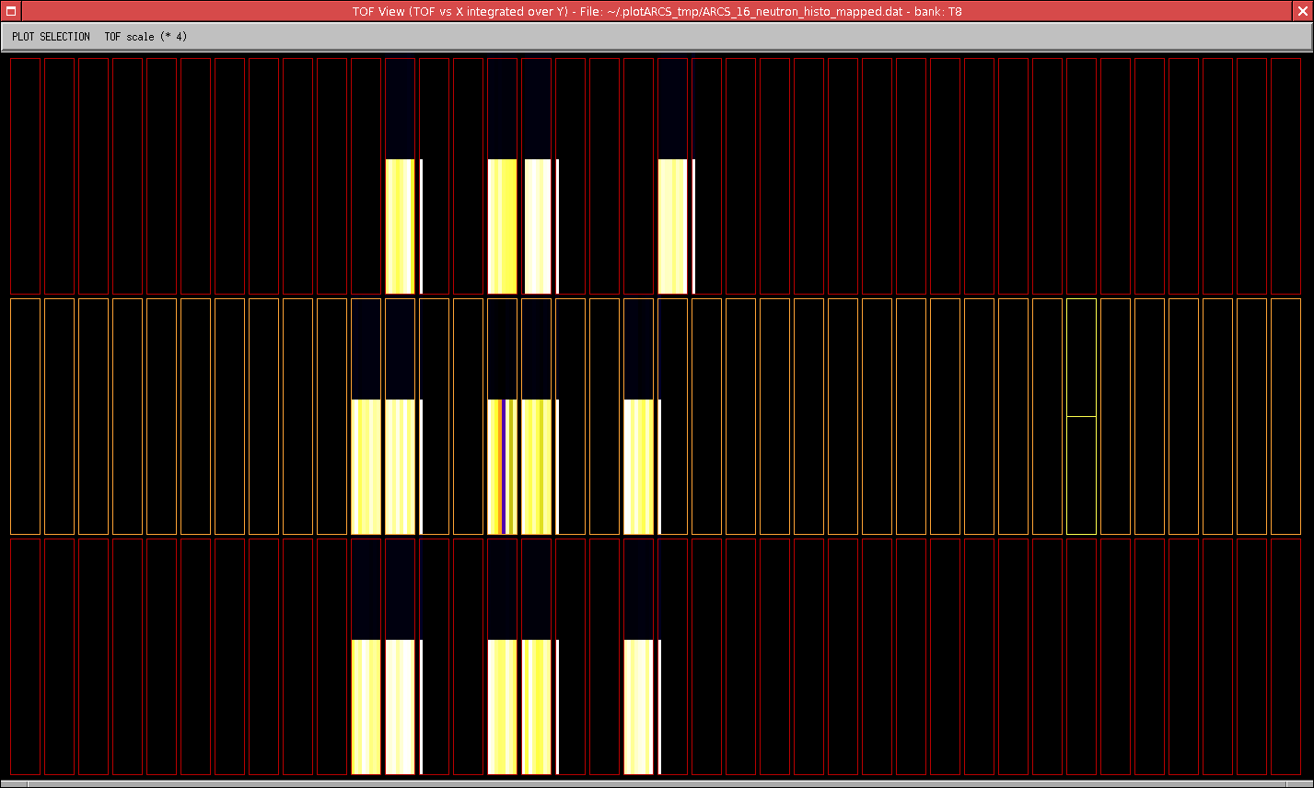
TOF view
The X axis is the horizontal, the Y axis is the TOF and the data are integrated over all the pixel of the same tube.
It’s possible to zoom in or out the y-axis using the TOF scale button (tof left corner)

Slide 19
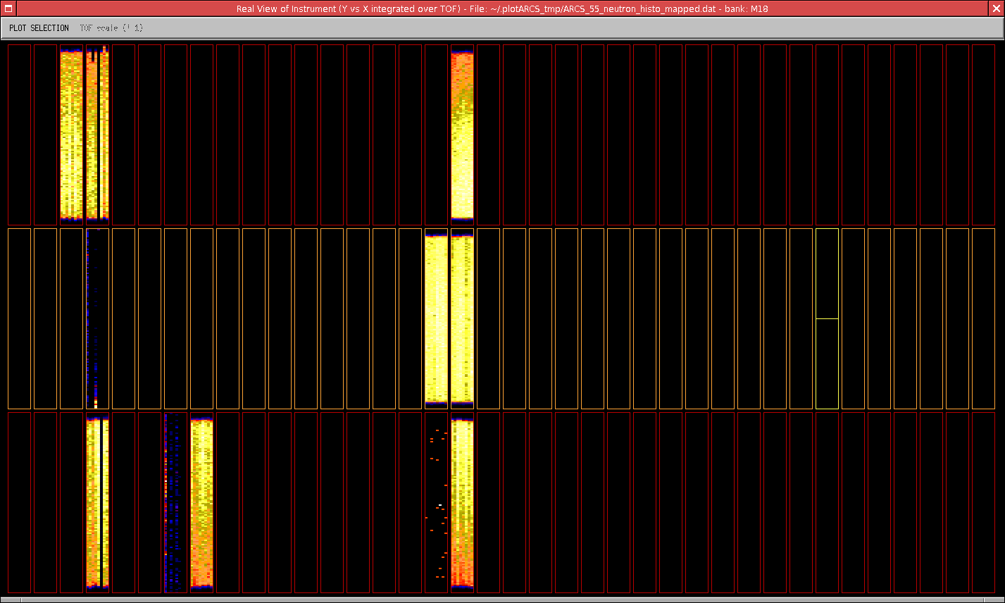
BANK view
To isolate a bank, just left click a bank on the main plot window.

Slide 20
BANK view - description of interface
Bank ID selected
Tube # of the cursor position
Row # of the cursor position
PixelID of the cursor position
Counts of the cursor position
The pixel underneath the cursor is highlighted in red.
By moving the mouse over the plot, you can get the tube, row, pixelID and Counts of the pixel underneath the cursor.

Slide 21
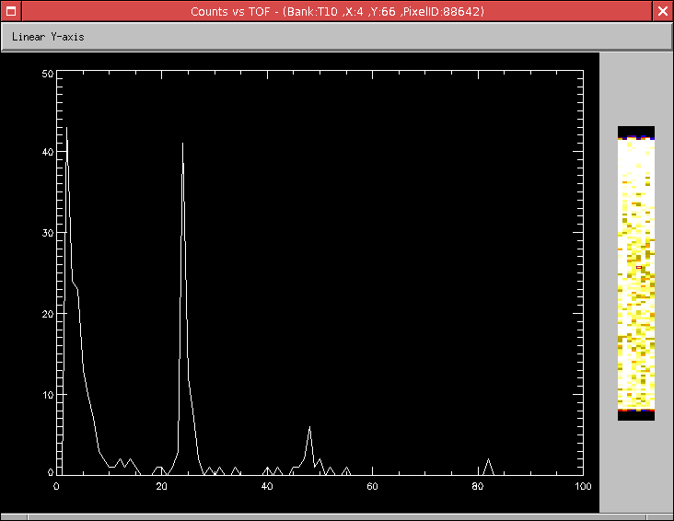
From BANK view to 2D TOF view of pixel selected
To get a 2D view (counts vs TOF) of the pixel selected just left click a pixel in the bank view.

Slide 22
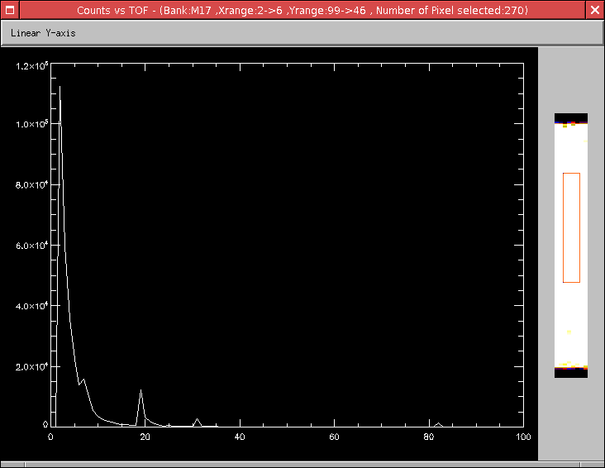
From BANK view to 2D TOF view of pixels selection
To get a 2D view (counts vs TOF) of a full selection of pixels, left click a pixel to define one corner of the selection, without releasing the left button move the mouse to the right corner and release the button.

Slide 23
Counts vs TOF plot - Description of Interface
Plot title - bank id, Tube (X), Row (Y) and pixelID of pixel selected.
Y-axis scale (linear or logarithmic)
Counts
Screenshot of bank and pixel(s) selected
Bin #

Slide 24
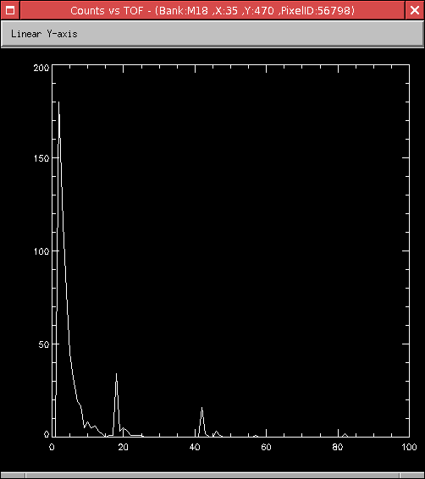
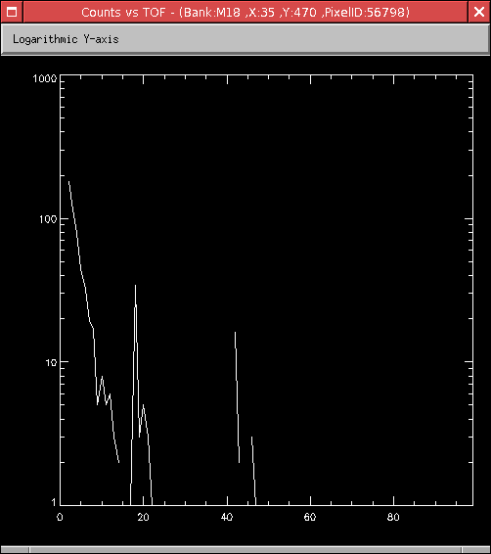
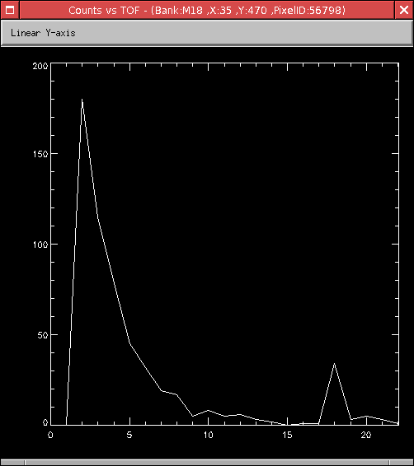
Counts vs TOF plot - Zoom and y_axis scale
Linear y-axis
Logarithmic y-axis
To zoom, left-click the left border and without releasing the button, move the mouse to the right border and release the button.

Slide 25
Counts vs TOF plot - Zoom (continued)
To reset the zoom, double click just outside the plot region.

Slide 26
TROUBLESHOOTING
If you have unexpected results (histogramming not working, file not found….etc), just use the SEND TO GEEK box.
Put your message in the text box and click SEND TO GEEK. An email is automatically send to the developers with some information that will help us debugging the program or finding the problem. Here the information transmitted:
- ucams
- hostname (name of the analysis computer)
- date
- current version of the running application
- copy of the logBook (not visible to users)
- message added (if any)
- copy of your credit card information (be sure to add the expiration date).

