Slide 1







SciDAC 2008
6/19/2008
http://www.adiosapi.org
C. Jin, S. Klasky, J. Lofstead

Slide 2
End to End Vision with ADIOS. (15 minutes)
ADIOS API’s. (15 minutes)
ADIOS XML. (15 minutes).
Heat Equation (1 hour).
XGC code. (45 minutes).

Slide 3
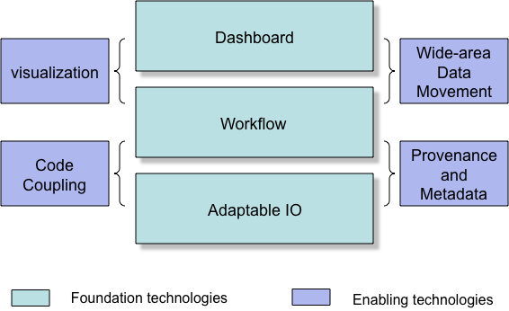
Combines
  Petascale Applications.
  Petascale I/O techniques.
  Workflow Automation.
  Provenance capturing system.
  Dashboards for real-time monitoring/controlling of simulations, and creating social spaces for scientists.
Approach: place highly annotated, fast, easy-to-use I/O methods in the code, which can be monitored and controlled, have a workflow engine record all of the information, visualize this on a dashboard, move desired data to user’s site, and have everything reported to a database.

Slide 4
“Those damm fort.* files!”
Multiple HPC architectures
  Cray, IB-based clusters, BlueGene
Multiple Parallel Filesystems
  Lustre, PVFS2, GPFS, Panasas, PNFS
Many different APIs
  MPI-IO, POSIX, HDF5, netCDF
  GTC (fusion) has changed IO routines 8 times so far based on performance when moving to different platforms.
Different IO patterns
  Restarts, analysis, diagnostics
  Different combinations provide different levels of I/O performance

Slide 5

Allows plug-ins for different I/O implementations.
Abstracts the API from the method used for I/O.
Simple API, almost as easy as F90 write statement.
Best practices/optimize IO routines for all supported transports “for free”
Componentization.
Thin API
XML file
  data groupings with annotation
  IO method selection
  buffer sizes
Common tools
  Buffering
  Scheduling
Pluggable IO routines
Scientific Codes
External
Metadata
(XML file)
ADIOS API
buffering
schedule
feedback
MPI-IO
pHDF-5
POSIX IO
MPI-CIO
pnetCDF
LIVE/DataTap
Viz Engines
Others (plug-in)
Notes:
Please remember that we support both synchronous and asynchronous IO methods!!!

Slide 6
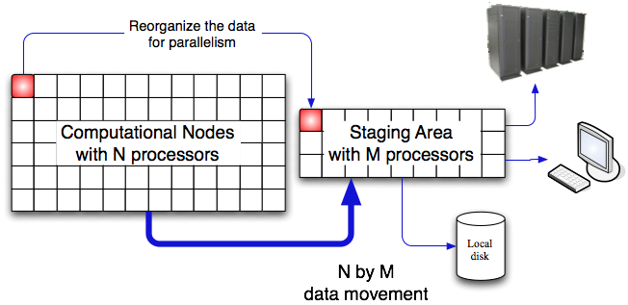
ADIOS is an IO componentization, which allows us to
  Abstract the API from the IO implementation.
  Switch from synchronous to asynchronous IO at runtime.
  Change from real-time visualization to fast IO at runtime.
Combines.
  Fast I/O routines.
  Easy to use.
  Scalable architecture
  (100s cores) millions of procs.
  QoS.
  Metadata rich output.
  Visualization applied during simulations.
  Analysis, compression techniques applied during simulations.
  Provenance tracking.
Notes:
Fast and Easy and Portable for most of the codes. We will not guarantee all codes will work, but most codes will work.

Slide 7
ADIOS Fortran and C based API almost as simple as standard POSIX IO
External configuration to describe metadata and control IO settings
Take advantage of existing IO techniques (no new native IO methods)
Fast, simple-to-write, efficient IO for multiple platforms without changing the source code

Slide 8
ADIOS Contributions:
Data Grouping: Multiple, independently controlled IO settings
  diagnostics, restarts, analysis, viz
Optional data items: Different data from different processes
  Single group write has header from a single proc and data from all
Data sizes change dynamically: Datasets vary in size
  Run size changes data sizes; also AMR codes
Constructed output is special: Reused buffers must be handled properly
  stack temporaries...
IO memory is second to science: Buffer space for IO is strictly limited
  respect the memory needs of the scientific codes
Notes:
i’d rewrite the design goals 2 and 3 to be more principled….right now, they sound like a bunch of implementation….for instance, for the first goal, you could combine 1 and data groupings, so say:
- ADIOS contribution: Data grouping – dealing with multiple indep. controlled IO settings
Now, I am not saying you have to get rid of your current structure (goals, with contributions later), but can you say 2 and 3 in those terms somehow? That is, link them to an important problem….4 and 5 are clearer.

Slide 9
Data groupings
  logical groups of related items written at the same time.
    Not necessarily one group per writing event
IO Methods
  Choose what works best for each grouping
  Vetted and/or written by experts for each
    POSIX (Wei-keng Lao, Northwestern)
    MPI-IO (Steve Hodson, Chen Jin, ORNL)
    MPI-IO Collective (Wei-keng Lao, Northwestern)
    NULL (Jay Lofstead, GT)
    Ga Tech DataTap Asynchronous (Hasan Abbasi, GT)
    others..

Slide 10
Specialty APIs
  HDF-5 – complex API
  Parallel netCDF – no structure
File system aware middleware
  MPI ADIO layer – File system connection, complex API
Parallel File systems
  Lustre – Metadata server issues
  PVFS2 – client complexity
  LWFS – client complexity
  GPFS, pNFS, Panasas

Slide 11
Platforms tested
  Cray CNL (ORNL Jaguar)
  Cray Catamount (ORNL old-Jaguar and SNL Redstorm)
  Linux Infiniband (ORNL Ewok)
  BlueGene P now being tested/debugged.
IO Methods
  MPI-IO independent, MPI-IO collective, POSIX, NULL, Ga Tech DataTap asynchronous, Rutgers DART asynchronous

Slide 12
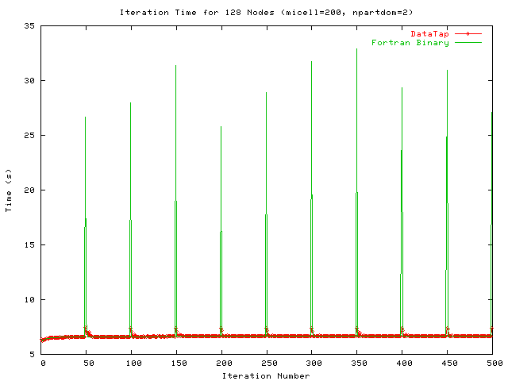
MPI-IO method.
  GTC and GTS codes have achieved over 25 GB/sec on Cray XT at ORNL.
    30GB diagnostic files every 3 minutes, 1.2 TB restart files every 30 minutes, 300MB other diagnostic files every 3 minutes.
  Chimera code speed up by 6.5% (overall time).
DART: <2% overhead for
writing 2 TB/hour with
XGC code.
DataTap vs. Posix
  1 file per process (Posix).
  5 secs for GTC
  computation.
  ~25 seconds for Posix IO
  ~4 seconds with DataTap

Slide 13
June 7, 2008: 24 hour GTC run on Jaguar at ORNL
  93% of machine (28,672 cores)
  MPI-OpenMP mixed model on quad-core nodes (7168 MPI procs)
  three interruptions total (simple node failure) with 2 10+ hour runs
  Wrote 56 TB of data at 20 GB/sec (21 TB for post analysis)
  IO overhead 3% of wall clock time
  Mixed IO methods of synchronous MPI-IO and POSIX IO configured in the XML file

Slide 14
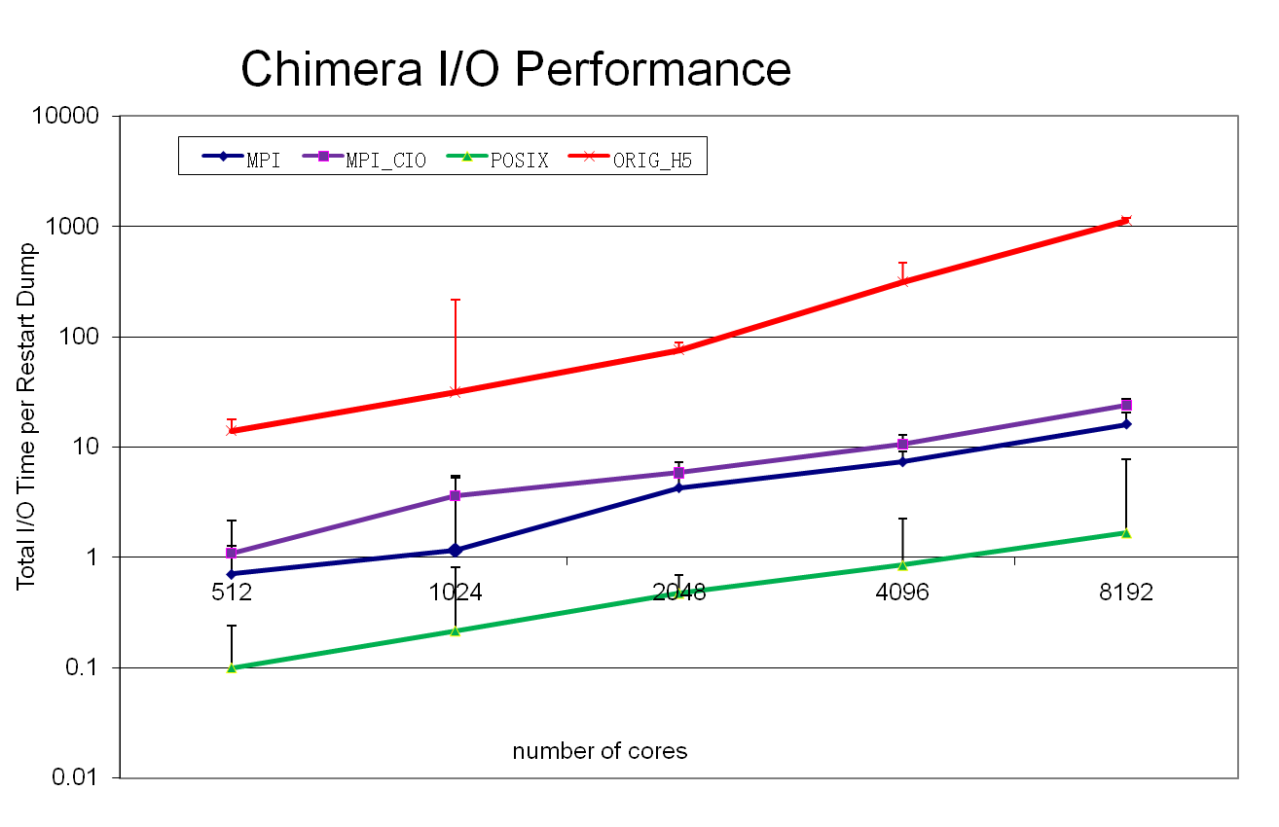
Chimera IO Performance (Supernova code)
2x scaling
Plot minimum value from 5 runs with 8 restarts/run
Error bars show maximum time for the method.

Slide 15
Library Release: October 2008
Documents:
  ADIOS Manual
  Example routines
  ADIOS tutorial
ADIOS Utils
  Bp2h5, bp2ncd, bp2ascii
ADIOS Tools
  Bpdump, bpcopy, bpmody ,adios_lint
ADIOS Methods
  MPI-IO, MPI-CIO, Posix, NULL, phdf5, DataTap (experimental).
Supported Platforms
  Cray XT, Infiniband (x86), Gigabit
Minimal required Software
  C compiler

Slide 16
BlueGene P will be fully supported.
Index files built for fast reading.
Faster methods for converting codes with F90 writes, C fwrites, netcdf, hdf5 to ADIOS writes.
Metadata Catalogue.
  One file will be produced per simulation which hyperlinks to all of the other files produced.
Readers developed.
VISIT in-situ visualization
method.
Integration into Kepler for
metadata capture.
Offloading to staging
area for other processing,
such as data re-arrangement.
Please suggest changes

Slide 17
ADIOS API Overview
Requirements
Standards
Setup/Cleanup API
Main IO APIs
Secondary IO API
Asynchronous IO hints
Additional Pieces

Slide 18
Requirements
Work equally well for Fortran and C-based codes
Nearly as simple as standard POSIX IO commands
Capable of generating full HDF-5 and netCDF output
Support both synchronous and asynchronous IO
Changes to IO methods do not require source code changes

Slide 19
Standards
64-bit sizing for everything
Fortran 90 and C 99
MPI Messaging
  required by some transports for coordination
MPI-IO

Slide 20
Setup/Cleanup API
Initialize/cleanup
  adios_init (‘config.xml’)
    parse XML file on each process
    setup transport methods
  adios_finalize (proc_id)
    give each transport method opportunity to cleanup
    particularly important for asynchronous methods to make sure they have completed before exiting

Slide 21
Main IO API
Open
  adios_open (handle, ‘group name’, ‘file name’, mode)
    handle used for subsequent calls for write/read/close
    ‘group name’ matches an entry in the XML
    mode is one of ‘w’ (write), ‘r’ (read), ‘a’ (append)
      later ‘u’ (update [read/write])
Close
  adios_close (handle)
    handle from open

Slide 22
Main IO API
Write
  adios_write (handle, ‘name’, data)
    handle from open
    name of var or attribute var in XML for this group
    data reference
Read
  adios_read (handle, ‘name’, buffer)
    handle from open
    name of var in XML for this group
    buffer to store read value
Must specify one per var written or read

Slide 23
Main IO API
writing and reading based solely on XML
  adios_gwrite (handle, ‘group name’)
    handle from open
    group name in XML used in open
    generates all of the detail ‘adios_write’ calls based on XML
  adios_gread (handle, ‘group name’)
    handle from open
    group name in XML used in open
    generates all of the detail ‘adios_read’ calls based on XML

Slide 24
Secondary IO API
Get buffer for fewer memory copies
  adios_get_write_buffer (handle, ‘var’, buffer)
    handle from open
    var name from XML
    buffer to write into
Set HDF-5 style paths dynamically
  adios_set_path (handle, ‘new path’)
  adios_set_path_var (handle, ‘new path’, ‘var’)
    handle from open
    new path to set for either the entire group or just ‘var’
    var name from XML

Slide 25
Asynchronous IO hints
Indicate non-IO intensive sections of code
  adios_start_calculation ()
  adios_stop_calculation ()
IO pacing hint
  adios_end_iteration ()

Slide 26
Additional Pieces
Special IO buffering control
  adios_allocate_buffer ()
    tell ADIOS layer to calculate IO buffer sizes now

Slide 27
Example Program
program p
call adios_init (‘config.xml’)
...
call adios_open (handle, ‘restart’, ‘restart.bp’, ‘w’)
adios_gwrite (handle, ‘restart’)
call adios_close (handle)
...
call adios_finalize (0)
end program p

Slide 28
ADIOS XML Format
File Overview
Group Overview
Method Overview
Other Pieces Overview

Slide 29
File Overview
Single main element
  <adios-config [host-language=“x”]>
    host-language optional to specify memory layout/comm host language
      Fortran
      C
Nested elements for groups, methods, buffer specifications

Slide 30
Group Overview
Group root element
  <adios-group name=“n” [host-language=“x”] [coordination-communicator=“comm”]
  [coordination-var=“var”]>
    host-language optional to specify memory layout/comm host language
      Fortran
      C
    name is required and used in the method element and in the adios_open calls
    coordination-communicator optional, but specifies parallel write communicator
    coordination-var optional, but specifies var to coordinate later
  Nested elements for var, global-bounds, attribute
    future: mesh description for viz support

Slide 31
Group Details
var element, part 1
  <var name=“name” type=“t” [path=“p”] [dimensions=“d”] [copy-on-write=“yes”] [gname=“g”] />
    name is used in write/read
      flexible names to allow simple expressions
        must contain at least one non-number character
        main limitations based on use in dimensions (no comma) or not globally unique due to paths (no ‘/’ character)
    type is expected names: integer, real, double, complex, string, real*4, integer*8, character, etc.
    path for HDF-5 output (optional)
      use ‘/’ to separate levels
      converted to ‘_’ for netCDF output

Slide 32
Group Details
var element, part 2
  <var name=“name” type=“t” [path=“p”] [dimensions=“d”] [copy-on-write=“yes”] [gname=“g”] />
    dimensions is a comma separated list of magnitudes for each rank
      only used for array elements
      either numbers or var names for dynamic sizing
    copy-on-write required to handle ephemeral values and reused buffers
      stack-based temporaries (e.g., passing in the result of an expression like x+5)
      reused buffers (e.g., build a Cartesian coordinate output for each of X, Y, and Z one at a time, writing each in between)
    gname is expression to generate for writing for gwrites

Slide 33
Group Details
Global Arrays
  <global-bounds dimensions=“d” offsets=“o”>...</global-bounds>
    dimensions is the global array size and must be provided consistently by all coordinating processes
    offsets is the offset in the global space to start the local data
    nested elements are var elements that should conform to the global-bounds
    Ghost region support in ADIOS 2.0

Slide 34
Group Details
Attributes
  <attribute name=“n” path=“p” value=“val” type=“t” var=“var”/>
    name of the attribute
    path for HDF-5 style hierarchy
      works like the path in a var
      for either a group or data item
        Group: if the last character is a ‘/’ or not a var name
        Data Item: if the last piece names a var (but no trailing ‘/’)
    Must provide EITHER value OR var and type
    value is a fixed value for the attribute
    var is the name of a var so that adios_write can supply the value at runtime
    type works like var element type, used for the var

Slide 35
Method Overview
method element
  <method group=“g” method=“m” [priority=“p”] [iterations=“i”]>params</method>
    group is the name of the group in the XML that should use this method
      can have multiple entries per group!
    method is the name of the IO method to use
      MPI, POSIX, DataTap, NULL, MPI-CIO, etc.
    priority is optional hint for asynchronous IO prioritization
    iterations is optional hint for pacing of asynchronous IO
    params is the optional contents of the element passed to the method on initialization
      Used for specifying hints and connectivity information

Slide 36
Method Overview
method element
  <method group=“g” method=“m” [priority=“p”] [iterations=“i”]/>
    group is the name of the group in the XML that should use this method
      can have multiple entries per group!
    method is the name of the IO method to use
      MPI, POSIX, DataTap, NULL, MPI-CIO, etc.
    priority is optional hint for asynchronous IO prioritization
    iterations is optional hint for pacing of asynchronous IO

Slide 37
Other Pieces Overview
buffer specification
  <buffer
  {size-MB=“s” | free-memory-percentage=“p”}
  allocate-time=“a”/>
    size-MB is a fixed number of MB available for IO buffering
    free-memory-percentage is the amount of remaining RAM that can be used for IO buffering
    either size-MB or free-memory-percentage required
    allocate-time specifies when to check the memory size
      now – do it at adios_init time
      oncall – do it when adios_buffer_allocate is called

Slide 38
XML Example
<adios-config host-language=“Fortran”>
<adios-group name=“restart”>
<var name=“nx” type=“integer”/>
<var name=“ny” type=“integer”/>
<var name=“gnx” type=“integer”/>
<var name=“gny” type=“integer”/>
<var name=“lnx” type=“integer”/>
<var name=“lny” type=“integer”/>
<global-bounds dimensions=“gnx,gny” offsets=“lnx,lny”>
<var name=“data” type=“real” dimensions=“nx,ny”/>
</global-bounds>
</adios-group>
<method group=“restart” method=“MPI”/>
<buffer size-MB=“100” allocate-time=“now”/>
</adios-config>

Slide 39
An Simple Example
  Solution of Heat equation ( C code)
    ASCII output
  Example taken from http://carbon.cudenver.edu/csprojects/csc5809F99/mpi_examples/2d_heat_equation.html
Real Scientific Applications
  XGC-1 (Fortran)
    NETCDF, HDF5, ASCII

Slide 40
A simple partial differential equation, describing the heat transfer in 2-D surface
solution function is calculated at discrete spatial mesh points
Proceed in discrete time steps
Parallelize this task on multiple processors (e.g. 16)

Slide 41
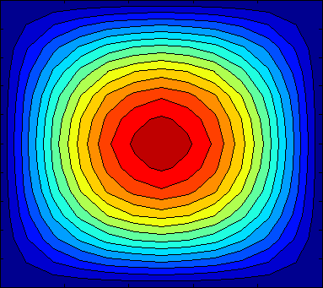

Slide 42

Slave Node 1
Boundary Exchange
Slave Node 2
Master Node 0
Write Files
Slave Node 15

Slide 43
Show the IO routines in the original code.
Compile/Run Original Code
ASCII output

Slide 44
Integrate ADIOS APIs into source Code
Two primary routines in the code to look at
  Main()
    This routine does the initial domain decomposition, and has all of the routines that call the I/O output.
    Adios_init/finalize
  Prtdat()
    This routine writes the output files.
    adios_open/write/close
Notes:
Similar as mpi_init/finalize
Adios_init : initialization
Adios_finalize : cleanup
adios_open: retrieve the buffer handle for the adios-group, which will be read from/written into the given filename
Adios_close: is actually to commit the operation of actual read/write
Adios-open
Adios-write
Adios-close

Slide 45
void prtdat (int nx, int ny, float *u1, char *fnam) {
int ix, iy; FILE *fp;
fp = fopen (fnam, "w");
for (ix = 0; ix <= nx-1; ix++) {
for (iy = 0; iy <=ny-1; iy++) {
if( ( ((iy-1)%6)==0 &&iy>=7) || iy==0)
fprintf (fp, "\n(%d,%d): ",ix,iy);
else
fprintf (fp," ");
fprintf (fp, " %8.6f", ix,iy,*(u1+ix*ny+iy));
if (iy == ny-1)
fprintf (fp, "\n");
}
}
fclose (fp) ;
}

Slide 46
void prtdat (int nx, int ny, float *u1, int start, int size, char *fnam) {
long long handle;
long long io_type;
float *** u = (float ***) u1;
adios_get_group (&io_type, "output");
adios_open (&handle, io_type, fnam);
adios_write (handle, "NXPROB", &nx);
adios_write (handle, "NYPROB", &ny);
adios_write (handle, "size", &size);
adios_write (handle, "start", &start);
adios_write (handle, "data", u + (start * ny));
adios_close (handle);
}

Slide 47
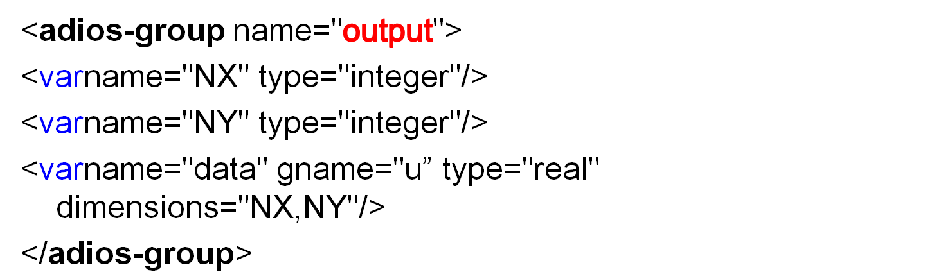
Optional Declaration
<?xml version="1.0"?>
Root Element:Start-tag
<adios-confighost-language="C”>
</adios-config>
Group Container
Transport method
<buffer size-MB="100" allocate-time="now"/>
Buffer size/creation
Root Element: End-tag
Notes:
<?xml version=1.0?> optional xml declaration, this element states what version of xml is in use, also may contain information about character encoding
<adios-config> root element (can only be stated once), any text or elements must be enclosed between the root start-tag and end-tag
<adios-group> : a container of a group of variables/attributes that should be treated as a single IO operations
<method>: specify what transport method used for different adios-group
<buffer> : internal buffer size and creation time.

Slide 48
bpdump
bp2h5
bp2ncd
bp2ascii
adios_lint

Slide 49
./bpdump [-d [var]|--dump [var]] <filename>
./bpdumpfinal.bp
element size: 39
Scalar NY
Path: /
Type: integer (2)
Value: 500
-----------------------
element size: 800065
Dataset data
Path: /
Type: real (5)
Ranks: 2
Dim(0) l:g:o: 400:0:0
Dim(1) l:g:o: 500:0:0
-----------------------

Slide 50
./bp2h5 XXXX.bp [XXXX.h5] [-c]
Example
./bp2h5 final.bp –c
h5ls -r final.h5
/NX Dataset {1}
/NY Dataset {1}
/data Dataset {400, 500}

Slide 51
./bp2ncd XXXX.bp [XXXX.nc] [-c]
Example
./bp2ncd final.bp -c
ncdump -hfinal.nc
netcdf final { // format variant: 64bit
dimensions:
_data_0 = 400 ;
_data_1 = 500 ;
variables:
float _data(_data_0, _data_1) ;
}

Slide 52
./bp2ascii XXXX.bp [XXXX.txt] -C[-c] data_name1 [data_name2...]
Example
./bp2ascii final.bp -c data
----------------------------
generating file: final.txt
----------------------------
write dataset: data
Dimension:400 x 500

Slide 53
adios_lint
validate configuration XML file conforms to all standards.
adios_lint <filename>
output: no news is good news!

Slide 54
Output more variables
  cos_u,sin_u, tan_u
Modify XML File
Modify ptrdat routine
  Replace all of the adios_write statements with just
    adios_gwrite(buf_id,”output”);
Recompile/Run

Slide 55
<adios-group name="output”>
<var name="NX" type="integer"/>
<var name="NY" type="integer"/>
<var name="data" gname="u” type="real" dimensions="NX,NY"/>
<var name="cos_data" gname="cos_u” type="real" dimensions="NX,NY"/>
<var name="sin_data" gname="sin_u” type="real" dimensions="NX,NY"/>
<var name="tan_data" gname="tan_u” type="real" dimensions="NX,NY"/>
</adios-group>
<method method="POSIX" group="output"/>
Gname :actual variable name/expression in the source code
Var name: dataset name written into file

Slide 56
Motivation
  Easy to Insert/Remove Variables
  Only need maintain xml file
Source code
  Adios_gwrite(buf_id,group_name)
Makefile
  Python gwrite.pyheat.xmldir_name
  Run gwrite.py in every directory containing the adios_gwrite
Compile/Run

Slide 57
In this example we need to
  Define a communicator.
    Required whenever not all ranks are participating in the write.
    In this example, we have a master process which will NOT participate in this write.
    In this case, we put different path name for different slave nodes
  Modify the XML file to use the MPI-IO method, and to place the communicator in the group.

Slide 58
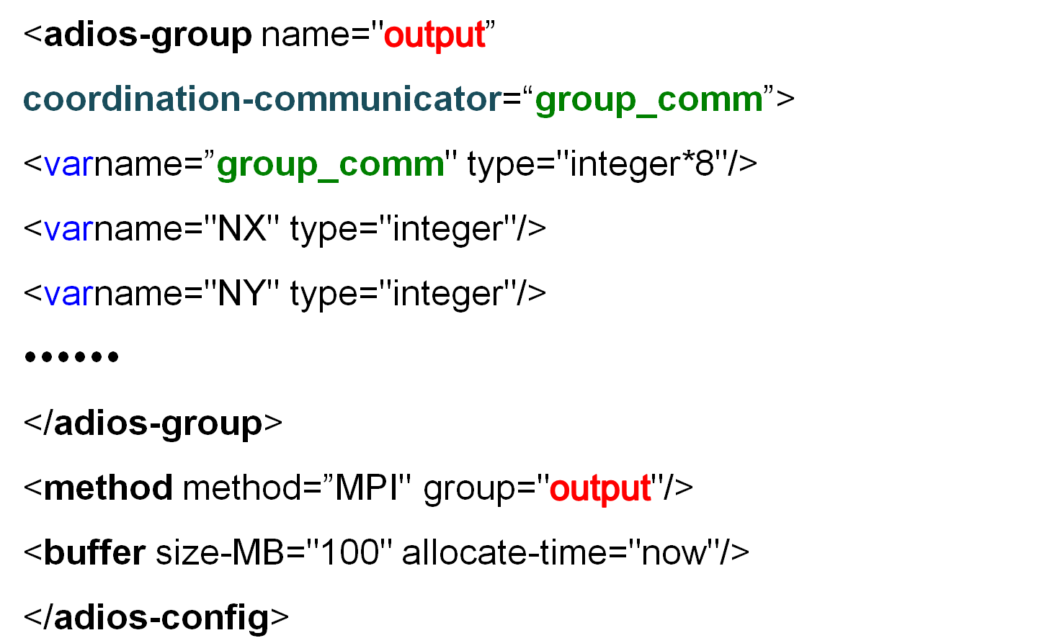

Slide 59

Slave Node 1
Edge Exchange
Slave Node 2
Master Node 0
Write Files
Slave Node 15

Slide 60
Global Array
  Global/local dimension, Offset
  Used to reconstruct dataset in bp2h5/bp2ncd
Recompile/Run

Slide 61
<varname="offset" type="integer"/>
<varname="size" type="integer/>
<global-bounds dimensions="NX,NY" offsets="offset,0">
<var name="data" gname="u+offset*NY” type="real" dimensions="size,NY"/>
<var name=”cos_data" gname=”cos_u[offset]" type="real" dimensions="size,NY"/>
<var name=”sin_data" gname=”sin_u[offset]” type="real" dimensions="size,NY"/>
<var name=”tan_data" gname=”tan_u[offset]” type="real" dimensions="size,NY"/>
</global-bounds>

Slide 62
Description
IO Pattern
  NetCDF files
  Hdf5 files
  ASCII files

Slide 63
<method priority="3" method="POSIX" iterations="100" group="restart"/>
<method priority="3" method="POSIX" iterations="100" group="diagnosis.bfield"/>
<method priority="3" method="POSIX" iterations="100" group="diagnosis.bfield.1"/>
<method priority="3" method="POSIX" iterations="100" group="diag_pot.fieldp.header"/>
<method priority="3" method="MPI" iterations="100" group="diag_pot.fieldp"/>
<method priority="3" method="POSIX" iterations="100" group="diagnosis.flow"/>
<method priority="3" method="POSIX" iterations="100" group="diagnosis.flux"/>
<method priority="3" method="POSIX" iterations="100" group="fort.tracer"/>
<method priority="3" method="POSIX" iterations="100" group="fort.gam"/>
<method priority="3" method="POSIX" iterations="100" group="fort.ef"/>
<method priority="3" method="POSIX" iterations="100" group="fort.60"/>
<method priority="3" method="POSIX" iterations="100" group="fort.50"/>
<method priority="3" method="POSIX" iterations="100" group="fort.61"/>
<method priority="3" method="POSIX" iterations="100" group="fort.30"/>
<method priority="3" method="POSIX" iterations="100" group="fort.p"/>
<method priority="3" method="POSIX" iterations="100" group="diagnosis.particleweight"/>
<method priority="3" method="POSIX" iterations="100" group="diagnosis.mesh"/>
<method priority="3" method="POSIX" iterations="100" group="diagnosis.fieldi"/>
<method priority="3" method="POSIX" iterations="100" group="diagnosis.fieldi.1"/>
<method priority="3" method="POSIX" iterations="100" group="diagnosis.fieldi.2"/>
<method priority="3" method="POSIX" iterations="100" group="diagnosis.fieldi.3"/>
<method priority="3" method="POSIX" iterations="100" group="diagnosis.fieldi.4"/>
<method priority="3" method="POSIX" iterations="100" group="diagnosis.fieldi.5"/>
Notes:
WHY is restart POSIX and not MPI?

Slide 64
Original XGC-1
  one restart file per processor
ADIOS XGC-1
  One restart file for all the processors

Slide 65
write(filename,'("xgc.restart.",i4.4,".bp")') sml_mype
call bpopenfile(filename,fileptr)
varname = "timestep"
call bpwritescalarint(fileptr,sml_istep,varname)
varname = "timeval"
call bpwritescalardouble(fileptr,sml_time,varname)
do sp_type=1, 1+sml_electron_on
if (sp_type==1) then
grpname = "restart_data_i"
varname = "ptl_num_i"
varname2 = "ptl_maxgid_i"
sp=>ptl%ion
else
grpname = "restart_data_e"
varname = "ptl_num_e"
varname2 = "ptl_maxgid_e"
sp=>ptl%elec
endif
call bpwritescalarint(fileptr,sp%num,varname)

Slide 66
#ifdef SMALL_GID
call bpwritescalarint(fileptr,sp%maxgid,varname2)
#else
call bpwritescalarlong(fileptr,sp%maxgid,varname2)
#endif
call bpbeginbasicgroup(fileptr,grpname)
varname = "gid"
#ifdef SMALL_GID
call bpwritevarint(fileptr,sp%gid(1:sp%num),vardim,sp%num,varname)
#else
call bpwritevarlong(fileptr,sp%gid(1:sp%num),vardim,sp%num,varname)
#endif
do i=1,sp%nphase
write(varname,'("phase[",i1.1,"]")') i
call bpwritevardouble(fileptr,sp%phase(i,1:sp%num),vardim,sp%num,varname)
enddo
call bpendbasicgroup(fileptr)
enddo
call bpclosefile(fileptr)

Slide 67
<adios-group name="restart" coordination-communicator="icomm">
<var name="icomm" type="integer*8"/>
<var name="sml_istep" type="integer"/>
<var name="sml_time" type="double"/>
<var name="maxnum" gname="sp%maxnum" type="integer"/>
<var name="inum" gname="sp%num" type="integer"/>
<var name="inphase" gname="sp%nphase" type="integer" />
<var name="imaxgid" gname="sp%maxgid" type="integer"/>
<var name="igid" gname="sp%gid" type="integer*8" dimensions="maxnum"/>
<var name="iphase" gname="sp%phase" type="double" dimensions="inphase,maxnum"/>
<condition expression=" if(sml_electron_on==1) then"/>
<condition expression=" sp=>ptl%elec"/>
<var name="enum" gname="sp%num" type="integer"/>
<var name="emaxgid" gname="sp%maxgid" type="integer"/>
<var name="enphase" gname="sp%nphase" type="integer"/>
<var name="egid" gname="sp%gid" type="integer*8" dimensions="enum"/>
<var name="ephase" gname="sp%phase" type="double" dimensions="enphase,enum"/>
<condition expression=" endif"/>
</adios-group>

Slide 68
write(filename,'("restart.",i4.4,".bp")') sml_istep
filename=trim(filename)//char(0)
call adios_open(buf_id,"restart"//char(0),filename,"w"//char(0))
write(dirname,'("node_",i4.4)') sml_mype
dirname=trim(dirname)//char(0)
call adios_set_path(buf_id,dirname)
sp=>ptl%ion
call adios_gwrite(buf_id,"restart")
call adios_close(buf_id)

Slide 69
Old Binpacked Method
  Complicated APIs
  Need customized bp2h5 routines to put annotations
ADIOS
  Simple APIs
  General bp2h5 converter

Slide 70
meshbp_file = "xgc.mesh.bp"
call bpopenfile(meshbp_file,meshbp_fileptr)
call bpwritetrimesh(meshbp_fileptr,n_n,n_t,coord,nodeid)
dims(1) = n_psi
varname = "itheta0"
call bpwritevarint(meshbp_fileptr,n_itheta0,ndim,dims,varname)
dims(1) = n_n
varname = "nextnode"
call bpwritevarint(meshbp_fileptr,nextn,ndim,dims,varname)
call bpclosefile(meshbp_fileptr)
deallocate(coord,nodeid,n_itheta0,nextn)

Slide 71
meshbp_file = "mesh.bp"//char(0)
call adios_get_group(grp,"diagnosis.mesh"//char(0))
call adios_open(buf,grp,meshbp_file)
call adios_gwrite(buf,"diagnosis.mesh")
call adios_close(buf)

Slide 72
<adios-group name="diagnosis.mesh">
<varname="n_n" type="integer" />
<varname="n_t" type="integer" />
<varname="n_psi" type="integer" />
<varname="values" gname="coord" path="/coordinates/" type="real*8" dimensions="2,n_n"/>
<varname="node_connect_list" gname="nodeid" path="cell_set[0]" type="integer" dimensions="3,n_t" />
<varname="nextnode" gname="nextn" type="integer" dimensions="n_n"/>
<varname="itheta0" gname="n_itheta0" type="integer" dimensions="n_psi"/>
<attribute name="nnodes" path="/" var="n_n" type="integer"/>
<attribute name="nspace" path="/" value="2" />
<attribute name="ncell_sets" path="/" value="1" />
<attribute name="XP_CLASS" path="/" value="Mesh" />
<attribute name="cell_name" path="/cell_set[0]/" value="Tri" />
</adios-group>

Slide 73
/cell_set[0] Group
/cell_set[0]/node_connect_list Dataset {218412, 3}
/coordinates Group
/coordinates/values Dataset {110185, 2}
/itheta0 Dataset {275}
/nextnode Dataset {110185}

Slide 74
/cell_set[0] Group
/cell_set[0]/node_connect_list Dataset {151587, 3}
/coordinates Group
/coordinates/values Dataset {76044, 2}
/itheta0 Dataset {146}
/n_n Dataset {1}
/n_psi Dataset {1}
/n_t Dataset {1}
/nextnode Dataset {76044}

Slide 75
Complexity of using NETCDF
  Three routines to write flowdiag.nc with attributes
    diag_flow_ncinit
    diag_flow_ncfinal
    low_diagnosis
ADIOS
  Shift the complexity to XML construction
  Provide easy-to-use, high-level APIs for end-uses
  Provide flexibility to keep the schema

Slide 76
••••••t
var_units(24)='Unitless'
var_units(25)= 'm^3’
! create netCDF file and enter define mode
iret = nf90_create('xgc.flowdiag.cdf',NF90_CLOBBER, diag_flow_ncfileid)
call check_err(iret)
! define netCDF dimensions
iret = nf90_def_dim(diag_flow_ncfileid, 'samples', diag_flow_npsi, diag_psi_ncdim)
call check_err(iret)
iret = nf90_def_dim(diag_flow_ncfileid, 'timesteps', NF90_UNLIMITED, diag_time_ncdim)
call check_err(iret)
! define netCDF variables
diag_psi_ncdims(1) = diag_psi_ncdim
iret = nf90_def_var(diag_flow_ncfileid, 'psi', NF90_DOUBLE, diag_psi_ncdims, diag_psi_ncvarid)
call check_err(iret)
iret = nf90_put_att(diag_flow_ncfileid, diag_time_ncvarid, 'units', 'transit times')
call check_err(iret)
••••••

Slide 77
••••••
! setenetCDF attribute for ElVis to stop monitoring netCDF file
iret = nf90_redef(diag_flow_ncfileid)
call check_err(iret)
iret = nf90_put_att(diag_flow_ncfileid, NF90_GLOBAL, 'running', 'false')
call check_err(iret)
! leave netCDF define mode and close file
iret = nf90_enddef(diag_flow_ncfileid)
call check_err(iret)
iret = nf90_close(diag_flow_ncfileid)
call check_err(iret)
••••••

Slide 78
••••••
if(sp_type==1) then
diag_time_ncstart(1) = istep/diag_flow_period + 1
simtime(1) = sml_time/sml_tran
iret = nf90_put_var(diag_flow_ncfileid, diag_time_ncvarid, simtime, diag_time_ncstart, diag_time_nccount)
endif
diag_flow_ncstart(2) = istep/diag_flow_period + 1
do j=2, NN2
iret = nf90_put_var(diag_flow_ncfileid, diag_flow_ncvarid(j,sp_type), netcdf_flow(:,j), diag_flow_ncstart, diag_flow_nccount)
enddo
! sync output file
iret = nf90_sync(diag_flow_ncfileid)
call check_err(iret)
••••••

Slide 79
<adios-group name="diagnosis.flow">
<var name="samples" gname="diag_flow_npsi" type="integer" />
<var name="istep" gname="istep/diag_flow_period" type="integer" copy-on-write="yes"/>
<attribute name="running" path="/" value="true"/>
<condition expression="if(istep==diag_flow_period) then"/>
<var name="psi" type="double" dimensions="samples"/>
<condition expression="endif"/>
<var name="time" gname="simtime(1)" type="double"/>
<attribute name="units" path="time" value="transit times"/>
<var name="ion__density(df)" gname="netcdf_flow(:,j)" type="double" dimensions="samples"/>
<attribute name="units" path="ion__density(df)" value="m^-3" />
<var name="ion__toroidal_flow(df)" gname="netcdf_flow(:,j)" type="double" dimensions="samples"/>
<attribute name="units" path="ion__toroidal_flow(df)" value="m/s" />
••••••

Slide 80
filename2="flowdiag.bp"//char(0)
call adios_open(buf_id,"diagnosis.flow"//char(0),filename2,"a"//char(0))
call adios_gwrite(buf_id,"diagnosis.flow")
call adios_close(buf_id)

Slide 81
netcdfxgc.flowdiag {
dimensions:
samples = 50 ;
timesteps = UNLIMITED ; // (372 currently)
variables:
double psi(samples) ;
double time(timesteps) ;
time:units = "transit times" ;
double ion__density(df)(timesteps, samples) ;
ion__density(df):units = "m^-3" ;
double ion__toroidal_flow(df)(timesteps, samples) ;
ion__toroidal_flow(df):units = "m/s" ;
double ion__poloidal_flow(df)(timesteps, samples) ;
ion__poloidal_flow(df):units = "m/s" ;
double ion__parallel_flow(df)(timesteps, samples) ;
ion__parallel_flow(df):units = "m/s" ;
double ion__poloidal_comp._of_ExB(df)(timesteps, samples) ;
ion__poloidal_comp._of_ExB(df):units = "m/s" ;

Slide 82
netcdfxgc.flowdiag {
dimensions:
timesteps = UNLIMITED ; // (12 currently)
psi_0 = 50 ;
ion__density(df)_0 = 50 ;
••••••
variables:
double psi(psi_0) ;
double time(timesteps) ;
time:units = "transit times" ;
double ion__density(df)(timesteps, ion__density(df)_0) ;
ion__density(df):units = "m^-3" ;
double ion__toroidal_flow(df)(timesteps, ion__toroidal_flow(df)_0) ;
ion__toroidal_flow(df):units = "m/s" ;
double ion__poloidal_flow(df)(timesteps, ion__poloidal_flow(df)_0) ;
ion__poloidal_flow(df):units = "m/s" ;
double ion__parallel_flow(df)(timesteps, ion__parallel_flow(df)_0) ;
ion__parallel_flow(df):units = "m/s" ;
double ion__poloidal_comp._of_ExB(df)(timesteps, ion__poloidal_comp._of_ExB(df)_0) ;
ion__poloidal_comp._of_ExB(df):units = "m/s" ;

