Slide 1
Demonstration of CPFEM code femPX

Slide 2
Initial set up
Load module for mpi
module load mpi
Add math kernel library to the library path
export LD_LIBRARY_PATH=$LD_LIBRARY_PATH:/opt/intel/mkl/lib/intel64 (if using bash)
setenv LD_LIBRARY_PATH $LD_LIBRARY_PATH/opt/intel/mkl/lib/intel64 (if using csh)
Use mpirun to submit the job
Example files are in the directory ~sarmag/polycrys/datafiles/demo/run on vulcan2

Slide 3
Input files needed
ps_comp.in.tty (contains input to be read from tty)
utx_101010.inp (mesh file)
idump.els (list of elements for output)
ran1023.grn (grain orientations)
fcc.param (material parameters)
hkl.list (list of {hkl} of interest for lattice strains)
vertex.fcc (single crystal yield surface)
cubic.sym (cubic crystal symmetry operations)
hard_particle.elm (list of elements with enhanced hardness)

Slide 4
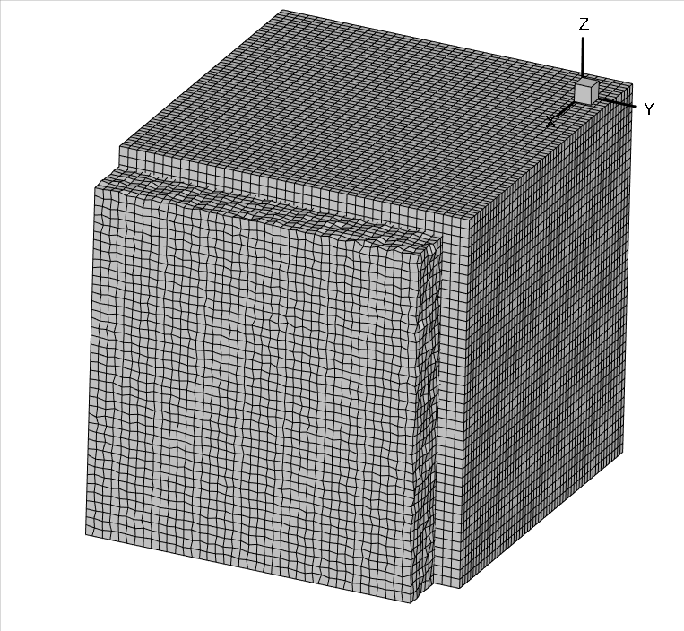
Initial and deformed meshes

