Slide 1
iMars3d

Slide 2
What is iMars3d
A package for CT reconstruction for CG-1D data
python / Tomopy
Preprocessing (tilt correction, ring artifact removal, etc)
“GUI” based on jupyter notebook widgets https://www.youtube.com/watch?v=t7B37NUJrJg
Automatic reconstruction for CG-1D

Slide 3
Workflow
Intensity corrections
Outlier removal
Tilt correction
Normalization
Finding rotation center
Sinogram creation
Cropping
Removing ring-artifact 1
Smoothing / denoising
Intensity fluctuation correction
Reconstruction
Removing ring-artifact 2

Slide 4
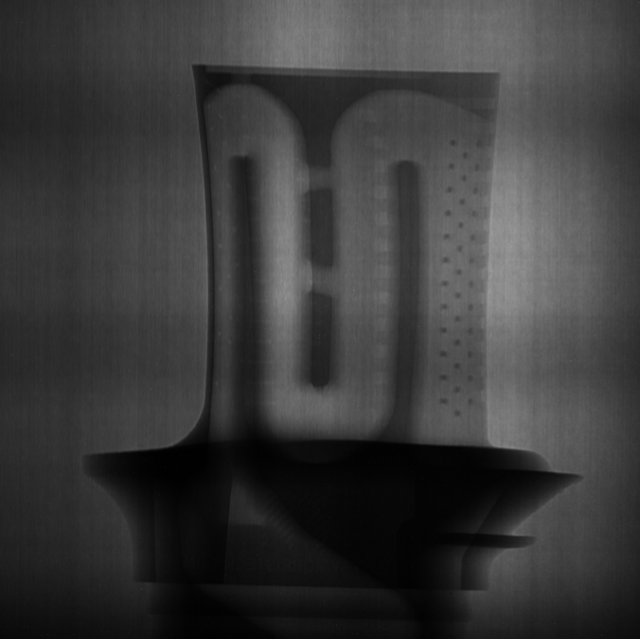
Original

Slide 5
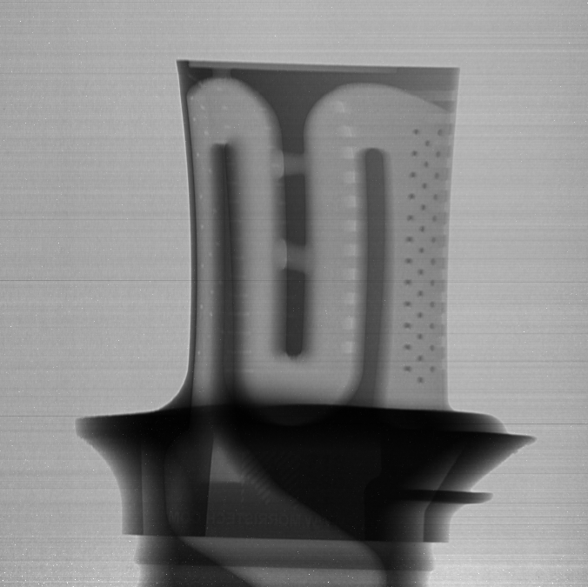
Normalized and Intensity fluctuation corrected

Slide 6
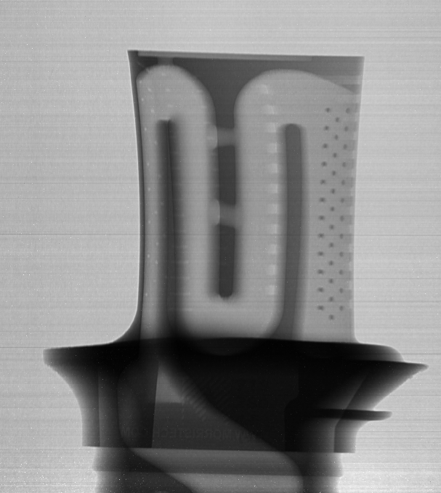
Crop

Slide 7
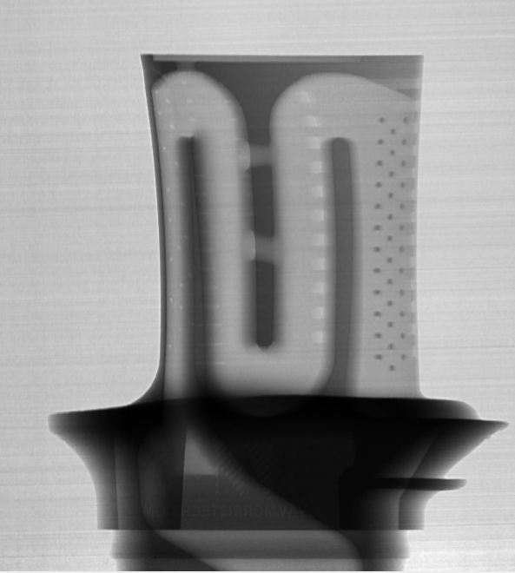
Tilt corrected

Slide 8

Sinogram

Slide 9
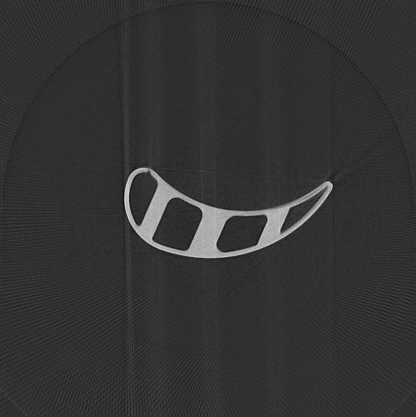
Reconstructed

Slide 10
Package structure
ImageSeries
CTProcessor
Components
ImageFile
Image filters/operators

Slide 11
Restore CI
https://github.com/ornlneutronimaging/iMars3D/pull/130

Slide 13
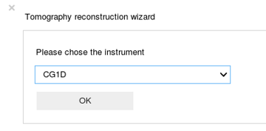
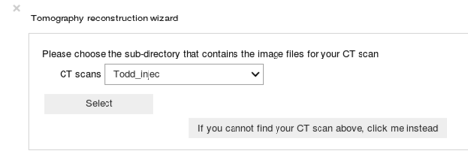
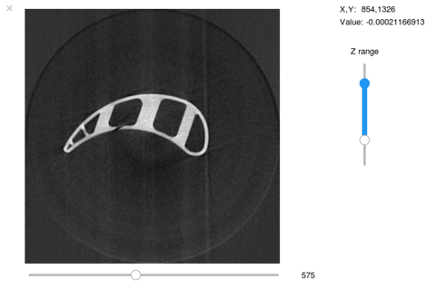
Jupyter Notebook for Tomography Reconstruction
A wizard to set up reconstruction
Significance and Impact
This work encapsulates a semi-automatic tomography reconstruction workflow in a jupyter-notebook-based user interface. The steep learning curve for neutron computed tomography (CT) reconstruction is thus removed. The obtained reconstructed data represent linear attenuation coefficients, which allow for direct quantitative assessments of material compositions in 3D.
Turbine blade
Contrast
Adjustment
Details
A wizard allows for easy collection of user inputs on data whereabouts and reconstruction parameters.
Embedded image series viewer allows for selection of region of interests, and examination of intermediate and final results as image series.
Ring-artifact-removal algorithms were explored and the Ketcham algorithm¹ was implemented and added as an optional step in reconstruction.
Embedded image series viewer
Image slider
Contributors: Jiao Lin, Yuxuan Zhang, Ian Lumsden, Jean Bilheux, and Hassina Bilheux
This work can be used for data reconstruction of neutron imaging computed tomograms acquired at ORNL SNS’s SNAP/VULCAN diffractometers, and HFIR’s CG-1D Imaging beamline, sponsored by DOE Office of Science, Scientific User Facilities Division.
1. Ketcham, Richard A. "New algorithms for ring artifact removal." Proc. SPIE. Vol. 6318. 2006.

