Slide 1
GitHub Collaboration
Intro to Branching

Slide 2
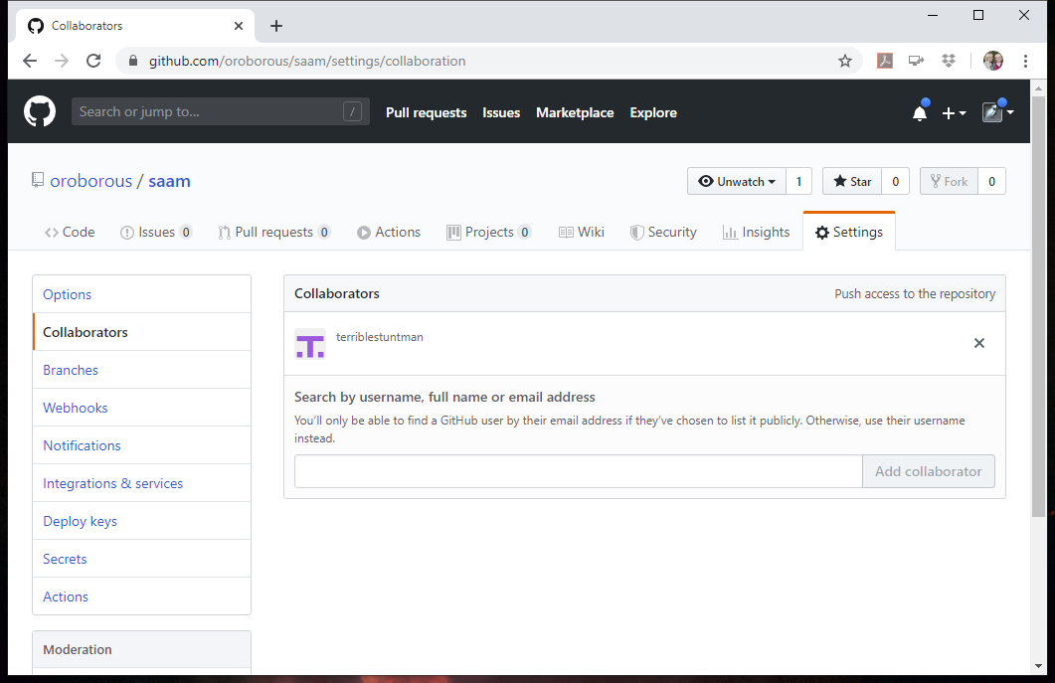
Add Collaborators
GitHub.com
Select repository
Settings
Collaborators
Enter usernames

Slide 3
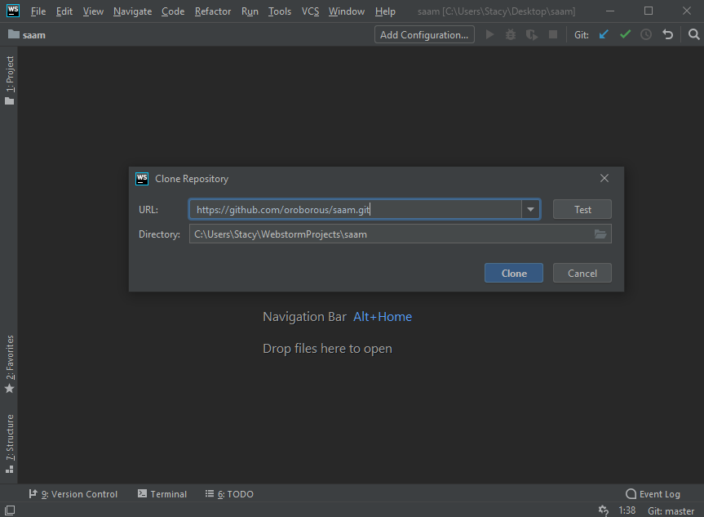
Clone Using IDE
WebStorm or IntelliJ
VCS > Checkout from Version Control > Git
Can also use Fork to clone

Slide 4
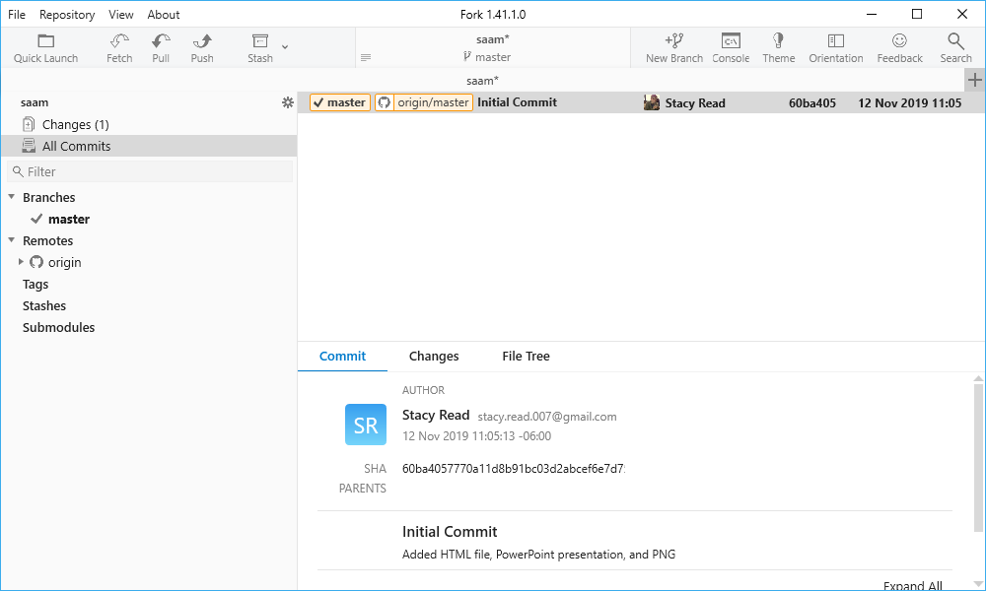
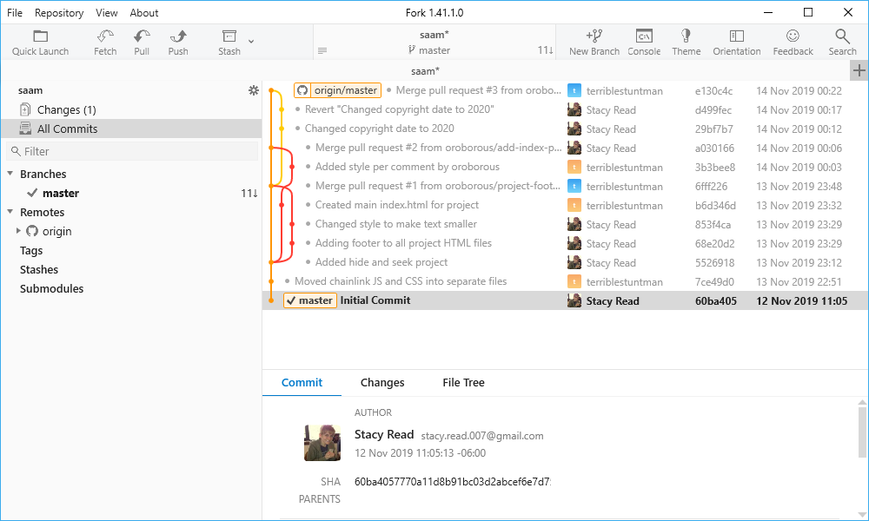
Fetch

Slide 5
Pull
Fetch + merge
Will incorporate others' changes

Slide 6
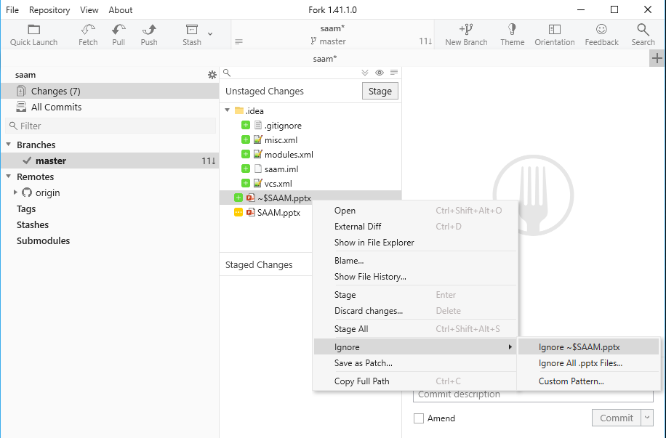
Ignoring Files
Don't track in version control
Ignore compiled code directories
classes
out
.gitignore on top level of repo

