Slide 1
GitHub Collaboration
Intro to Branching

Slide 2
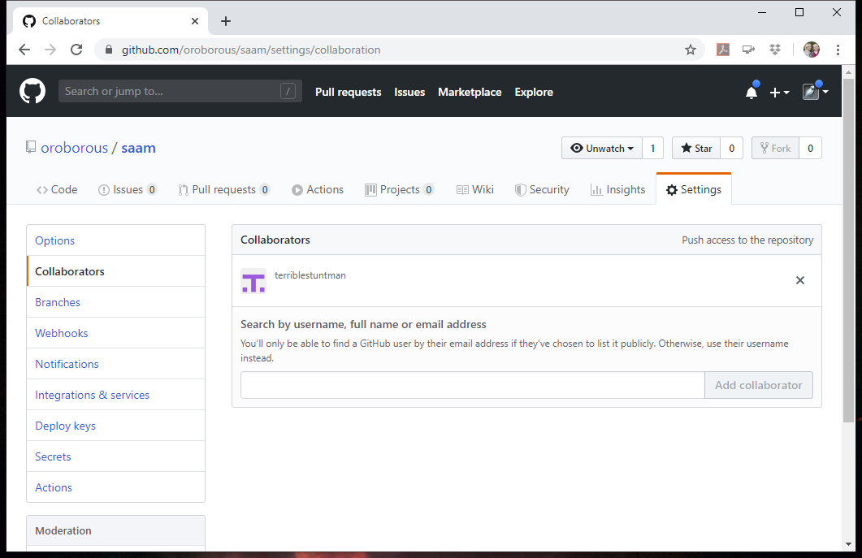
Add Collaborators
GitHub.com
Select repository
Settings
Collaborators
Enter usernames

Slide 3
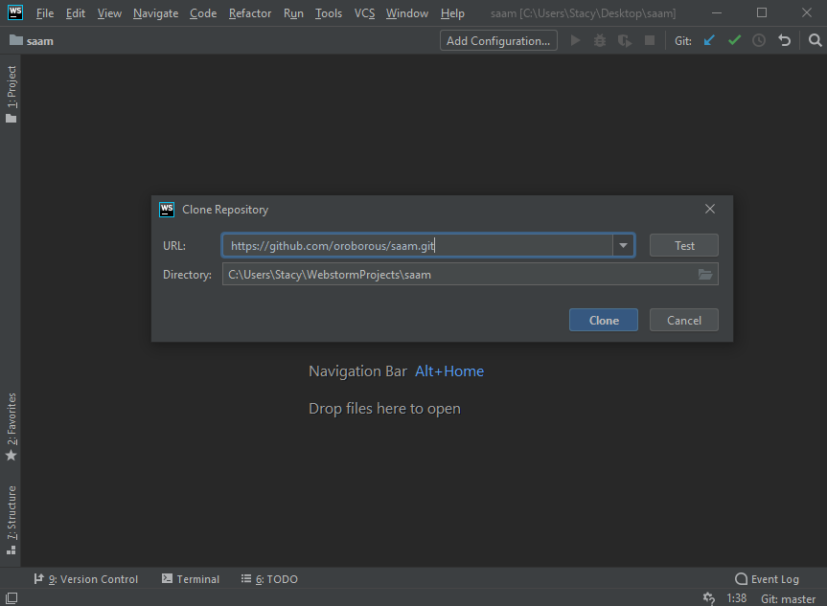
Clone Using IDE
WebStorm or IntelliJ
VCS > Checkout from Version Control > Git
Can also use Fork to clone

Slide 4
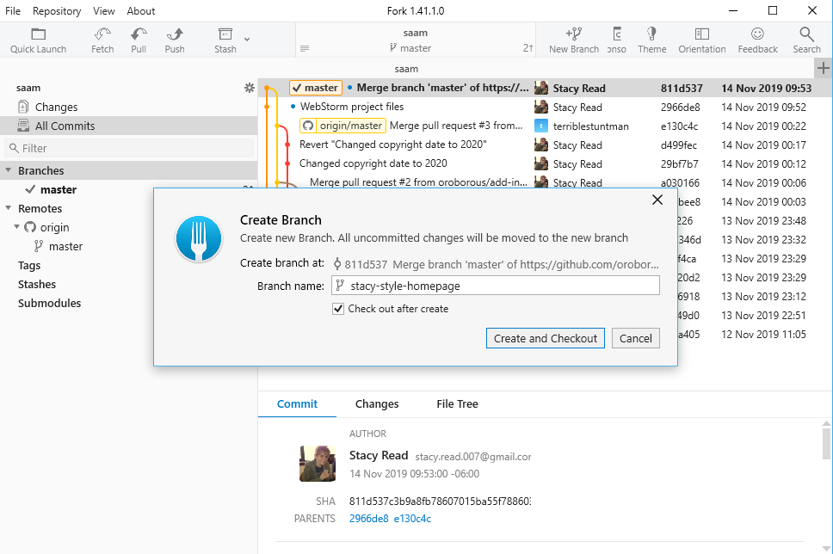
Start Feature Branch
Uncommitted changes moved to new branch
Check out
Work in branch

Slide 5
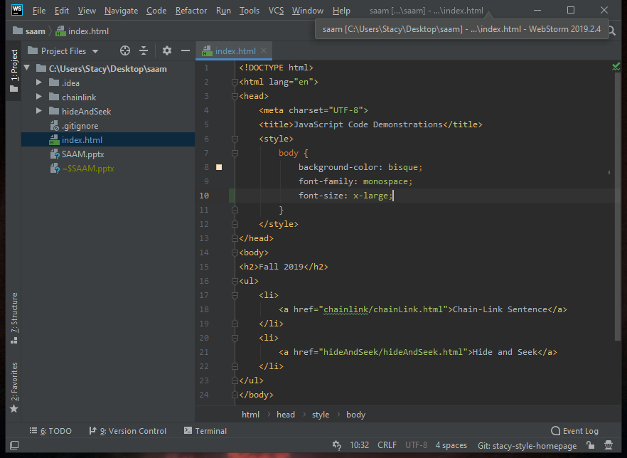
Make Changes
Make your changes
Still working locally

Slide 6
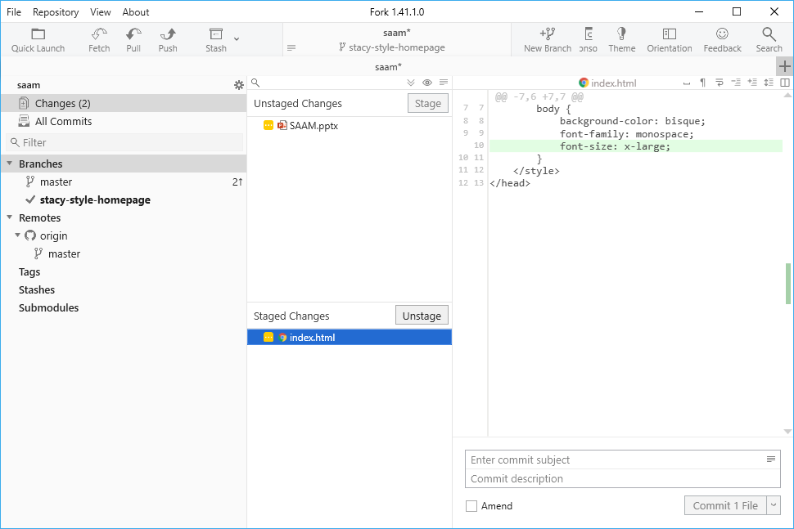
Unstaged vs. Staged
Stage the changes related to your feature
Staged changes will be included in next commit
Only committed changes get pushed to remote

Slide 7
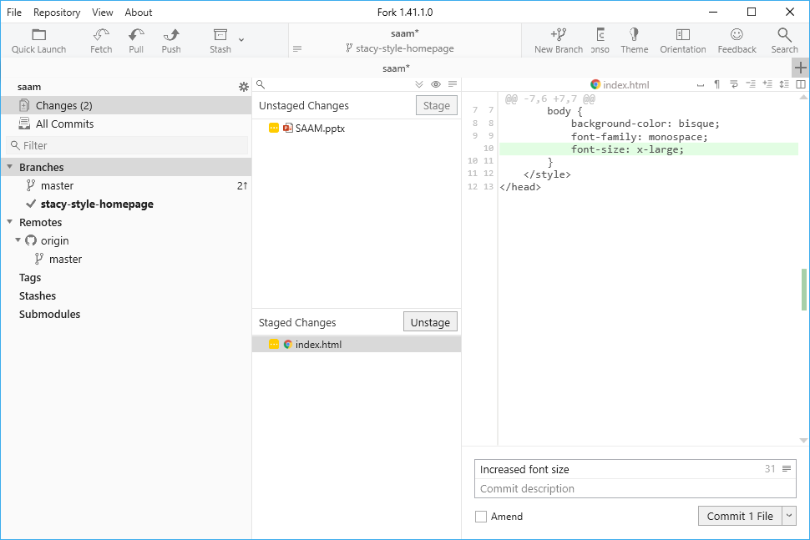
Commit Changes
When you're happy with your changes
Still working locally!
Don't be afraid to commit often

Slide 8
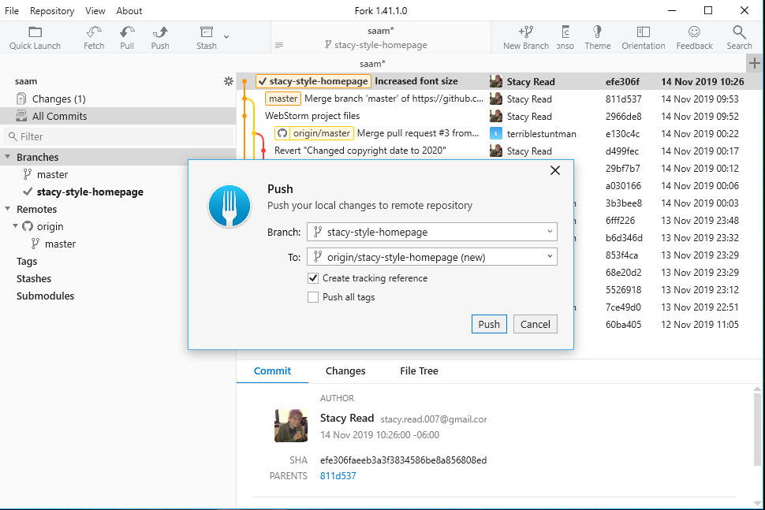
Push
Upload changes to remote (GitHub)
Don't push directly to master branch!
Create a new branch on GitHub

Slide 9
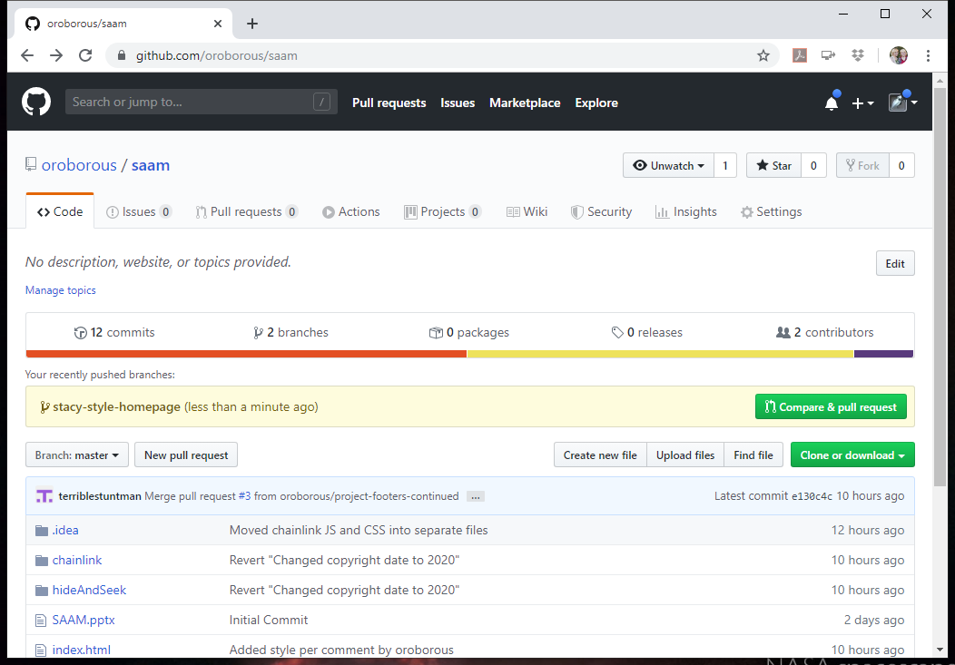
Create Pull Request
Request to merge your changes into master branch
From repo main page
Compare & pull request
From branches page
New pull request

Slide 10
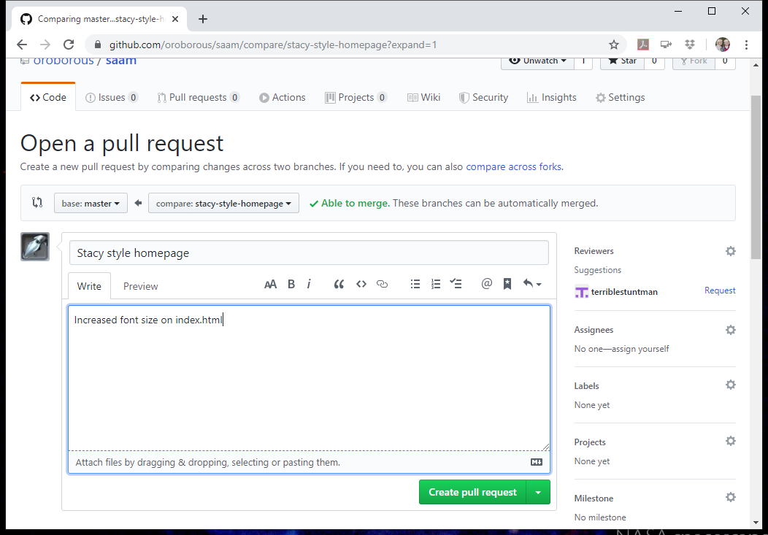
Create Pull Request
Describe your changes
Create pull request

Slide 11
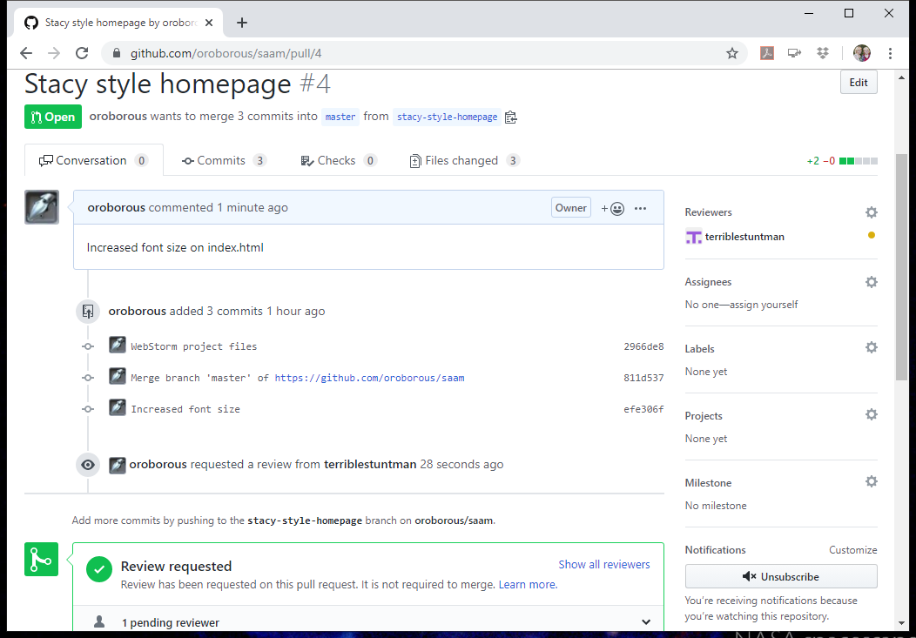
Request Review (Optional)
Ask team member(s) to review your changes

Slide 12
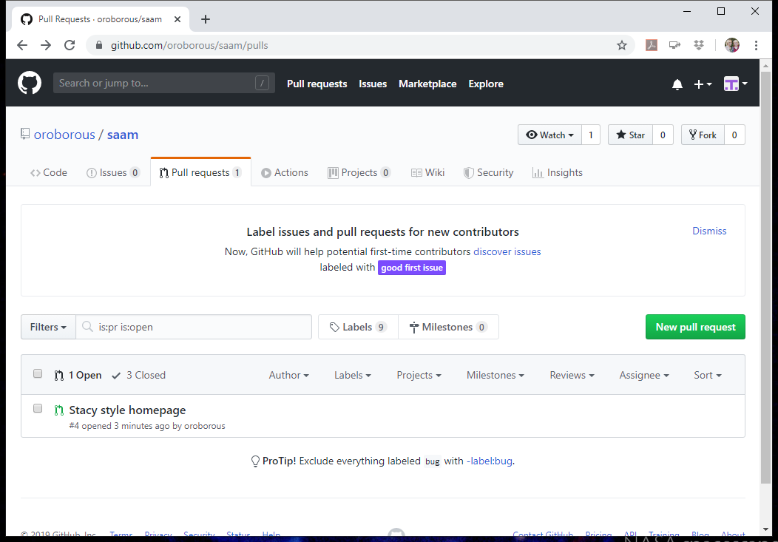
Reviewer: Access Pull Requests
On GitHub
Pull requests tab

Slide 13
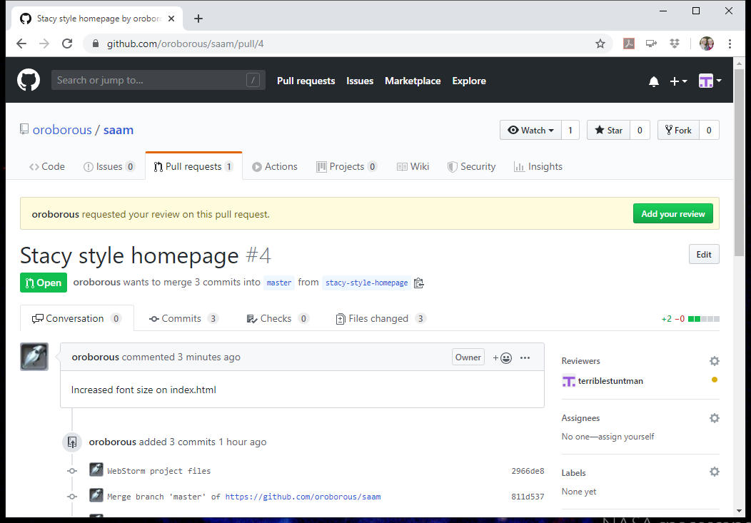
Reviewer: Add Review
Select to add your review

Slide 14
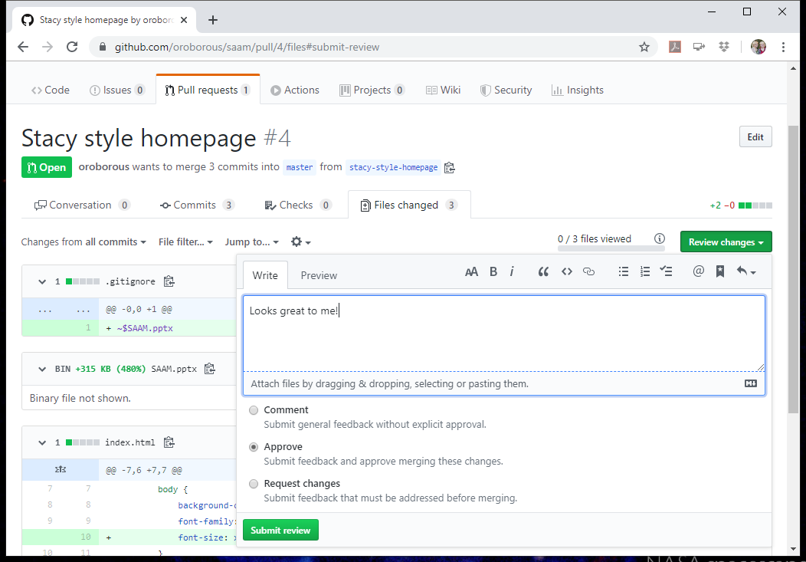
Reviewer: Comment or Approve
Comment if more work needs to be done
Approve if you think changes should merge with master

Slide 15
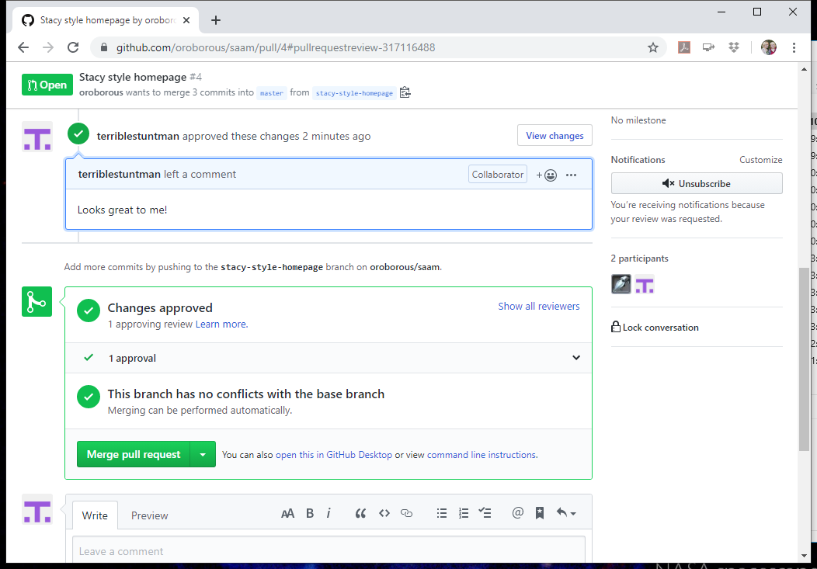
Master Committer: Merge
Recommended only one person merge branches into master
On the branch page, select Merge pull request
Confirm the merge

Slide 16
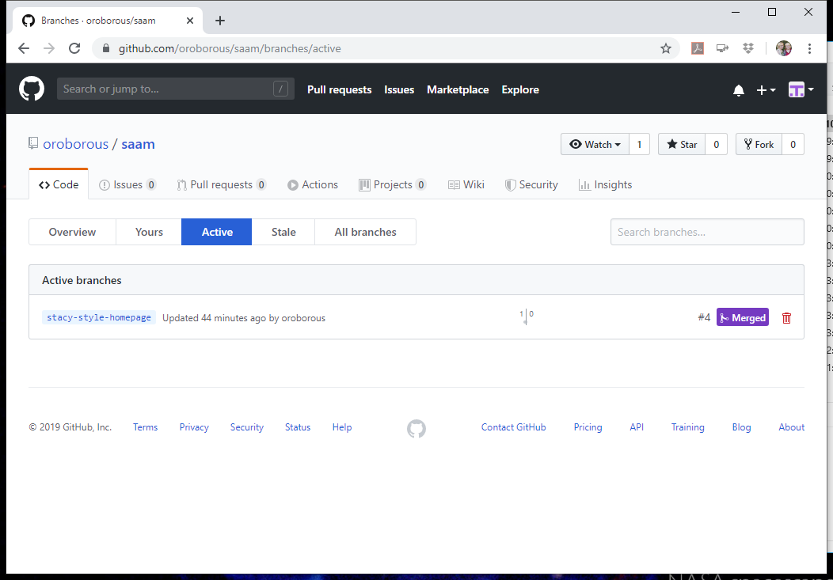
Master Committer: Delete Branch
Completed feature branches should be deleted
After merging pull request
From Branches page
Only deletes the remote branch!
Team member must cleanup local branch

Slide 17
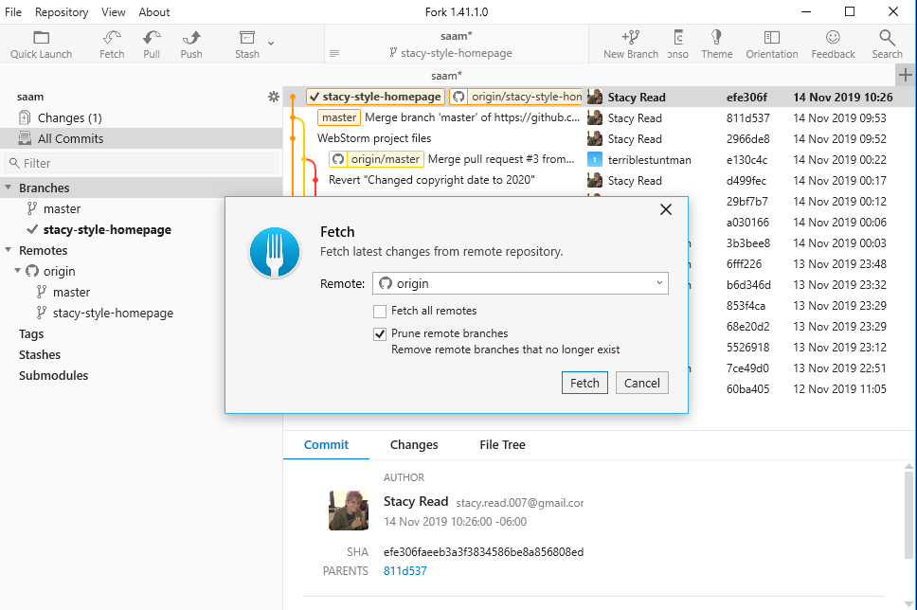
Fetch
See what other team members are doing
Doesn't change your working directory
Prune remote branches

Slide 18
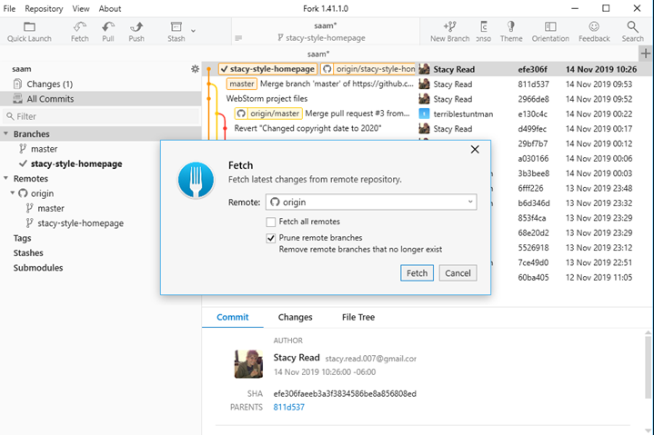
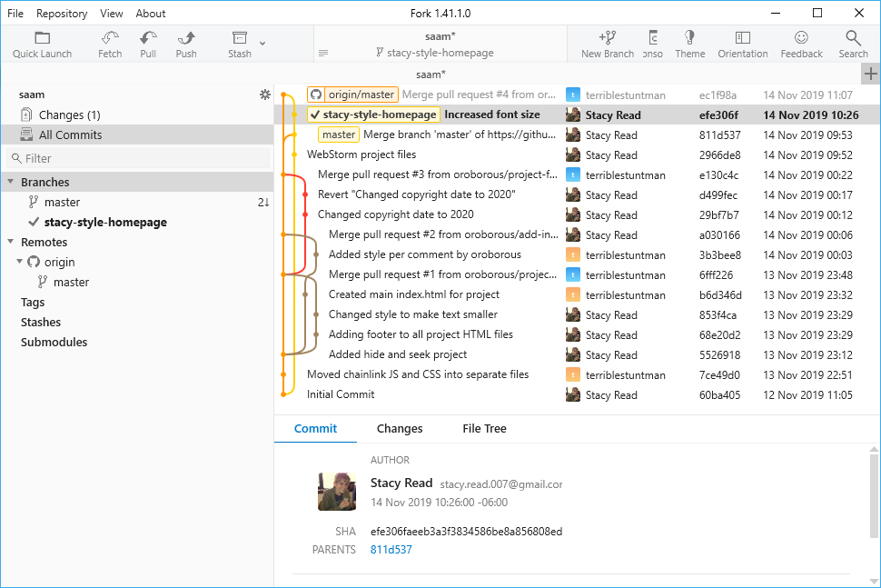
Prune Remote Branches
Before Fetch
After Fetch

Slide 19
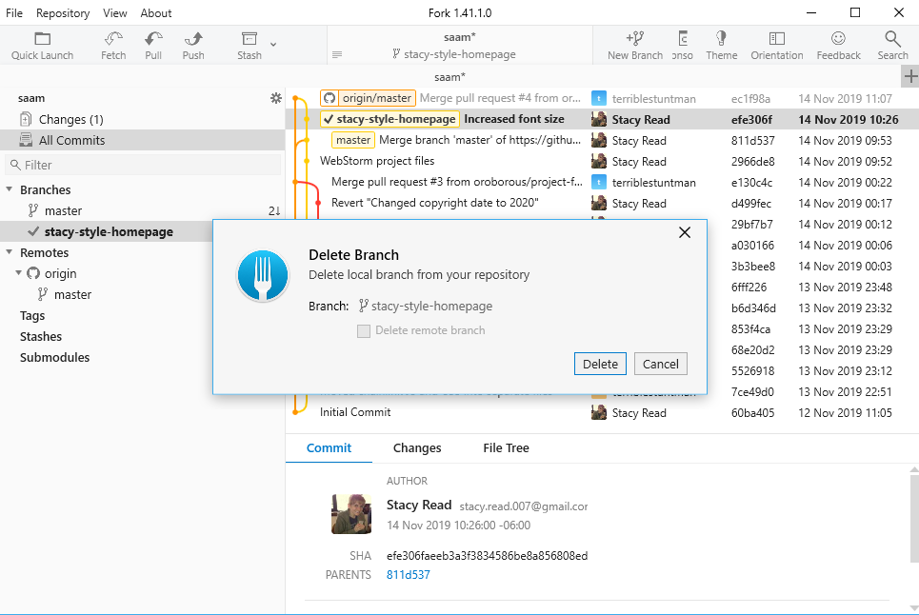
Delete Local Branch
Checkout master
Right click master > Checkout 'master'
Right click branch > Merge into 'master'
Right click branch > Delete

Slide 20
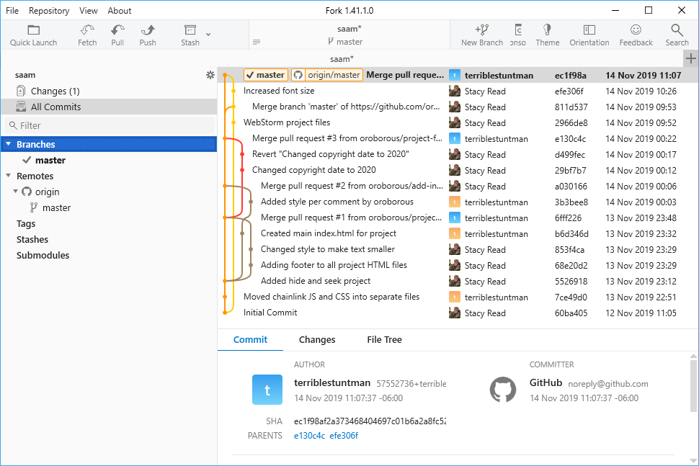
Pull
Fetch and merge
Will incorporate others' changes into your working directory
May need to resolve merge conflicts manually

Slide 21
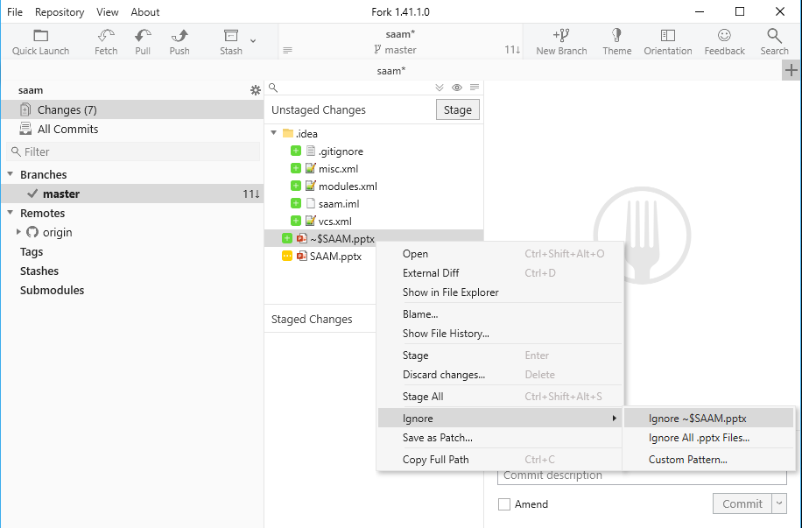
Ignoring Files
Don't track in version control
Ignore compiled code directories
classes
out
.gitignore on top level of repo

