Slide 1


아두이노 보드 매니저 활용
2019.07.12
최규남

Slide 2
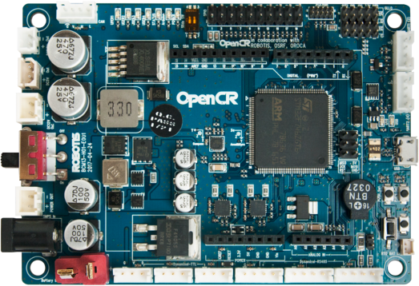
Items | Specifications
Microcontroller | STM32F746ZGT6 / 32-bit ARM Cortex®-M7 with FPU (216MHz, 462DMIPS) Reference Manual, Datasheet
Sensors | Gyroscope 3Axis, Accelerometer 3Axis, Magnetometer 3Axis (MPU9250)
Programmer | ARM Cortex 10pin JTAG/SWD connector USB Device Firmware Upgrade (DFU) Serial
Digital I/O | 32 pins (L 14, R 18) *Arduino connectivity 5Pin OLLO x 4 GPIO x 18 pins PWM x 6 I2C x 1 SPI x 1
Analog INPUT | ADC Channels (Max 12bit) x 6
Communication Ports | USB x 1 (Micro-B USB connector/USB 2.0/Host/Peripheral/OTG) TTL x 3 (B3B-EH-A / Dynamixel) RS485 x 3 (B4B-EH-A / Dynamixel) UART x 2 (20010WS-04) CAN x 1 (20010WS-04)
LEDs and buttons | LD2 (red/green) : USB communication User LED x 4 : LD3 (red), LD4 (green), LD5 (blue) User button x 2 Power LED : LD1 (red, 3.3 V power on) Reset button x 1 (for power reset of board) Power on/off switch x 1
Input Power Sources | 5 V (USB VBUS), 7-24 V (Battery or SMPS) Default battery : LI-PO 11.1V 1,800mAh 19.98Wh Default SMPS : 12V 4.5A External battery Port for RTC (Real Time Clock) (Molex 53047-0210)
Output Power Sources | *12V max 4.5A(SMW250-02) *5V max 4A(5267-02A), 3.3V@800mA(20010WS-02)
Dimensions | 105(W) X 75(D) mm
Weight | 60g
OpenCR 1.0

Slide 3
Items | Specifications
Microcontroller | ATmega328P
Sensors | Gyroscope 3Axis, Accelerometer 3Axis, Magnetometer 3Axis (MPU9250)
Programmer | 시리얼 다운로더
Digital I/O | 14 (of which 6 provide PWM output)
Analog INPUT | ADC Channels x 6
Communication Ports
LEDs and buttons | User LED x 4 Full Color LED x 1 User button x 2 Power LED : LD1 (red, 3.3 V power on) Reset button x 1 (for power reset of board)
Input Power Sources | 5 V
Etc | IR In/Out, SG90, DC Motor Driver, 초음파센서(?)
Dimensions | 105(W) X 75(D) mm
Weight
iTurtleBoard 1.0

Slide 4
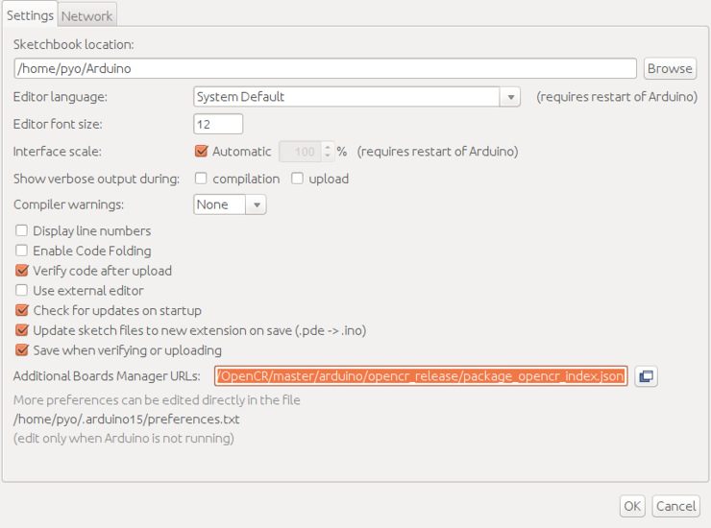
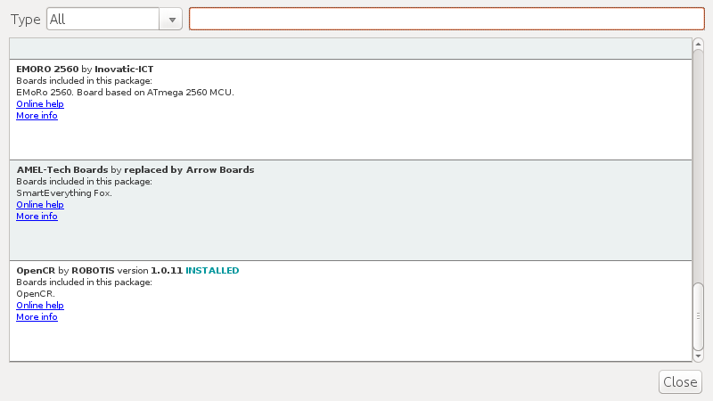
https://raw.githubusercontent.com/ROBOTIS-GIT/OpenCR/master/arduino/opencr_release/package_opencr_index.json

Slide 5
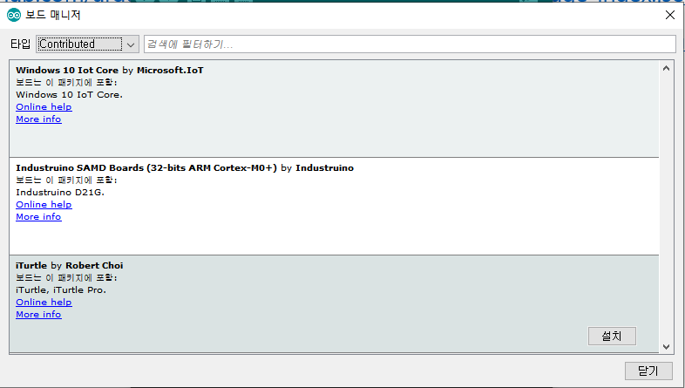
https://github.com/arduino/Arduino/wiki/Arduino-IDE-1.6.x-package_index.json-format-specification
https://raw.githubusercontent.com/orocapangyo/iTurtle/master/OpenCrArduino/package_opencrarduino_index.json

Slide 6
{
"packages": [
{
"name": "iTurtle",
"maintainer": "Robert Choi",
"websiteURL": "https://github.com/orocapangyo/iTurtle/OpenCrArduino",
"email": "robertchoimail@gmail.com",
"help": {
"online": "https://github.com/orocapangyo/iTurtle/OpenCrArduino"
},
"platforms": [
{
"name": "iTurtle",
"architecture": "avr",
"version": "1.0.0",
"category": "Contributed",
"help": {
"online": "https://github.com/orocapangyo/iTurtle/OpenCrArduino"
},
"url": "https://raw.githubusercontent.com/RobotCing/Cing/master/Software/Packages/RobotCing-4.0.0.zip",
"archiveFileName": "RobotCing-4.0.0.zip",
"checksum": "SHA-256:38675bea350e7c99c9af19653c80837f1fc290bb3e4013456076221f293638ec",
"size": "61272",
"boards": [
{"name": "iTurtle"},
{"name": "iTurtle Pro"}
],
"toolsDependencies": [
{
"packager": "arduino",
"name": "avr-gcc",
"version": "4.8.1-arduino5"
},
{
"packager": "arduino",
"name": "avrdude",
"version": "6.0.1-arduino5"
}
]
}
],
"tools":[]
}
]
}
윈도우 PS : Get-FileHash
Mac : shasum -a 256 filename

