Slide 1
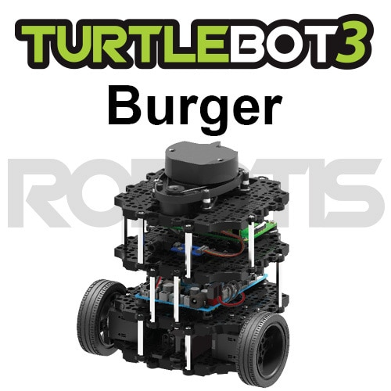
1부
PC Setup

Slide 2

PC Setup/Ubuntu
ROS1 Raspberry Pi 3B+
Jetson Nano does not support ROS Kinectic Kinetic : https://releases.ubuntu.com/16.04.7/
ROS2 Raspberry Pi 4 4G Humble : https://releases.ubuntu.com/22.04/

Slide 3
PC Setup/ROS Install
ROS1
$ sudo apt-get update
$ sudo apt-get upgrade
$ wget https://raw.githubusercontent.com/ROBOTIS-GIT/robotis_tools/master/install_ros_kinetic.sh
$ 755 ./install_ros_kinetic.sh
$ bash ./install_ros_kinetic.sh
ROS2

Slide 4
PC Setup/ROS Dependent Package
ROS1
$ sudo apt-get install ros-kinetic-joy ros-kinetic-teleop-twist-joy \
ros-kinetic-teleop-twist-keyboard ros-kinetic-laser-proc \
ros-kinetic-rgbd-launch ros-kinetic-depthimage-to-laserscan \
ros-kinetic-rosserial-arduino ros-kinetic-rosserial-python \
ros-kinetic-rosserial-server ros-kinetic-rosserial-client \
ros-kinetic-rosserial-msgs ros-kinetic-amcl ros-kinetic-map-server \
ros-kinetic-move-base ros-kinetic-urdf ros-kinetic-xacro \
ros-kinetic-compressed-image-transport ros-kinetic-rqt* \
ros-kinetic-gmapping ros-kinetic-navigation ros-kinetic-interactive-markers
ROS2
$ sudo apt ros-humble-gazebo-*
$ sudo apt ros-humble-cartographer
$ sudo apt ros-humble-cartographer-ros
$ sudo apt ros-humble-navigation2
$ sudo apt ros-humble-nav2-bringup

Slide 5
PC Setup/Turtlebot Package
ROS1
$ sudo apt-get ros-kinetic-dynamixel-sdk
$ sudo apt-get ros-kinetic-turtlebot3-msgs
$ sudo apt-get ros-kinetic-turtlebot3
ROS2
$ source ~/.bashrc
$ sudo apt ros-humble-dynamixel-sdk
$ sudo apt ros-humble-turtlebot3-msgs
$ sudo apt ros-humble-turtlebot3

Slide 6
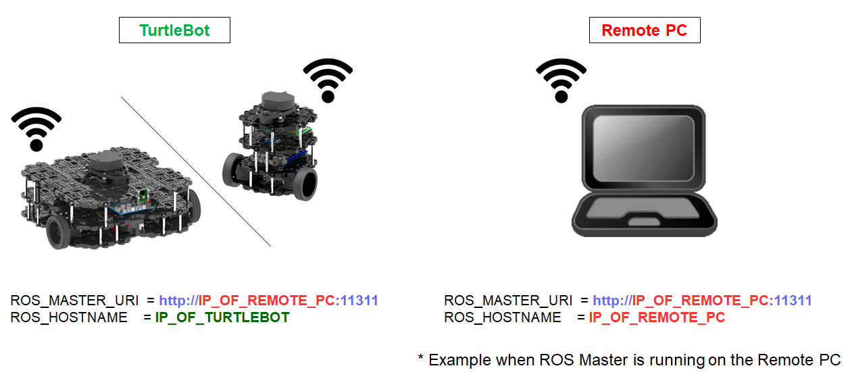
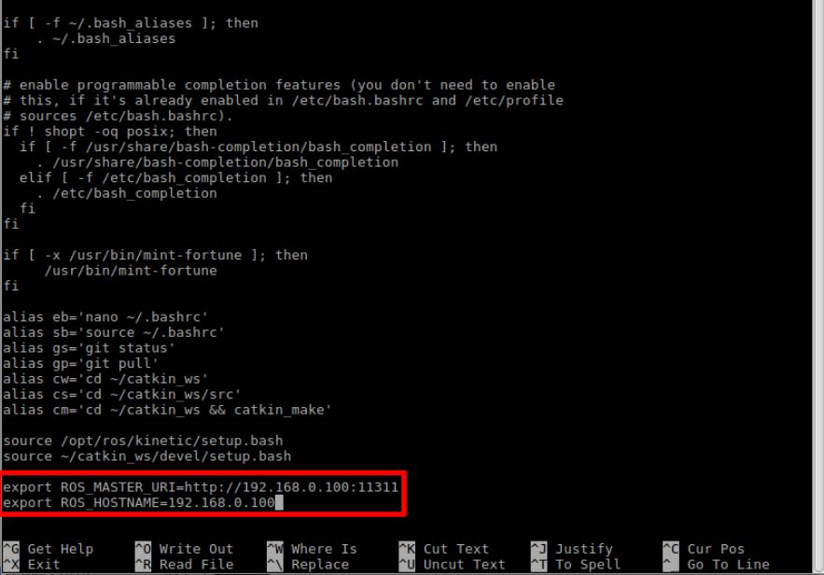
PC Setup/Environment Configuration
ROS1
$ echo "export TURTLEBOT3_MODEL=burger" >> ~/.bashrc

Slide 7
PC Setup/Environment Configuration
ROS2
$ echo 'export ROS_DOMAIN_ID=30 #TURTLEBOT3' >> ~/.bashrc
$ source ~/.bashrc

