Slide 1
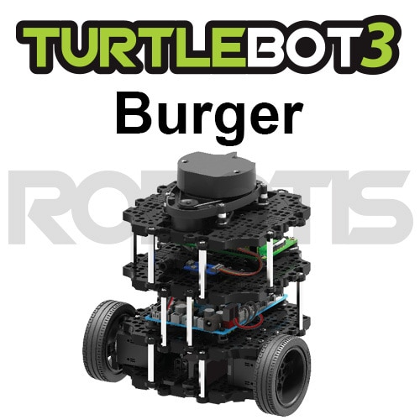
1부
SBC Setup

Slide 2

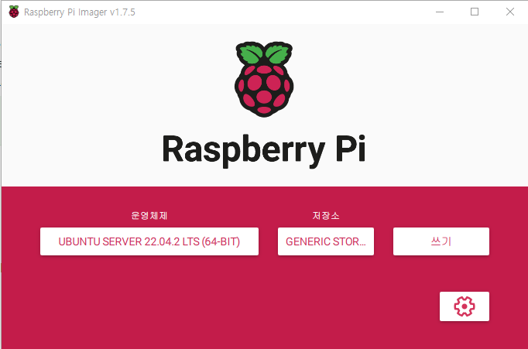
SBC Setup/Image Setup
ROS1 Raspberry Pi 3B+
https://www.robotis.com/service/download.php?no=1738 https://www.raspberrypi.com/software/ Raspberry Pi Imager sudo apt install rpi-imager
ROS2 Raspberry Pi 4 4G
CHOOSE OS > Other general-purpose OS > Ubuntu > Ubuntu Server 22.04.2 LTS(64-bit)

Slide 3
ROS1 / Raspberry Pi Setup
Find IP Address on Raspberry
$ ifconfig
- PC
$ ssh pi@192.168.X.X // default password : turtlebot $ sudo apt-get install ntpdate
$ sudo ntpdate ntp.ubuntu.com
$ sudo raspi-config
// Advanced Options > Expand Filesystem $ nano ~/.bashrc
export ROS_MASTER_URI=http://{IP_ADDRESS_OF_REMOTE_PC}:11311
export ROS_HOSTNAME={IP_ADDRESS_OF_RASPBERRY_PI_3}
// save
$ source ~/.bashrc

Slide 4
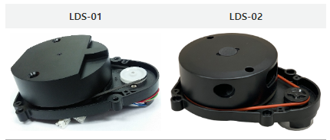
ROS1 & ROS2 / LDS Setup
LDS-02 Setup(no need for ROS2)
$ sudo apt update
$ sudo apt install libudev-dev
$ cd ~/catkin_ws/src
$ git clone -b develop https://github.com/ROBOTIS-GIT/ld08_driver.git
$ cd ~/catkin_ws/src/turtlebot3 && git pull
$ rm -r turtlebot3_description/ turtlebot3_teleop/ turtlebot3_navigation/ turtlebot3_slam/ turtlebot3_example/
$ cd ~/catkin_ws && catkin_make
$ echo ‘export LDS_MODEL=LDS-02’ >> ~/.bashrc
$ source ~/.bashrc

Slide 5
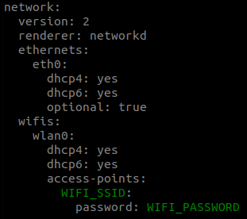
ROS2/Ubuntu Setup for Raspberry Pi
Login(ubuntu / ubuntu)
Wifi Setup
$ sudo nano /writable/etc/netplan/50-cloud-init.yaml

Slide 6
ROS2/Ubuntu Setup for Raspberry Pi
Automatic Update setting
$ sudo nano /etc/apt/apt.conf.d/20auto-upgrades
APT::Periodic::Update-Package-Lists "0";
APT::Periodic::Unattended-Upgrade "0";
// save
$ systemctl mask systemd-networkd-wait-online.service
$ sudo systemctl mask sleep.target suspend.target hibernate.target hybrid-sleep.target
$ reboot

Slide 7
ROS2/Ubuntu Setup for Raspberry Pi
ROS2 Install
$ sudo apt-get update
$ sudo apt-get upgrade
$ wget https://raw.githubusercontent.com/orocapangyo/turtlebot/blob/main/Tutorial/02-Week/robert/install_ros2_humble_rpi.sh
$ chmod 755 ./install_ros2_humble_rpi.sh
$ bash ./install_ros2_humble_rpi.sh

Slide 8
ROS2/Ubuntu Setup for Raspberry Pi
Install ROS2 Package
$ sudo apt install python3-argcomplete python3-colcon-common-extensions libboost-system-dev build-essential
$ sudo apt install ros-humble-hls-lfcd-lds-driver
$ sudo apt install ros-humble-turtlebot3-msgs
$ sudo apt install ros-humble-dynamixel-sdk
$ sudo apt install libudev-dev
$ mkdir -p ~/turtlebot3_ws/src && cd ~/turtlebot3_ws/src
$ git clone -b humble-devel https://github.com/ROBOTIS-GIT/turtlebot3.git
$ git clone -b ros2-devel https://github.com/ROBOTIS-GIT/ld08_driver.git
$ cd ~/turtlebot3_ws/src/turtlebot3
$ rm -r turtlebot3_cartographer turtlebot3_navigation2
$ cd ~/turtlebot3_ws/
$ echo 'source /opt/ros/humble/setup.bash' >> ~/.bashrc
$ source ~/.bashrc
$ colcon build --symlink-install --parallel-workers 1
$ echo 'source ~/turtlebot3_ws/install/setup.bash' >> ~/.bashrc
$ source ~/.bashrc

Slide 9
ROS2/Ubuntu Setup for Raspberry Pi
USB Port Setting for OpenCR
$ sudo cp `ros2 pkg prefix turtlebot3_bringup`/share/turtlebot3_bringup/script/99-turtlebot3-cdc.rules /etc/udev/rules.d/
$ sudo udevadm control --reload-rules
$ sudo udevadm trigger
ROS2 Domain ID Setting
$ echo 'export ROS_DOMAIN_ID=30 #TURTLEBOT3' >> ~/.bashrc
$ source ~/.bashrc

Slide 10
PC Setup/Turtlebot Package
ROS1
$ sudo apt-get ros-kinetic-dynamixel-sdk
$ sudo apt-get ros-kinetic-turtlebot3-msgs
$ sudo apt-get ros-kinetic-turtlebot3
ROS2
$ source ~/.bashrc
$ sudo apt ros-humble-dynamixel-sdk
$ sudo apt ros-humble-turtlebot3-msgs
$ sudo apt ros-humble-turtlebot3

Slide 11
PC Setup/ROS Dependent Package
ROS1
$ sudo apt-get install ros-kinetic-joy ros-kinetic-teleop-twist-joy \
ros-kinetic-teleop-twist-keyboard ros-kinetic-laser-proc \
ros-kinetic-rgbd-launch ros-kinetic-depthimage-to-laserscan \
ros-kinetic-rosserial-arduino ros-kinetic-rosserial-python \
ros-kinetic-rosserial-server ros-kinetic-rosserial-client \
ros-kinetic-rosserial-msgs ros-kinetic-amcl ros-kinetic-map-server \
ros-kinetic-move-base ros-kinetic-urdf ros-kinetic-xacro \
ros-kinetic-compressed-image-transport ros-kinetic-rqt* \
ros-kinetic-gmapping ros-kinetic-navigation ros-kinetic-interactive-markers
ROS2
$ sudo apt ros-humble-gazebo-*
$ sudo apt ros-humble-cartographer
$ sudo apt ros-humble-cartographer-ros
$ sudo apt ros-humble-navigation2
$ sudo apt ros-humble-nav2-bringup

Slide 12
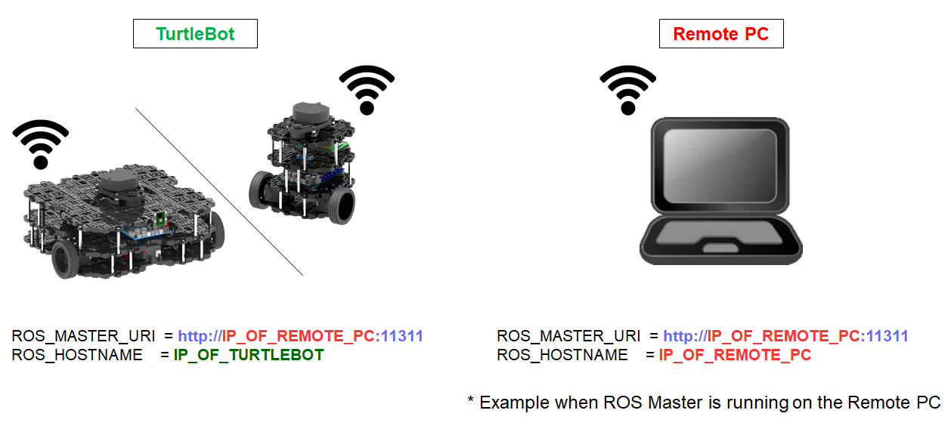
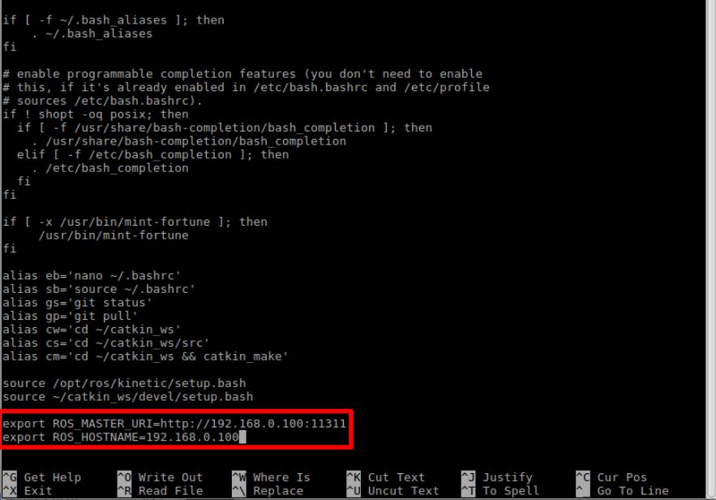
PC Setup/Environment Configuration
ROS1
$ echo "export TURTLEBOT3_MODEL=burger" >> ~/.bashrc

Slide 13
PC Setup/Environment Configuration
ROS2
$ echo 'export ROS_DOMAIN_ID=30 #TURTLEBOT3' >> ~/.bashrc
$ source ~/.bashrc

