Slide 1
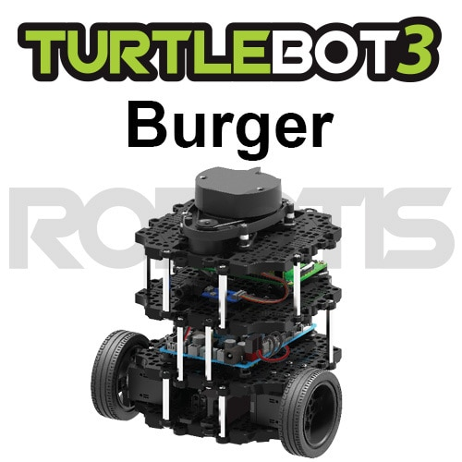
1부
OpenCR Setup

Slide 2

OpenCR Setup with ROS1
라즈베리파이에 OpenCR 펌웨어 다운로드에 필요한 패키지 설치
$ sudo dpkg --add-architecture armhf
$ sudo apt-get update
$ sudo apt-get install libc6:armhf
버거에 맞는 네임 설정 및 준비
$ export OPENCR_PORT=/dev/ttyACM0
$ export OPENCR_MODEL=burger
$ rm -rf ./opencr_update.tar.bz2
펌웨어 다운로드와 업로드
$ wget https://github.com/ROBOTIS-GIT/OpenCR-Binaries/raw/master/turtlebot3/ROS1/latest/opencr_update.tar.bz2
$ tar -xvf opencr_update.tar.bz2
$ cd ./opencr_update
$ ./update.sh $OPENCR_PORT $OPENCR_MODEL.opencr

Slide 3
OpenCR Setup with ROS2
라즈베리파이에 OpenCR 펌웨어 다운로드에 필요한 패키지 설치
$ sudo dpkg --add-architecture armhf
$ sudo apt update
$ sudo apt install libc6:armhf
버거에 맞는 네임 설정 및 준비
$ export OPENCR_PORT=/dev/ttyACM0
$ export OPENCR_MODEL=burger
$ rm -rf ./opencr_update.tar.bz2
펌웨어 다운로드와 업로드
$ wget https://github.com/ROBOTIS-GIT/OpenCR-Binaries/raw/master/turtlebot3/ROS2/latest/opencr_update.tar.bz2
$ tar -xvf opencr_update.tar.bz2
$ cd ./opencr_update
$ ./update.sh $OPENCR_PORT $OPENCR_MODEL.opencr

Slide 4
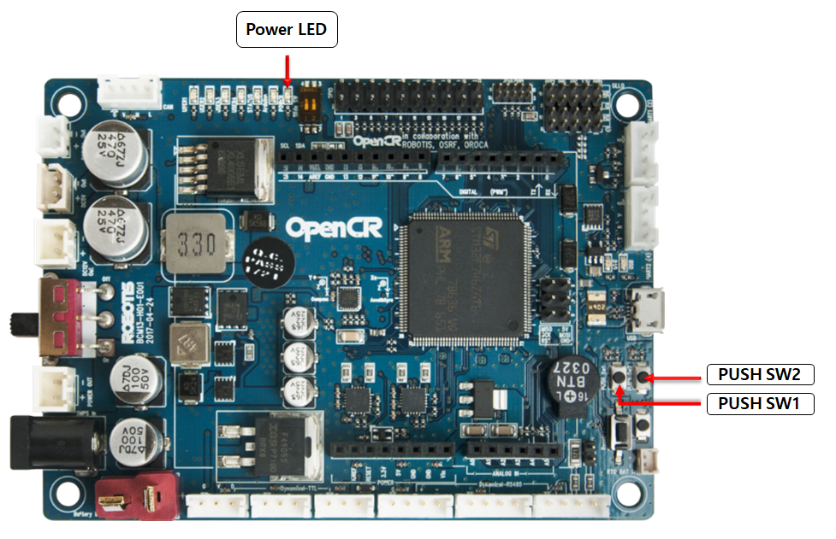
OpenCR Test with ROS1 & ROS2
전원을 공급하면, Power LED가 점등 된다.
SW1를 누르면, 30센치 앞으로 전지
SW2를 누르면, 180도 회전

Slide 5
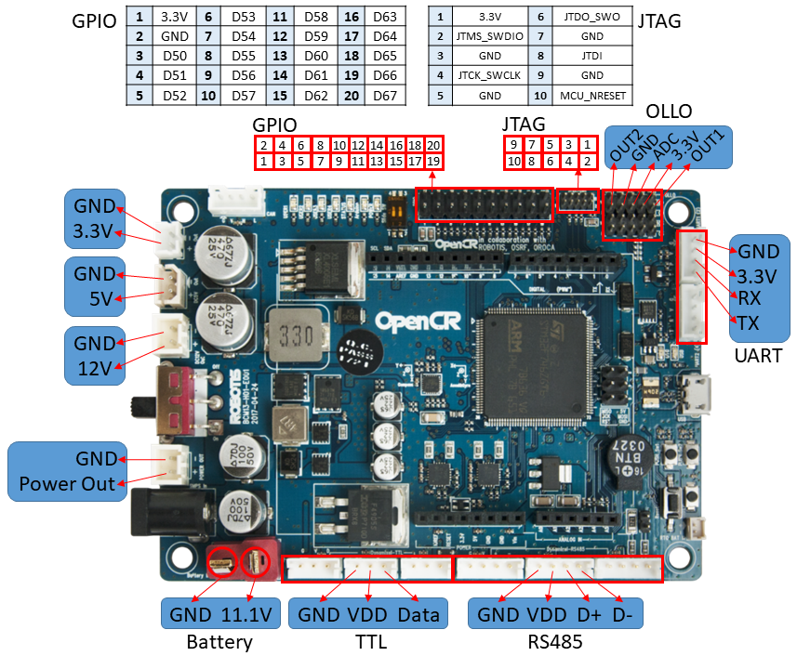
OpenCR Test with ROS1 & ROS2
Pin Map

Slide 6
Arduino IDE with ROS1 & ROS2
USB Port Settings
$ wget https://raw.githubusercontent.com/ROBOTIS-GIT/OpenCR/master/99-opencr-cdc.rules
$ sudo cp ./99-opencr-cdc.rules /etc/udev/rules.d/
$ sudo udevadm control --reload-rules
$ sudo udevadm trigger
Compiler Settings
// Since the OpenCR libraries is built for 32 bit platform, 64 bit PC needs the 32 bit compiler relevants for the ArduinoIDE.
$ sudo apt-get install libncurses5-dev:i386
Arduino IDE Install
$ cd ~/tools/arduino-1.6.4
$ ./install.sh
$ gedit ~/.bashrc
$ export PATH=$PATH:$HOME/tools/arduino-1.6.4
$ source ~/.bashrc

Slide 7
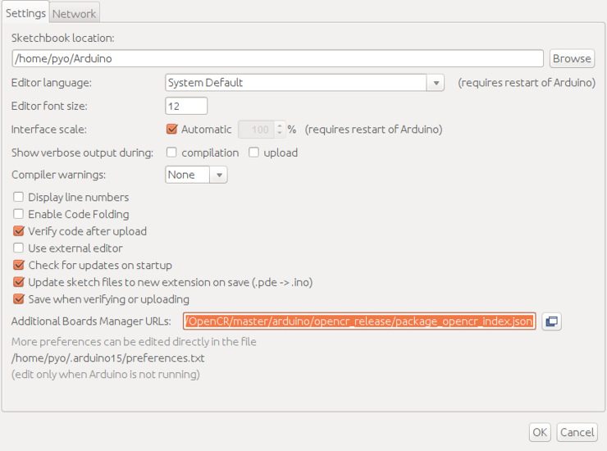
Arduino IDE with ROS1 & ROS2
Preferences
https://raw.githubusercontent.com/ROBOTIS-GIT/OpenCR/master/arduino/opencr_release/package_opencr_index.json

Slide 8
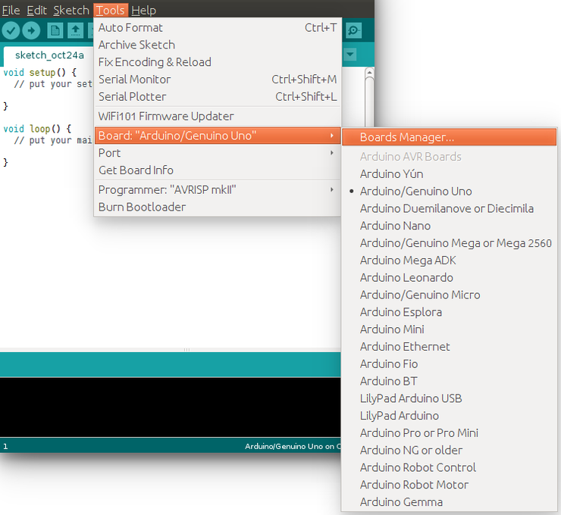
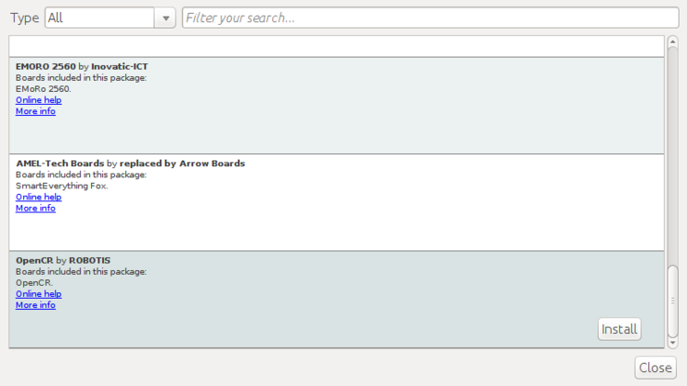
Arduino IDE with ROS1 & ROS2

Slide 9
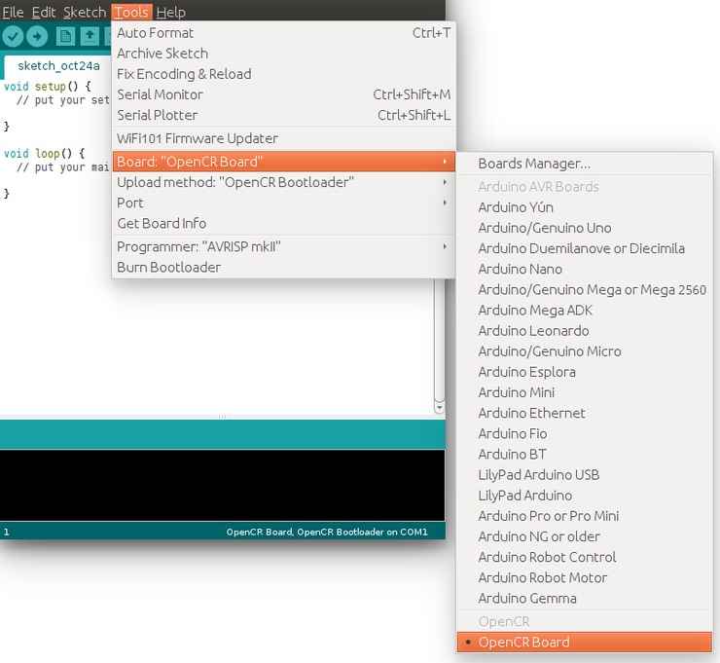
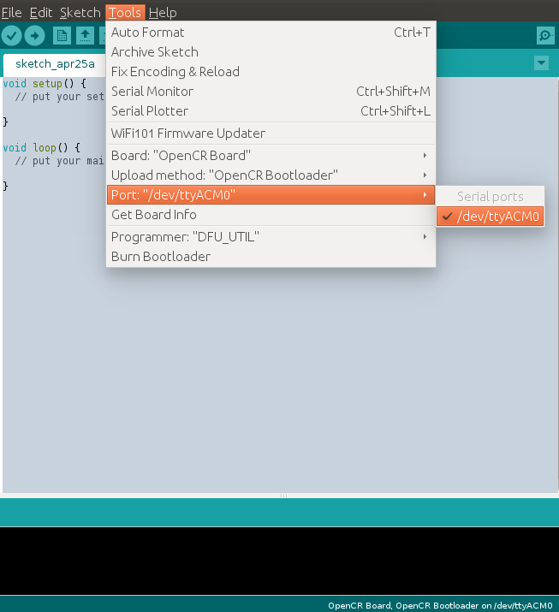
Arduino IDE with ROS1 & ROS2

