Slide 1
Orocos Real-Time Toolkit Software
Challenge
Orocos Solution
Real-time control
Run-time
(re-)configuration
Reusable components
Interactive application development
Distributed applications
Real-time execution
and data exchange
Scripting, XML and run-
time parameter setting
Standard component
interfaces
Online, browseable
component interface
CORBA framework for
networked components

Slide 2
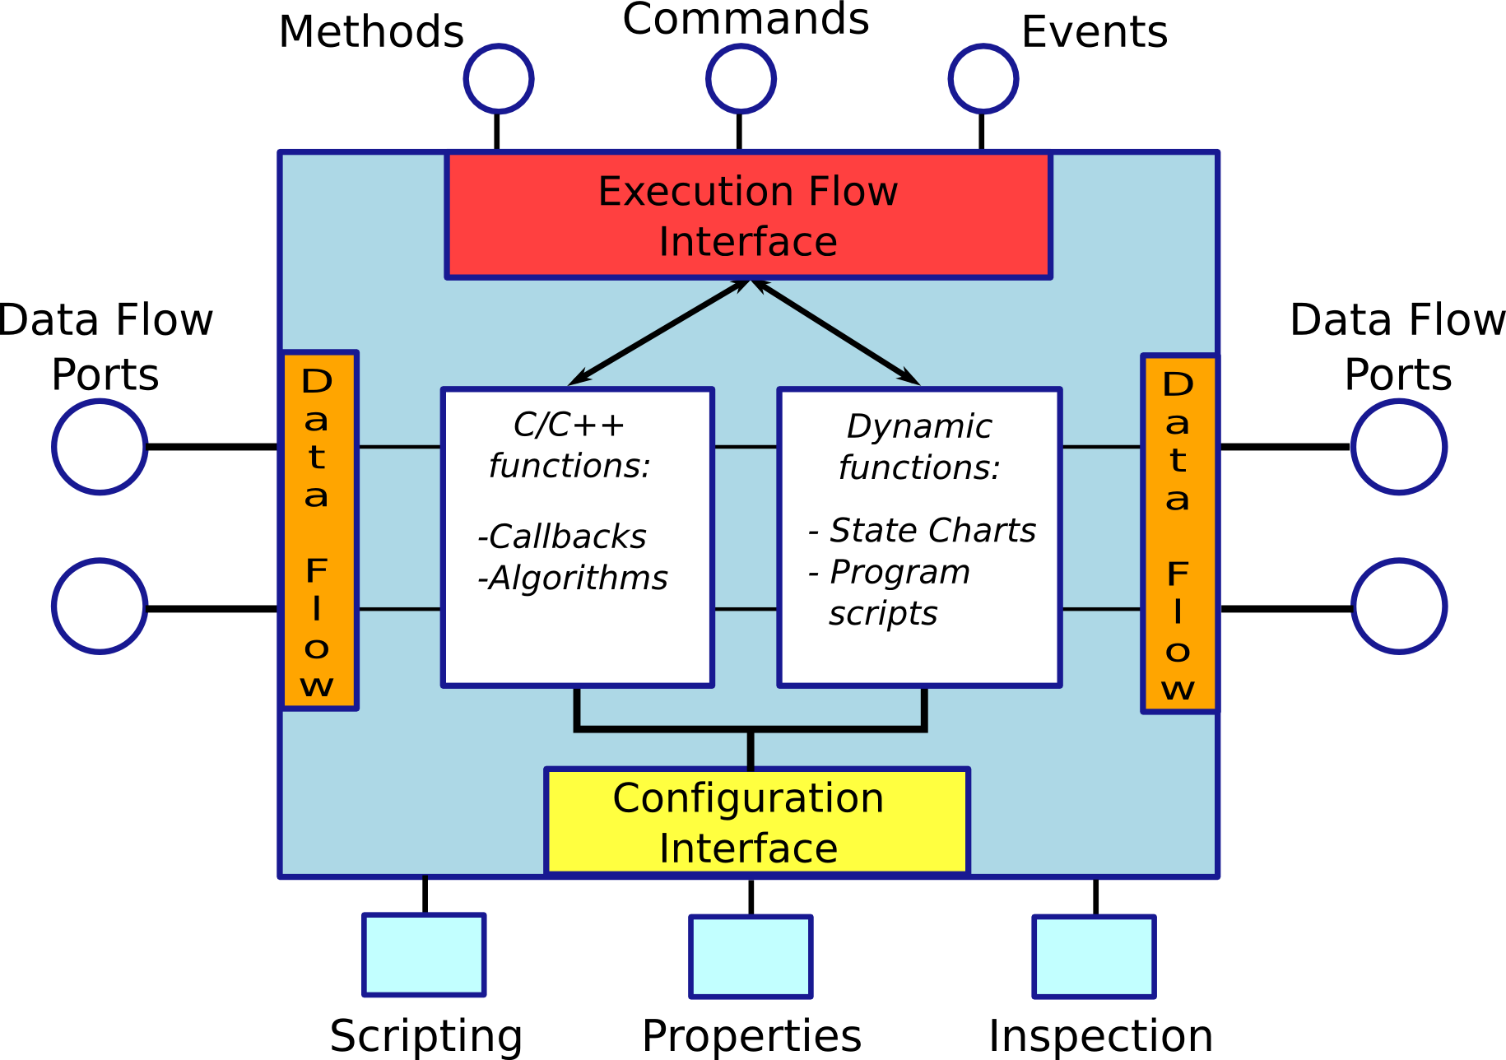
Technical Advantages
Lock-Free, thread-
safe, real-time
data exchange:
buffered and
unbuffered
Execution Flow:
control what
is executed
when and why
-Portable
-Extendable
-Open architecture
-Stable API
-Mature Code
-Hard real-time
Real-time scripting,
state charts
Interactive interface
console access
Run-time configurable

Slide 3
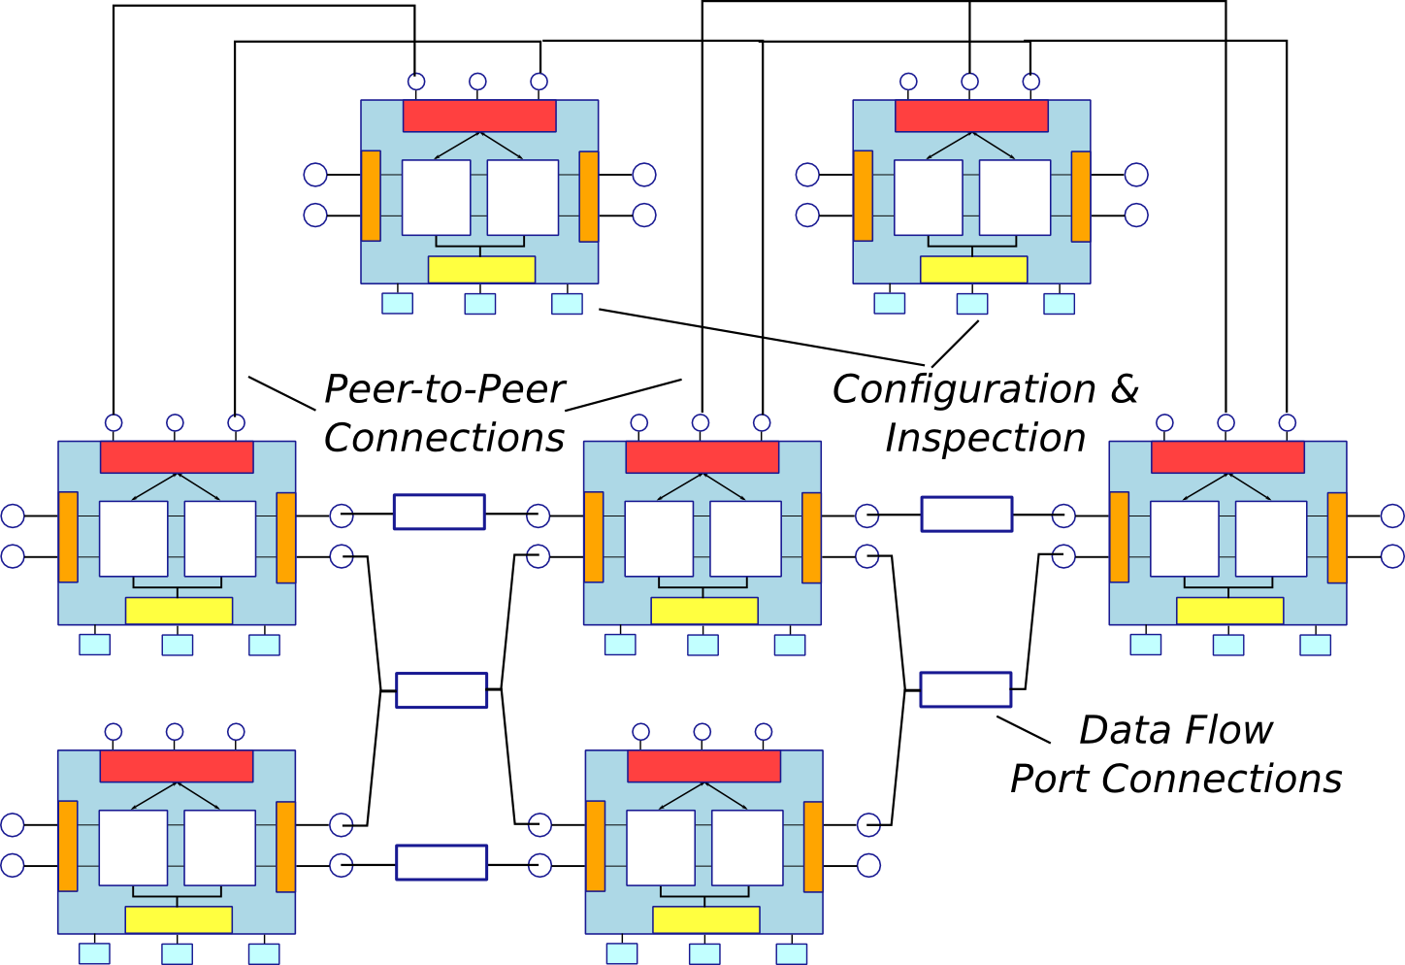
Application Layout

