Slide 1
One control plane, two stacks
LARGEST FREE BLOCK · FLOOR 2 GB
edge-1
3764 MB
edge-2
3844 MB
A BlackWatch-style DDoS scrubbing-fleet simulation, built twice:
classic AWS primitives, then Convex — same lifecycle, same demo, different substrate.
edge-3
1462 MB
▲ edge-3 fragmented → orchestrator will drain it
● push configs
● detect fragmentation
● drain safely
● resync
oroghene/neetcode-submissions · branch claude/convex-product-exploration-03f0yn
Educational simulation from public descriptions — no proprietary internals of any real system.

Slide 2
What a scrubbing-fleet control plane must do
The fleet sits inline with live attack traffic — every operation below has to be safe while packets are flowing through the hosts.
● Push mitigations
● Watch host health
Get ACL / rate-limit / filter configs onto every host, globally, against a 30-second-class load SLA. A slow push is unmitigated attack traffic.
Heartbeats plus dataplane memory: largest_free_block_bytes is the early warning — total free memory looks fine while fragmentation makes the next mitigation unloadable.
● Reboot safely
● Rotate datapath keys
Unhealthy ≠ safe to drain. Capacity gate per POP, one host per sweep, mutual exclusion between orchestrators — a host mid-mitigation is load-bearing.
Scheduled rotation with a grace window: new key active, old key pending retirement until every host confirms reload.
register → mitigate → fragment → drain → reboot → resync

Slide 3
Build 1 — the stack I know
blackwatch-sim-aws: every moving part is code or infrastructure you operate.
Go + gRPC + protobuf
Control plane: fleet registry, server-streaming config push, backlog replay for reconnecting hosts — ~300 lines that must themselves be operated.
agents × N (Python)
↕ gRPC streams + health
Python host agents
Load configs into a simulated dataplane, measure against the load SLA, report health incl. largest_free_block_bytes.
control plane (Go)
↕ ListFleet / DrainHost
DynamoDB lease locks
Auto-reboot mutual exclusion via conditional writes + fencing tokens — the subtlest code in the repo.
orchestrator (Python)
↕ lease locks · fencing
DKGR key rotation; retirement grace window enforced by DynamoDB TTL.
DynamoDB
Lambda
Lambda + EventBridge
CDK · CloudWatch · S3
CDK + CloudWatch
Three tables, schedules, S3 archive; Prometheus /metrics scraped into a CloudWatch dashboard; EMF from Lambda.
6 runtime pieces, 3 languages, 1 IaC layer

Slide 4
Build 2 — the same system on Convex
blackwatch-sim-convex: the platform's primitives absorb the infrastructure.
schema.ts
Tables are the infra: hosts, mitigations, rebootLog, datapathKeys, loadEvents. No CDK layer, no codegen.
agents × N (Node)
↕ subscriptions + mutations
mitigations.active
One reactive query IS the push pipeline. Agents subscribe; placing a mitigation pushes the new set to every host. Reconnect resync = the same code path.
Convex deployment
tables · functions · crons
(open-source backend)
orchestrator.sweep
The entire drain decision — classify, capacity-gate, pick victim, audit log — is one serializable transaction. The distributed lock has no equivalent to get wrong.
↕ live queries
reactive dashboard
crons + scheduler
Sweep every 15s; key rotation daily; retirement is a transactionally-scheduled function instead of a TTL.
Verified against the self-hosted
convex-local-backend binary
components
@convex-dev/rate-limiter guards the operator API — installed, not built.
1 runtime piece + agents, 1 language

Slide 5
What replaced what
Concern | AWS-style stack | Convex
Config push pipeline | gRPC streams + registry + backlog replay (~300 lines Go) | Agents subscribe to one query (~30 lines)
Reboot mutual exclusion | DynamoDB lease locks + fencing tokens | Gone — sweep is one serializable transaction (OCC)
Command channel | RebootCommand message on the stream | Status field write; agent's subscription delivers it
Orchestrator | Long-running daemon you deploy and babysit | 15-second cron over an internal mutation
Key retirement | Lambda + EventBridge + DynamoDB TTL | ctx.scheduler.runAfter(grace, retire)
Observability | Prometheus scrape + 2s-poll dashboard + CloudWatch | Metrics are queries; dashboard is subscribed, pushed
Audit trail | Second table + careful dual-writes | Inserted in the same transaction as the decision

Slide 6
Measured in the demo
Same lifecycle executed end-to-end on both builds, locally, no cloud account.
43 ms
~300 → ~30
mitigation propagation p50
lines of push pipeline
operator mutation → loaded on host. The classic pipeline is built to a 30-second-class SLA; the polling dashboard's freshness floor alone is 2s.
stream registry, backlog replay and reconnect handling collapse into one reactive query.
0
1
distributed locks
transaction per drain decision
the trickiest correctness code in the AWS build has no Convex equivalent to write, test, or get wrong.
classify → capacity gate → drain → audit log commit atomically. Two sweeps can't double-drain a POP.
[edge-3] loaded mit-001 action=drop cidr=203.0.113.0/24 propagation=43ms largest_free_block=3742MB

Slide 7
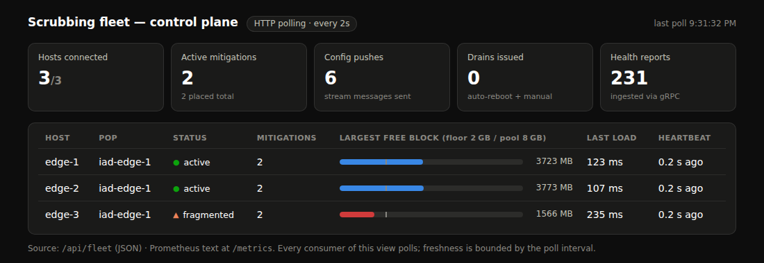
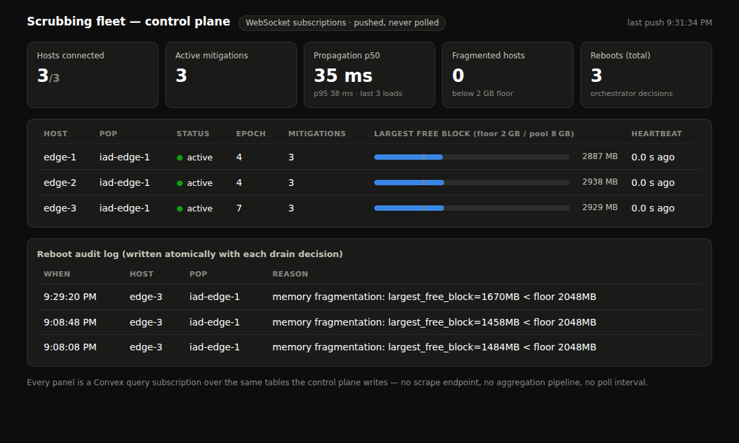
Two dashboards, one fleet
● HTTP polling · every 2s
● WebSocket · pushed, never polled
Go control plane serves /metrics (Prometheus), /api/fleet, and this
embedded dashboard. Freshness is bounded by the poll interval —
every consumer polls.
Metrics are queries over the tables the control plane already writes.
Three subscriptions drive the page; the reboot audit log commits
atomically with each drain decision. Propagation p50 tile: 35 ms.
Same fleet state, captured during the same lifecycle — edge-3 fragmented on the left, already drained + rebooted (epoch 4) on the right.

Slide 8
What Convex does not replace
The honest half of the comparison — this replaces the control and ops plane, not the system.
● The dataplane
Line-rate packet scrubbing is C/DPDK on metal. Nothing about a reactive backend touches kernel-bypass packet processing.
● The on-host agent
Something still runs on each appliance to load filters and measure memory — here it speaks Convex instead of gRPC.
● Fan-out at appliance-fleet scale
Thousands of hosts each holding subscriptions is exactly Convex's model — but 10k+ inline appliances would need real load validation.
● Partition semantics
The gRPC design degrades explicitly on network partition; here you inherit the Convex client's reconnect behavior.
Each of these is a question worth asking, not a conclusion →

Slide 9
Questions this demo earns
For the Convex team — each one comes straight from something the build surfaced.
Fan-out ceiling
Metrics at scale
Would you trust a query subscription as the config push path for tens of thousands of appliance hosts? Where does the reactor's fan-out actually cap out today?
My metrics queries rerun on every heartbeat write. Is “move it to the aggregate component” the intended pattern, or is incremental view maintenance coming to core?
The lock I deleted
Determinism's edge
The sweep relies on OCC serializability instead of a distributed lock. At what write-contention level does retry pressure make that trade stop being free?
You built a deterministic runtime to get retries and subscriptions. What workload have you seen where that constraint genuinely didn't fit?

Slide 10
Run it yourself
Both demos are one script; no cloud account needed for either.
blackwatch-sim-aws
blackwatch-sim-convex
pip install grpcio
make build
./scripts/demo.sh
# dashboard
open http://localhost:8061/dashboard
npm install
npx convex dev # “start without an account”
./scripts/demo.sh
# dashboard (URL printed by the script)
open http://localhost:8090
● repo: oroghene/neetcode-submissions
● branch: claude/convex-product-exploration-03f0yn
Interactive replay of both dashboards (no setup): claude.ai artifact “BlackWatch Sim — Dashboard Replay”

