Slide 1
Capstone Project— Final Report: U.S. Organization. Department of defense
Olga Romanovska
Colorado State University Global
MIS581: Capstone – Business Intelligence and Data Analytics
Dr. Justin Bateh
4/10/2022

Slide 2
content
Department of Defense: Company profile
DoD award data
Study overview
Data security and ethical concerns
Research hypothesis and literature review
Tools and techniques
DATA PREPROCESING
Findings
linear regression results
decision tree and random forest regressor
hypothesis testing
visualizations
recommendations

Slide 3

Department of Defense: Company profile
Figure 1
Department of Defense emblem
Department of Defense (DoD) was founded in 1947
3 million service members and civilians
4,800 sites in over 160 countries
Complex structure, main sub-agencies:
Army
Marine Corps
Air Force
Space Force
Coast Guard
National Guard
Services, products
Note. Image from https://www.dla.mil/About-DLA/Images/igphoto/2002310058/
Notes:
DoD was founded in 1947. As of today, it is the largest government agency in the United States, employing almost 3 million service members and civilians across 4,800 sites in over 160 countries (U.S. Department of Defense, n.d.).
Currently, the main components of the DoD are (U.S. Department of Defense, n.d.): Army, Marine Corps, Air Force, Space Force, Coast Guard, and National Guard.
Some other sub-agencies included in the structure of the DoD are Defense Advanced Research Projects Agency, Defense Intelligence Agency, Defense Threat Reduction Agency, Defense Logistics Agency, and others (USAGov, n.d.).
Reasons why DoD was chosen:
The largest federal buyer
Complex contracting practices (different sub-agencies have different rules)
Personal experience of work with DoD (from contractor’s standpoint)
Balances transparency and data security and privacy

Slide 4
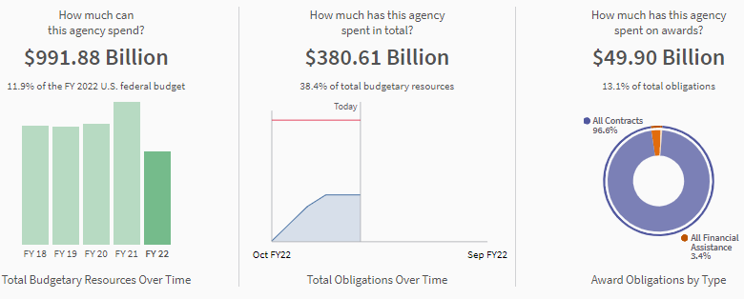
DoD award data
Figure 2
Department of Defence (DoD): Breakdown of spending for FY 2022
Federal procurement data:
https://www.usaspending.gov/
https://datalab.usaspending.gov/
https://fiscaldata.treasury.gov/
Original dataset description:
Contains details on awarded contracts
284 features
Award data for FY2021
Dataset limitations:
Large number of categorical variables
No quantitative data about awardees (company size, revenue)
No information about competition
Note. Adapted from USAspending.gov. (n.d.). https://www.usaspending.gov/
Notes:
DoD performs all its acquisitions using standard federal procurement procedures, which allows the agency to acquire goods and services at the lowest acceptable cost (Harvey, 2019) while maintaining transparent and open competition among qualifying offerors. To increase transparency of government spending, a lot of data on procurement operations is publicly available.
USASpending.gov compiles data from multiple sources (U.S. Department of State, n.d.): Central Accounting Reporting System, Government-wide Treasury Account Symbol Adjusted Trial Balance System, Census data, North American Industry Classification System, and Product Service Codes databases. This consolidated database integrates several sources as a part of the effort to establish a data-centric culture in the federal government, and to ensure transparency in government spending per the Digital Accountability and Transparency Act of 2014 (U.S. Department of Treasury, 2018).
The dataset chosen for the capstone project contains historic data on all contracts awarded by the DoD for fiscal year 2021. The award dataset from USASpending.gov contains information about every prime and subcontracted contract that the agency awarded, including the attributes and descriptions of each award and its recipient. Additionally, the dataset contains data about the amount of funding per contract, dates, and location of performance, and information about the sub-agency responsible for managing the contract.
The limitations of this study are linked to the limitation of the data that is made publicly available by DoD. The federal agency does not disclose any information on other companies that responded to the solicitations, so the DoD dataset contains only the winners. This limits number of tools that can be used (for example, limited use for classification). This also makes an in-depth analysis of competition on each contract impossible.

Slide 5
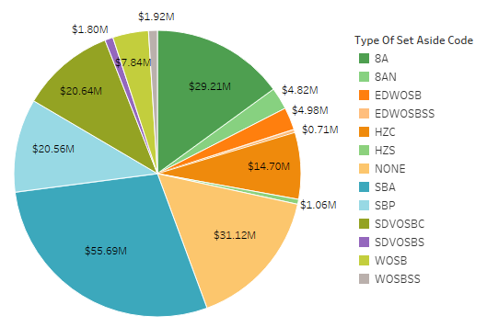
Study overview
Figure 3
Percentage of awards competed: by federal agency
Challenges of small business in federal procurement
SBA fair opportunity program for small and disadvantaged businesses:
8(a) certified
HUBZone
Women-owned
Service-disabled veteran-owned
Ways to qualify for set-aside contracts:
Get certified
Form joint venture with qualifying company
Study objectives:
Provide tools for small businesses
Seasonal trends in DoD spending
Note. Pie chart created in Tableau Public. Average of Award Value. Color shows details about type of set-aside code. Size shows sum of Award Value. The marks are labeled by average of Award Value. The view is filtered on Type of Set Aside Code, which keeps 13 of 19 members.
Notes:
Small businesses face even more challenges than large corporations in their attempts to find defense contracts they can potentially win. United States Government Accountability Office (2021) found that in addition to regular difficulties in dealing with DoD, small businesses are also more likely to experience a competitive award process than large contractors. Schilling et al. (2017) identified 26 potential barriers related to the awarding process, contract requirements, and contract execution, that can prevent small businesses from doing business with DoD. For this reason, DoD is losing contractors to industry. Despite increased federal funding, the opportunities did not seem to attract more competition among small businesses since 2006 (Carril & Duggan, 2020).
To assist small businesses, the Small Business Administration (SBA) created designated contracting programs for qualifying small and disadvantaged businesses. Federal agencies set-aside some of their procurement opportunities to certified businesses. Award data can provide knowledge to inexperienced companies that are trying to enter the field and do not have an in-depth knowledge about the DoD awarding tendencies.
Federal procurement data can offer additional help in extracting as many useful insights as possible. Such analysis can help potential contractors to answer questions like whether starting new joint venture business only to meet the eligibility for set-aside solicitations outweighs its costs and risks. The ability to analyze DoD award data can help small defense contractors save time by directing their attention to work they are more likely to win based on the historic data. This helps to assess risks, manage expectations for budget planning, and save costs.

Slide 6
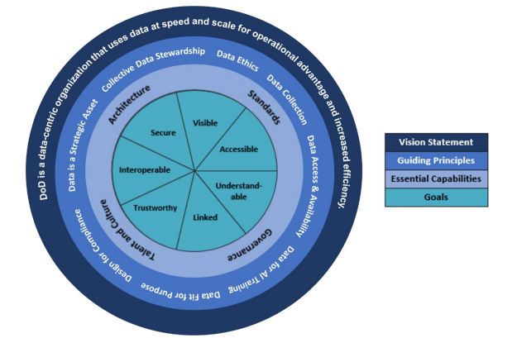
DATA Security and ethical concerns
Figure 4
DoD Data Strategy Framework
Data security:
The “Defense-in-Depth” approach: people, technology, operations (Panton et al., 2014).
Collective data stewardship: contractors also responsible for DoD data security
DoD complies with numerous national and federal policies on cybersecurity
Cybersecurity Maturity Model Certification (CMMC) adopted to remove barriers for contractors doing business with the DoD
Ethical concerns:
Control Unclassified Information (CUI) program
DoD Visual Information Style Guide
Note. Source DoD Data Strategy (U.S. Department of Defense, 2020)
from https://media.defense.gov/2020/Oct/08/2002514180/-1/-1/0/DOD-DATA-STRATEGY.PDF
Notes:
High-level DoD policies:
2018 DoD Cyber Strategy (U.S. Department of Defense, 2018).
DoD Digital Modernization Strategy (U.S. Department of Defense, 2019)
DoD Cloud Strategy (U.S. Department of Defense, 2018)
DoD Identity, Credential, and Access Management (ICAM) Strategy (U.S. Department of Defense, 2020)
DoD Information Sharing Strategy (U.S. Department of Defense, 2007).
DoD’s complex cybersecurity policies are among the main barriers for small businesses. A new program completed in 2021, the Cybersecurity Maturity Model Certification (CMMC) aims to remove barriers for contractors doing business with the DoD. The new framework will be incorporated into the federal acquisition process. Its goal is to provide clear guidance to contractors to ensure their compliance with DoD cybersecurity regulations, while maintaining the highest level of protection for defense information by promoting security practices to deflect threats (U.S. Department of Defense, 2021).
Controlled Unclassified Information (CUI) program, regulated by the DoD Instruction 5200.48 (Office of the Under Secretary of Defense for Intelligence and Security, 2020). The instruction outlines the basic data security requirements for non-DoD sources that generate, share, or handle defense data in any way (including all legacy materials). The policy regulates data management procedures ranging over identification of defense CUI, marking, safeguarding, storage, and even destruction of qualifying data in non-DoD systems (Office of the Under Secretary of Defense for Intelligence and Security, 2020).
Visual information that is released or published by DoD is regulated by Instruction 5040.02 (Defense Imagery Management Operations Center, 2018), and has to adhere to the DoD Visual Information Style Guide. The adherence to policy are required by DoD personnel responsible for producing or releasing visual information; the same guidelines will be followed in the capstone data analysis project in the event that any imagery will be used for creating or enhancing visualizations of the DoD award dataset.

Slide 7
Research hypothesis and literature review
H0: The average predicted award amount per company is greater for contracts with no set-aside requirement than that for set-aside contracts (H0: µ1 > µ2).
H1: The average predicted award amount per company is less for contracts with no set-aside requirement than that for set-aside contracts (H1: µ1 < µ2).
Thornton, J. & Lecy, J. (2019) used regression on the award data from USAspending.gov (n.d.) to predict whether for-profit or non-profit contractors will get an award based on the complexity and asset specificity of a contract
Gill et al. (2019) used random forest model to predict the probability of performance issues in businesses leading to further contract terminations
Davis et al. (2020) used a combination of tools for semantic analysis and Naïve Bayes classifiers to predict program performance based on certain data points extracted from the contracts (such as document types, dates, etc.).
Tyms (2017) performed an extensive qualitative study to explore most profitable strategies for small businesses’ federal acquisitions.
Notes:
Testing the null hypothesis can help a business in evaluating which types of opportunities are more beneficial to pursue. If the average award amount is higher for opportunities with specific set-aside requirements, then more companies may be more motivated to meet the requirements that will allow them to qualify for those contracts. If, however, the average award amount for the set-aside opportunities is lower than that for non-qualifying opportunities, then each company considering the joint venture should perform a careful cost-benefit analysis before committing to forming the joint venture; if its sole purpose for doing so is an increase in bidding opportunities, the ultimate reward does not outweigh the cost.

Slide 8
Tools and techniques
Python libraries and tools:
Pandas library: loading and analyzing data
Numpy library: linear algebra operations
Seaborn library: visualizing descriptive statistics
Matplotlib: statistical visualizations
Scikit-learn library: LinearRegression, LassoCV, DecisionTreeRegressor, RandomForestRegressor
Kmodes library: k-Modes clustering
Scipy library: independent samples t-test
Tableau Public for visualizations
Notes:
Predicting award values was attempted for several reasons. The first reason was that federal opportunities are released gradually throughout the fiscal year, so not all data on expected awards is immediately available at the beginning of the year. Then, even though the DoD is obligated to release the forecast of acquisitions for each fiscal year (Department of Defense Office of Small Business Programs, n.d.), not all sub-agencies identify the expected acquisition strategy for each contract (whether the opportunity will be a set-aside contract, or open for bidding to any small business). Finally, even if the DoD agency identifies the anticipated acquisition strategy, it can change upon the official release of the proposal. Predicting the contract values is an attempt to project future costs based on the latest trends by analyzing the contracts that are already awarded

Slide 9
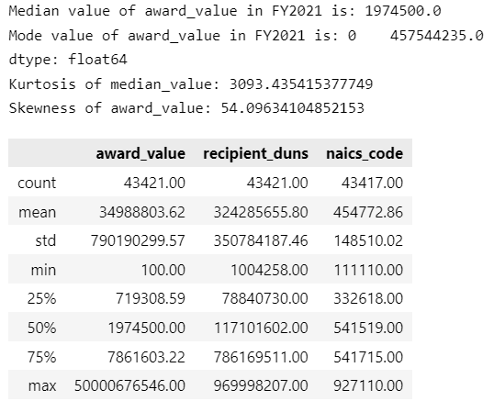
DATA PREPROCESING
Total number of observations: 43,421
Response variable: award_value
Descriptive statistics:
testing for missing values,
calculating measures of central tendency (mean, median, mode) and measures of variability (range, standard deviation)
plotting numeric and categorical variables
Data preprocessing:
converting variable types
recording values to missing
encoding dummy variables
transforming the response variable for normality
Figure 5
Descriptive statistics for response variable award_value
Note. Table created in Visual Studio Code software.
Notes:
The dataset was split 80-20 into the training and testing subsets.
Data was filtered based on:
- determination_of_business_size variable values set equal to small business, excluding observations with values equal to other.
- award_type set equal to definitive contract.
During the data preparation, four additional features were added to the dataset:
three new categorical variables were created through manual encoding of categorical variables with high cardinality: extent_competed, type_of_set_aside_code, and action_date
num_months variable - to enhance the dataset with numeric values.

Slide 10
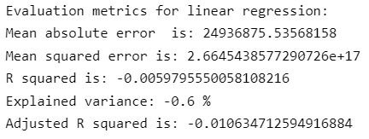
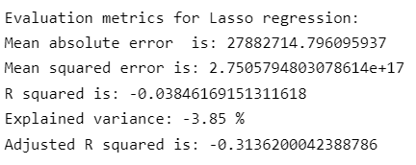
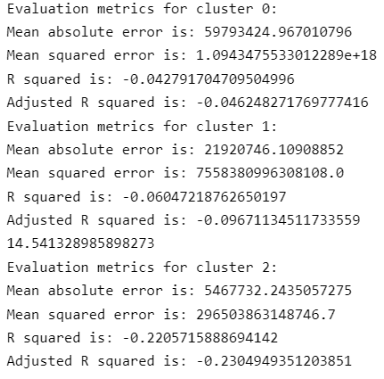
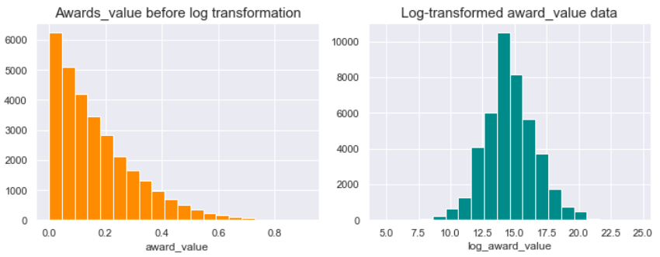
Findings: linear regression results
Figure 6
Linear regression model results
Figure 7
Lasso regression model with cross validation
Figure 8
Lasso regression on data clustered with k-mode clustering
Note. Code output from Visual Studio Code software.
Note. Code output from Visual Studio Code software.
Figure 9
Distribution of award_value before and after log transformation
Note. Code output from Visual Studio Code software.
Note. Code output from Visual Studio Code software (plot).
Notes:
To reduce the dimensionality of linear regression model after creating the dummy variables, variables naics_code and product_or_service_code were excluded from the set of predictors due to their high cardinality: naics_code had 501 unique categories; and product_or_service code had 1264 unique categories. After the set of predictor variables was selected, categorical variables were converted into dummy variables using pandas.get_dummies() function. To avoid creating predictors that were highly correlated with each other (the dummy variable trap), the last dummy variable in each category was dropped from the set of predictors.
First, a multiple linear regression model LinearRegression() from the scikit-learn Python library was used to test the relationship between the dummy predictor variables type_of_contract_pricing_code, setaside_requirement, competitiveness, num_months, sub_agency_name, and the log-transformed response variable log_award_value. Both test and predicted response variables were back-transformed to improve result interpretation.
To reduce the number of insignificant predictors in the model, Lasso (Least Absolute Shrinkage and Selection Operator) regression with iterative fitting was then performed on the same set of predictors using the LassoCV() model from the scikit-learn library (Sklearn, n.d.). For optimal feature selection, variables naics_code and product_or_service_code were included in the set of predictors. Lasso regression uses L1 regularization, which forces the parameters of insignificant features to be zero, minimizing model complexity.
To overcome the heterogeneity of the awards dataset and improve the outcome of regression analysis, clustering using K-mode algorithm was performed in the attempt to partition the most similar observations into groups. K-mode works similar to K-means clustering, but uses mode of a cluster as a measure of similarity instead of a mean to enable clustering of categorical data (Huang, 1998). The elbow method was used to determine that the optimal number of clusters for the awards dataset to be three

Slide 11
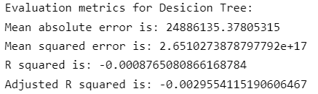
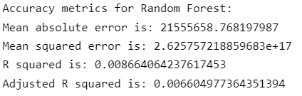
Findings: decision tree and random forest regressors
Figure 10
Decision Tree model results
Figure 11
Random Forest model results
Note. Code output from Visual Studio Code software.
Note. Code output from Visual Studio Code software.
Notes:
Decision Tree regressor algorithm uses binary rules for calculating a predicted response variable, and does not assume a linear relationship between predictor and response variables. Random Forest regressor fits a number of Decision Trees and uses the average of all predictions to find the optimal fit. On the awards dataset, both Decision Tree, and Random Forest failed to explain the variation in response variable and did not yield a reasonably accurate prediction of the award_value

Slide 12
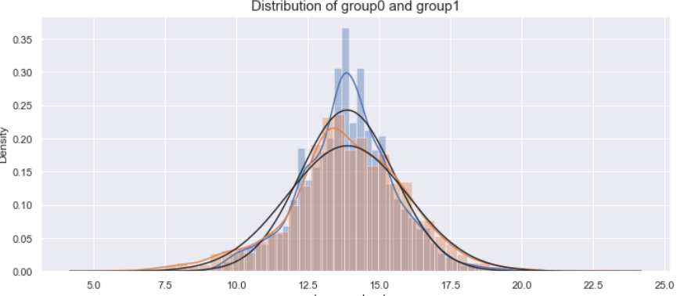
findings: hypothesis testing
Independent two-sample t-test on log-transformed data
Test statistic = 0.236
P-value = 0.593
Wilcoxon signed-rank test for non-normalized data
Test statistic = -0.030
P-value = 0.488
Figure 12
Distribution of group means for hypothesis testing
Note. Code output from Visual Studio Code software.
Notes:
The null hypothesis stated that in FY2021 the average predicted award amount per company was greater for contracts with no set-aside requirement than that for set-aside contracts (H0: µ1 > µ2). Alternative hypothesis stated that the average predicted award amount per company was less for contracts with no set-aside requirement than that for set-aside contracts (H1: µ1 < µ2).
A one-tailed two-sample independent t-test was chosen to compare the means of the two groups. The t-test is a parametric statistical method that assumes the normal distribution of the means. For this reason, this test was performed on the log-transformed data. To ensure that the test on the log-transform data yielded accurate test statistics, the non-transformed means of two groups were then compared using the non-parametric Wilcoxon signed-rank test.

Slide 13
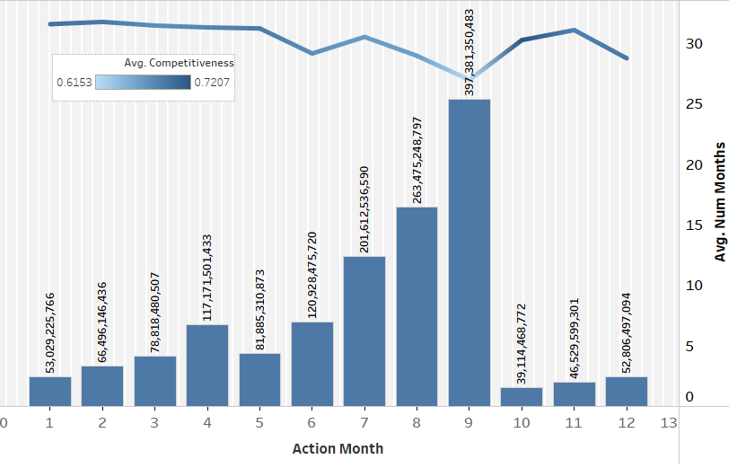
Research findings: visualizations
Figure 13
Total awards to small businesses by month and contract competitiveness: FY2021
Note. The trends of Award Value and average of Num Months for Action Month. For pane Sum of Award Value: Color shows details about Award Value. For pane Average of Num Months: Color shows average of Competitiveness.
Notes:
The color of the trend line indicates how competitive the awards were. The awards given In the first part of the fiscal year (October through March) seem to be As the total value of awards grow July through September, the competitiveness decreases.
The largest amount of work is awarded to contractors at the end of the government fiscal year in September (total amount awarded - over $397 billion). The contracts seem to be of a shorter length, but this month offers the highest chance of getting a noncompetitive contract. This could be related to the fact that at the end of the fiscal year government has to meet their annual spending goals. Businesses looking for shorter-term contracts with less competition should attempt bidding in July, August, or Septemer. Businesses that are looking for longer-term contracts should consider bidding in April – June, but should be prepared for more competitive awardee selection.

Slide 14
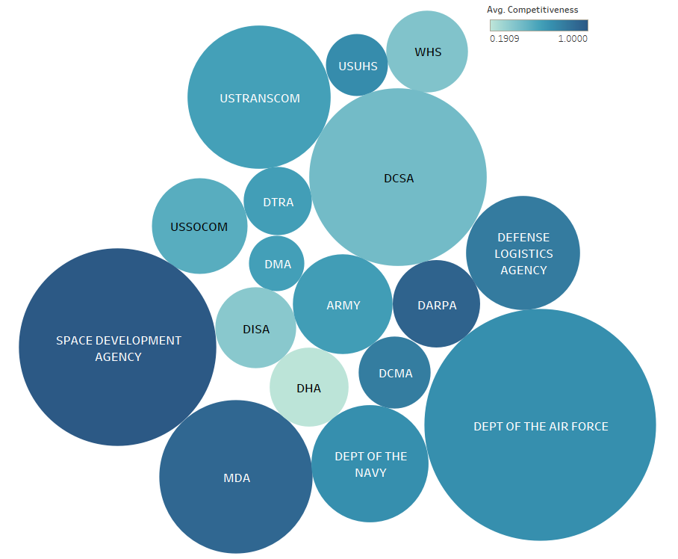
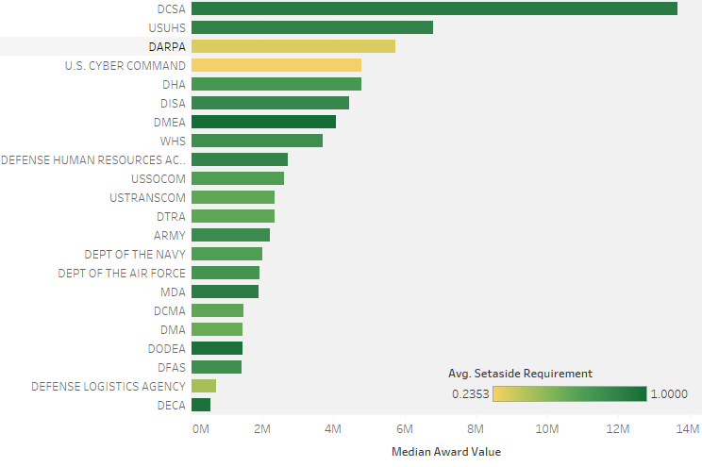
Research findings: visualizations
Figure 14
Competitiveness of small business awards by sub-agency: FY2021
Figure 15
Median award value by sub-agency: FY2021
Note. Packed bubble chart created in Tableau Public software. Color shows average of competitiveness, size shows average of award value. The marks are labeled by sub-agency name. The view is filtered on Sub Agency Name, which keeps 17 of 34 members.
Note. Median of Award Value for each Sub Agency Name. Color shows average of Setaside Requirement. The view is filtered on median of Award Value, which includes values less than or equal to 30,000,000.
Notes:
Figure 14 allows to evaluate which DoD sub-agencies have the most competitive awarding process: the larger the bubble, the larger the average award amount; and the darker the color of the bubble, the more competitive is the awarding process that the sub-agency implements. For example, the Defense Health Agency has the least competitive process, but its average award value is much smaller than of the Space Development Agency (which, in turn, awards the majority of work competitively).
Another important factor that government contractors can consider before deciding to pursue set-aside opportunities are:
the median amounts of contracts per each sub-agency
the average contract value distributed to different types of set-aside contracts. Figure shows that the top two agencies with the highest median value per contract, DSCA and USUHS, show a tendency to award disadvantaged small businesses. DARPA and U.S. that have the third and fourth largest median contract value, more often give awards with no set-aside requirement.

Slide 15
recommendations
Testing other non-linear predictive models (non-linear regression, neural network models)
Improving a way of encoding categorical variables with high cardinality, such as Gamma-Poisson matrix factorization, or min-hash encoder (Cerda & Varoquaux, 2020);
Considering the low-level analysis of data (for example, on a single sub-agency, or a set-aside code), or using multilevel modeling.
Gathering historical data for forecasting.
Enriching the current dataset with other meaningful features for in-depth analysis
Notes:
The DoD awards dataset contained mainly categorical data, with the response variable award_value being the only numeric variable in the original dataset. Several categorical predictors had a large number of levels (> 100). This created issues with dummy encoding, producing a large number of variables with uncommon values. Using Lasso regression model for feature selection did not result in finding the optimal set of predictors for award_value. None of the predictors were found to have linear relationships, or strong correlation with the response variable. As a result, linear regression and decision tree models did not produce predictions that were reasonably close to the real values.

Slide 16
References
Congressional Research Service. (2022, February 25). An overview of small business contracting. Retrieved March 19, 2022, from https://sgp.fas.org/crs/misc/R45576.pdf
USAGov. (n.d.). U.S. Department of Defense. USAGov. Retrieved March 5, 2022, from https://www.usa.gov/federal-agencies/u-s-department-of-defense
U.S. Department of Defense. (n.d.). Our story. U.S. Department of Defense. Retrieved February 27, 2022, from https://www.defense.gov/About/
United States Government Accountability Office. (2021, October). Small business contracting: Actions needed to implement and monitor DoD's small business strategy. Retrieved March 19, 2022, from https://www.gao.gov/assets/gao-22-104621.pdf
Panton, B. C., Colombi, J. M., Grimaila, M. R., & Mills, R. F. (2014). Strengthening DoD Cyber Security with the Vulnerability Market. Defense Acquisition Research Journal: A Publication of the Defense Acquisition University, 21(1), 465–484.
Office of the Under Secretary of Defense for Intelligence and Security. (2020, March 6). DoD Instruction 5200.48. Retrieved March 21, 2022, from https://www.esd.whs.mil/Portals/54/Documents/DD/issuances/dodi/520048p.PDF
Schilling, R., Mazzuchi, T. A., & Sarkani, S. (2017). Survey of small business barriers to Department of Defense contracts. Defense Acquisition Research Journal: A Publication of the Defense Acquisition University, 24(1), 2–29.
U.S. Department of Defense. (2007, May 4). Department of Defense information sharing strategy. Retrieved March 20, 2022, from https://dodcio.defense.gov/Portals/0/Documents/InfoSharingStrategy.pdf
U.S. Department of Defense. (2018). U.S. Department of Defense cyber strategy. Retrieved March 20, 2022, from https://media.defense.gov/2018/Sep/18/2002041658/-1/-1/1/CYBER_STRATEGY_SUMMARY_FINAL.PDF
U.S. Department of Defense. (2018, December). DoD Cloud Strategy. Retrieved March 20, 2022, from https://media.defense.gov/2019/Feb/04/2002085866/-1/-1/1/DOD-CLOUD-STRATEGY.PDF
U.S. Department of Defense. (2019, June 5). DoD Digital Modernization Strategy 2019. Retrieved March 20, 2022, from https://media.defense.gov/2019/Jul/12/2002156622/-1/-1/1/DOD-DIGITAL-MODERNIZATION-STRATEGY-2019.PDF

Slide 17
U.S. Department of Defense. (2020). DoD Data Strategy. Retrieved March 16, 2022, from https://media.defense.gov/2020/Oct/08/2002514180/-1/-1/0/DOD-DATA-STRATEGY.PDF
U.S. Department of Defense. (2020, March 30). ICAM strategy. Retrieved March 20, 2022, from https://dodcio.defense.gov/Portals/0/Documents/Cyber/ICAM_Strategy.pdf
U.S. Department of Defense. (2021, November 4). Strategic direction for cybersecurity maturity model certification (CMMC) program. U.S. Department of Defense. Retrieved March 20, 2022, from https://www.defense.gov/News/Releases/Release/Article/2833006/strategic-direction-for-cybersecurity-maturity-model-certification-cmmc-program/

