Slide 1
Predicting good/bad loans among high-risk loans using Lending Club data

Slide 2
Considerations
Restricted data to just loans issued in 2018
Adopted a loan investment perspective and restricted my investigation to high risk loans since:
Higher risk loans come with higher interest rates that are more attractive from the investor's perspective
However, they pose risks of being not returned at all (defaulted)
Models to try:
Decision trees
KNN
Logistic regression
Evaluation metrics:
Misclassification of bad loans as good loans (as an investor will lose money on such cases) matters more
Focus on a higher precision (i.e. lower false positives) even if it comes at the expense of a lower recall (i.e. higher false negatives).

Slide 3
EDA and data processing

Slide 4
Reduce number of features
147
Remove features with possible lookahead bias
109
Remove empty features
105
Remove correlated features
89

Slide 5
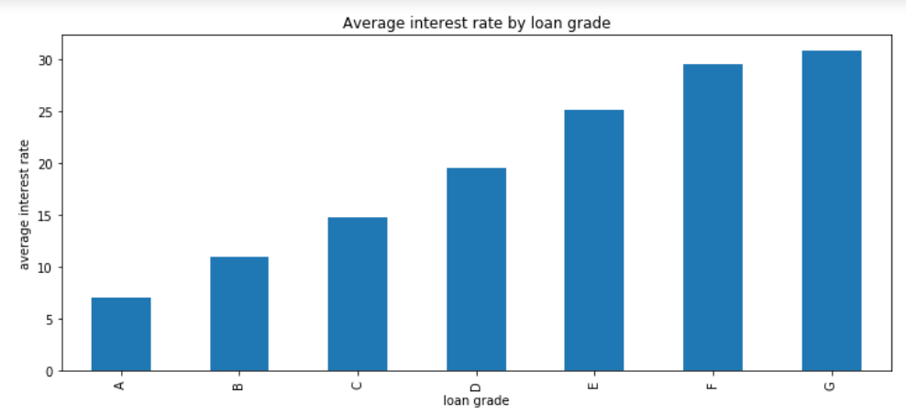
Definition of risky loans
Risky loans

Slide 6
Definition of good and bad loans
Loan statuses:
Current: Loan is up to date on all outstanding payments.
In Grace Period: Loan is past due but within the 15-day grace period.
Fully paid: Loan has been fully repaid, either at the expiration of the 3- or 5-year year term or as a result of a prepayment.
Late (16-30): Loan has not been current for 16 to 30 days.
Late (31-120): Loan has not been current for 31 to 120 days.
Default: Loan has not been current for an extended period of time.
Charged Off: Loan for which there is no longer a reasonable expectation of further payments.
Good
Bad
20,900 good loans; 1904 bad loans
→ Naïve baseline accuracy/precision: 0.9165

Slide 7
Modelling

Slide 8
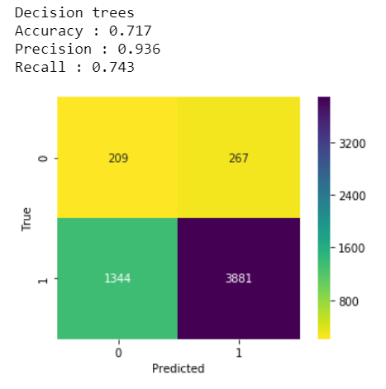
Summary of decision trees model (1)
Use catboost package
Use validation vs training data to find optimum number of iterations/trees
With optimum number of trees, predict using the test data

Slide 9
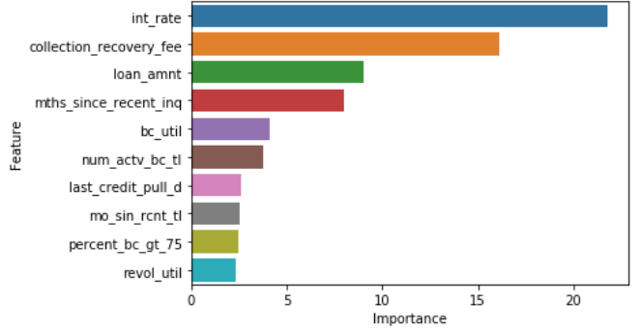
Summary of decision trees model (2)
Feature importance
To use in KNN

Slide 10
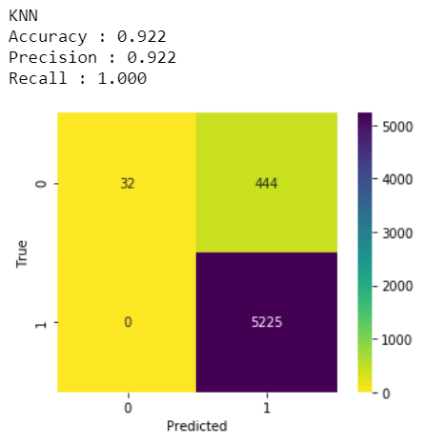
Summary of KNN model
Use top 10 float objects from feature importance analysis above
Use cross-validation to find optimum k
With optimum k (=48), predict using the test data

Slide 11
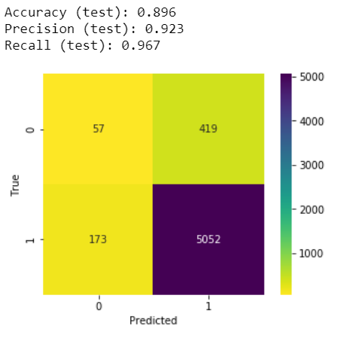
Summary of logistic regression model
Use all variables except datetime objects
Use L1 regularization (lasso)
Use validation vs training data to find optimum C
Recall that C = 1/alpha, where alpha is the coefficient of the penalty term)
With optimum C = 100, predict using test data

Slide 12
Summary – which model?
Decision trees model has the highest precision, though the other two are not far behind (0.936 vs 0.922/0.923)
However, note that the decision trees model has the lowest recall

