Slide 1
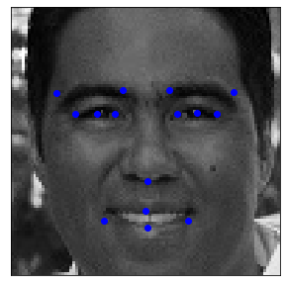
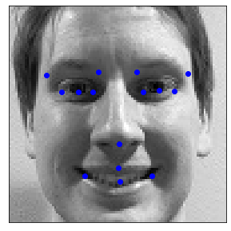
Facial Keypoints Detection
Ernesto Oropeza
Michael Hubert

Slide 2
Problem Overview
The Inference Problem
Predict coordinates for 15 key facial features based on a grayscale colored image of a face
The Data 7,049 - 96 by 96 pixels images
The Challenge Two-thirds of images do not have all key facial features labeled

Slide 3
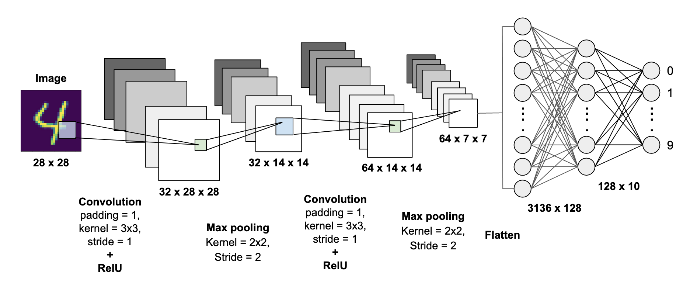
The Model
Convolutional Neural Network
Source: https://towardsdatascience.com/mnist-handwritten-digits-classification-using-a-convolutional-neural-network-cnn-af5fafbc35e9

Slide 4
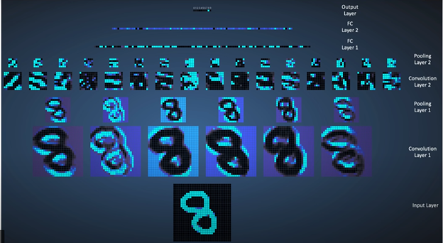
CNN Example
Source: https://www.wandb.com/tutorial/convolutional-neural-networks

Slide 5
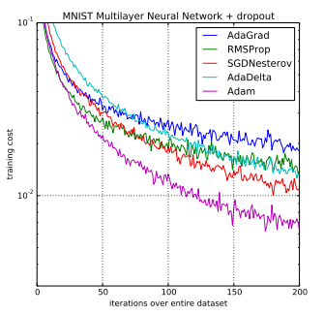
Parameters, Loss Function, Optimizer
Parameters: Filter weights for Convolutional Layers
Objective: Minimize Root Mean Squared Error of Predictions
Loss Function: Root Mean Squared Error
Optimizer: Adam, a stochastic gradient descent method
Source: https://machinelearningmastery.com/adam-optimization-algorithm-for-deep-learning/

Slide 6
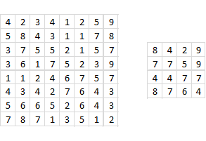
Techniques to Avoid Overfitting
Maxpool
Dropout

Slide 7
Base and Extended Models
Base and Extended models were trained using images with all facial features (1,730 out of 5,640 training examples)
Base Model
Extended Model
Times Repeated
Times Repeated
1 X | Covolutional (32, (3,3) filter) - ReLU Activation
1 X | MaxPool (pool size = (2,2))
1 X | Batch Normalization
1 X | Flatten Layer
1 X | Dense Layer (512) - ReLU Activation
1 X | Dropout Layer (0.1)
1 X | Output Layer (30) - Linear Activation
3 X | Covolutional (32/64/128, (3,3) filter) - ReLU Activation
3 X | MaxPool (pool size = (2,2))
3 X | Batch Normalization
1 X | Flatten Layer
1 X | Dense Layer (512) - ReLU Activation
1 X | Dropout Layer (0.1)
1 X | Output Layer (30) - Linear Activation

Slide 8
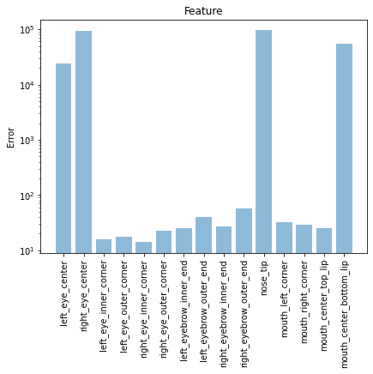
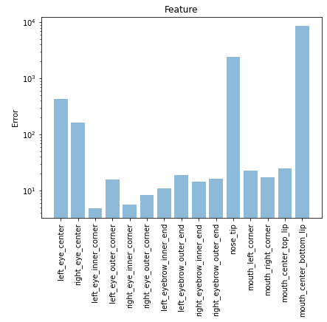
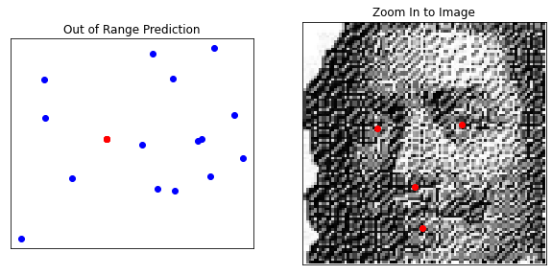
Error Analysis - Base and Extended Model
Features with Largest Error
Prediction with Largest Error (9.21 e+07)
Base Model
Extended Model
Original image had very poor resolution

Slide 9
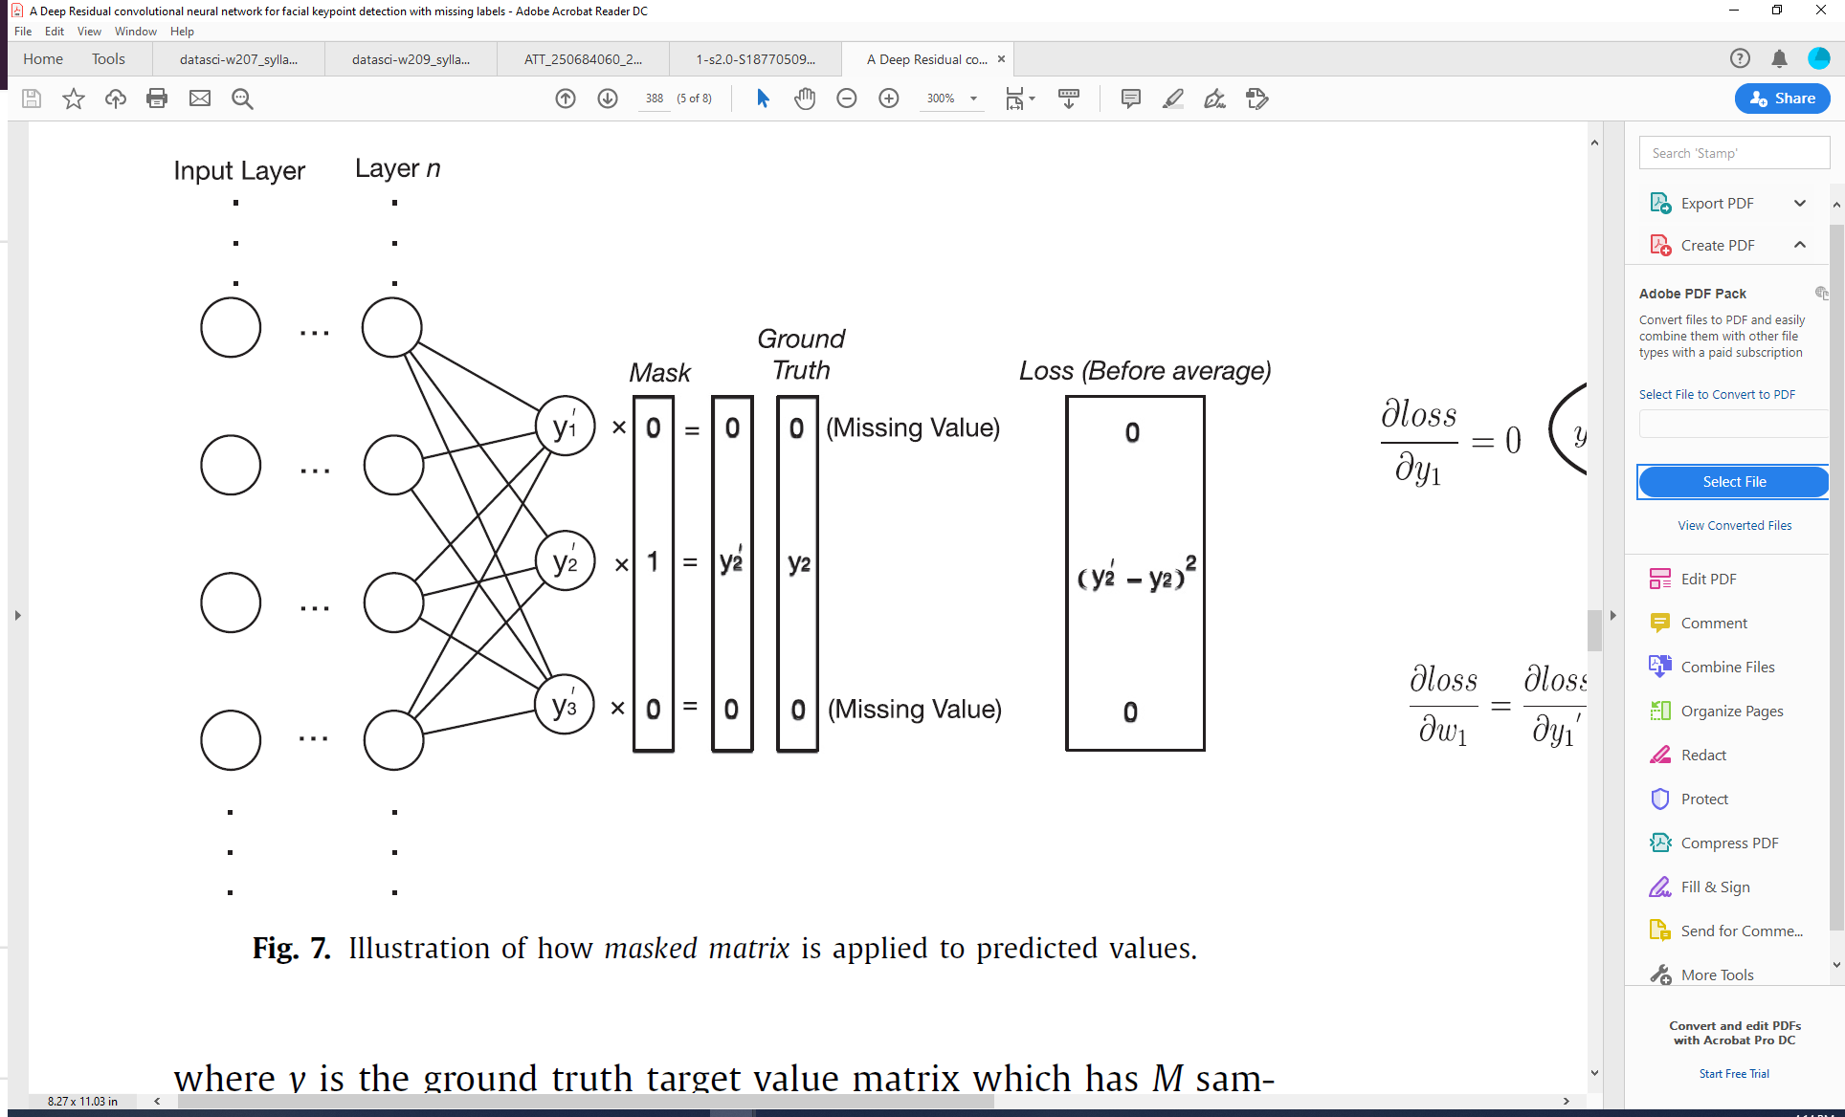
Masked Model
The goal of the masked model is to force the residual to be zero on facial features are not labeled.
There is not update associated to unlabeled features
Our implementation
Base Extended Architecture
Costume Loss Function
(y’ * Mask - y)²
*Wu et. al. (2018) A Deep Residual convolutional neural network for facial keypoint detection with missing labels

Slide 10
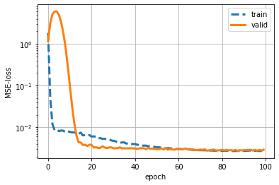
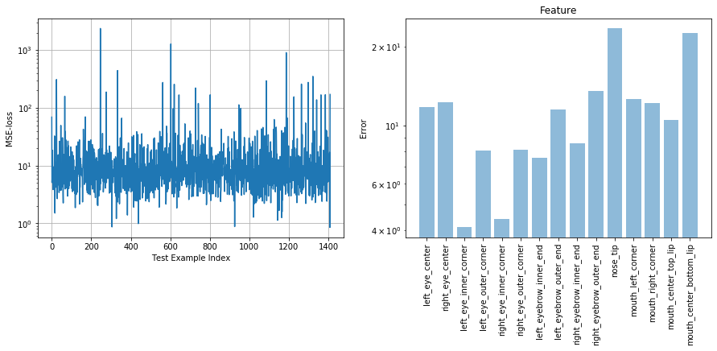
Masked Model Performance

Slide 11
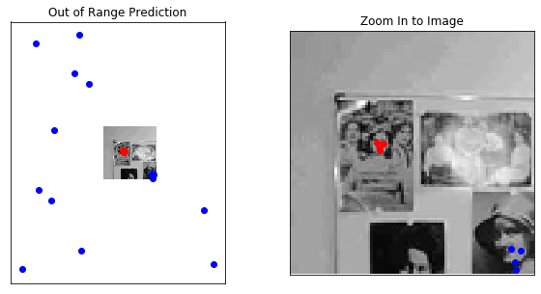
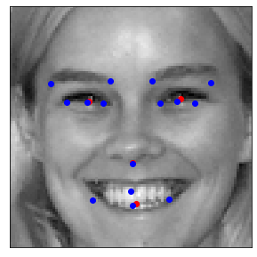
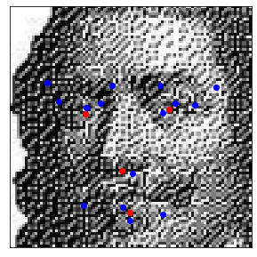
Masked Model Performance
Best Prediction
Worst Prediction
Improvement Example
MSE = 0.85
MSE = 2378.88
MSE = 6.15
3.61 e+06 Base Extended Model
9.21 e+07 Base Model

Slide 12
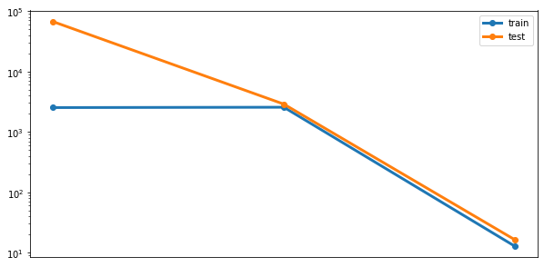
Model Error Comparison
Base Model (RMSE = 258.34)
Base Extended Model (RMSE = 53.64)
Mean Squared Error (Log)
Masked Model (RMSE = 4.06)

Slide 13
Future Innovations
Discrimination by Face Size in the image
Feature Classifier Convolutional Neural Network
Data Augmentation (Zoom, Flip, etc.)

Slide 14
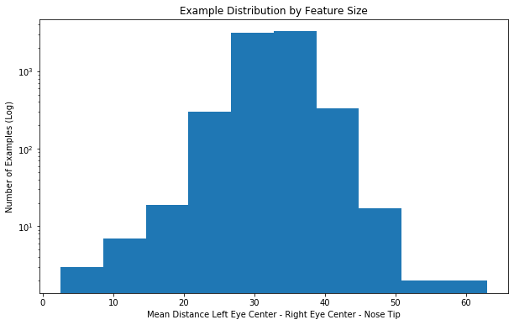
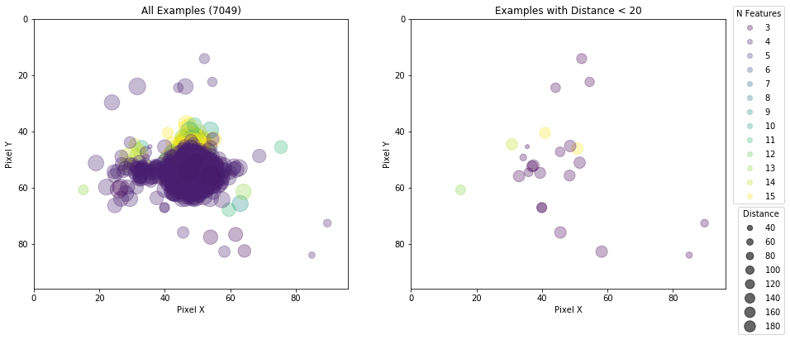
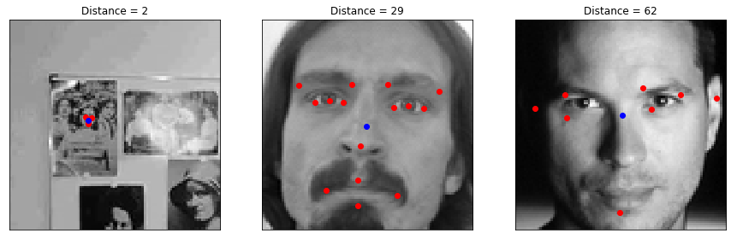
Future Innovations - Account for Face Size

Slide 15
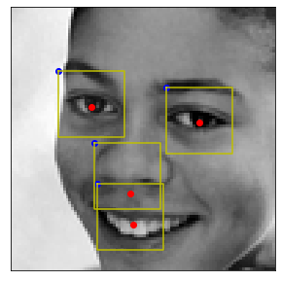

Future Innovations - Feature Classifier
1
0
0
0
0
1
0
0
0
0
1
0
0
0
0
1
Create a CNN to classify features that are present in the images before locating the keypoints

Slide 16
Conclusions
A Convolutional Neural Network is designed to detect 15 facial keypoints with RMSE of 4.06
The masked loss function is helpful to reduced the RMSE of the model (from 53.64 to 4.06) not only because it considers the missing labels but also because it allows us to increase the amount of training data we can use
Zoomed out and low quality images remain challenging for the implemented network and encourage future improvements

Slide 17

Facial Keypoints Detection
Ernesto Oropeza
Michael Hubert

