Slide 1

Scalable data processing on computer clusters
Gergely Lukács
Pázmány Péter Catholic University
Faculty of Information Technology
Budapest, Hungary
lukacs@itk.ppke.hu

Slide 2
Problem with amount of data?
Better algorithms
Numba, C/Cython
More efficient formats for data
Data subsampling
Laptop (4 cores, 16GB RAM, 1 TB hdd)
Server (24 cores, 1TB RAM)
Parallelization
  Methods/architectures for parallelization
HW accelerators (depending on task: GPGPU, FPGA)

Slide 3

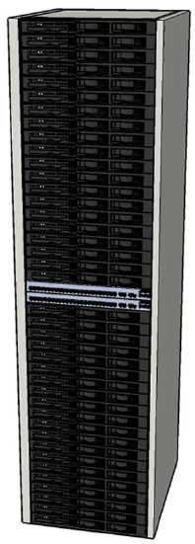
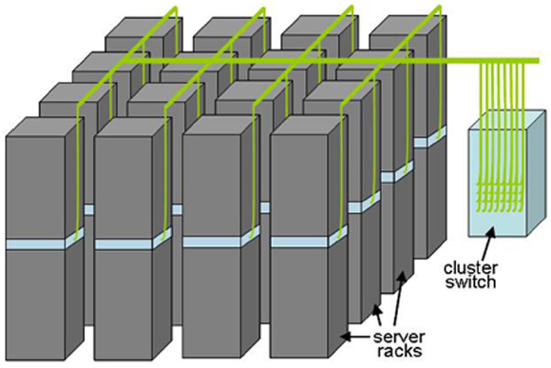
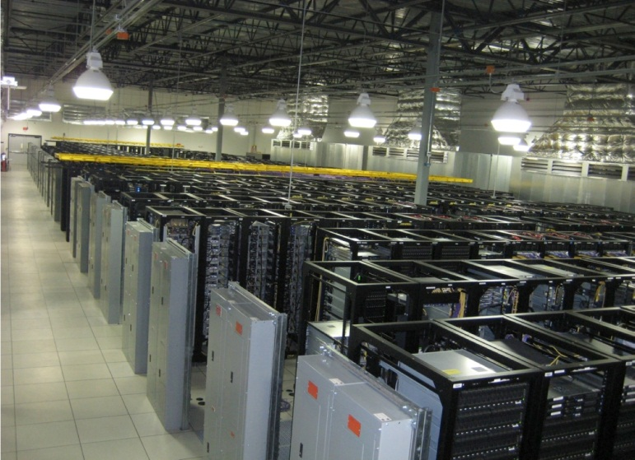
Building Blocks
Source: Barroso and Urs Hölzle (2009)

Slide 4
Major ideas
Process data sequentially, avoid random access
  Seeks are expensive, disk throughput is reasonable
Move processing to the data
  Cluster have limited bandwidth
Seamless scalability
From the mythical man-month to the tradable machine-hour
  Automatic parallelization & distribution
  Fault tolerance
  I/O scheduling
  Monitoring & status updates

Slide 5
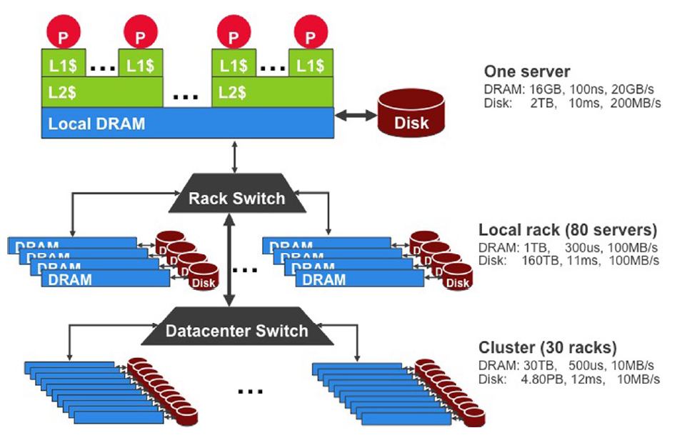
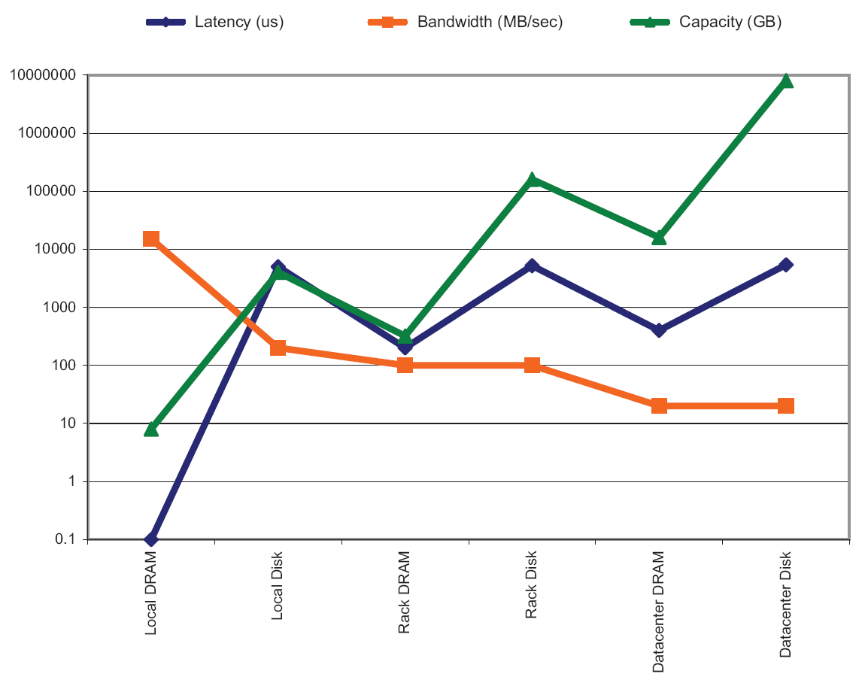
Storage Hierarchy, Seek vs. scan
Consider a 1 TB database with 100 byte records
  We want to update 1 percent of the records
Scenario 1: random access
  Each update takes ~30 ms (seek, read, write)
  10⁸ updates = ~35 days
Scenario 2: rewrite all records
  Assume 100 MB/s throughput
  Time = 5.6 hours(!)
Lesson: avoid random seeks!
Source: Barroso and Urs Hölzle (2009)

Slide 6
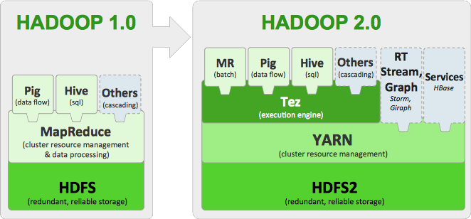
Hadoop (1.0), MapReduce
Elosztott fájlrendszer: HDFS
  Skálázódás, hibatűrés
  Elosztott, redundáns
MapReduce

Slide 7
Map/Reduce
Map/Reduce
  Programming model from Lisp
  (and other functional languages)
Many problems can be phrased this way
Easy to distribute across nodes
Nice retry/failure semantics

Slide 8
Map in Lisp (Scheme)
Unary operator
(map f list [list₂ list₃ …])
(map square ‘(1 2 3 4))
  (1 4 9 16)
(reduce + ‘(1 4 9 16))
  30
(reduce + (map square (map – l₁ l₂))))
Binary operator

Slide 9
Map/Reduce ala Google
map(key, val) is run on each item in set
  emits new-key / new-val pairs
reduce(key, vals)
  All values with the same key are reduced together
  emits final output

Slide 10
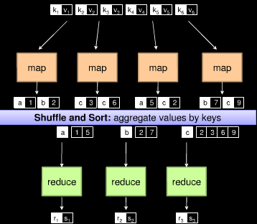

Slide 11
count words in docs
  Input consists of (url, contents) pairs
  map(key=url, val=contents):
    For each word w in contents, emit (w, “1”)
  reduce(key=word, values=uniq_counts):
    Sum all “1”s in values list
    Emit result “(word, sum)”

Slide 12
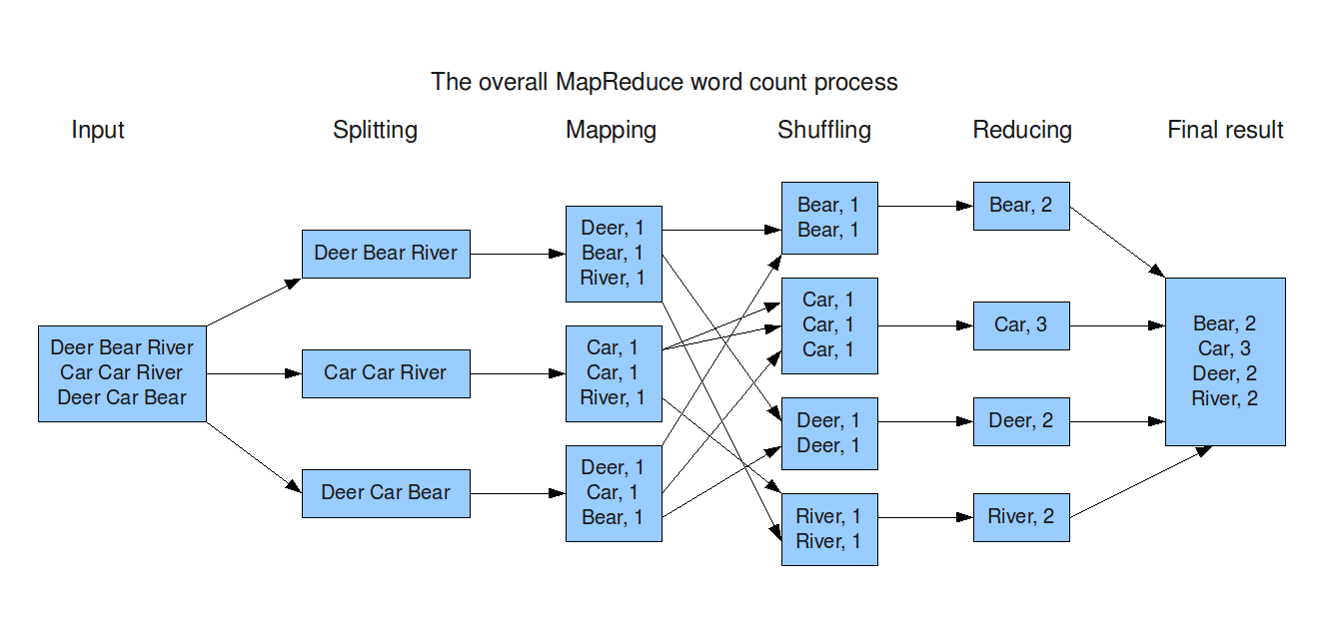

Slide 13
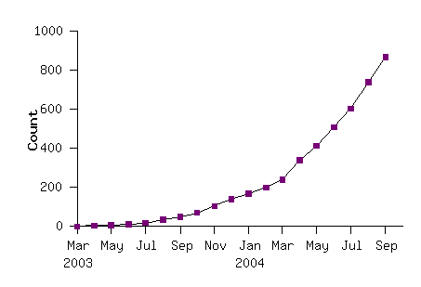
Model is Widely Applicable
MapReduce Programs In Google Source Tree
Example uses:
distributed grep |  | distributed sort |  | web link-graph reversal
term-vector / host |  | web access log stats |  | inverted index construction
document clustering |  | machine learning |  | statistical machine translation
... |  | ... |  | ...

Slide 14
Execution Framework
The execution framework handles everything else…
  Scheduling: assigns workers to map and reduce tasks
  “Data distribution”: moves processes to data
  Synchronization: gathers, sorts, and shuffles intermediate data
  Errors and faults: detects worker failures and restarts
Limited control over data and execution flow
  All algorithms must expressed in m, r, c, p
You don’t know:
  Where mappers and reducers run
  When a mapper or reducer begins or finishes
  Which input a particular mapper is processing
  Which intermediate key a particular reducer is processing

Slide 15
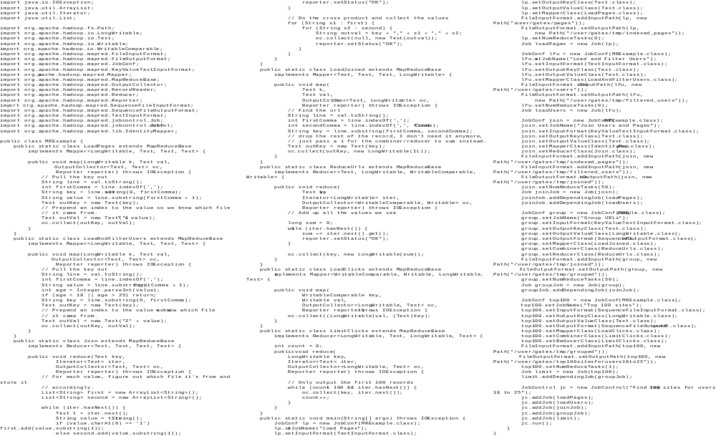
In MapReduce
Example from http://wiki.apache.org/pig-data/attachments/PigTalksPapers/attachments/ApacheConEurope09.ppt
Notes:
My point in putting in the java code isn’t too actually walk through it. It’s just to show that you have to hand code a fair amount of java. That way I can just point and say “look how much java you’d have to write to accomplish this”

Slide 16
In Pig Latin
Users = load ‘users’ as (name, age);
Filtered = filter Users by
age >= 18 and age <= 25;
Pages = load ‘pages’ as (user, url);
Joined = join Filtered by name, Pages by user;
Grouped = group Joined by url;
Summed = foreach Grouped generate group,
count(Joined) as clicks;
Sorted = order Summed by clicks desc;
Top5 = limit Sorted 5;
store Top5 into ‘top5sites’;
Example from http://wiki.apache.org/pig-data/attachments/PigTalksPapers/attachments/ApacheConEurope09.ppt
Notes:
Rather than using capital letters, which makes Pig Latin look like SQL, I added Eclipse style highlighting instead. Hopefully this makes clear what are the key words without making it look like a Matisse painting.

Slide 17
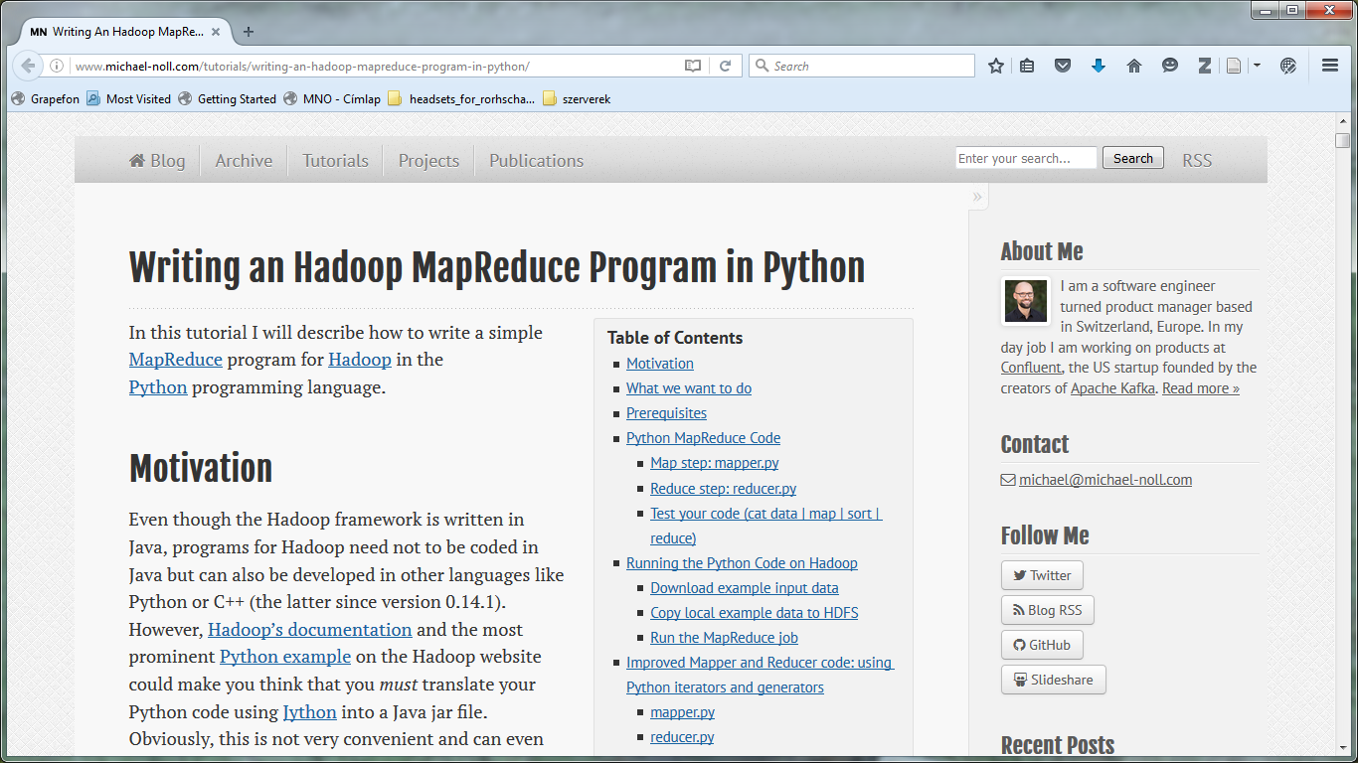
2010

Slide 18
Limitations of MapReduce
Linear dataflow:
  read input data from disk,
  map, reduce…,
  store result on disk
Iterations - when you need to process data again and again
When your processing requires lot of data to be shuffled over the network.
Real-time processing.
Complex algorithms
Processing graphs
….

Slide 20
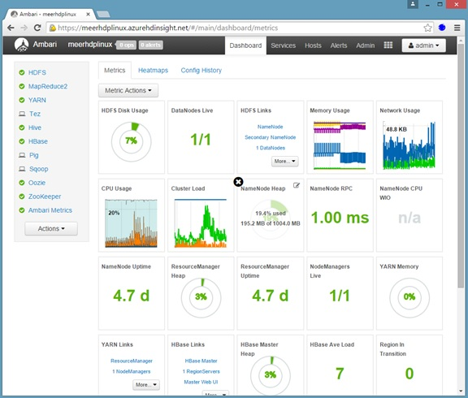

Slide 21
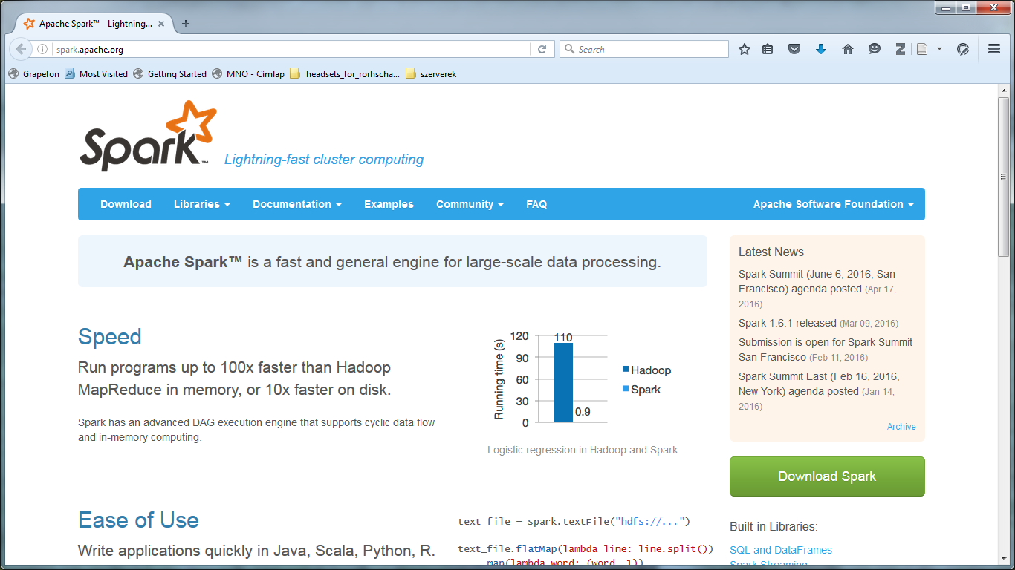

Slide 22
Spark
Resilient Distributed Dataset (RDD)
  Read-Only
  Distributed
  Fault-tolerant
  Caching can be controlled
  Iterative algorithms
  Interactive/exploratory data analysis

Slide 23
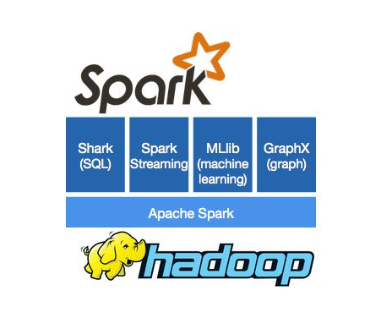
Spark
Standalone (native Spark cluster)
Hadoop YARN
…

Slide 24
Spark disztribúciók, cloud
Hortonworks
Cludera
Felhőszolgáltatók
Szolgáltatás | Google | Microsoft | Amazon
SQL adatbázis | + | + | +
NoSQL adatbázis | Hbase | Hbase, DocumentDb | Amazon DynamoDB
Disztribúciók | Hortonworks, Cloudera | Hortonworks beépítve, Cloudera | -
Gépi tanulás | - | + | +
Különböző védelmi eszközök | + | + | +

Slide 25
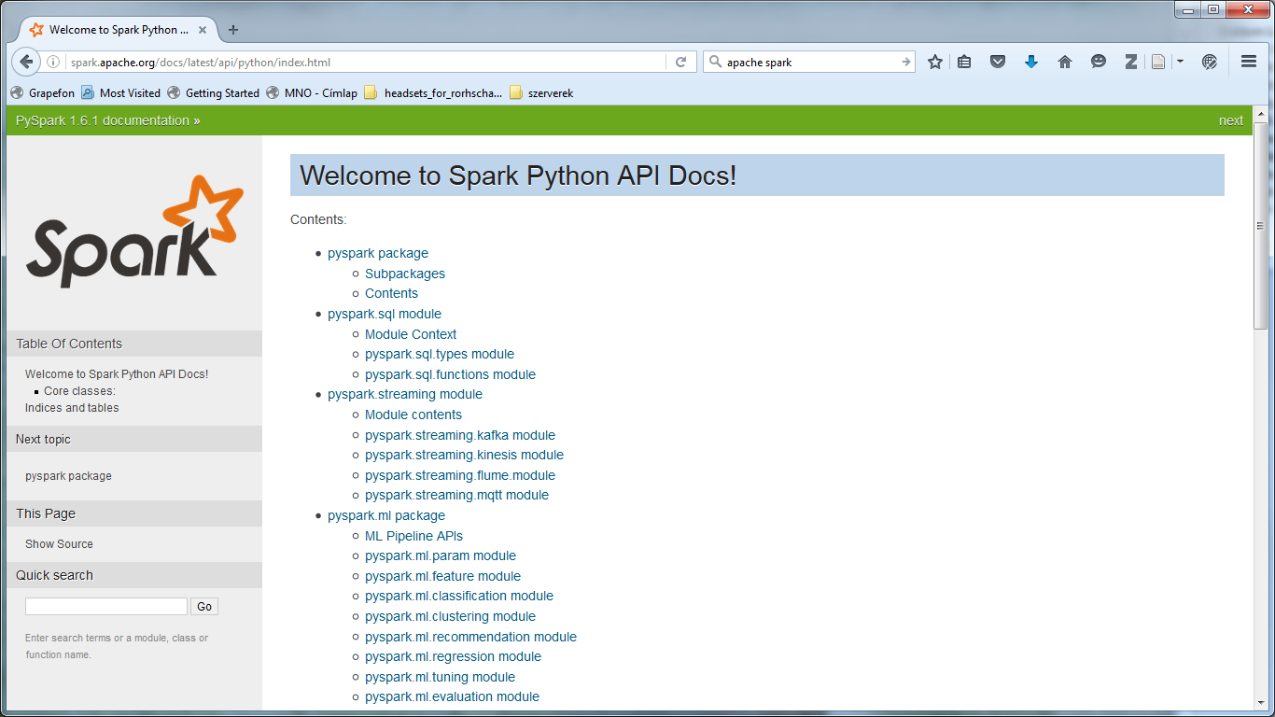
Spark - Python

Slide 26
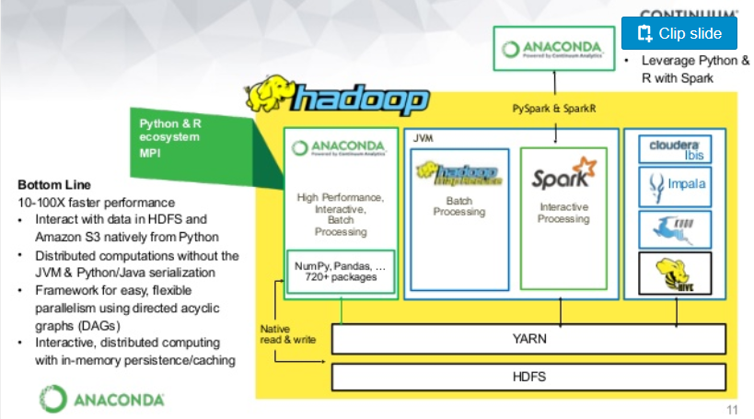

Slide 27
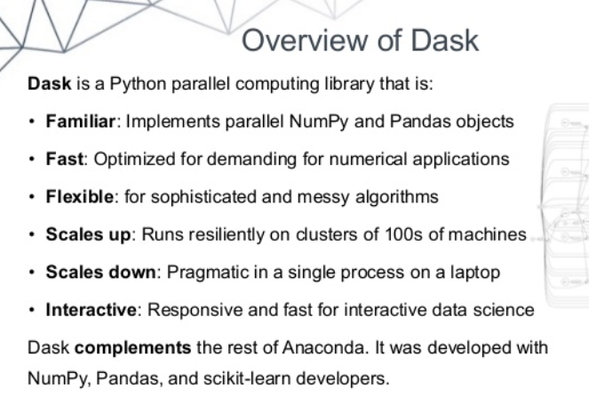

Slide 28
