Slide 1
HematoSim
A real-time journey through the human bloodstream
Three.js · WebGL · Browser-native
Notes:
Good afternoon, I’m Ángel and I’m going to present my project, HematoSim. The idea is to simulate an immersive journey through the human bloodstream.

Slide 2
01 — MOTIVATION
Our approach
"Biology should be something kids can explore,
not just memorise."
Notes:
Okay so seeing the limitations that there are regarding this manner, let’s talk about my motivation. I believe that biology was a controversial subject I had when I was young. This is because I found it really interesting but really hard to just memorise without understanding everything. This is the reason why I came up with this idea.

Slide 3
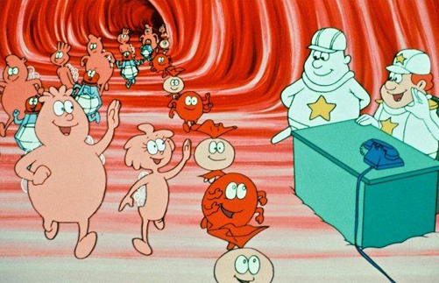
01 — MOTIVATION
Our approach
"Biology should be something kids can explore,
not just memorise."
Notes:
I was inspired by a tv show for kids which I used to see when I was young, which helped me to understand better.

Slide 4
01 — MOTIVATION
Our approach
"Biology should be something kids can explore,
not just memorise."
🎯
High-level, not rigorous
Not complex structures and interactions
Just simple and common behaviors for general knowledge
Notes:
So I tried to create a high-level application, with the basic structures and interactions with just educational purpose, not trying to replicate the actual behavior rigorously.

Slide 5
01 — MOTIVATION
Our approach
"Biology should be something kids can explore,
not just memorise."
🎯
🧒
High-level, not rigorous
Built for young audiences
Not complex structures and interactions
Just simple and common behaviors for general knowledge
All audiences are susceptible → no need of previous knowledge
Anyone curious can be eligible to use it
Notes:
As I already mentioned, the main audience would be young audiences and schools but everyone is susceptible as there is no need of prior knowledge.

Slide 6
01 — MOTIVATION
Our approach
"Biology should be something kids can explore,
not just memorise."
🎯
🧒
🎮
High-level, not rigorous
Built for young audiences
Visual & interactive > static
Not complex structures and interactions
Just simple and common behaviors for general knowledge
All audiences are susceptible → no need of previous knowledge
Anyone curious can be eligible to use it
Usually, school resources are flat schemas or even blurred images
Amusing and useful tool for education
Notes:
Related to this, from my experience, usually schools do not have the best material for this, so this could be a cool tool to implement for them.

Slide 7
02 — RELATED WORK
What already exists
Notes:
But before entering the discussion of the project, let’s have some perspective on what already exists related to this area. After some research, these are the most interesting findings I obtained.

Slide 8
02 — RELATED WORK
What already exists
SCIENTIFIC / PROFESSIONAL TOOLS
BioDigital Human
—
3D anatomical atlas
Notes:
Firstly, BioDigital Human, a pretty accurate 3D anatomical atlas that simulates the blood flow and many other biological human body interactions, with a lot of detail as we can observe.

Slide 9
02 — RELATED WORK
What already exists
SCIENTIFIC / PROFESSIONAL TOOLS
BioDigital Human
—
3D anatomical atlas
Neuroglancer
—
WebGL neural map viewer
Notes:
As another example I discovered Neuroglancer, more centered on molecular studio, is a WebGl volumetric neural map viewer, again really precise but not really close to what I had in mind for the project.

Slide 10
02 — RELATED WORK
What already exists
SCIENTIFIC / PROFESSIONAL TOOLS
THE COMMON THREAD
BioDigital Human
—
3D anatomical atlas
Neuroglancer
—
WebGL neural map viewer
Share scientific rigour and professional accuracy
They are built for experts → visualize complex scenarios
Far from educational view
None of them are amusing or engaging, just precise
Notes:
As we can see, they both share scientific rigour and professional accuracy. They are built for experts in order to better visualize complex scenarios, far from the educational view that I want. Apart from that, none of them combine emergent cell behaviour, a guided narrative and a real-time interactive parameters in the browser, which I believe would make them really interesting and what I created in the end.

Slide 11
03 — THE APPLICATION
What you will see
Notes:
Now, we are going to explore the technical aspects and the proper application that I built. Overall, what you are going to see are the following interactions:

Slide 12
03 — THE APPLICATION
What you will see
🎥
Autonomous camera
The camera travels through the vein on its own, like being another cell
Notes:
The camera travels through the vein on its own, like being another cell. You ride the flow and observe everything happening around you in real time.

Slide 13
03 — THE APPLICATION
What you will see
🎥
Autonomous camera
The camera travels through the vein on its own, like being another cell
🔬
Cell Tracker
At any moment you can lock the camera onto a specific cell and follow it up close.
Notes:
However, at any moment you can lock the camera onto a specific cell (depending on the scenario) and follow it up close, helping you to have a better understanding of individual cells.

Slide 14
03 — THE APPLICATION
What you will see
🎥
Autonomous camera
🖱
Hover tooltips
The camera travels through the vein on its own, like being another cell
Shows specific information about that cell at any moment
🔬
Cell Tracker
At any moment you can lock the camera onto a specific cell and follow it up close.
Notes:
At any moment, you can also hover over any cell to identify it instantly: cell type, current state, nearest threat, oxygen saturation. We use raycasting against static and instanced meshes.

Slide 15
03 — THE APPLICATION
What you will see
🎥
Autonomous camera
🖱
Hover tooltips
The camera travels through the vein on its own, like being another cell
Shows specific information about that cell at any moment
🔬
Cell Tracker
📖
Narrator & HUD
At any moment you can lock the camera onto a specific cell and follow it up close
A typewriter-style narrator advances through phases as real events happen in the simulation
Notes:
Finally, we observe a typewriter-style narrator advancing through phases as real events happen in the simulation. In addition, a mini HUD shows phase progress and per-scenario stats.

Slide 16
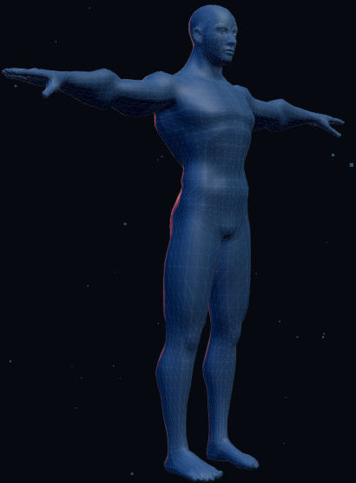
03 — THE APPLICATION
Three scenarios
Each scenario is a self-contained experience sharing the same bloodstream world
APPLICATION MENU — THREE ENTRY POINTS
Notes:
For this, I created three different scenarios. Each scenario is a self-contained experience sharing the same bloodstream world.

Slide 17
03 — THE APPLICATION
Three scenarios
Each scenario is a self-contained experience sharing the same bloodstream world
🦠
Bacterial Infection
Watch leukocytes hunt, chase and destroy pathogens inside the vessel
APPLICATION MENU — THREE ENTRY POINTS
Notes:
The first one simulates a bacterial infection where we can see how white blood cells behave in the presence of pathogens.

Slide 18
03 — THE APPLICATION
Three scenarios
Each scenario is a self-contained experience sharing the same bloodstream world
🦠
🫁
Bacterial Infection
Oxygen Exchange
Watch leukocytes hunt, chase and destroy pathogens inside the vessel
Follow red blood cells absorbing O₂ in the pulmonary capillaries
APPLICATION MENU — THREE ENTRY POINTS
Notes:
The second one is related to the oxygen absorption of the red blood cells inside the pulmonary capillaries.

Slide 19
03 — THE APPLICATION
Three scenarios
Each scenario is a self-contained experience sharing the same bloodstream world
🦠
🫁
🩸
Bacterial Infection
Oxygen Exchange
Wound Coagulation
Watch leukocytes hunt, chase and destroy pathogens inside the vessel
Follow red blood cells absorbing O₂ in the pulmonary capillaries
See platelets seal a breach in the vessel wall and fibrin form a clot
APPLICATION MENU — THREE ENTRY POINTS
Notes:
And the last one, simulates a wound in the vein so we can see how platelets seal the breach.

Slide 20
04 — IMPLEMENTATION
Shared world & entities
Notes:
As we can see, there are many similarities between all the scenarios, which allows us to have a modular and shared structure, reusable in different scenarios.

Slide 21
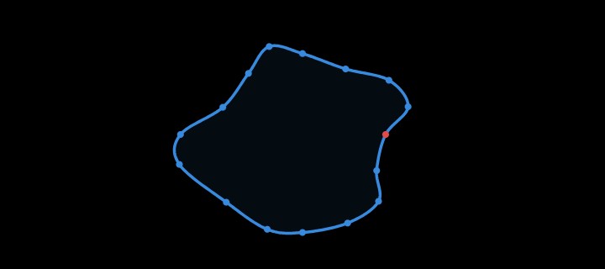
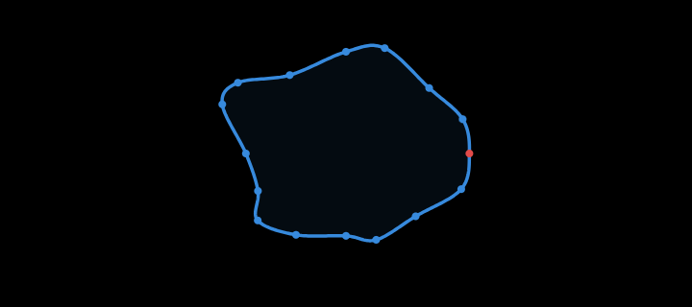
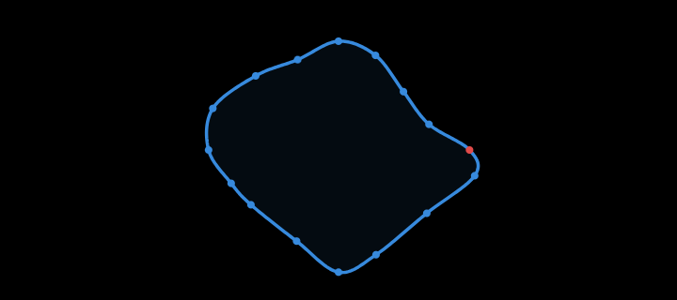
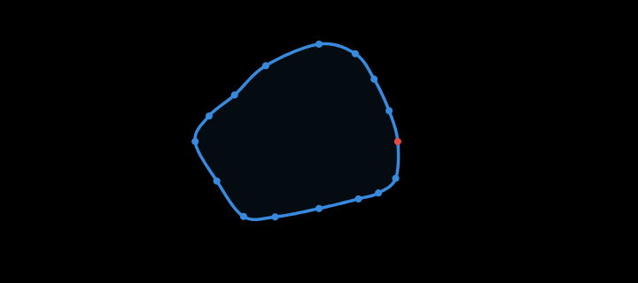
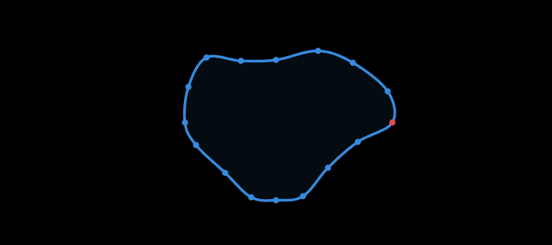
04 — IMPLEMENTATION
Shared world & entities
Bloodstream & Path
The bloodstream builds the tube mesh, outer shell and fog/lighting
Path is generated randomly every run
Notes:
They all share the class bloodstream as, obviously, they all need a blood flow. This builds the tube mesh, the outer shell and the fog and lighting. The path is always a close circular loop with some random deviations, which is randomly generated every time to create different feelings. Here are some examples of paths.

Slide 22
04 — IMPLEMENTATION
Shared world & entities
Bloodstream & Path
The bloodstream builds the tube mesh, outer shell and fog/lighting
Path is generated randomly every run

Slide 23
04 — IMPLEMENTATION
Shared world & entities
Bloodstream & Path
The bloodstream builds the tube mesh, outer shell and fog/lighting
Path is generated randomly every run

Slide 24
04 — IMPLEMENTATION
Shared world & entities
Bloodstream & Path
The bloodstream builds the tube mesh, outer shell and fog/lighting
Path is generated randomly every run
RBCSystem & Plasma
Specific entity but shared by all scenarios as it is the main blood component
Plasma is created with the bloodstream to generate a more immersive sensation
Notes:
Also, all scenarios have red blood cells and plasma, as they are the main blood component. Plasma is created with the bloodstream to generate a more immersive sensation.

Slide 25
04 — IMPLEMENTATION
Shared world & entities
Bloodstream & Path
The bloodstream builds the tube mesh, outer shell and fog/lighting
Path is generated randomly every run
RBCSystem & Plasma
Camera & Narrator
Specific entity but shared by all scenarios as it is the main blood component
Plasma is created with the bloodstream to generate a more immersive sensation
The camera has the same interaction for all scenarios with easy look-ahead
The narrator behavior is the same but displays different information in each scenario
Notes:
Lastly, we use the same camera and narrator classes for all interactions, as despite being different scenarios, their behavior is going to be the same. The camera flows autonomously with an easy look-ahead, and the narrator has a typewriter style whose text varies based on each scenario.

Slide 26
04 — Scenarios
01 Bacterial Infections
Notes:
Finally, after the last bacteria has been eliminated, we end the simulation entering the resolved phase.

Slide 27
04 — Scenarios
01 Bacterial Infections
Bacteria — 3 types
Notes:
Finally, after the last bacteria has been eliminated, we end the simulation entering the resolved phase.

Slide 28
04 — Scenarios
01 Bacterial Infections
Bacteria — 3 types
● Coccus sphere
Notes:
Finally, after the last bacteria has been eliminated, we end the simulation entering the resolved phase.

Slide 29
04 — Scenarios
01 Bacterial Infections
Bacteria — 3 types
● Coccus sphere
● Bacillus cylinder
Notes:
Finally, after the last bacteria has been eliminated, we end the simulation entering the resolved phase.

Slide 30
04 — Scenarios
01 Bacterial Infections
Bacteria — 3 types
● Coccus sphere
● Bacillus cylinder
● Spirilla icosahedron
Notes:
Finally, after the last bacteria has been eliminated, we end the simulation entering the resolved phase.

Slide 31
04 — Scenarios
01 Bacterial Infections
Bacteria — 3 types
● Coccus sphere
● Bacillus cylinder
● Spirilla icosahedron
WBC — Leukocyte
Notes:
Finally, after the last bacteria has been eliminated, we end the simulation entering the resolved phase.

Slide 32
04 — Scenarios
01 Bacterial Infections
Bacteria — 3 types
● Coccus sphere
● Bacillus cylinder
● Spirilla icosahedron
WBC — Leukocyte
PATROL
Notes:
Finally, after the last bacteria has been eliminated, we end the simulation entering the resolved phase.

Slide 33
04 — Scenarios
01 Bacterial Infections
Bacteria — 3 types
● Coccus sphere
● Bacillus cylinder
● Spirilla icosahedron
WBC — Leukocyte
PATROL
→
CHASE
Notes:
Finally, after the last bacteria has been eliminated, we end the simulation entering the resolved phase.

Slide 34
04 — Scenarios
01 Bacterial Infections
Bacteria — 3 types
● Coccus sphere
● Bacillus cylinder
● Spirilla icosahedron
WBC — Leukocyte
PATROL
→
CHASE
→
ATTACK
Notes:
Finally, after the last bacteria has been eliminated, we end the simulation entering the resolved phase.

Slide 35
04 — Scenarios
01 Bacterial Infections
Bacteria — 3 types
● Coccus sphere
● Bacillus cylinder
● Spirilla icosahedron
WBC — Leukocyte
PATROL
→
CHASE
→
ATTACK
after kill
Notes:
Finally, after the last bacteria has been eliminated, we end the simulation entering the resolved phase.

Slide 36
04 — Scenarios
01 Bacterial Infections
Bacteria — 3 types
ImmuneSystem — simulation logic
Three phases: OBSERVING → RESPONSE → RESOLVED.
OBSERVING:
bacteria and WBCs introduced one by one
The Narrator advances each step by detecting real events
● Coccus sphere
● Bacillus cylinder
● Spirilla icosahedron
WBC — Leukocyte
PATROL
→
CHASE
→
ATTACK
after kill
Notes:
Finally, after the last bacteria has been eliminated, we end the simulation entering the resolved phase.

Slide 37
04 — Scenarios
01 Bacterial Infections
Bacteria — 3 types
ImmuneSystem — simulation logic
Three phases: OBSERVING → RESPONSE → RESOLVED.
OBSERVING:
bacteria and WBCs introduced one by one
The Narrator advances each step by detecting real events
RESPONSE:
new bacteria spawn near the camera
WBCs relay from behind the camera to keep action visible
Spawning stops after 30 s
● Coccus sphere
● Bacillus cylinder
● Spirilla icosahedron
WBC — Leukocyte
PATROL
→
CHASE
→
ATTACK
after kill
Notes:
Finally, after the last bacteria has been eliminated, we end the simulation entering the resolved phase.

Slide 38
04 — Scenarios
01 Bacterial Infections
Bacteria — 3 types
ImmuneSystem — simulation logic
Three phases: OBSERVING → RESPONSE → RESOLVED.
OBSERVING:
bacteria and WBCs introduced one by one
The Narrator advances each step by detecting real events
RESPONSE:
new bacteria spawn near the camera
WBCs relay from behind the camera to keep action visible
Spawning stops after 20 s
RESOLVED:
fires when bacteria = 0
● Coccus sphere
● Bacillus cylinder
● Spirilla icosahedron
WBC — Leukocyte
PATROL
→
CHASE
→
ATTACK
after kill
Notes:
Finally, after the last bacteria has been eliminated, we end the simulation entering the resolved phase.

Slide 39
04 — SCENARIOS
02 Oxygen Exchange
Notes:
The second scenario simulates the oxygen exchange.

Slide 40
04 — SCENARIOS
02 Oxygen Exchange
O₂ Particles & absorption
cyan spheres spawn on the tube wall, drifting radially inward
Each frame, if a particle comes close of any RBC, it is absorbed
This boosts the oxiFactor
Notes:
For this, we introduce O2 particles as a new entity. Cyan spheres spawn on the tube wall, drifting radially inward. Each frame, if a particle comes close of any RBC, it is absorbed. This boosts the oxiFactor which is how much oxygen is contained in the blood cell, with purple meaning low and bright red meaning high.

Slide 41
04 — SCENARIOS
02 Oxygen Exchange
DEOXYGENATED
OXYGENATED
O₂ Particles & absorption
cyan spheres spawn on the tube wall, drifting radially inward
Each frame, if a particle comes close of any RBC, it is absorbed
This boosts the oxiFactor
RBCColorSystem
Auxiliar system to modify the RBC color based on the oxygen level they have (oxiFactor)
Inside the alveolar zone the oxiFactor rises
Outside the alveolar zone th oxiFactor decays
Notes:
For this color change, we implement an auxiliary system that modifies the color based on the oxiFactor, which rises within the alveolar zone and decays outside of it.

Slide 42
04 — SCENARIOS
02 Oxygen Exchange
DEOXYGENATED
OXYGENATED
O₂ Particles & absorption
AlveoliZone & zone detection
cyan spheres spawn on the tube wall, drifting radially inward.
Each frame, if a particle comes close of any RBC, it is absorbed.
This boosts the oxiFactor
Two phases: PULMONARY CAPILLARY → CIRCULATION
RBCColorSystem
Auxiliar system to modify the RBC color based on the oxygen level they have (oxiFactor)
Inside the alveolar zone the oxiFactor rises
Outside the alveolar zone th oxiFactor decays
Notes:
The simulation logic has two phases:

Slide 43
04 — SCENARIOS
02 Oxygen Exchange
DEOXYGENATED
OXYGENATED
O₂ Particles & absorption
AlveoliZone & zone detection
cyan spheres spawn on the tube wall, drifting radially inward.
Each frame, if a particle comes close of any RBC, it is absorbed.
This boosts the oxiFactor
Two phases: PULMONARY CAPILLARY → CIRCULATION
PULMONARY CAPILLARY:
Slightly wider tube on a specific zone of the path
Lighting and fog change → signals exchange area
O2 particles spawn and are absorbed
RBCColorSystem
Auxiliar system to modify the RBC color based on the oxygen level they have (oxiFactor)
Inside the alveolar zone the oxiFactor rises
Outside the alveolar zone th oxiFactor decays
Notes:
The first one is the pulmonary capillary. The alveoli zone is defined as a specific part of the tube and it is slidely wider. It also has a different lighting and fog that signals the exchange area. Here, oxygen particles spawn and are absorbed when close to red blood cells.

Slide 44
04 — SCENARIOS
02 Oxygen Exchange
DEOXYGENATED
OXYGENATED
O₂ Particles & absorption
AlveoliZone & zone detection
cyan spheres spawn on the tube wall, drifting radially inward.
Each frame, if a particle comes close of any RBC, it is absorbed.
This boosts the oxiFactor
Two phases: PULMONARY CAPILLARY → CIRCULATION
PULMONARY CAPILLARY:
Slightly wider tube on a specific zone of the path
Lighting and fog change → signals exchange area
O2 particles spawn and are absorbed
CIRCULATION:
RBCs return to tissues → oxiFactor decreases as they drop oxygen to other cells
RBCColorSystem
Auxiliar system to modify the RBC color based on the oxygen level they have (oxiFactor)
Inside the alveolar zone the oxiFactor rises
Outside the alveolar zone th oxiFactor decays
Notes:
Once we get out of the alveoli, rbcs flow through the body providing other cells with oxygen. This means they lose oxygen, so oxiFactor decreases, turning them purple again.

Slide 45
04 — SCENARIOS
03 Wound Coagulation
Notes:
The last scenario simulates a wound.

Slide 46
04 — SCENARIOS
03 Wound Coagulation
WoundZone & RBC escape
Ring simulating a breach in the vein wall
Near RBCs escape through the break
Another flow is generated to simulate bleeding
Notes:
For this, we introduce a wound zone. A ring appears in the tube emulating a breach in the vein wall and near rbcs scape through it. Also another flow is generated to simulate bleeding.

Slide 47
04 — SCENARIOS
03 Wound Coagulation
WoundZone & RBC escape
Ring simulating a breach in the vein wall
Near RBCs escape through the break
Another flow is generated to simulate bleeding
PlateletSystem & FibrinMesh
Notes:
We also created two new entities. First the platelets, which have three different states:

Slide 48
04 — SCENARIOS
03 Wound Coagulation
WoundZone & RBC escape
Ring simulating a breach in the vein wall
Near RBCs escape through the break
Another flow is generated to simulate bleeding
PlateletSystem & FibrinMesh
FLOWING
Notes:
Flowing, before being active they flow as any other blood cell.

Slide 49
04 — SCENARIOS
03 Wound Coagulation
WoundZone & RBC escape
Ring simulating a breach in the vein wall
Near RBCs escape through the break
Another flow is generated to simulate bleeding
PlateletSystem & FibrinMesh
FLOWING
→
ACTIVATED
Notes:
Activated, when the wound is detected they flow towards it to block it.

Slide 50
04 — SCENARIOS
03 Wound Coagulation
WoundZone & RBC escape
Ring simulating a breach in the vein wall
Near RBCs escape through the break
Another flow is generated to simulate bleeding
PlateletSystem & FibrinMesh
FLOWING
→
ACTIVATED
→
ADHERED
Notes:
and adhered. Once they have reached the wound they glue together to block it.

Slide 51
04 — SCENARIOS
03 Wound Coagulation
WoundZone & RBC escape
Ring simulating a breach in the vein wall
Near RBCs escape through the break
Another flow is generated to simulate bleeding
PlateletSystem & FibrinMesh
FLOWING
→
ACTIVATED
→
ADHERED
FibrinMesh → proteins that help stabilize the clot
Notes:
And the other entity is the fibrin mesh. Some protein structure that helps to stabilize the clot.

Slide 52
04 — SCENARIOS
03 Wound Coagulation
WoundZone & RBC escape
Wound System
Ring simulating a breach in the vein wall
Near RBCs escape through the break
Another flow is generated to simulate bleeding
Six phases: APPROACHING→DAMAGE→ACTIVATION→AGGREGATION→FIBRIN→STABLE
PlateletSystem & FibrinMesh
FLOWING
→
ACTIVATED
→
ADHERED
FibrinMesh → proteins that help stabilize the clot
Notes:
The wound logic consists of six phases:

Slide 53
04 — SCENARIOS
03 Wound Coagulation
APPROACHING
WoundZone & RBC escape
Wound System
Ring simulating a breach in the vein wall
Near RBCs escape through the break
Another flow is generated to simulate bleeding
Six phases: APPROACHING→DAMAGE→ACTIVATION→AGGREGATION→FIBRIN→STABLE
APPROACHING: default flow until the wound is triggered
PlateletSystem & FibrinMesh
FLOWING
→
ACTIVATED
→
ADHERED
FibrinMesh → proteins that help stabilize the clot
Notes:
First the approaching phase. The default configuration until the wound is triggered.

Slide 54
04 — SCENARIOS
03 Wound Coagulation
APPROACHING
→
DAMAGE
WoundZone & RBC escape
WoundSystem
Ring simulating a breach in the vein wall
Near RBCs escape through the break
Another flow is generated to simulate bleeding
Six phases: APPROACHING→DAMAGE→ACTIVATION→AGGREGATION→FIBRIN→STABLE
APPROACHING: default flow until the wound is triggered
DAMAGE: spawn of the wound on the tube wall
PlateletSystem & FibrinMesh
FLOWING
→
ACTIVATED
→
ADHERED
FibrinMesh → proteins that help stabilize the clot
Notes:
Once the user has activated the wound we enter the damage phase, where the wound spawns in the vein wall.

Slide 55
04 — SCENARIOS
03 Wound Coagulation
APPROACHING
→
DAMAGE
→
ACTIVATION
WoundZone & RBC escape
WoundSystem
Ring simulating a breach in the vein wall
Near RBCs escape through the break
Another flow is generated to simulate bleeding
Six phases: APPROACHING→DAMAGE→ACTIVATION→AGGREGATION→FIBRIN→STABLE
APPROACHING: default flow until the wound is triggered
DAMAGE: spawn of the wound on the tube wall
ACTIVATION: near RBCs start flowing out through the wound
PlateletSystem & FibrinMesh
FLOWING
→
ACTIVATED
→
ADHERED
FibrinMesh → proteins that help stabilize the clot
Notes:
Once the camera has focused on the wound we swap to the activation phase, where near rbcs start flowing out the wound simulating the bleeding effect.

Slide 56
04 — SCENARIOS
03 Wound Coagulation
APPROACHING
→
DAMAGE
→
ACTIVATION
→
AGGREGATION
WoundZone & RBC escape
WoundSystem
Ring simulating a breach in the vein wall
Near RBCs escape through the break
Another flow is generated to simulate bleeding
Six phases: APPROACHING→DAMAGE→ACTIVATION→AGGREGATION→FIBRIN→STABLE
APPROACHING: default flow until the wound is triggered
DAMAGE: spawn of the wound on the tube wall
ACTIVATION: near RBCs start flowing out through the wound
AGGREGATION: platelets become active and block the wound
PlateletSystem & FibrinMesh
FLOWING
→
ACTIVATED
→
ADHERED
FibrinMesh → proteins that help stabilize the clot
Notes:
After a bit of time, platelets become active and start blocking the wound, entering the aggregation phase.

Slide 57
04 — SCENARIOS
03 Wound Coagulation
APPROACHING
→
DAMAGE
→
ACTIVATION
→
AGGREGATION
→
FIBRIN
WoundZone & RBC escape
WoundSystem
Ring simulating a breach in the vein wall
Near RBCs escape through the break
Another flow is generated to simulate bleeding
Six phases: APPROACHING→DAMAGE→ACTIVATION→AGGREGATION→FIBRIN→STABLE
APPROACHING: default flow until the wound is triggered
DAMAGE: spawn of the wound on the tube wall
ACTIVATION: near RBCs start flowing out through the wound
AGGREGATION: platelets become active and block the wound
FIBRIN: once platelets have blocked the wound, the start spawning to strengthen the structure
PlateletSystem & FibrinMesh
FLOWING
→
ACTIVATED
→
ADHERED
FibrinMesh → proteins that help stabilize the clot
Notes:
Once the clot is almost stable, the fibrin mesh starts spawning in order to strengthen the structure.

Slide 58
04 — SCENARIOS
03 Wound Coagulation
APPROACHING
→
DAMAGE
→
ACTIVATION
→
AGGREGATION
→
FIBRIN
→
STABLE
WoundZone & RBC escape
WoundSystem
Ring simulating a breach in the vein wall
Near RBCs escape through the break
Another flow is generated to simulate bleeding
Six phases: APPROACHING→DAMAGE→ACTIVATION→AGGREGATION→FIBRIN→STABLE
APPROACHING: default flow until the wound is triggered
DAMAGE: spawn of the wound on the tube wall
ACTIVATION: near RBCs start flowing out through the wound
AGGREGATION: platelets become active and block the wound
FIBRIN: once platelets have blocked the wound, the start spawning to strengthen the structure
STABLE: the wound is completely closed
PlateletSystem & FibrinMesh
FLOWING
→
ACTIVATED
→
ADHERED
FibrinMesh → proteins that help stabilize the clot
Notes:
Finally, once the wound is completely blocked we conclude the simulation entering the stable phase.

Slide 59
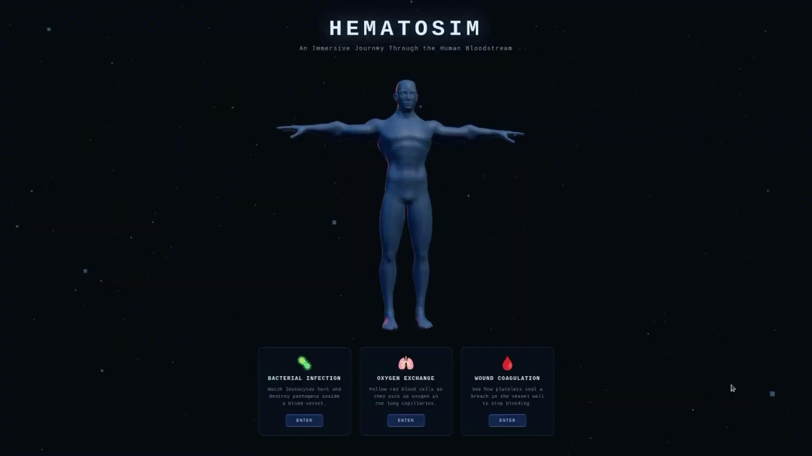
Live Demo

Slide 60
05 — Closure
Conclusions & Future Work
Conclusions
The result aligns closely with the initial goals:
High-level explanation
Visually engaging
Understandable and explanative
Interactive
Both observation modes give different levels of experience
The entity and scenario architecture is modular

Slide 61
05 — Closure
Conclusions & Future Work
Conclusions
Future Work
The result aligns closely with the initial goals:
High-level explanation
Visually engaging
Understandable and explanative
Interactive
Both observation modes give different levels of experience
The entity and scenario architecture is modular
More scenarios using the same structure: glucose transport, allergic response…
Guided vs free mode
Non-circular path: linear or branching route (more realistic simulation)
Modify direction of spin and enable look backwards

