Slide 1

Technology in human development
By: Tasnima Orpa
CSIT 100

Slide 2


What is Human Development?
Lifelong growth process
Includes emotional development
Includes mental + physical growth
Includes social skills
Changes across all life stages

Slide 3




Technology in Today’s World
Smartphones + social media
Artificial intelligence (AI)
Internet everywhere
Instant communication
Constant information access

Slide 4



Cognitive Development Impact
Attention span changes
Memory shifts
Multitasking behavior
Faster decision-making
Information overload

Slide 5
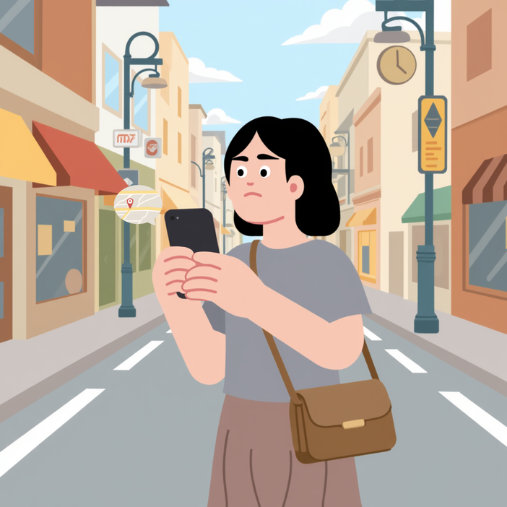

Attention & Focus
Constant notifications
Shorter attention span
Switching tasks quickly
Harder deep focus
Digital distractions everywhere

Slide 6



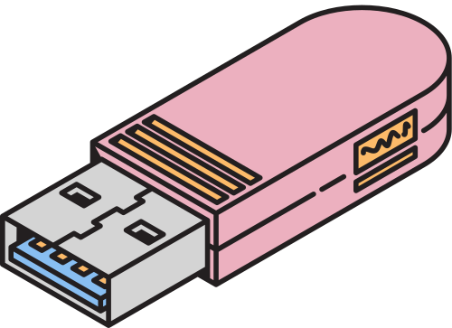
Memory & Thinking
Less memorization
Rely on search engines
External memory storage
Faster answers
Reduced recall practice

Slide 7

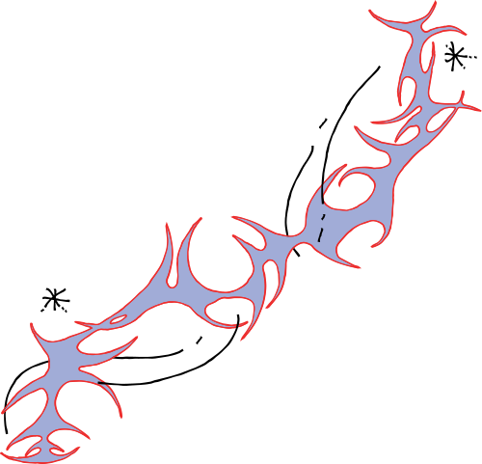
Brain Development
Brain adapts (neuroplasticity)
Strong digital stimulation
Early childhood impact
Learning pattern changes
Environment shapes brain

Slide 8
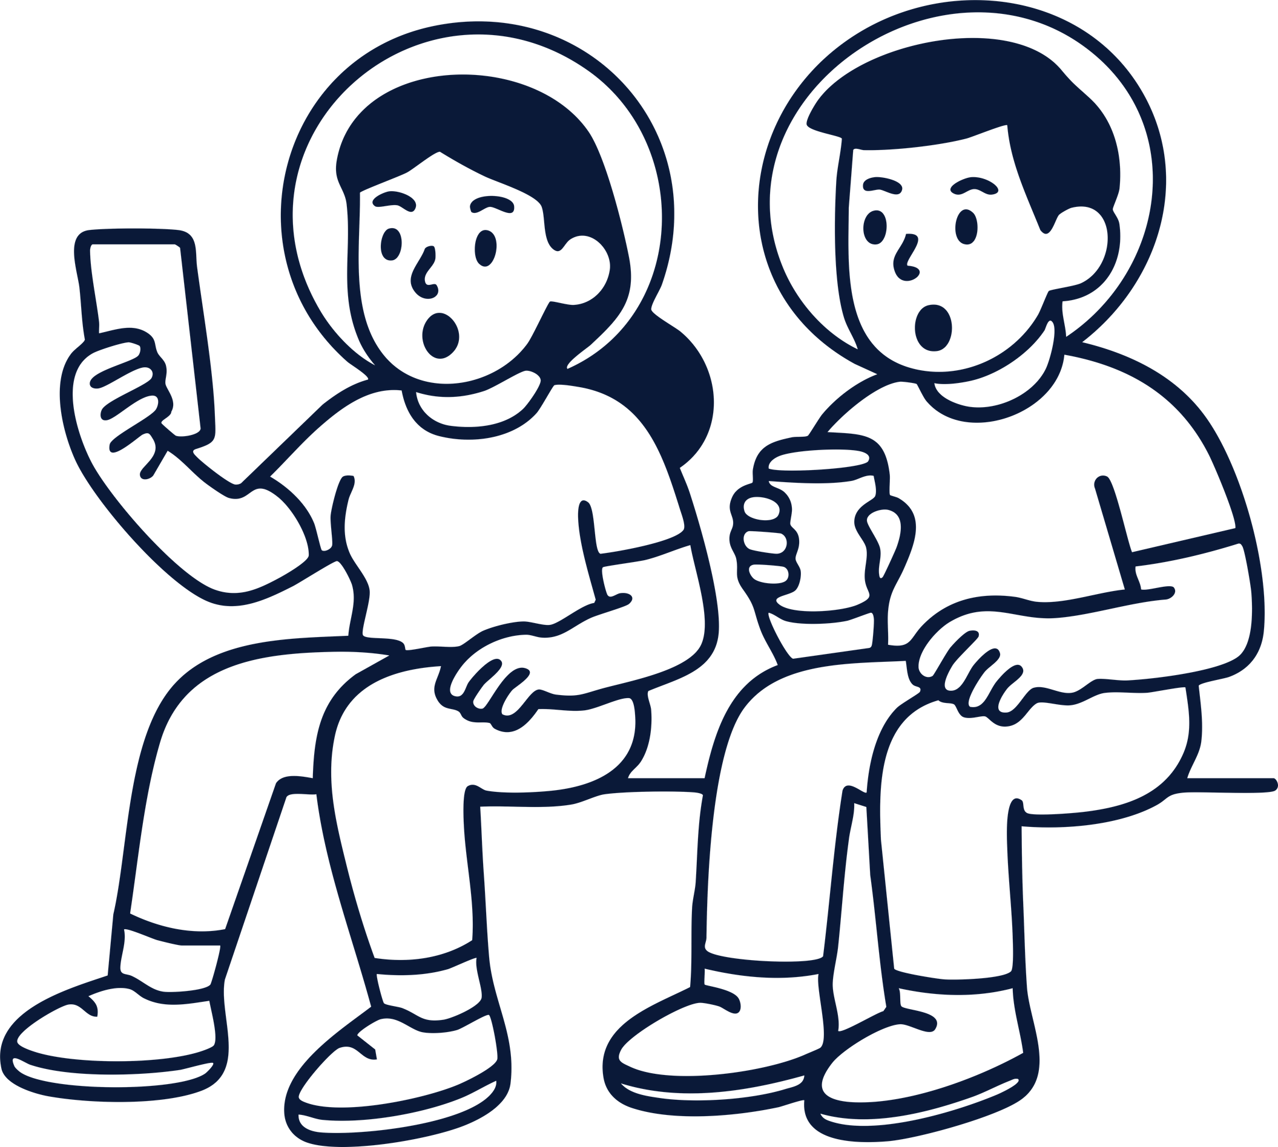
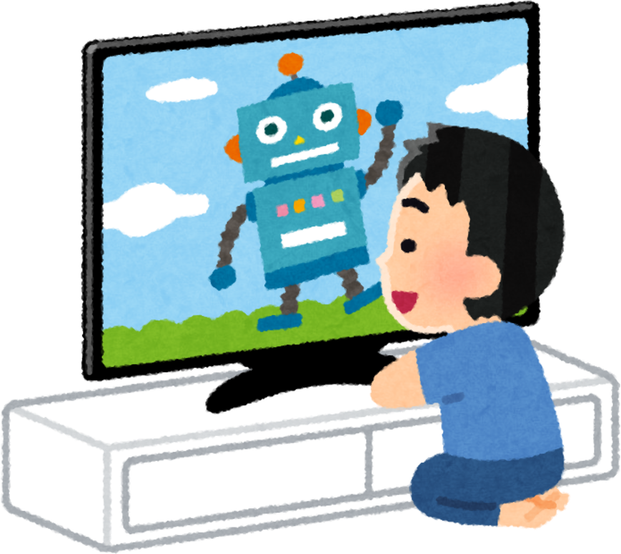
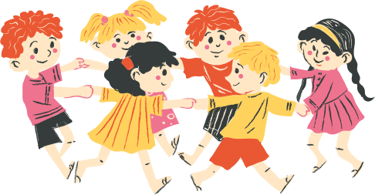
Children & Learning
Learn through play
Face-to-face interaction
Social skill development
Balance needed with tech
Too much screen time risky

Slide 9

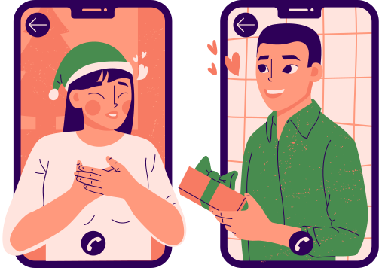
Social Development
Easy global communication
Long-distance relationships
Social media connections
Less in-person interaction
Changing communication style

Slide 10

Mental Health Effects
Social comparison online
Anxiety in teens
Self-esteem issues
Online support groups
Emotional influence

Slide 11


Global Impact
Education access online
Telemedicine healthcare
Digital economy growth
Unequal access (digital divide)
Worldwide connectivity

Slide 12

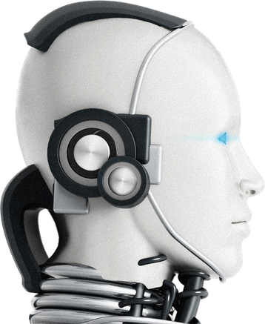
Jobs & Future Work
AI replacing jobs
New tech careers
Automation growth
Skill development needed
Constant learning required

Slide 13


My Personal Experience
Grew up in Bangladesh
Limited early technology
More outdoor play
Strong face-to-face skills
Later digital adaptation

Slide 14
Advantages Disadvantages
Better education access
Faster communication
Global knowledge sharing
Increased productivity
Eye strain & health issues
Less physical activity
Privacy risks
Distraction & addiction
Misinformation online

Slide 15
Conclusion
Technology shapes development
Affects brain + behavior
Has pros and cons
Balance is essential
Human choice matters most

Slide 16
Thank you!

