Slide 1
From XML to Database And Back
Rob Ratcliff

Slide 2
Single Source Modeling
The data model and persistence scheme described in one place – the XML Schema in this case
All JavaBean code related to the data model is auto-generated from this one source
Database schema driven by same source

Slide 3
JAXB 2.x
Version 2 is ready for Prime Time
Fast and Clean (no claptrap code)
Part of the Metro Project (JAXB, JAXWS, etc.)

Slide 4
Customizing Timestamps
<?xml version="1.0" encoding="UTF-8"?>
<xs:schema xmlns:xs="http://www.w3.org/2001/XMLSchema" elementFormDefault="qualified" attributeFormDefault="unqualified" xmlns:jaxb="http://java.sun.com/xml/ns/jaxb" xmlns:xjc="http://java.sun.com/xml/ns/jaxb/xjc" jaxb:extensionBindingPrefixes="xjc" jaxb:version="2.0">
<xs:annotation>
<xs:appinfo>
<jaxb:globalBindings>
<jaxb:serializable/>
<xjc:javaType name="java.sql.Timestamp“
xmlType="TimestampStringType" adapter="TimeConverter"/>
</jaxb:globalBindings>
</xs:appinfo>
</xs:annotation>

Slide 5
Timestamp Customization
XMLGregorian Calendar the default
Need global custom type to change this
(Why is MySQL going to get a decent timestamp!)
Use datetime string for timestamps rather than longs

Slide 6
JAXB Customizations with JAXB 2.0 Commons
Fluent design
  Return “this” from setter
  USAddress address = new USAddress() .setName(name) .setStreet(street) .setCity(city) .setState(state) .setZip(new BigDecimal(zip));
toString() of all properties
Contructors – default and all instance variables
Code snippets – add functionality to generated classes

Slide 7
JAXB Support for XML ID/IDREF/IDREFS
Advantages
  Referential Integrity
  Reference objects in XML document by ID to limit duplication of data
  Model cyclic graphs
Disadvantages
  IDRef doesn’t specify type
  JAXB generates type Object for the referenced type

Slide 8
ID Example
<document>
<box>
<appleRef ref="a1" />
<orangeRef ref="o1" />
<apple id="a1" />
<orange id="o1" />
</box>
<box>
<apple id="a2" />
<appleRef id="a2" />
</box>
</document>

Slide 9
Generated Class for Related Schema
@XmlRootElement class Apple {
@XmlID String id;
}
@XmlRootElement class AppleRef {
@XmlIDREF Object ref;
}
@XmlRootElement class Orange {
@XmlID String id;
}
@XmlRootElement class OrangeRef {
@XmlIDREF Object ref;
}
class Box {
@XmlElementRef List fruits;
}
http://weblogs.java.net/blog/kohsuke/archive/2005/08/pluggable_ididr.html

Slide 10
Serialization
Bidirectional Relationships can make serialization more complicated
Must us ID/IDREF for XML
Must use ValueTypes for CORBA rather than struct
GWT and RMI support Bidirectional Relationships

Slide 11
HyperJaxB 3
Generates JPA and Hibernate Bindings from XML Schema
Leverages all of JAXB’s capabilities

Slide 12
Getting Latest HyperJaxB3
svn checkout https://hj3.dev.java.net/svn/hj3/trunk hj3 --username username
cvs -d :pserver:username@cvs.dev.java.net:/cvs login
cvs -d :pserver:username@cvs.dev.java.net:/cvs checkout jaxb2-commons
svn checkout https://maven-jaxb2-plugin.dev.java.net/svn/maven-jaxb2-plugin/trunk maven-jaxb2-plugin --username username
mvn clean install each module
Lots of stuff gets downloaded using Maven ☹

Slide 13
Running HyperJaXB 1-3
Put your schema files into the src/main/resources. Schemas should have the *.xsd extensions.
Put your binding files into the same directory (src/main/resources). Binding files should have the *.xjb extensions.
Put your sample XML (*.xml) into the src/test/samples directory. These samples will be used for the automatic roundtrip testing.
Run mvn clean install.

Slide 14
Surrogate Keys VS. Natural Keys
Surrogate Keys are computer generated unique keys
Natural Keys come from the actual data that is naturally unique like zipcode or phone number

Slide 15
Best Options for
Surrogate Keys
Autoincrement
    Simple
    Data may not be importable
GUID
  Nastier Key
  No round trips to database
  Data importable to other databases
Other?

Slide 16
One to Many Relationships
Join Table
Child Has Foreign Key to Parent
Two way relationships between parent and child
Serialization issues

Slide 17
Equals and Hashcode Best Practices
What is the best approach?
Equals
  Primary Key?
  Apache commons equals builder
    All properties?
Hashcode
  Apache commons hashcode builder?

Slide 18
Enumerations
Use Strings rather than ordinals when persisting
  Less Brittle
  More Readable

Slide 19
Disadvantages
JPA doesn’t support custom types (like Hibernate)
Maven complicates things a bit
Can’t leverage IDEs support for annotations
Harder to add custom methods

Slide 20
Hibernate Custom Types

Slide 21
Reverse Engineering JPA Classes using NetBeans
Demo

Slide 22
Generating a Simple CRUD Editor with NetBeans

Slide 23
Soap Communication with JAXWS
Starting with XML guarantees that clean generation from Java class
Faster and more robust than Apache Axis 2

Slide 24
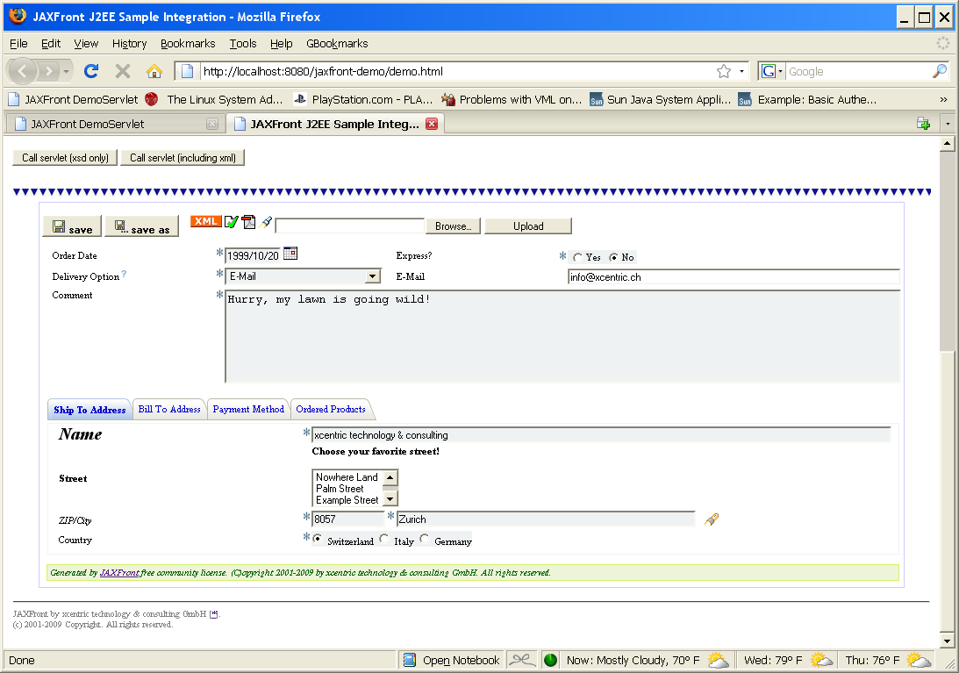
JAXFront
Generation of Forms from XML Schema

