Slide 1
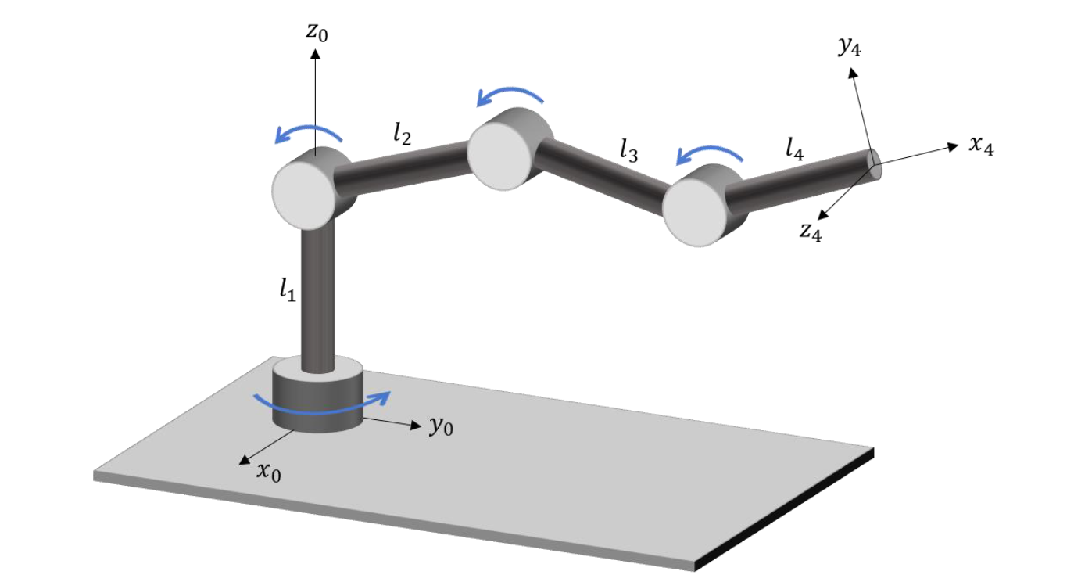



Joint 2
Joint 3
Joint 4
Joint 1

Slide 2
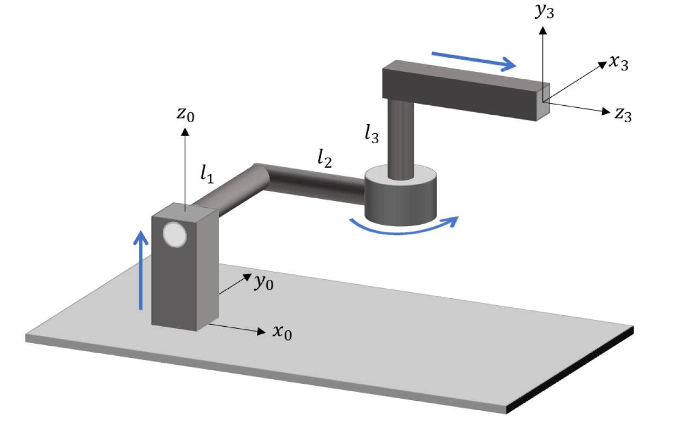


Joint 3
Joint 2
Joint 1

