Slide 1


Amazon Simple Queue Service - Everything You Need to Know
...and probably some things you don’t need to know

Slide 2

Who am I?
Software crafting @ Vat IT
@orrymr | github.com/orrymr
www.orrymr.com

Slide 3

Outline
About SQS
Demo
Vat IT application

Slide 4

So... What’s it All About?
Amazon Simple Queue Service (SQS) is a fully managed message queuing service that makes it easy to decouple and scale microservices, distributed systems, and serverless applications. (from https://aws.amazon.com/sqs/)
So – it offers message queues as a service
Been around for 10 + years.
One of the oldest in the AWS portfolio.
Notes:
- I’m gonna just read the defn, then I’ll elaborate
- The definition from the website is...
- Actually the oldest

Slide 5
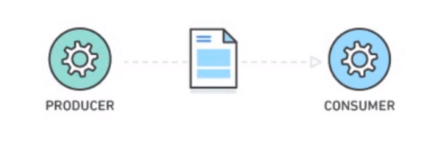
What’s a Message Queue?
Durable buffer for application messages
This buffer sits between a producer and a consumer (or many of each)
Temporary message storage when destination app is busy
I’ll demonstrate why this is necessary
Notes:
- It’s essentially a place for your applications to put messages.
- Direct talk: means that the system is dependent consumer not breaking at that exact moment.
- Also, consumer could be much slower than producer.

Slide 6
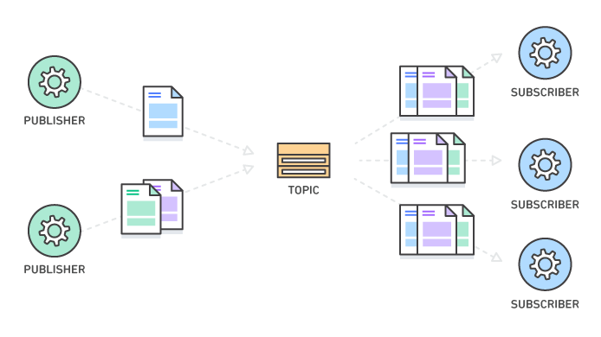
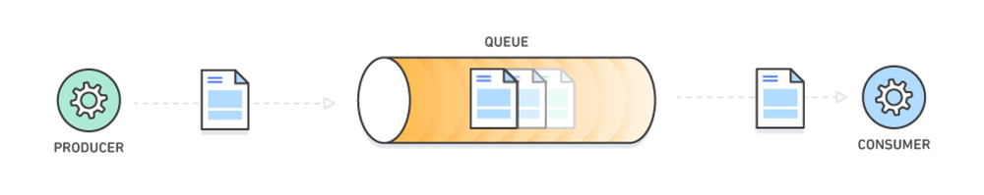
Pub-Sub / Message Queue
Pub / Sub
Using topics
SNS
Different functions
Message Queue
Many producers and consumers
Each message is processed only once, by a single consumer
Notes:
- (Standard queues support a nearly unlimited number of transactions per second (TPS) per API action.) Standard up to 100k messages per second
- FIFO queues support up to 300 messages per second (300 send, receive, or delete operations per second) but can be 10x better, if you batch. Batch limit is 10. Can also file a support request for more if needed.
- standard queues are designed to be massively scalable using a highly distributed architecture, receiving messages in the exact order they are sent is not guaranteed.
- $0.50 cents per million API requests (first million monthly requests are free)
- Orry find out how much Standard Queues cost
- Not all regions
- Create all the queues you like. Only billed per request

Slide 7
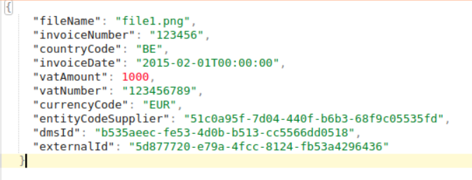

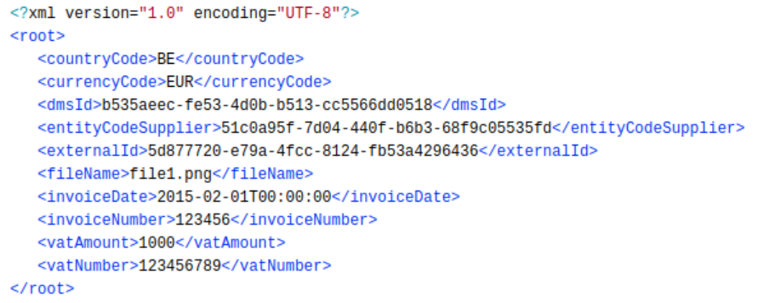
What’s a Message?
JSON
Key/Value pairs
XML
Notes:
- Payload and Attributes
- Can encrypt the body (payload)

Slide 8

Why Should I (You) Care?
Services run at different speeds
Services can go down – fault tolerance
Updating services (so... downtime)
Decoupling application components
Scaling! (Stateless pods)
Notes:
- Capacity mismatch - database getting pummelled with requests, can’t keep up - use queue as a durable buffer. Queue in the middle absorbs all the extra traffic going into the system (limit on number of messages in queue? - No limit.
- Limit is how long it can stay in the queue - 14 days! There have been instances of > 1 Billion messages in a queue)
- limit on sqs message sizes: 256kb - extended client for storage in S3 - gotta pay for storage on S3

Slide 9


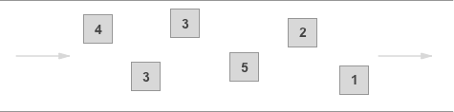
Two Types of Queues
Standard Queue
Performance!
...comes at a cost
At-Least-Once Delivery
Best-Effort Ordering
FIFO Queue
Still pretty good performance
Exactly-Once Processing
First-In-First-Out Delivery per group
#NotAllRegions
Notes:
- (Standard queues support a nearly unlimited number of transactions per second (TPS) per API action.) Standard up to 100k messages per second
- FIFO queues support up to 300 messages per second (300 send, receive, or delete operations per second) but can be 10x better, if you batch. Batch limit is 10. Can also file a support request for more if needed.
- standard queues are designed to be massively scalable using a highly distributed architecture, receiving messages in the exact order they are sent is not guaranteed.
- $0.50 cents per million API requests (first million monthly requests are free)
- Orry find out how much Standard Queues cost
- Not all regions
- Create all the queues you like. Only billed per request

Slide 10
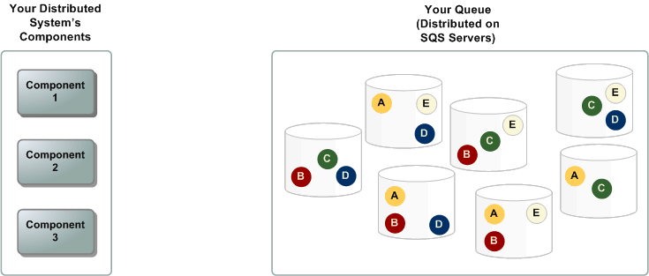
Architecture Overview
Notes:
- Distributed architecture
- your messages are stored on multiple servers for redundancy and high availability.

Slide 11
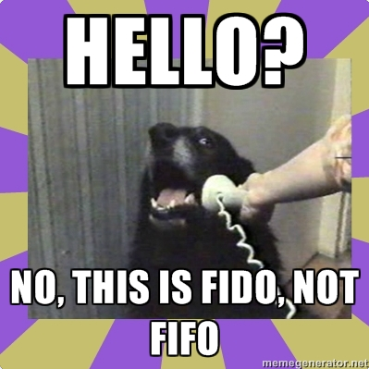
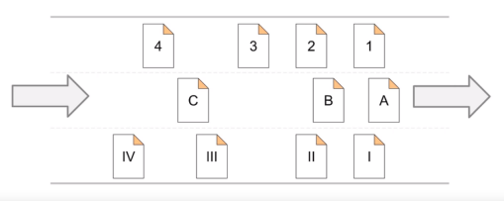
Some More about FIFO
FIFO queue logic applies only per message group ID
Can’t specify group ID...
Deduplication
Quick Console Demo
Notes:
- FIFO logic applies per group ID: you may get messages from several groups, but within the group, order is preserved
- messages sent with the same deduplication ID are accepted successfully but aren't delivered during the 5-minute deduplication interval. - this means that if you send a message with dedup ID “alpha”, new message with dedup ID “alpha” can only get accepted into the queue for 5 mins
- applies to entire queue, not just group.
- SQS continues to track message deduplication ID even after the message is received and deleted.

Slide 12

What could go wrong?
Ok, now we have our queue full of tasks.
What if two consumers pick the same task?
Do we:
a) – Panic
b) – Blame DevOps
c) – Go make some coffee
d) – Not panic, because AWS got your back.

Slide 13

The Visibility Timeout!
Lock out period for messages
Until delete, or timeout expires
FIFO: When you receive a message with a message group ID, no more messages for the same message group ID are returned unless you delete the message or it becomes visible.

Slide 14
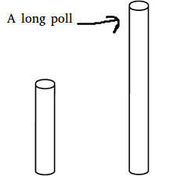
Long Polling
Have to keep making “receive” calls... Always.
Or... Push delivery. Risky
Long polling is the correct solution: it says - “I’m willing to wait for a message for x amount of seconds”
Notes:
- Have to keep calling receive. not nice. - costly
- push - if there is message in the queue, then call me so I (the consumer) can process message. Risky - huge traffic. Overloaded by notification about messages in the queue.
- Long polling is in between. "I'm willing to wait, like 20 seconds". Cheap - one call per 20 seconds.

Slide 15

Dead Letter Queues
Edge cases
Errors
On consumer, you fail to process
Specify policy for retrying; for example try up to 5 times

Slide 16
Demo
Orry – Show the people a demo
More writing to make this slide seem important
I feel a third and fourth bullet point would also assist
See above point
Notes:
watch -n 0.1 java -jar sqstalk-fat-1.jar s

Slide 17
Theia OCR explanation
Message Queue
Can’t fan out (order is NB)
1) – OCR
2) – Field Extraction
3) – Field Highlighting
4) – Supplier determination
5) – DMS Upload
6) – DB upload (via service)
Notes:
- Not Pub Sub
- Consumer reads message then depending on body sends to different services.
- order is important. Can’t fan out (pub sub style)
Notes:
Why SQS? Why not kafka, redis, etc... (already hooked into aws, easy to use, nothing to configure... you can, but... nice defaults)
Expand on Theia usage, how much it can churn
Arpeggio usage vs Theia

Slide 18
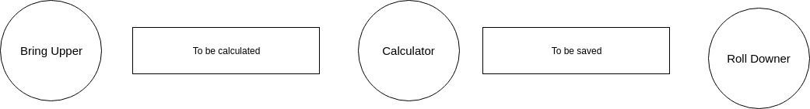
Arpeggio
ARP

