Slide 1


Amazon Simple Queue Service - Everything You Need to Know
...and probably some things you don’t need to know

Slide 2
Who am I?

Slide 3
Outline

Slide 4

So... What’s it All About?
Amazon Simple Queue Service (SQS) is a fully managed message queuing service that makes it easy to decouple and scale microservices, distributed systems, and serverless applications. (from https://aws.amazon.com/sqs/)
So – it offers message queues as a service
Been around for 10 + years.
One of the oldest in the AWS portfolio.

Slide 5
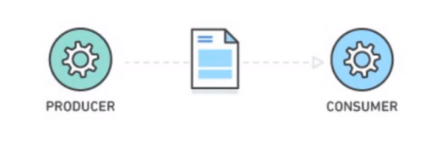
What’s a Message Queue?
Durable buffer for application messages
This buffer sits between a producer and a consumer (or many of each)
Temporary message storage when destination app is busy
Demo will show why this is necessary

Slide 6

Why Should I (You) Care?

