Slide 1
Predicting the type of restaurant that will be the most successful
Or Sadikov & Sagi Barak

Slide 2
RESEARCH QUESTION
Can we predict which restaurant type will be the most successful in a specific city area? Should you open a restaurant with a Mediterranean, or American, or Italian cuisine? Or any other kitchen?

Slide 3
Project phases
Data gathering and Crawling
EDA
Predictions and Results
1
3
5
Data Clearing
2
4
Machine Learning and model evaluation

Slide 4
1.
Data Gathering
And Crawling

Slide 5

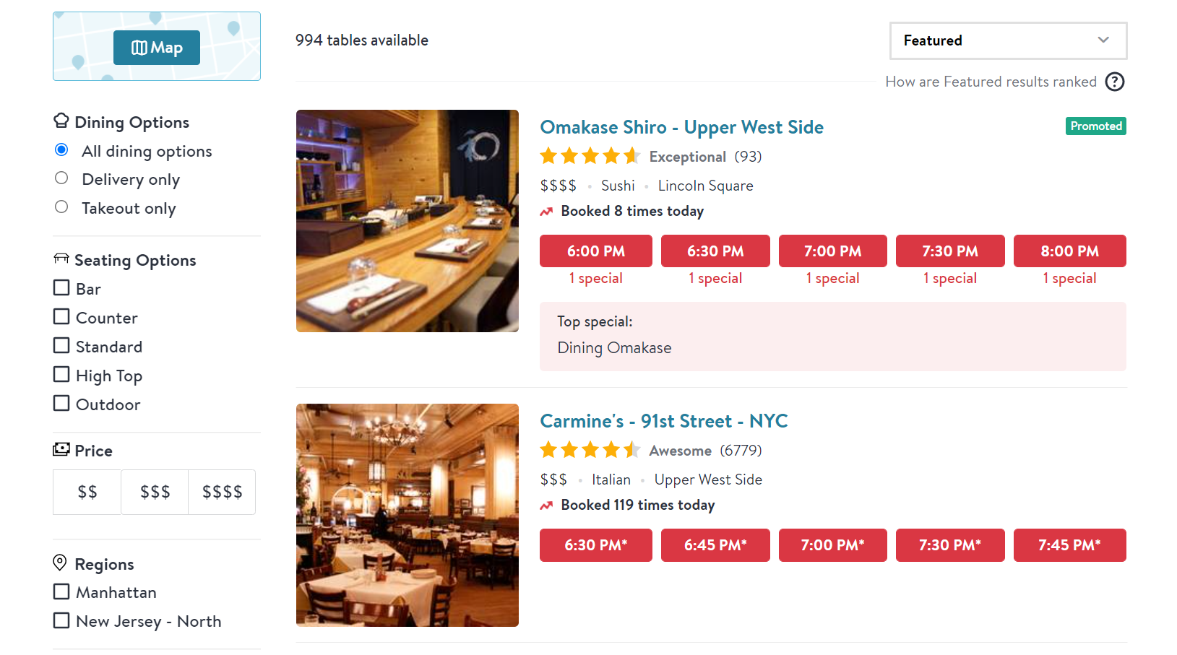
Data Gathering and Crawling
Sources we used for our project:
https://www.opentable.com/
https://www.tripadvisor.com/
We used BeautifulSoup and Selenium for gathering data.
Beautiful Soup is a Python library for pulling data out of HTML and XML files,
Selenium allows us to handle dynamic content generated using JavaScript

Slide 6
Crawling strategy
We worked with list of restaurants located New York
We extracted content and data from any record of restaurants in the list:
“Title“, “Location”, “Price”, “Rating”, “Borough”,
“Clients last day”, “Voters”, “Cuisine”

Slide 7
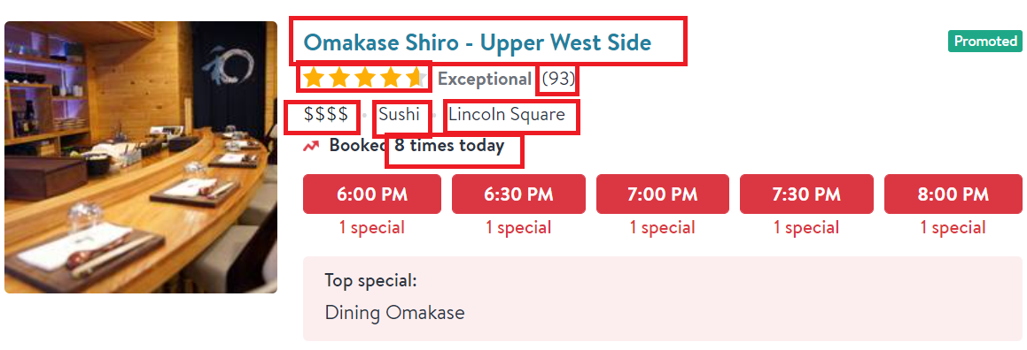
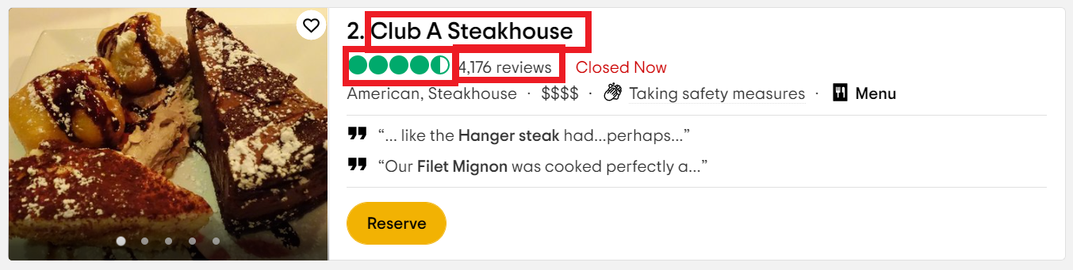
From each record of restaurant we extracted data are available

Slide 8
2. Data Cleaning
After Crawling we had some features (for instance: “Rating”) with Nane values. So we had to delete these rows from our dataset since there are useless for our research

Slide 9

For instance, there is no score in this record

Slide 10
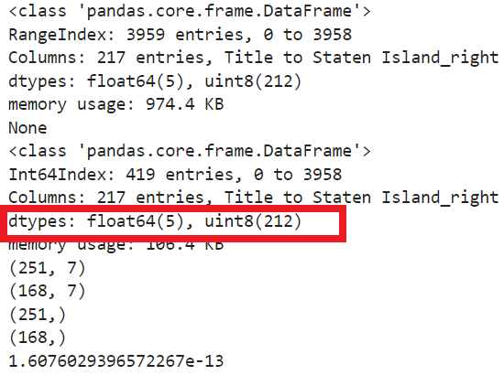
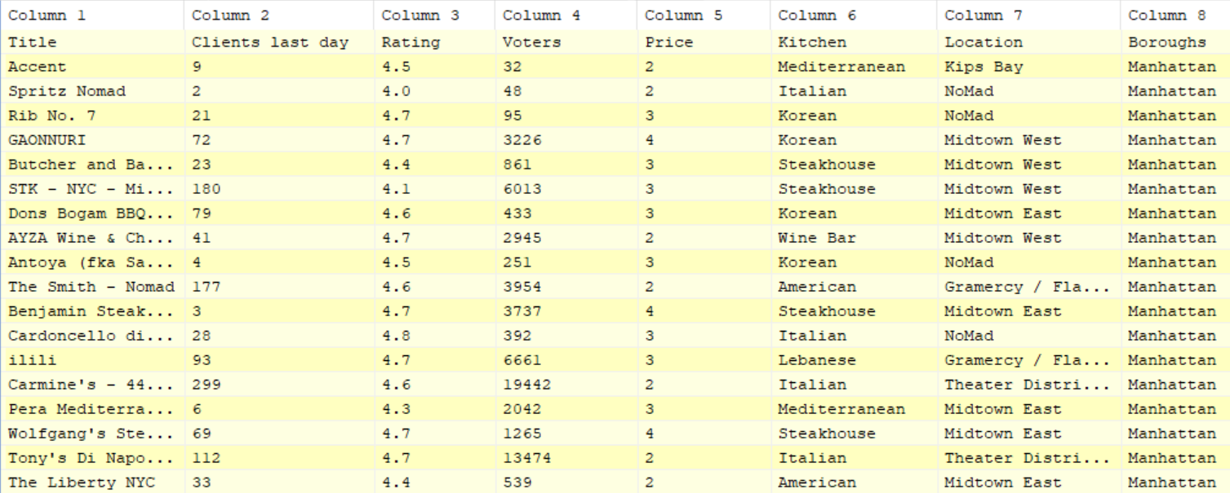
Cleaned Data

Slide 11
3. EDA
Exploratory Data Analysis

Slide 12
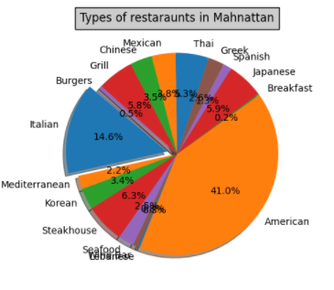
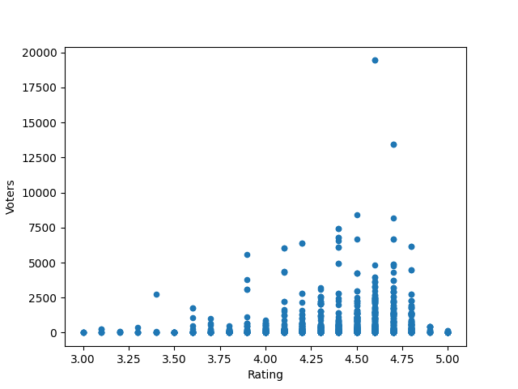
Ratio of visitors to voters

Slide 13
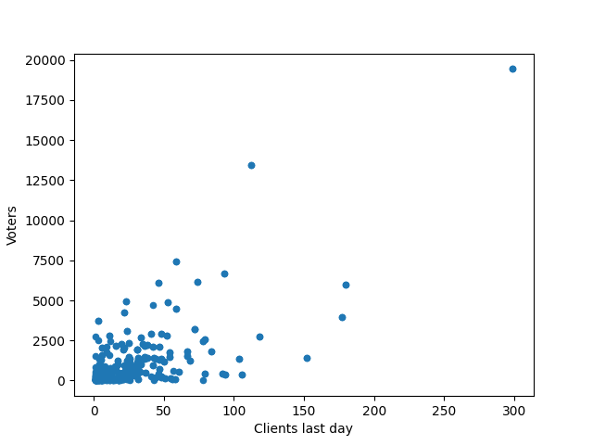
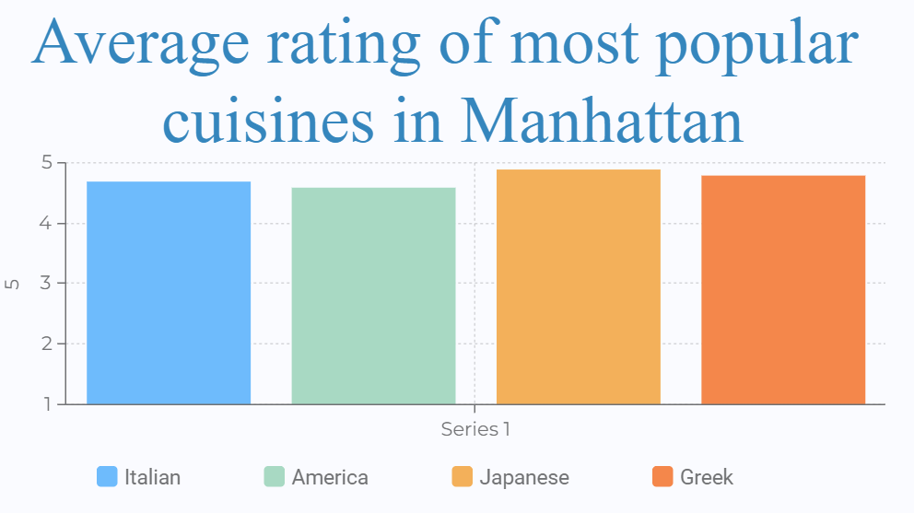

Slide 14
4. Machine Learning and
Model Evaluation

Slide 15
Preparation for ML Model
We need to clean our data and prepare it for Linear Regression
After this we need to train our model using Supervised machine learning
We predict rating of the restaurant (Y-axis)
by getting X-data: Cuisine, Boroughs, Prices etc

Slide 17
5. Predictions and results

Slide 18
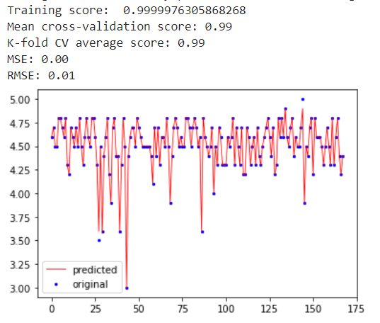
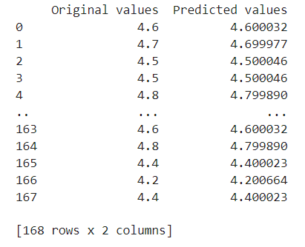
Predicted and Actual Values
XGBRegressor

Slide 19
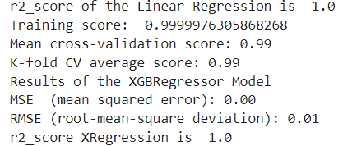


MSE & RMSE
Of the Models
R2 scores

Slide 20
THANKS!
Any questions?
You can find me at
@username
user@mail.me

