Slide 1
LABJOURNAL
Orsi & Steven

Slide 2
The Idea ; Digital Labjournal
Logbook for recording operations and sample parameters
Create experiments and samples which belong to a project
Experiments have operations
Samples have subsamples
Able to search experiments by sample
Able to search operations by subsample

Slide 3
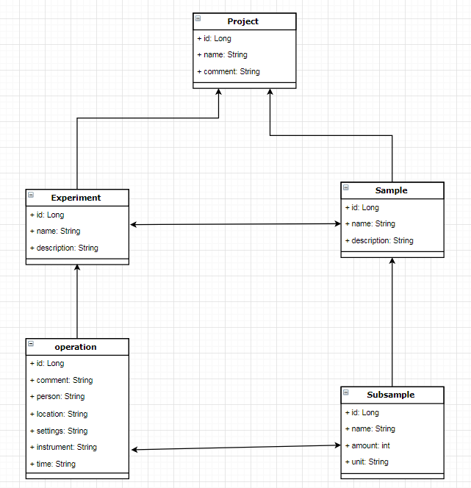


Slide 4
Technical details
Client/Server
HTML/CSS/JS
Spring/Hibernate
MVC
REST
Git

Slide 5
Learning process
Personal learning process
Contribution to the project
What, how and why?
Problems and solutions.

Slide 6
Demo
Look at existing project and modify titlename
Navigate from the home page all the way to operations
Add new experiment and add operations done on subsamples
Finally search for all experiments done on a selected sample

Slide 7
Special thanks

Slide 8
Questions

