Slide 1

Predict human wine taste preferences based on analytical data

Slide 2
The Data
Two joined datasets comprised out of white and red “vinho verde” wine samples from Portugal.
The classes are imbalanced:
4898 white and 1599 red samples
Much more normal wines than excellent (~3%) or poor ones (~4%)
Target column = “Quality”
each sample was evaluated by a minimum of three sensory assessors (using blind tastes), which graded the wine in a scale that ranges from 0 (very bad) to 10 (excellent). The final sensory score is given by the median of these evaluations.

Slide 3
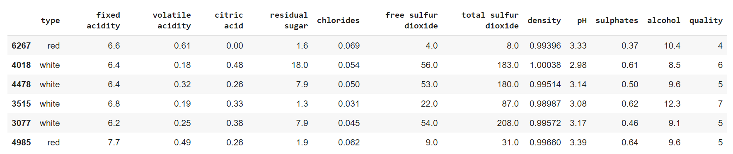
Target = “Quality column

Slide 4
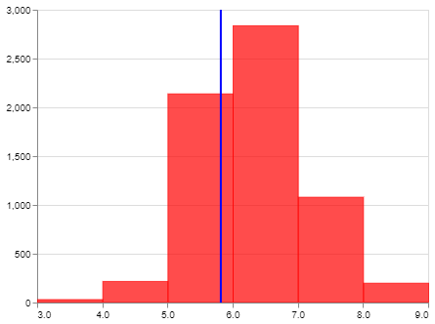
“Quality” score
The classes are imbalanced - there are much more normal wines than excellent or poor ones
Non- Premium ()
Premium ()

Slide 5
Pre-defined requirements
“Premium” Test Recall > 0.7
Test F1-score /Train F1-score > 0.7

Slide 6
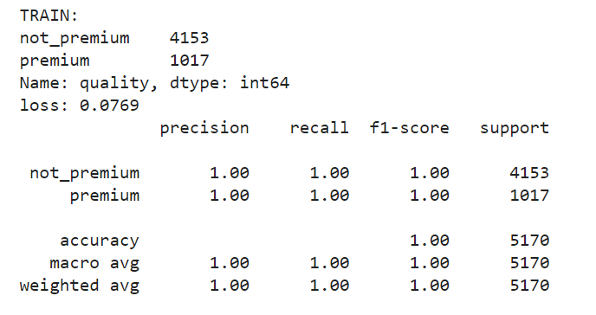
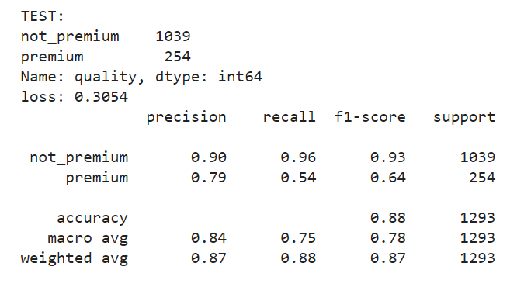
Model #1 - Base
Overfit
Test Recall = 0.54
F1 ratio = 0.64

Slide 7
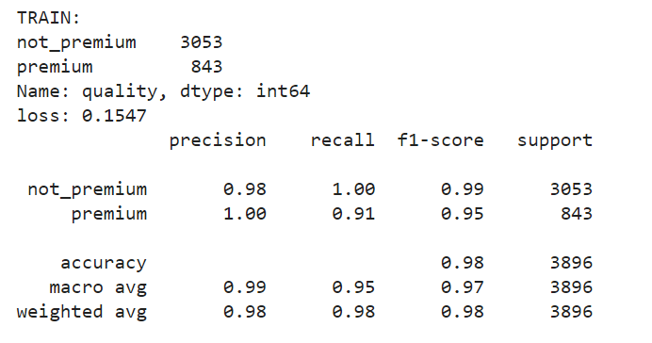
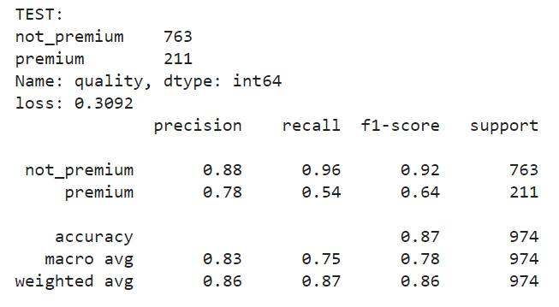
“Type” importance
Since the red and white tastes are quite different, We decided to perform the analysis separately
White wine
Test Recall = 0.54
F1 ratio = 0.673

Slide 8
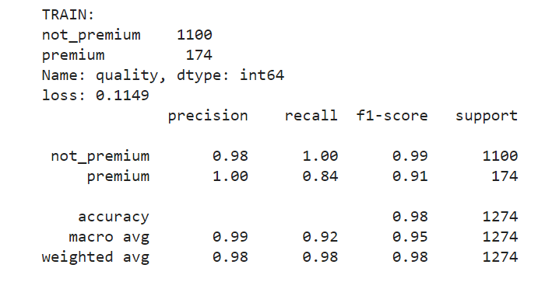
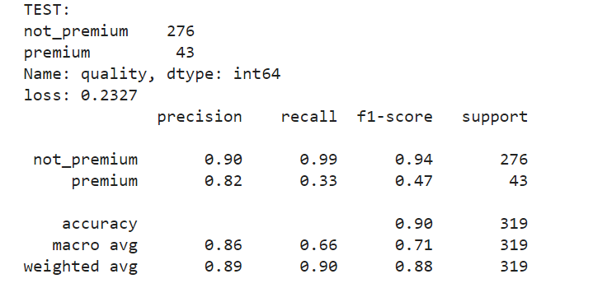
“Type” importance
Since the red and white tastes are quite different, We decided to perform the analysis separately
Red wine
Test Recall = 0.33
F1 ratio = 0.516

Slide 9
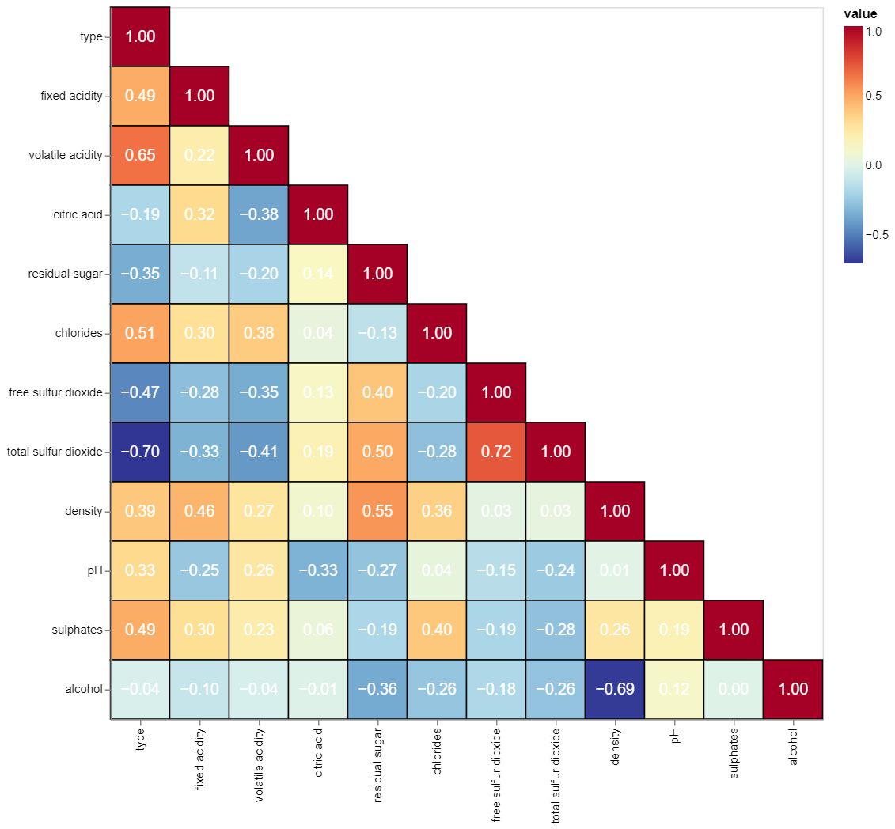
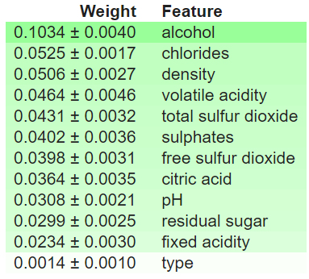
Permutation importance

Slide 10
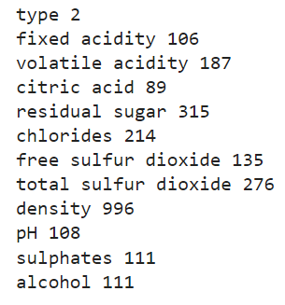
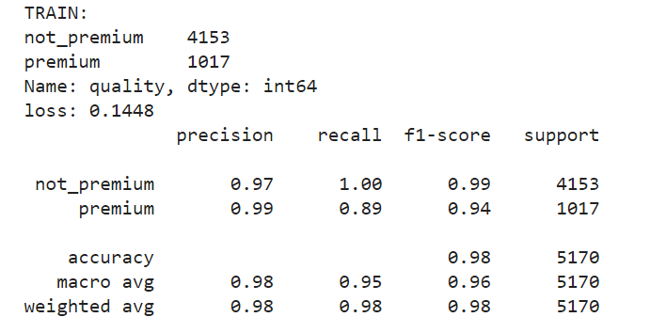
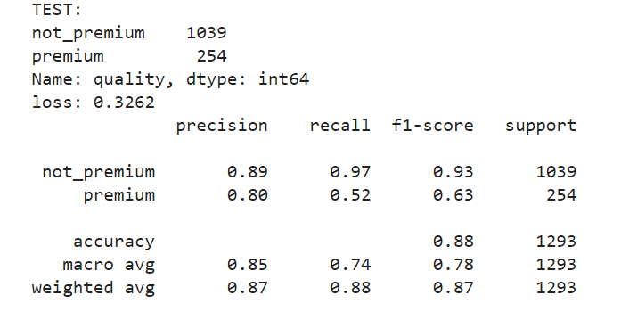
Cardinality
Density column was re-categorized to 100 subsections
Test Recall = 0.52
F1 ratio = 0.67

Slide 11
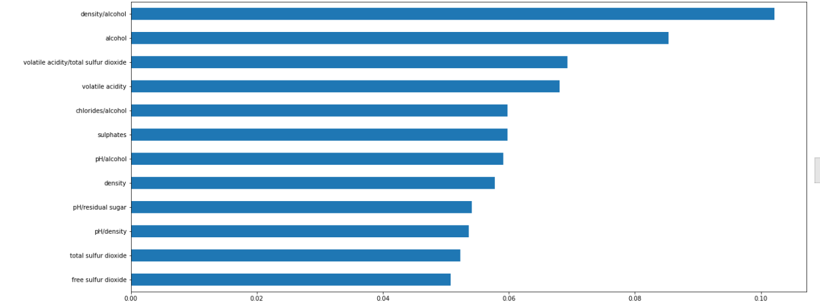
Enhancing the data
Drop columns ( type, free sulfur dioxide)
Inter-attribute metrices- cross relations across all attributes

Slide 12
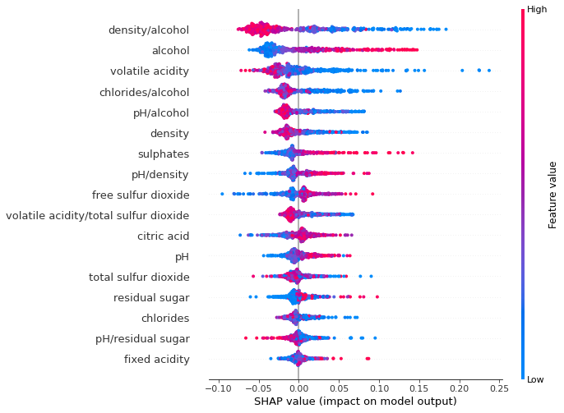

Slide 13
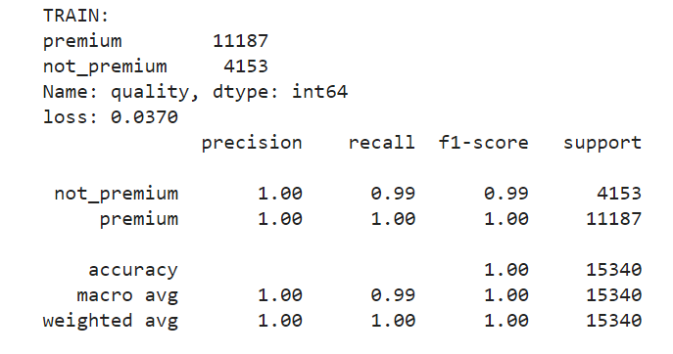
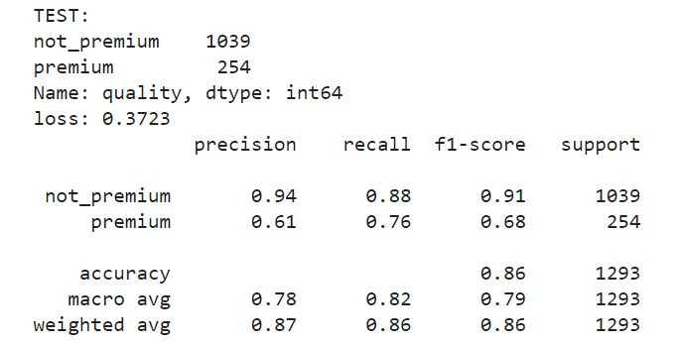
Over-sampling
Oversampling 10* Premium
Test Recall = 0.76
F1 ratio = 0.68

Slide 14
Max samples/ train-test size

