Slide 3
Brain Tumor Classification (MRI)

Slide 4
background
4 classes of tumors:

Slide 5
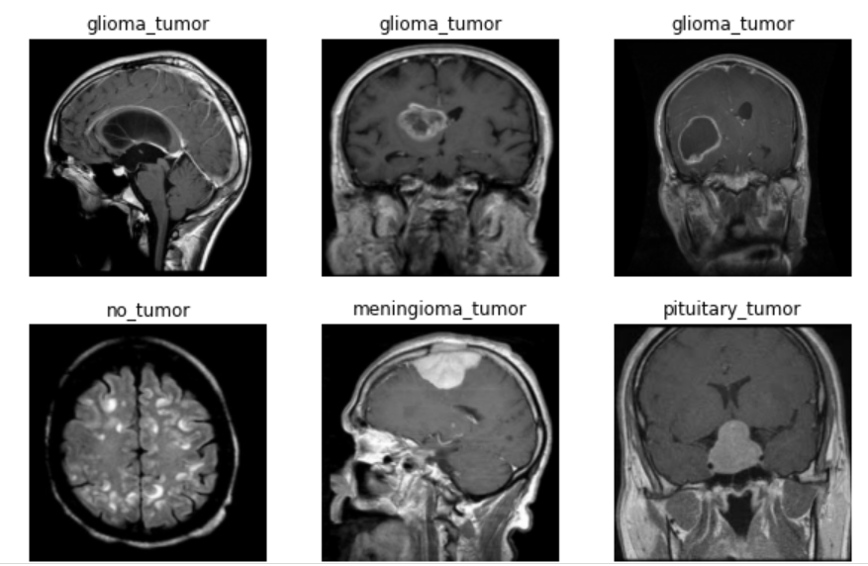
Dataset
Kaggle link
Number of pics- Testing training

Slide 6
Use deep learning to analyze if a MRI scan detects tumor or not. If yes: which type of tumor
Wide tools applications
Transfer learning
two models
CNN

Slide 7
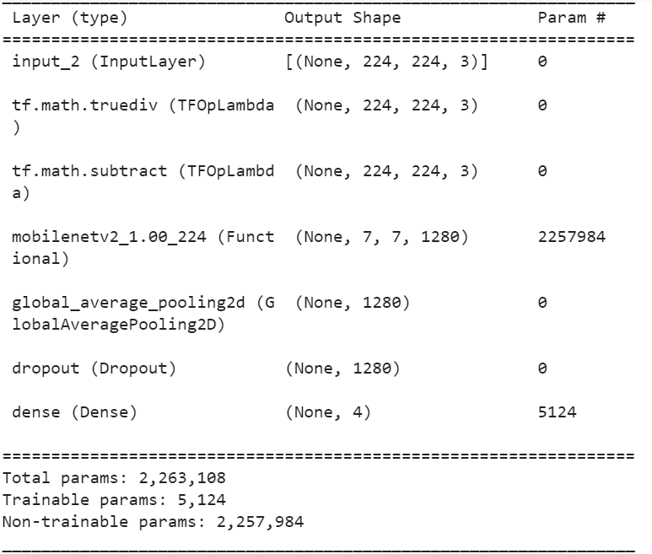
Transfer learning
Model: Mobilenet
Pooling2d
Dense
Activation: softmax
Dropout
Optimizers: Adam
Epochs : 30
Early stopping
Val accouracy

Slide 8
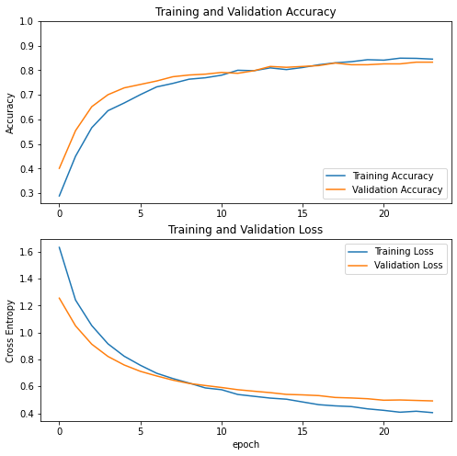

Slide 9
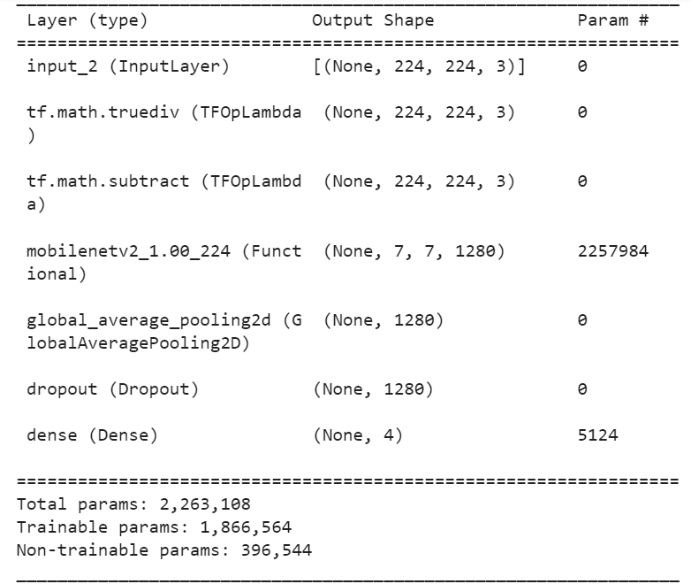
Fine tune
keras.callbacks.ReduceLROnPlateau
fine_tune_epochs = 10
total_epochs = initial_epochs + fine_tune_epochs

Slide 10
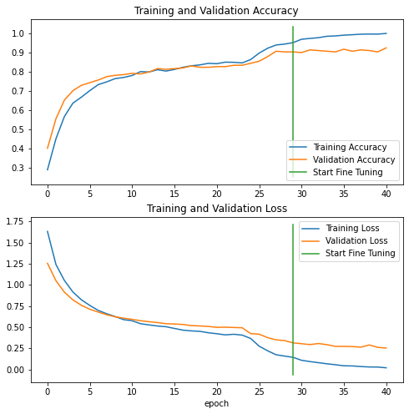
Test data :

Slide 11
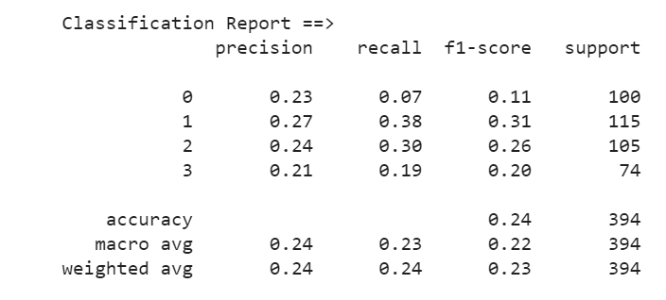
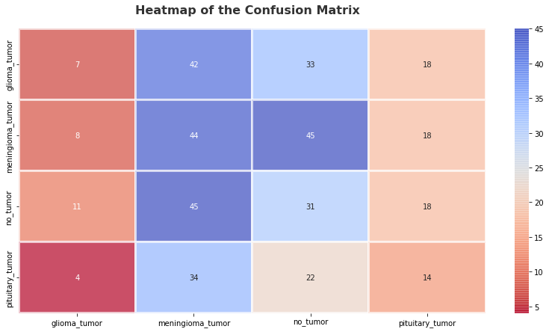

Slide 12
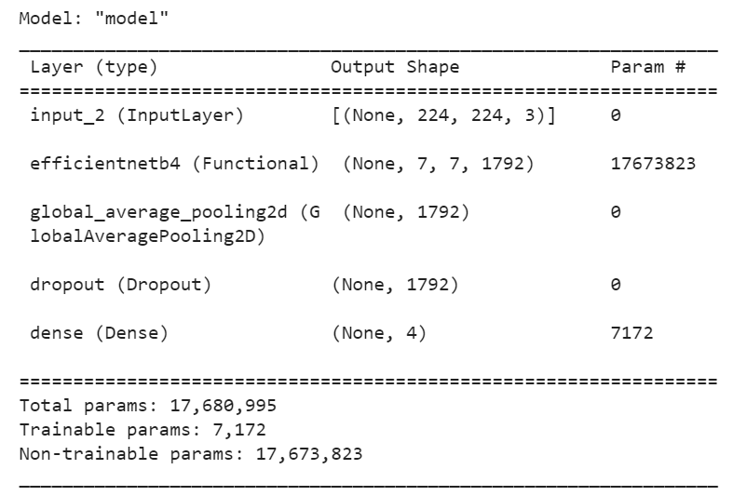
Transfer learning
Model: Efficientnet
Pooling2d
Dense
Activation: softmax
Dropout
Optimizers: Adam
Epochs : 30
Early stopping
Val accuracy

Slide 13
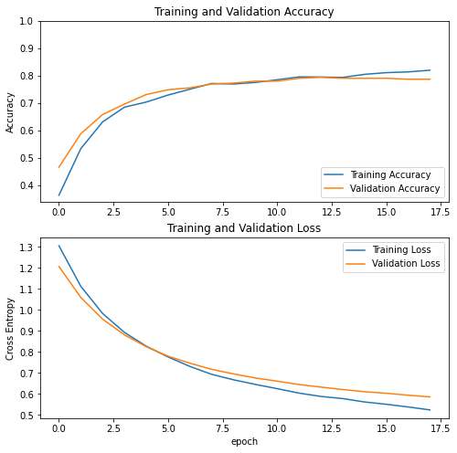

Slide 14
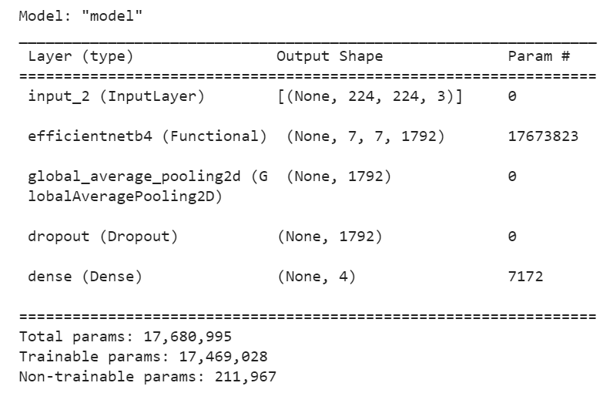
Fine tune
keras.callbacks.ReduceLROnPlateau
fine_tune_epochs = 10
total_epochs = initial_epochs + fine_tune_epochs

Slide 15
Test data :

Slide 17
Test data is biased
Test fraction is biased
Show very low (~79%) accuracy rates
Joining the Testing and Training data.
Construct one joint reshuffle dataset
90% train, 10% test
10% out of train is validation

Slide 18
Continue with Leading model - Efficientnet

Slide 19
Transfer learning
Model: Efficientnet
Pooling2d
Dense
Activation: softmax
Dropout
Optimizers: Adam
Epochs : 30
Early stopping
Val accuracy

Slide 21
Fine tune
keras.callbacks.ReduceLROnPlateau
fine_tune_epochs = 10
total_epochs = initial_epochs + fine_tune_epochs

Slide 22
Test data :

Slide 24
CNN

Slide 25
Comet ML
background

Slide 26
Comperison (mobilenet/efficientnet/CNN)

Slide 27
Summary

