Slide 1
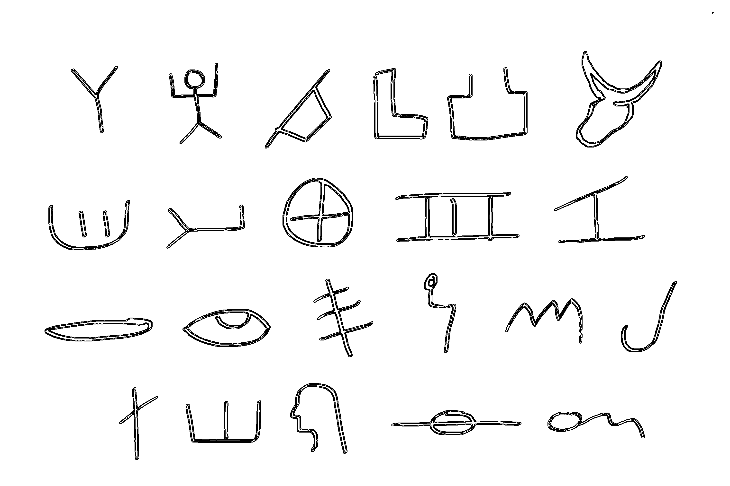
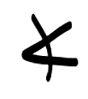
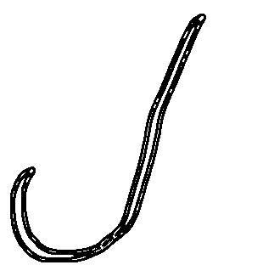
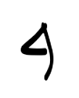

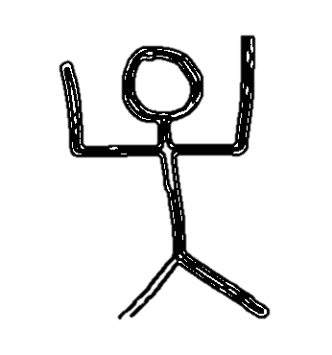

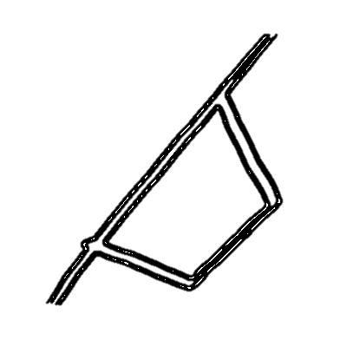
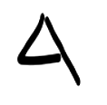
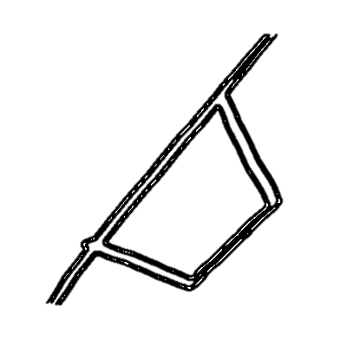
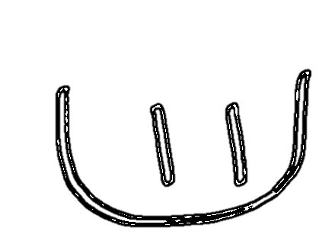
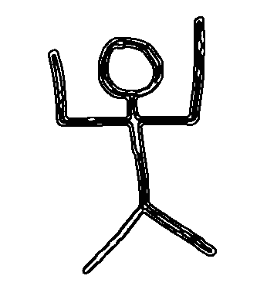
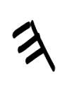
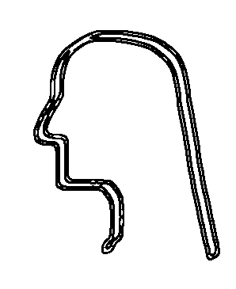
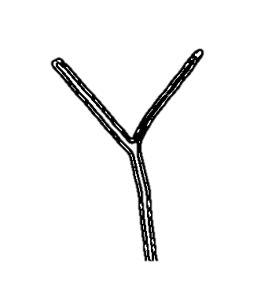

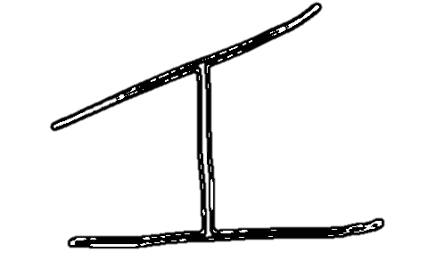
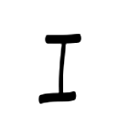
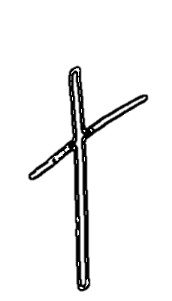
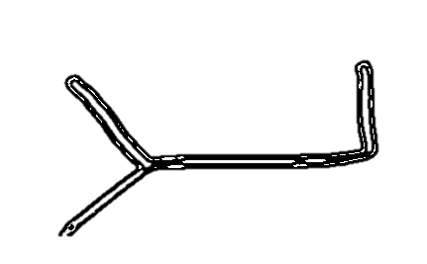
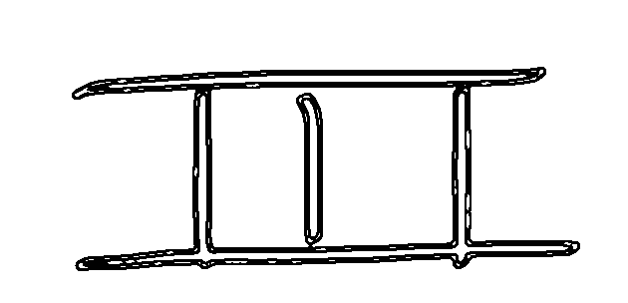
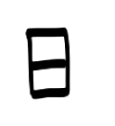
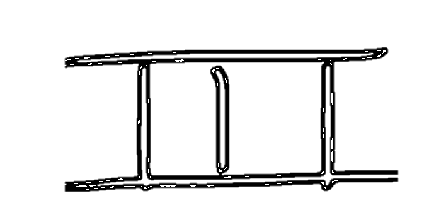

Original Hebrew | Later Hebrew | Modern Aramaic | Name | Sounds | Picture | Common Letter Meanings | Closest Hebrew Word(s), with Strongs # | Sample Use
 |  | א | Alef | A, E | Bull | Chief Leader Strong, strength | Eleph (H504): oxen | GOD (“EL” in Hebrew) is the Chief Shepherd (1 Peter 5:4). E (alef) = Chief L (lamed) = Shepherd
 |  | ב | Bet | B, V | Father’s House (temple) | In, inside, within House Father’s house (temple) | Bayit (H1004): YHVH’s temple, a house | The letter Bet is used as a prefix all throughout the scriptures to mean “in.”
 |  | ג | Gimmel | G | Camel Foot | Lift Walk Strength Ability | Gamal (H1581): camel | Pride (“geeh” in Hebrew) is lifting up the horn of man. G (gimmel) = lift E (alef) = horn H (hey) = man
 |  | ד | Dalet | D | Tent Door | Door, gate Move, movement Low, hanging down | Delet (H1817): door, gate | When the sole of a foot is lowered down, a thing is crushed (“dak” in Hebrew). D (dalet) = lower K (kaf) = sole of foot
 |  | ה | Hey | H, -ah | Man With Arms Raised | Look Lo, behold The, this Reveal Man, mankind Existence, life | He (H1887): behold, lo | The word for mountain (“har” in Hebrew) is a picture of beholding the top. H (hey) = behold R (resh) = top
 |  | ו | Vav | V | Hook | And, with To join things together | Vav (H2053): tabernacle hook | The letter Vav is used as a prefix all throughout the scriptures to mean “and.”
 |  | ז | Zayin | Z | Plow’s Edge | Cut Shake Make ready Overturn | n.a. | An olive tree (“zayit” in Hebrew) is manually harvested by a strong shaking. Z (zayin) = shake Y (yod) = arm T (tav) = strong
 |  | ח | Chet | Ch, -ach | Wall | Wall End Obstruction Outside | Chet (H2399): sin Chatam (H2856): seal (shut) | The Hebrew word for “outcast” is “dachah.” It’s a picture of a man being moved outside. D (dalet) = moved Ch (chet) = outside H (hey) = man
Free Download at www.fathersalphabet.com Public Domain | Page 1

Slide 2
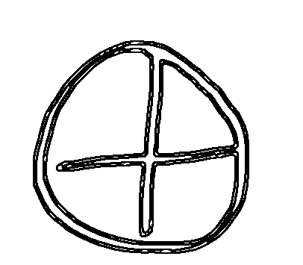
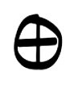
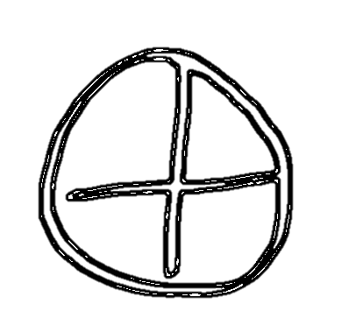
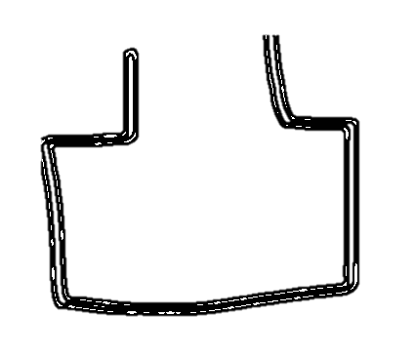
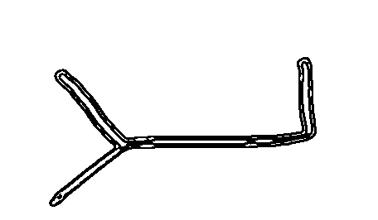
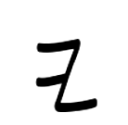
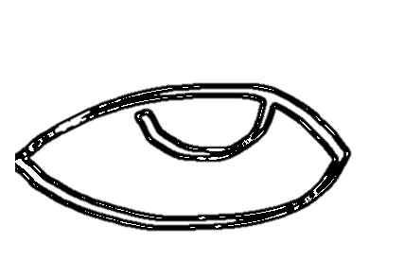
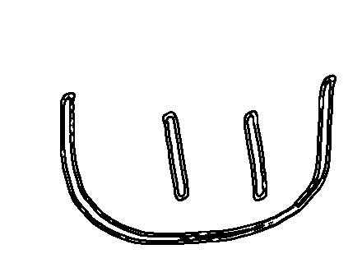


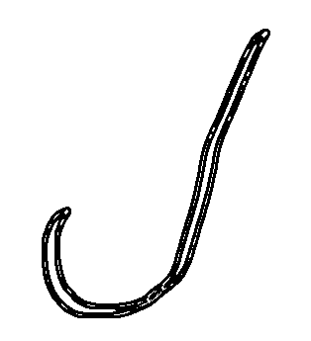
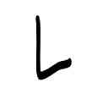
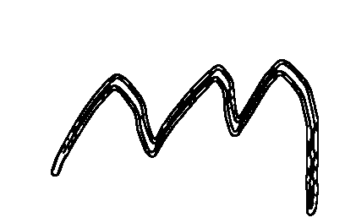
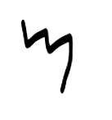
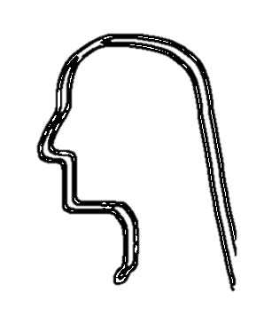
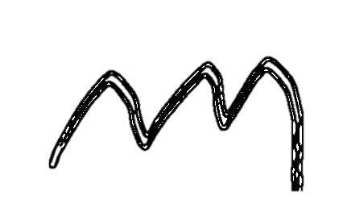
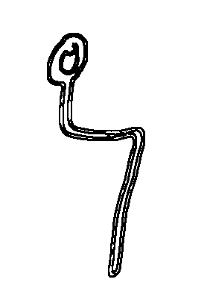

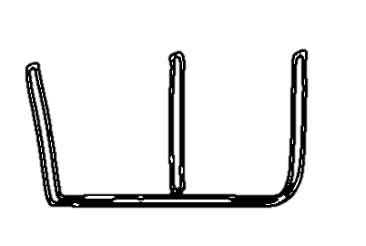
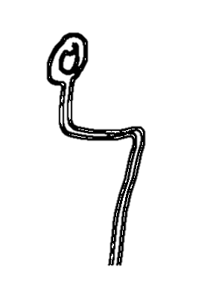
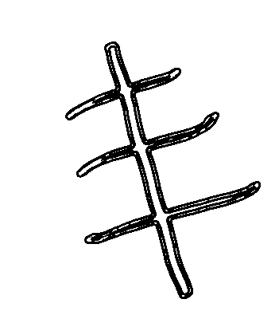
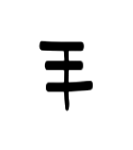
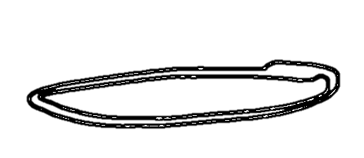
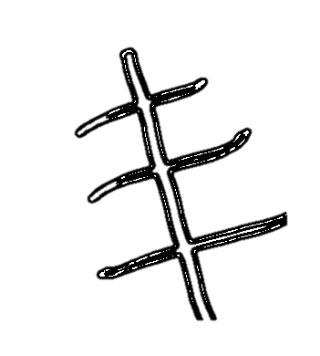
Original Hebrew | Later Hebrew | Modern Aramaic | Name | Sounds | Picture | Common Letter Meanings | Closest Hebrew Word(s), with Strongs # | Sample Use
 |  | ט | Tet | T | Container | Surround Store, keep, contain Cover Gather together Food | Teet (H2916): mud, mire, clay | To trust in Hebrew (“batach”) is a picture of being inside a surrounding wall. B (bet) = inside T (tet) = surrounding Ch (chet) = wall
 |  | ' | Yod | Y | Hand and Arm | Work, do, make Hand, arm Help Power, authority | Yad (H3028): hand, power, authority | The Hebrew word for knowing is “yada.” YAD (arm) = make A (ayin) = known
 |  | כך | Kaf | K, Kh, -akh | Palm of Hand | Hand, palm of hand Sole of foot Crush, grip, grasp Subjugate Cover | Kaph (H3709): hand, palm | To walk (“halak” in Hebrew) is a picture of a staff in the palm of one’s hand. H (hey) = man L (lamed) = staff K (kaph) = palm of hand
 |  | ל | Lamed | L | Shepherd’s Staff | Staff Lead, guide, teach Protect To, toward | Lamed (from H3925): teach | To those who are His, HE gives a new heart (“leb”) and a new spirit so we can follow His ways. L (lamed) = teacher/guide B (bet) = inside
 |  | מם | Mem | M | Water | Waters, sea, drink Tumult, upheaval Lift up (like waves) The unknown Many, people | Mayim (H4325): waters | Rain (“matar” in Hebrew) is a picture of water surrounding the head. M (mem) = water T (tet) = surrounds R (resh) = head
 |  | נן | Nachash | N | Serpent | Reflective, shiny GOD-given Life (as something GOD’s light shines on) Spiritual Serpent | Nachash (H5175): serpent | A snakebite (“nashak” in Hebrew) is a picture of a snake’s teeth crushing. N (nachash) = snake Sh (shin) = teeth K (kaf) = crush
 |  | ס | Samek | S | Barb | Hold Establish Prevent Turn | Samak (H5564): uphold | A book (“sepher” in Hebrew) is used to hold the sayings of men. S (samek) = hold P (peh) = saying R (resh) = man
Free Download at www.fathersalphabet.com Public Domain | Page 2

Slide 3
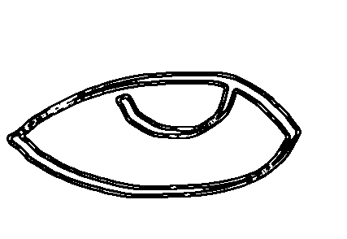
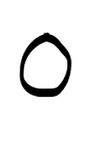
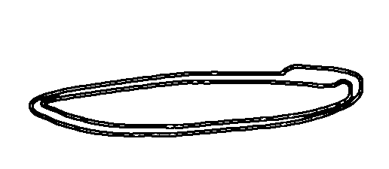
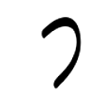
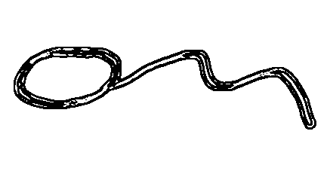

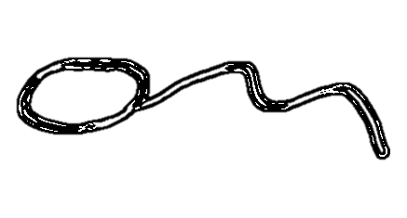
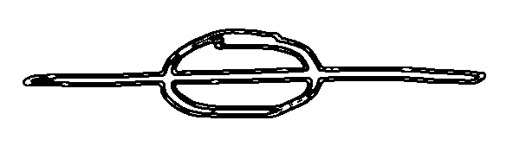

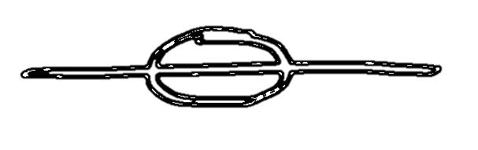
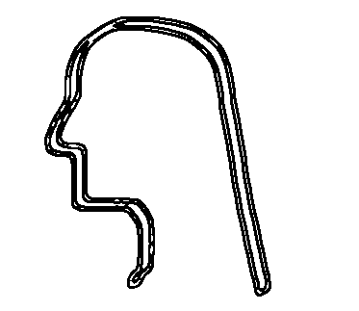





Original Hebrew | Later Hebrew | Modern Aramaic | Name | Sounds | Picture | Common Letter Meanings | Closest Hebrew Word(s), with Strongs # | Sample Use
 |  | ע | Ayin | A, E, O | Eye | Eye, sight Knowledge Understanding Perception | Ayin (H5869): eye, sight, appearance, knowledge | Weeping (“dama” in Hebrew) is the movement of water from the eyes. D (dalet) = move M (mem) = water A (ayin) = eye
 |  | פף | Peh | P | Mouth | Mouth Open, opening Edge, rim Saying, command | Peh (H6310): mouth, edge, opening, command | A morsel (“pat” in Hebrew) indicates a mouthful of something. P (peh) = mouth T (tav) = indicator
 |  | צץ | Tsade | Ts | Man on His Side | Lie in wait Lay down Wait Side | Tsad (H6654): side Tsud (H6679): hunt Tsadah (H6658): lie in wait | An adversary (“tsar” in Hebrew) lies in wait for man. Ts (tsade) = lie in wait R (resh) = man
 |  | ק | Quf | Q | The Sun at the Horizon | Circuit Sun, day Line Encompass Gather | Tequphah (H8622): turn, circuit Naqaph (H5362): encompass | The word for assembly in Hebrew is “qahal.” It’s a picture of men gathering to the staff. Q (quf) = gather H (hey) = man L (lamed) = staff
 |  | ר | Resh | R | Head | Man Head Chief Top First, beginning | Rosh (H7218): head, top, chief, beginning | The word for high, exalted, and tall in Hebrew is “rum.” It’s a picture of a lifted head. R (resh) = head M (mem) = lifted (like waves of water)
 |  | ש | Shin | Sh, S | Teeth | Teeth Eat Front Consume Destroy | Shin (H8127): tooth, teeth | To repent (“shub” in Hebrew) is to face Father’s House. Sh (shin) = face frontward B (bet) = Father’s House
 |  | ת | Tav | T | Mark | A mark Strong indicator Strength | Tav (H8420): mark | Writing (“katab” in Hebrew) is a picture of the hand marking the inside of something. K (kaf) = hand T (tav) = mark B (bet) = inside
Free Download at www.fathersalphabet.com Public Domain | Page 3

