Slide 1
FiCo / TARGET HYPOTHESIS
?
The Problem
Young employees are stuck with old retirement policies
and face new products with unvalidated decisions
01 / WHO
02 / TODAY
03 / WHY IT HURTS
Young German employees
with an existing pension
or life-insurance policy.
Dense PDFs.
Broker explanations.
Manual spreadsheets.
High, unclear fees
A 40-year payoff.
Jargon overload.
No clear next step.
Gen Z / Millennials
Confusion + pressure → “I’ll deal with it later.”
FiCo · Founders Hackathon Stuttgart
1 / 5
Notes:
Target persona is a hypothesis from the founders' own framing, not interview research. Add a real customer quote or number here once gathered.

Slide 2
FiCo / FINANCIAL COPILOT
✓
Our Solution
Old policies, unclear fees, new products. What now?
Fico is your financial copilot: it shows in minutes if switching plans pays off, and keeps you on track with a two-minute weekly money ritual.
THE SUNDAY RITUAL / PRODUCT DIRECTION
BUILT IN THE HACKATHON
2 min / week
React demo. Saved check-ins.
Deterministic ledger + waterfall.
Guard logic, unit-tested.
Target cadence. Not daily pressure.
Built hackathon prototype · AISP read-only stub, no transfers · Coverage check before switching
FiCo · Founders Hackathon Stuttgart
2 / 5
Notes:
Built hackathon prototype: React demo, saved check-ins, deterministic double-entry ledger and cashflow waterfall, regulatory guard logic covered by unit tests. The two-minute Sunday ritual (recap, 60–90 second Financial Snack, XP and a next step) is the intended weekly cadence and product direction: check-ins currently count per request, not a true weekly gate, and the snack button is not yet an evaluated quiz. Read-only AISP stub, no PISP, FiCo never moves money. Rewards are for learning, never for spending shame, trading or wealth. Source: https://github.com/ortenburger/FiCo pinned at commit 76855fb8fa53de40b579757202fb0ee06221cd5a.

Slide 3
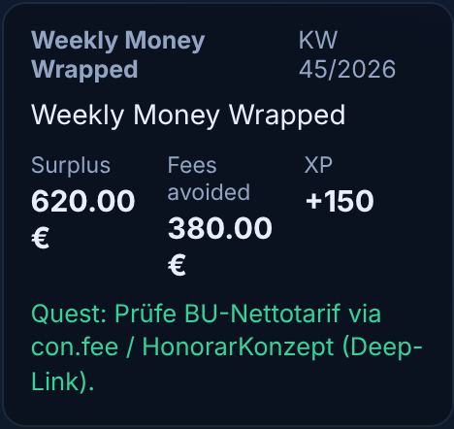
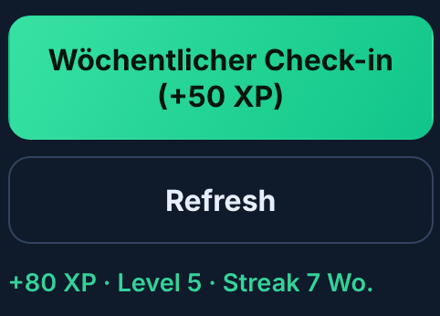
FiCo / RUNNING PROTOTYPE & EVIDENCE
✓
Product & validation
Local React demo. Persistent check-ins. Tested financial logic.
Source code: github.com/ortenburger/FiCo
Check-in saved
Customer validation
XP 780 → 860 · Streak 6 → 7
“Brokers are commission-hungry.
I’d definitely pay a subscription for access to net insurance.”
Gloria, Finance & Insurance
FiCo · Founders Hackathon Stuttgart
3 / 5
Notes:
Actual screenshots from the locally running React demo with an isolated synthetic user (Lena): not production, not a live bank, and the amounts are seeded demo values, not real user savings. Check-in persisted: XP 780 → 860, streak 6 → 7 (streak counts per request; weekly gate not yet enforced). Tests: pnpm test exit 0 at the pinned commit, 7 Nov 2026 15:28 CET; 50 tests in 12 files passed, including regulatory 8 (WpIG 4, VAG 2, cancellation/underwriting 2) and ledger 9; db/api/workers have no test files. Unit/invariant scope only, not E2E or legal approval. The GitHub link is source code, not a hosted deployment. Customer learning and trial/sign-up counts are still to be gathered; do not state zero or use sample quotes. Source: https://github.com/ortenburger/FiCo pinned at commit 76855fb8fa53de40b579757202fb0ee06221cd5a.

Slide 4
FiCo / PROPOSED FUNNEL · HYPOTHESES TO TEST
✓
Go-to-Market Plan
Start with fee clarity. Test the habit. Invite by consent.
01 / ACQUISITION
02 / ACTIVATION
Young German employees with old policies.
Recruit via graduate / young-pro groups.
Free fee-clarity check → first
90-sec Financial Snack.
03 / WEEKLY HABIT
04 / VOLUNTARY REFERRAL
2-minute Sunday ritual.
Test understanding and repeat check-ins.
Invite a friend to a learning quest.
Opt-in lessons/check-ins—not balances.
FiCo · Founders Hackathon Stuttgart
4 / 5
Notes:
Proposed funnel, not historical traction: free fee check, then the weekly ritual, then an optional opt-in learning invite (no balances shared). Sign-up/trial results pending; fee-only pricing is a willingness-to-pay hypothesis.

Slide 5
FiCo / THE PEOPLE & THE MOMENT
✓
Why Us / Why Now
Insurance domain + production AI + agent/software craft.
TEAM ADVANTAGE
WHY NOW
Alexander Ortenburger
Walter Übelhart
New Altersvorsorgedepot
starts in 2027.
Jargon overload today.
Production AI & fintech
Insurance & Product
15+ yrs; co-founded 4 companies
Insurance & Processes
Samuel Fleig
Robert Bardeanu
Applied AI student
Media Informatics student · HdM
FULL-TIME?
Builds MCPs + an algebra agent
Qualified IT Assistant
Full-time if traction
Make future-you proud. One small step each week.
WpIG/VAG/VVG-inspired technical guards, unit-tested · Legal review pending
FiCo · Founders Hackathon Stuttgart
5 / 5
Notes:
Team (self-reported by the team, not independently verified): Walter Übelhart – B.Sc. HdM; international insurance business development and process optimization; product/IT requirements. Alexander Ortenburger – production AI and fintech architect, 15+ years, co-founded 3 companies; GenAI pipelines at DEEPWERK and ADWERK; end-to-end fintech engineering at cashbuzz. Samuel Fleig – applied AI student; builds MCPs and an algebra agent. Robert Bardeanu – bachelor student, Media Informatics (Medieninformatik) at HdM; qualified IT Assistant. Full-time commitment is not yet confirmed. Altersvorsorgedepot is a proposed reform, subject to final rules. Guards (WpIG advice filter, VAG fee invariants, cancellation state machine) are implemented and unit-tested; the policy-issued check is hash presence/length only, not cryptographic verification. This is not legal approval or certified compliance; legal review pending. Guilds and habit agents are roadmap. Source: https://github.com/ortenburger/FiCo pinned at commit 76855fb8fa53de40b579757202fb0ee06221cd5a.

