Slide 1
🚧 Case study in progress
HOSPITALITY · POWER BI · MEWS + PRIMAVERA
Wotels
Multi-Property Reporting Platform
Ortensa Adhamidhi
Senior Data Analyst & Analytics Engineer

Slide 2
01 / THE CHALLENGE
Three systems, no single
source of truth
🛎️
Occupancy lived only in Mews
Live availability and bookings sat inside the PMS for each property, disconnected from financial performance.
🗄️
Financial actuals lived only in Primavera
The real P&L existed in the ERP, reachable only through the Primavera software – not built for reporting or analyzing property performance.
📊
Budgets lived only in Excel
Property and department budgets were maintained in spreadsheets outside both systems, with no shared structure.
Wotels — Case Study 2/9

Slide 3
02 / APPROACH
One governed model, three source systems
🔌
🗂️
Multi-source Power Query integration
Star-schema data model
Custom M functions call the Mews API directly; a SQL Server connection pulls P&L actuals from Primavera; Excel budgets feed the same model.
Fact tables for occupancy, financial actuals, and budget, joined to Date, Unit, and Cost Center dimensions.
📐
🔒
DAX measures for Actual vs. Budget vs. LY
Row-level security by property & department
Variance, YTD, and prior-year comparisons built to compare cleanly across 18 properties and head office.
Each property manager and department head opens the same report, filtered to exactly their own data.
Wotels — Case Study 3/9

Slide 4
03 / DATA MODEL
Star-schema architecture
DateTable
Movimentos
OccupancyByPeriod
Budget
Statistics
Units
Cost Centers
Beds
■ Fact tables □ Dimension tables
Wotels — Case Study 4/9

Slide 5
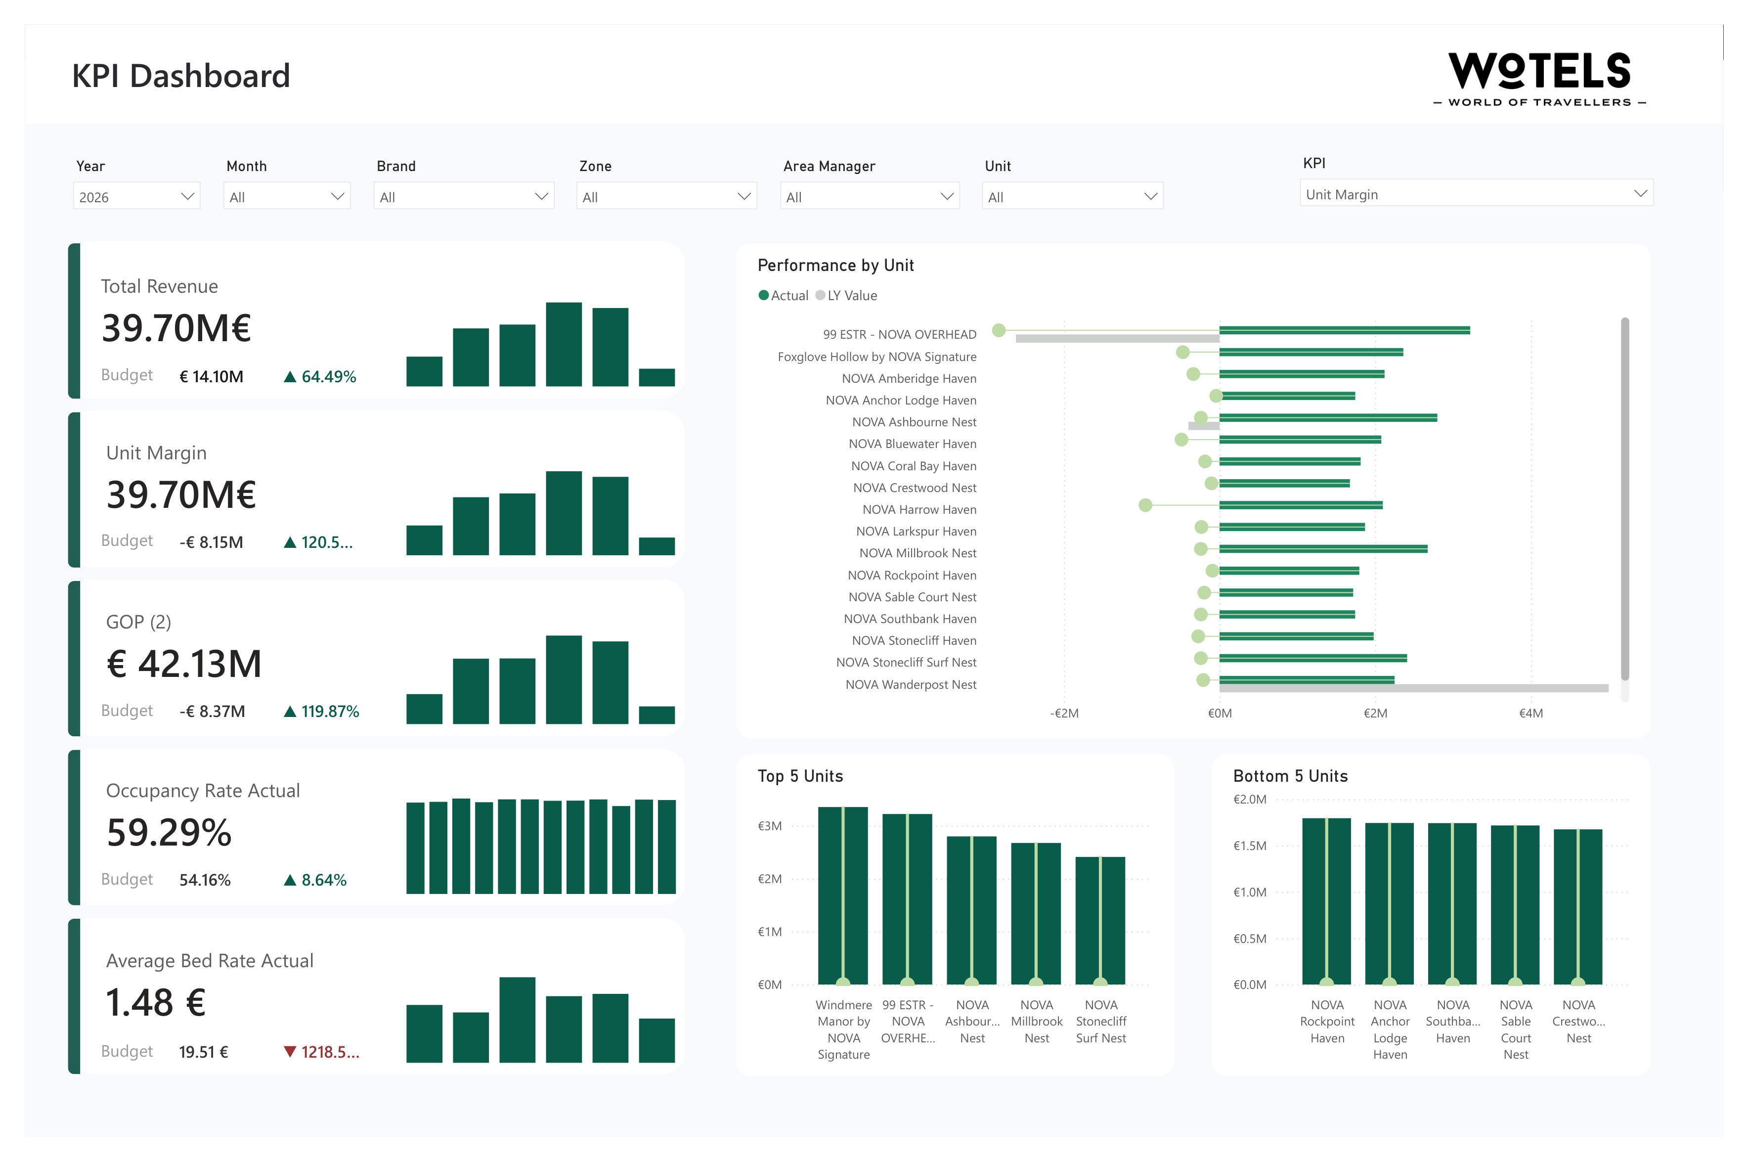
04 / DASHBOARD PREVIEW
Portfolio KPIs at a glance
A KPI slicer redraws the three right-hand charts across more than 30 metrics — headline figures like GOP, GOP (2), EBITDA, EBT, and Unit Margin; occupancy metrics (Occupancy Rate, Available/Occupied Beds, Average Bed Rate); department profit (Rooms, F&B, OPC); and per-occupied-bed cost ratios (Cleaning/POB, Electricity/POB, Water/POB, Food Cost, and more).
Wotels — Case Study 5/9

Slide 6
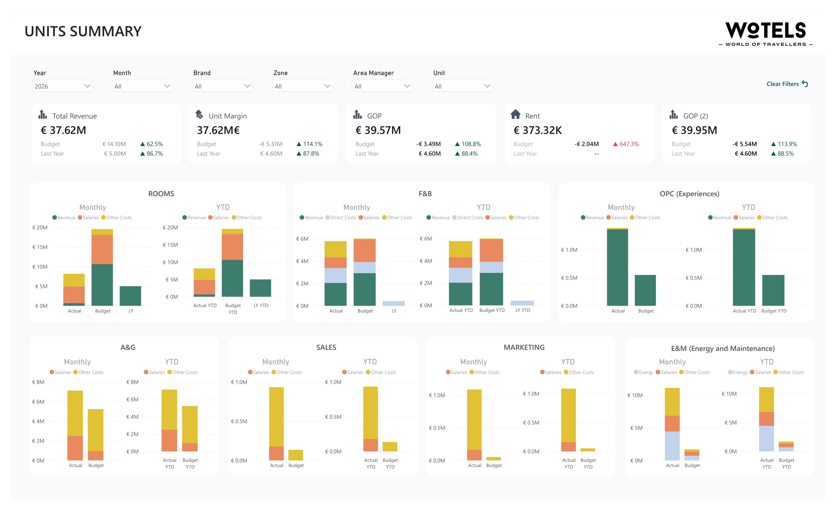
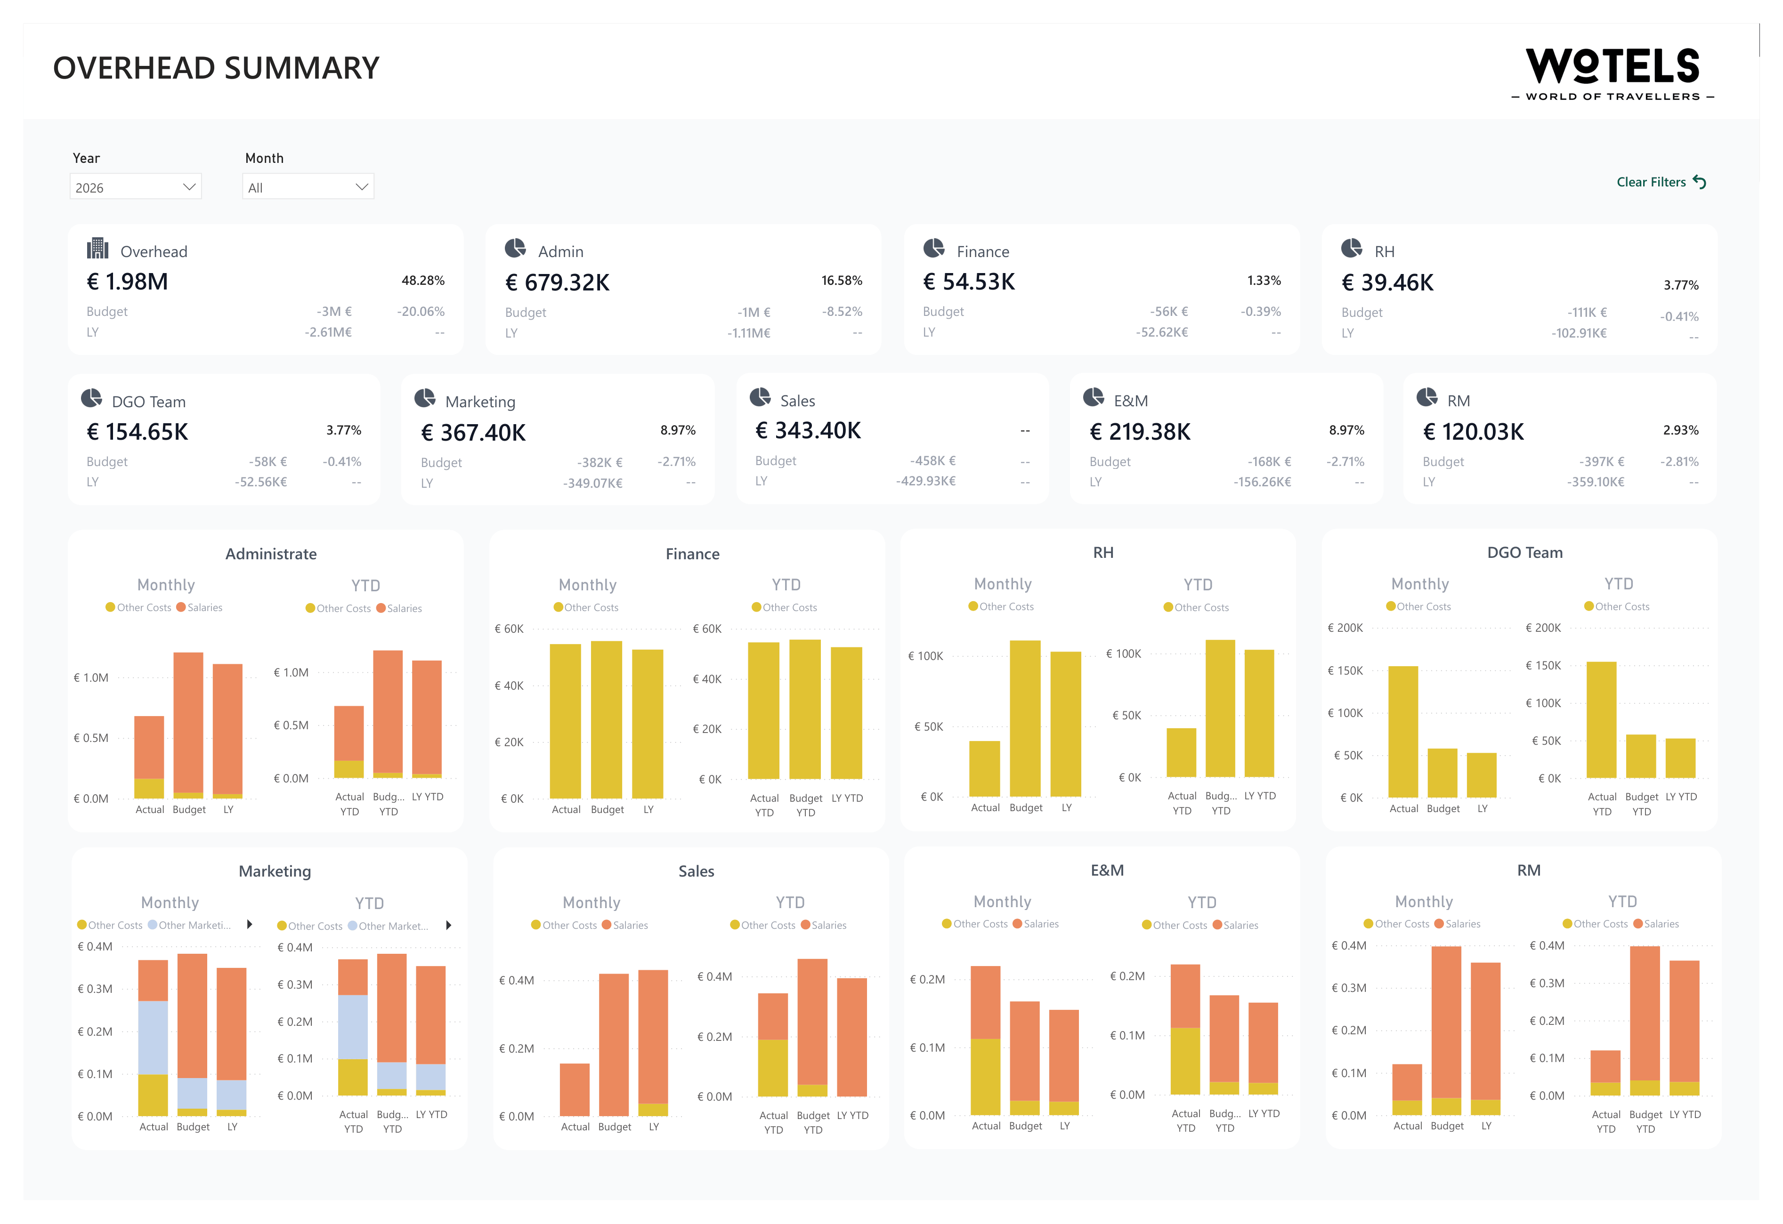
05 / DASHBOARD PREVIEW
Executive summaries
Each department card breaks down what was actually spent - salaries versus other costs - against Budget and Last Year, from Rooms, F&B, and OPC at property level to A&G, Marketing, Sales, E&M, and RM at head office.
All figures shown are synthetic — no real guest, revenue, or financial data.
Wotels — Case Study 6/9

Slide 7
06 / TECH STACK
Tools & technologies
A single Power BI semantic model sits on top of three connected systems: Power Query (M) calls the Mews API directly for stay data, a SQL Server connection pulls financial actuals from Primavera, and Excel feeds the budget. DAX handles the variance and YTD logic, and row-level security controls access by property and department. The same model is designed to extend as new reporting layers — like the day-to-day operations report now in development — are added on top.
Power BI
Power Query (M)
DAX
Mews API
Primavera ERP (SQL)
Star Schema
Row-Level Security
Wotels — Case Study 7/9

Slide 8
07 / OUTCOME & WHAT'S NEXT
One governed model, replacing a manual close
🔗
Three systems unified into one governed model
Delivered
🏨
18 properties plus head office, on one platform
Live
📈
Actual vs. Budget vs. Last Year, automated with YTD
Automated
🔒
Row-level security by property and department
Secured
📅
Day-to-day operations report — stay, connect & property benchmarking
In development
Wotels — Case Study 8/9

Slide 9
Let's put your data to work.
Open to freelance BI & data engineering projects, and full-time data engineering roles.
✉️
oadhamidhi@gmail.com
💼
linkedin.com/in/ortensa-adhamidhi
🔗
github.com/ortensa-adhamidhi/wotels-case-study
© 2026 Ortensa Adhamidhi

