Slide 1
EXSPORTS

Slide 2
WEBSITE

Slide 3

Design
Use of new the Web Design Trend : Flat Design
All is minimalist to ensure the user interface quality
Full Screen
Cold colors for winter / Hot colors for summer

Slide 4
Design
Top menu with differents categories
Hover with mouse cause a drop effect with subcategories
Perfect homepage to keep the client
Simple but efficient showcase with filters on the left

Slide 5
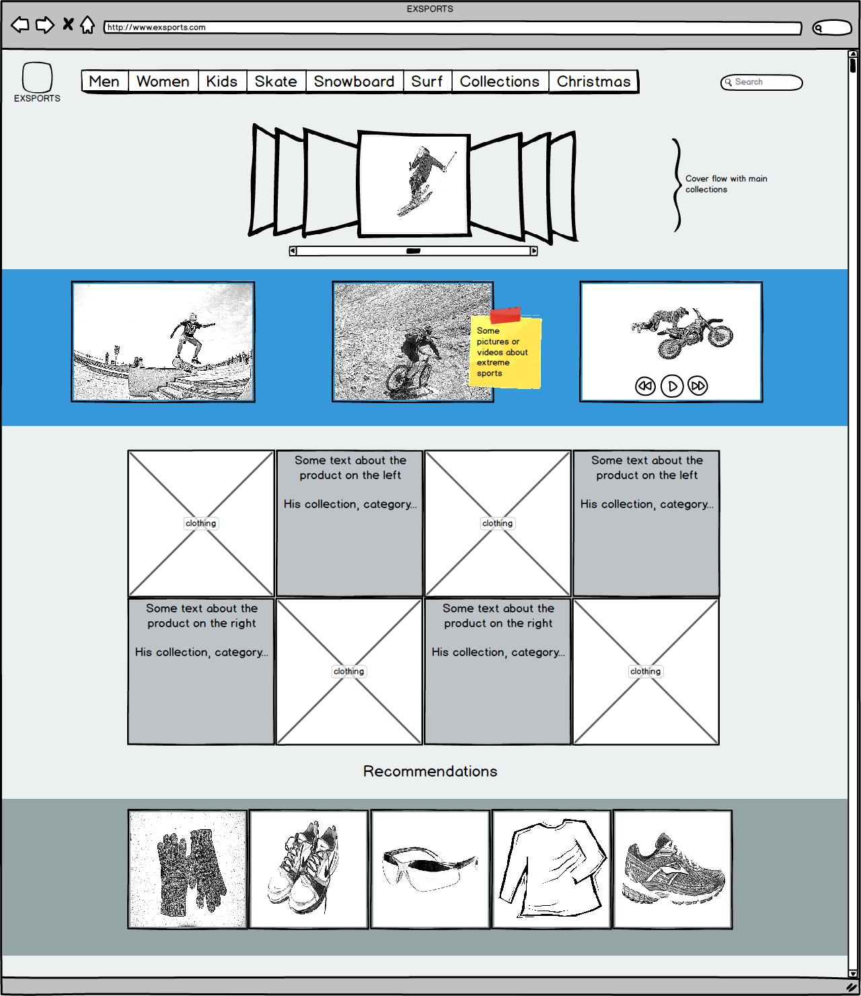

Slide 6
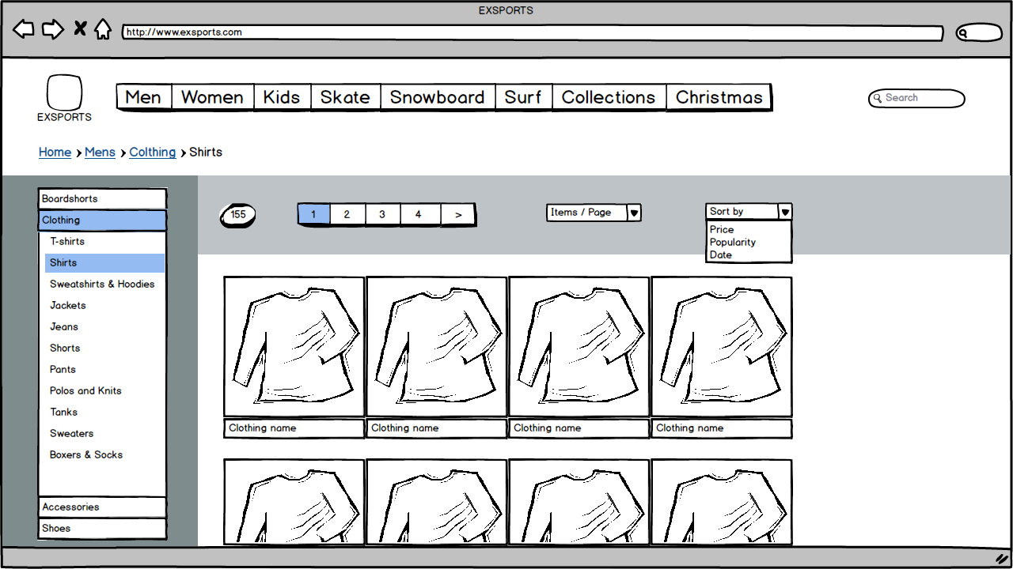

Slide 7
Content
Top menu contain all categories of the website (Men, Women, Kids, Ski, Snowboard …) and collections depending of the season (autumn, winter, Christmas, sales…)
Homepage is focused on showing collections with beautiful pictures first, then top products or products with reduction.
Showcase contains products with filters on the left in order to easily find the right product
Each product has his own page with detailed information about it

Slide 8

Technical
Orders, cart
Instant stock verification upon size choice (before item addition to cart)
Payment
payment methods : VISA MASTERCARD Paypal
SSL encryption for all transactions and personal data
partnership with market-leader in online payments solutions : OGONE

Slide 9
Technical
User can manage orders, returns, through account management panel
Other functionalities that influence the user in creating an account
Once the user has an account, free advertising through newsletters and special offers

Slide 10
Technical
Cookie tracking algorithm that underlines what type of product the user likes
Based on the web pages the user already visited
No problem with legality
Permits definition of user classes that share the same tastes
Used to highlight products, or modify website behavior, for a specific user or user class

Slide 11
Finance
Website costs :
Design, images and icons : 2000€
Payment solutions : 1000€
Responsive design : 1000€
Recurrent costs :
Domain name - hosting : 600 € a year
Updating content : 1200€ a year
Maintenance : 2000€ a year
Marketing costs :
Social medias : 1200€ a year
Advertising : 1500€ while the site is new then 750€
Sponsoring related business

Slide 12
VIDEO-GAME

Slide 13
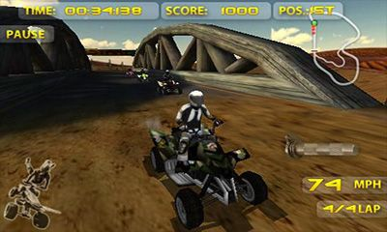
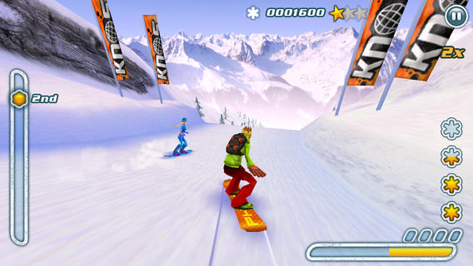
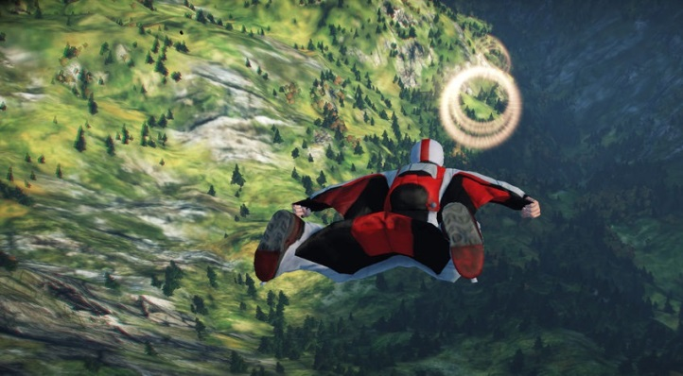
Gameplay
The game will be composed of multiple extreme sports, like skyDiving, snowboarding, surf, quad …
For each sports the player will be able to choose between three mode, tournament, time-trial or training.

Slide 14
Gameplay
Possibility to share his score in the time-trial or in tournament on social network to increase the game visibility.
All the equipment that can be bought in the real store will be represented in a virtual store in the game.
The player will receive adds about equipments of the sport he plays the most.

Slide 15
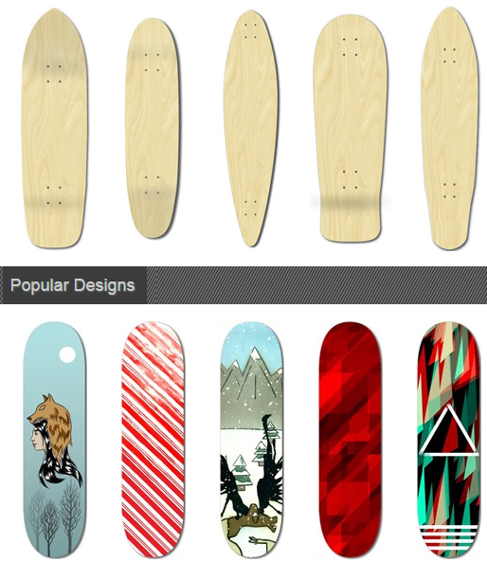
Gameplay
The game will also contain a part where the player will be able to craft his own equipment by choosing the materials used and more importantly it's appearance.

Slide 16
Music
We have chosen to play metal music during the game because this is the type of music which stick the best to extreme sports.

Slide 17
Finance
We can use cross-promotion to improve our benefits and our visibility.
Idea of cost : 140 000€ to 170 000€

Slide 18
COMMERCIAL VIDEO

