Slide 1
fastx toolkit
Illumina PE
Transcriptome raw data
Filtered Short Reads
Map using Bowtie
Pool All unmapped reads
Trinity Assembler
Reference Transcript Models¹
Map using Bowtie
Estimate FPKM/TMM values using RSEM
Denovo assembled Contigs
Estimate FPKM/TMM values using RSEM
Transdecode, HMMSCAN &
TargetP
Normalized Expression values
SOURCE ANNOTATIONS
PATHWAY MAPPINGS
SOURCE INTERACTIONS
ORTHOFUZZ package
Interaction Data:
Predicted Co-expressed Interaction Complexes with Enrichment Statistics
Functional Annotations: from
ORTHOFUZZ & Transdecode
Pathway Data:
Pathway Enrichment Statistics
Expression of Enzymes in Pathways
List Enrichment Results:
Functional terms enriched in selected lists of transcripts/contigs
Hierarchical Clustering of Enzyme Expressions in a Heat Map

Slide 2
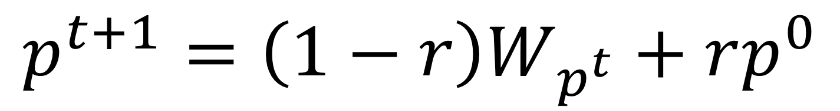
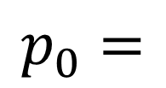
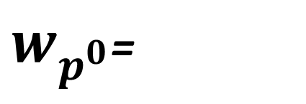

Random Walking with Restart !
C
0.6
0.5
D
0.8 (0.72)
E
Normalize by maximum score
0.7 (0.60)
0.4 (0.40)
A
0.8 (0.61)
B
(1.0)
0.5 (0.60)
F
0.7

Slide 3
A1 (a1s1 * s1t2 + a1s2*s2t2)
A1
s1t2
a1s1
S1
T2
A2 (a2s1 * s1t2)
a2s1
A2
s2t2
A3 (a3s2 * s2t2)
s1t1
A1 (a1s1 * s1t1 + a1s2*s2t1)
A1
a1s2
S2
s2t1
T1
A2 (a2s1 * s1t1 + a2s3*s3t1)
a3s2
A3
A3 (a3s2 * s2t1)
s3t1
a2s3
A2
S3
Figure X: Annotation flow network: A1-A3 are annotations of source sequences S1, S2 and S3. axsy represents the user-defined confidence of the annotation ax to be associated with sequence sy. sxty is the maximum score normalized orthofuzz score(sx,ty) obtained by querying the pairwise sequence similarity network using sx.

Slide 4
A1
A1
s1t2
a1s1
S1
T2
A2
a2s1
A2
s2t2
A3
s1t1
This translates as
matrix multiplication of
Annotation Confidence Matrix and Orthofuzz matrix
A1
A1
a1s2
S2
s2t1
T1
A2
a3s2
A3
s3t1
A3
a2s3
A2
S3
Notes:
;

Slide 6
Source Proteins
with Annotations
&
Confidence Scores
Pairwise Sequence Similarity Network
Network
Flow Module
Annotation Graph
Transfer Annotations
Extract Contigs with Annotations
Annotation File & Annotation Graph
Expression Data
Summarize Annotations
External Annotations
TRANSDECODE –
HMMSCAN, TargetP
Best Hits
Figure X: Protocol used for assigning functional annotations to the de-novo assembled contigs

Slide 7
C0
q2c0
C1
q2c1
Q2
E(Q2) = E(C1)*q2c1+E(C0)*c0q2
q1c1
C2
q1c2
Q1
E(Q1) = E(C1)*q1c1+E(C2)*c2q1+E(C3)*c3q1
q1c3
C3
Figure X: Expression summary network: C0-C3 are the contigs identified as homologs of Query Sets Q1 and Q2. E(X) is the normalized expression level of X. qxcy is the within species normalized orthofuzzscore (qx,cy) obtained by querying the network using the query set Q.

Slide 8
C0
q2c0
C1
q2c1
Q2
This translates as
matrix multiplication of
OrthoFuzz Matrix and
Contig Expression Vector
q1c1
C2
q1c2
Q1
q1c3
C3

Slide 10
Curated pathway mappings
Protein -> Gene-Set
Pairwise Sequence Similarity Network
Network
Flow Module
Gene-Set
Contig Expression Data
Summarize Expression
Figure: Protocol used for estimating expression levels of gene-sets

Slide 11
Source Sequences
Target Sequences
Known Interaction
Predicted Interaction
Neighbor
Expression Levels
Conditions
Interaction Unit 1
Interaction Unit 2
Are there interaction units whose expression levels are changing ?
Are they co-expressed ?
Is there evidence for protein complexes ?

Slide 12
Pairwise Sequence Similarity Network
Network
Flow Module
Gene-Set
Expression Data
Summarize Expression
Figure: Protocol used for estimating expression levels of gene-sets
Pairwise Sequence Similarity Network
Network
Flow Module
Sequences with Interaction Data
Predict Interaction Network
Interaction Network Data
Expression Data
Summarize Expression
for Interaction Units
Predict Protein Complexes
Figure: Protocol used for estimating expression levels of gene-sets

Slide 13
Source Sequences
Target Sequences
Known Interaction
Predicted Interaction
Neighbor
Expression Levels
Conditions
Interaction Unit 1
Interaction Unit 2
Are there interaction units whose expression levels are changing ?
Are they co-expressed ?
Is there evidence for protein complexes ?

