Slide 1
Trick or Text
Robert Kraig
2018 OCT 24
Notes:
This template is provided by http://www.free-power-point-templates.com/

Slide 2
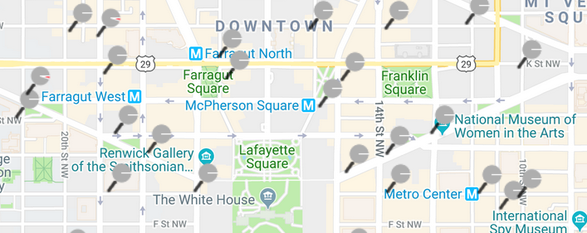
Motivation
CabiTracker

Slide 3
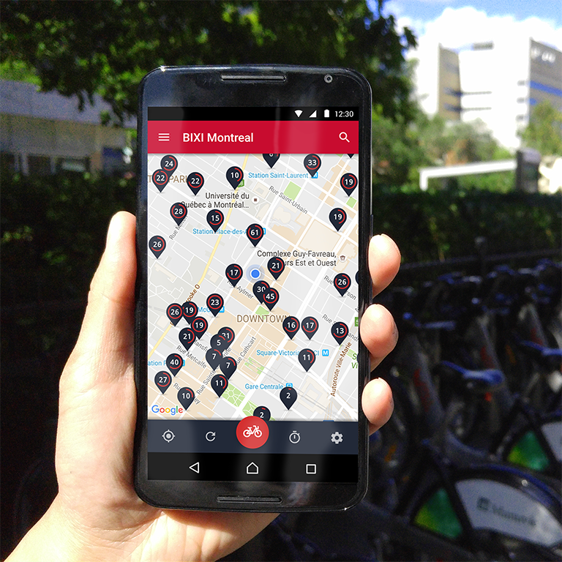
Motivation
CabiTracker
SpotCycle

Slide 4
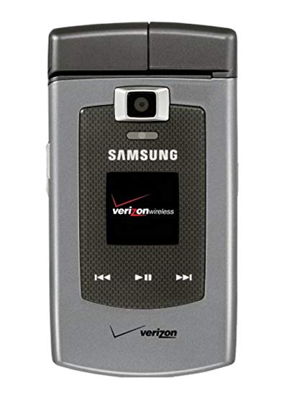
Motivation
CabiTracker
Samsung Alias SCH-U740
SpotCycle

Slide 5
Solution Design
Design Criteria:
Text-Messaging Interface Only
No Internet Browsing
No Location Services
User:
Send Location
Receive Bikeshare Data for that Location
App:
Monitor for Incoming Requests
Receive Location
Acquire Bikeshare Data
Respond with Data on Nearby Stations

Slide 6
Two Google APIs
Monitor for Requests: Gmail API
OAuth 2.0
SCOPE=‘’modify”
Read / Send / Delete Access
Interpret Location: Geocoding API
Street Address Lat/Long
Auto-completion (80 m st se)
Bounding Boxes (&bounds=38,-78|40,-76)
Street Addresses: Very Easy in DC and Arlington!

Slide 7
Find Nearby Stations
Acquire Capital Bikeshare Real-Time Dock Status Data:
https://feeds.capitalbikeshare.com/stations/stations.xml
Info includes (station id, name, lat, long, nbBikes, nbEmptyDocks
XML Format
Parser: BeautifulSoup
Sort by Distance to Input Address
Return Data from Three Nearest Stations
Supplement in case of Outages

Slide 8
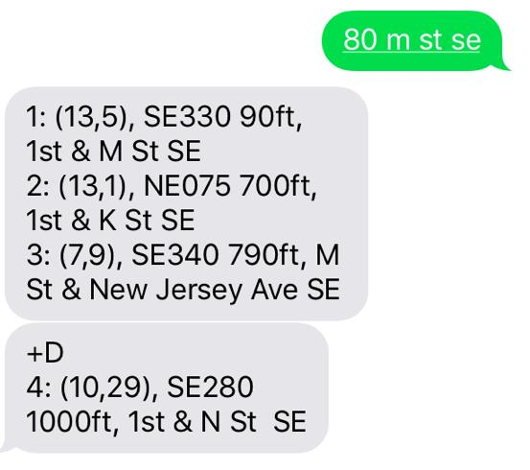
Demo / Screenshot
Text a DC-area street address to cabi7373@gmail.com
Responses:
(bikes,emptyDocks), Direction Distance(ft), stationName
https://github.com/orthonormalize/cabiScrapeJ

