Slide 1

Neural Network Project
Andrew Montalbano & Joshua Ortiz
April 20, 2020

Slide 2
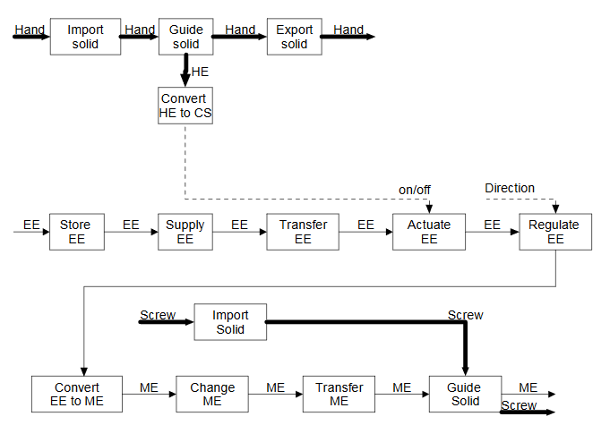
Dataset – Function Structure complexity
Compiled by former Clemson ME student
Purpose was to predict product data from the graph complexity of the function structure model generated early in the design process
In this case, market value of final product
Function structures graphically display the way in which energy and material moves through a system
Function structure example:

Slide 3
Dataset – Function Structure complexity
Dataset is extremely small, 20 samples
Challenge will be to find a method for making accurate predictions from very little data
Two approaches:
Data augmentation
Find ways to expand or add to dataset
Model optimization
Select most important features
Find hyperparameters that allow for high-quality training

Slide 4
Data Augmentation
Most augmentation techniques designed for classifier models. Since this is predicting a price, it is a regressor model.
Simplest augmentation method: Random noise
For each value, simply add or subtract a randomly chosen amount within a specified range
Every amount within the specified range has equal likelihood of being chosen
Assumes low sensitivity of target to input variable (may not be valid, difficult to test in small datasets)
Slightly better method: Gaussian noise
Still adding or subtracting a randomly chosen amount
Probability for perturbation values are normally distributed and centered on the original value
Requires std deviation of the distribution to be specified
Better -- but still not great -- for sensitive datasets

Slide 5
Feature selection
I run Lasso Regression on the data (min-max scaled) prior to neural network model generation to automatically select features.
Lasso automatically sets the coefficients for each variable, with unimportant variables receiving a coefficient of zero.
By running Lasso, I can see what features it believes to be important and ignore the rest.
Lasso is a linear regression technique. So this assumes that the same features will be important or not in a non-linear model, which may not be true.

Slide 6
Model optimization
Optimize model in five stages:
Choose the alpha value for the Lasso model
Search alpha values by powers of 2, from 2 ⁻¹⁰ to 2²
Lasso has built in R² scoring, so I take the alpha that provides the highest score for the data
Choose the number of layers and the number of nodes per layer
Randomly select layer quantities between 2 and 50
Randomly select node quantities between 10 and 100 per layer
Test 50 combinations and choose the one with the lowest percent error
Choose the activation function
Test each of Rectified Linear Unit, Exponential Linear Unit, Hyperbolic Tangent, Sigmoid, Linear, and Exponential Functions
Take the activation which gave the lowest percent error
Choose the batch size
Search powers of 2 from 4 to 256 and use the size with lowest sum of percent error and training time
Choose the number of epochs
Same process as batch size except I look for the point where improvements in percent error begin to diminish, since larger numbers of epochs can take significant amount of processing time
Ran process on three versions of the dataset: no augmentation, random noise augmentation, and gaussian noise augmentation

Slide 7
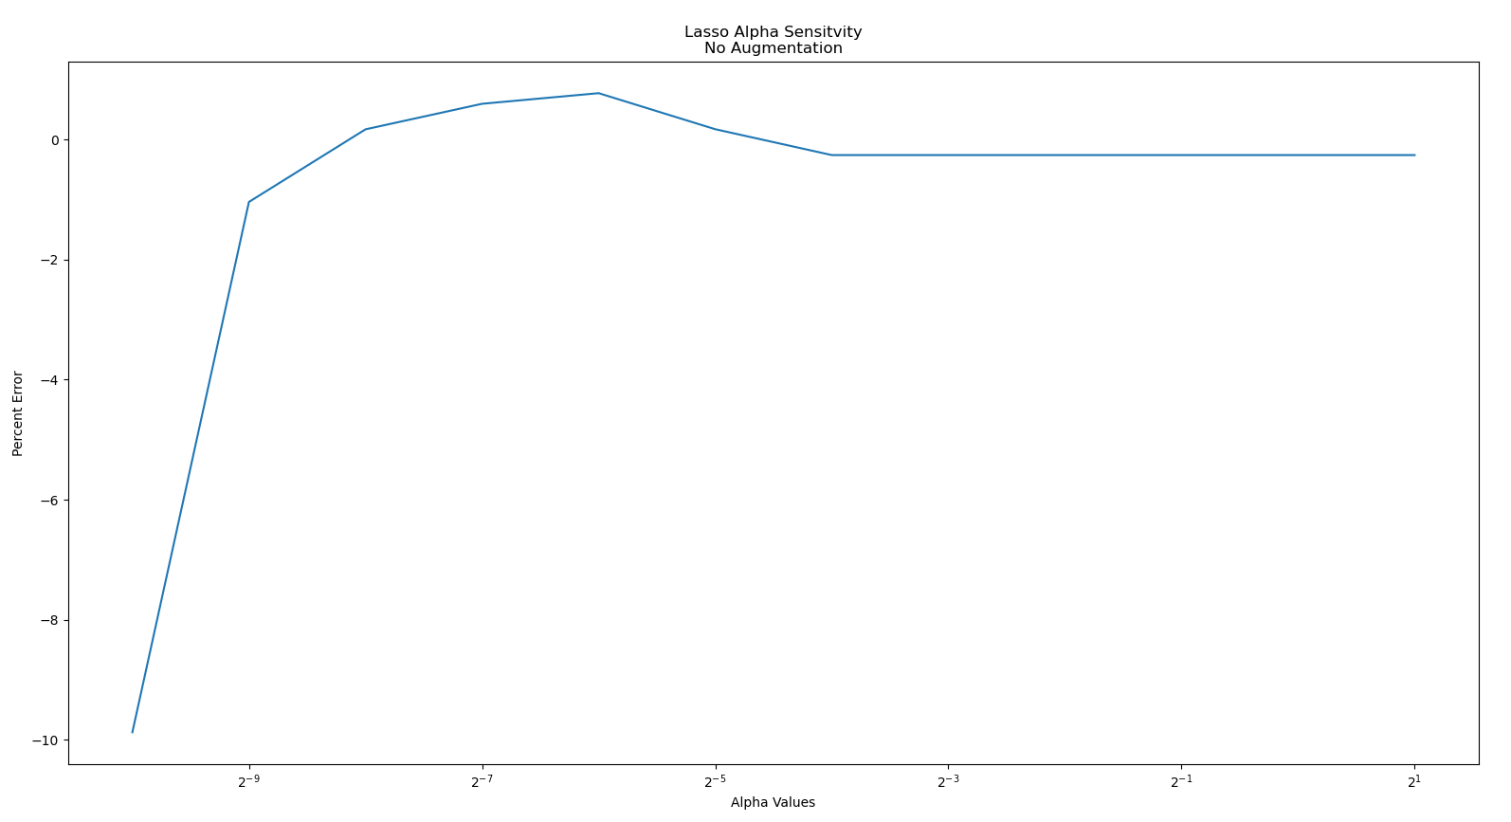
Results
Alpha value sensitivity in the non-augmented dataset

Slide 8
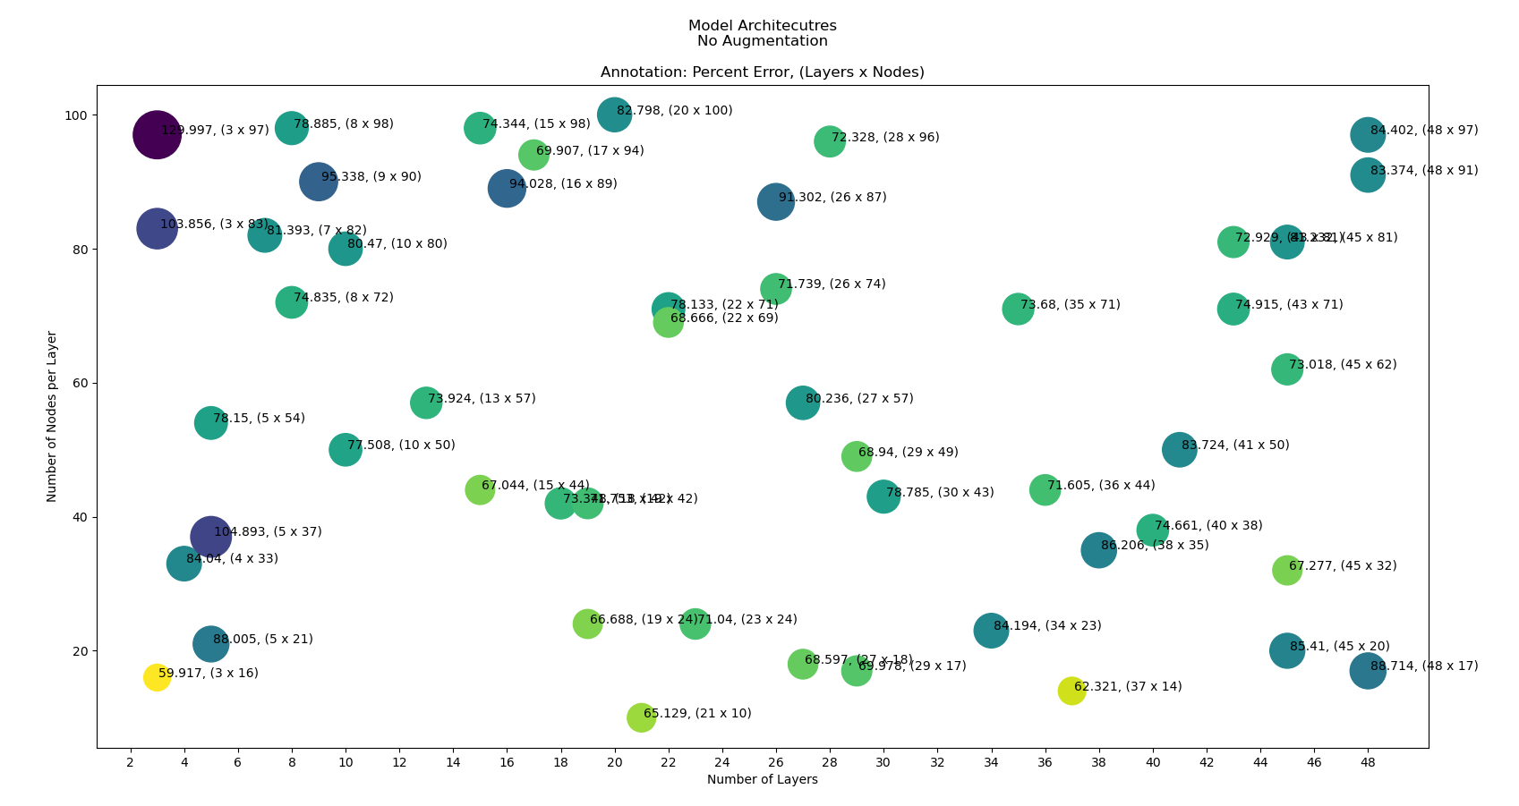
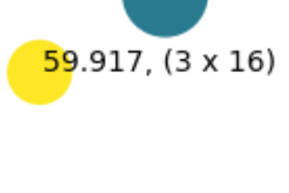
Results
Architecture selection for the non-augmented dataset
Best:
Layers: 3
Nodes: 16

Slide 9
Results
Activation performance in the un-augmented dataset
Best batch size:
Exponential Linear Unit

Slide 10
Results
Alpha value sensitivity in the un-augmented dataset
Best batch size:
2⁶ = 64

Slide 11
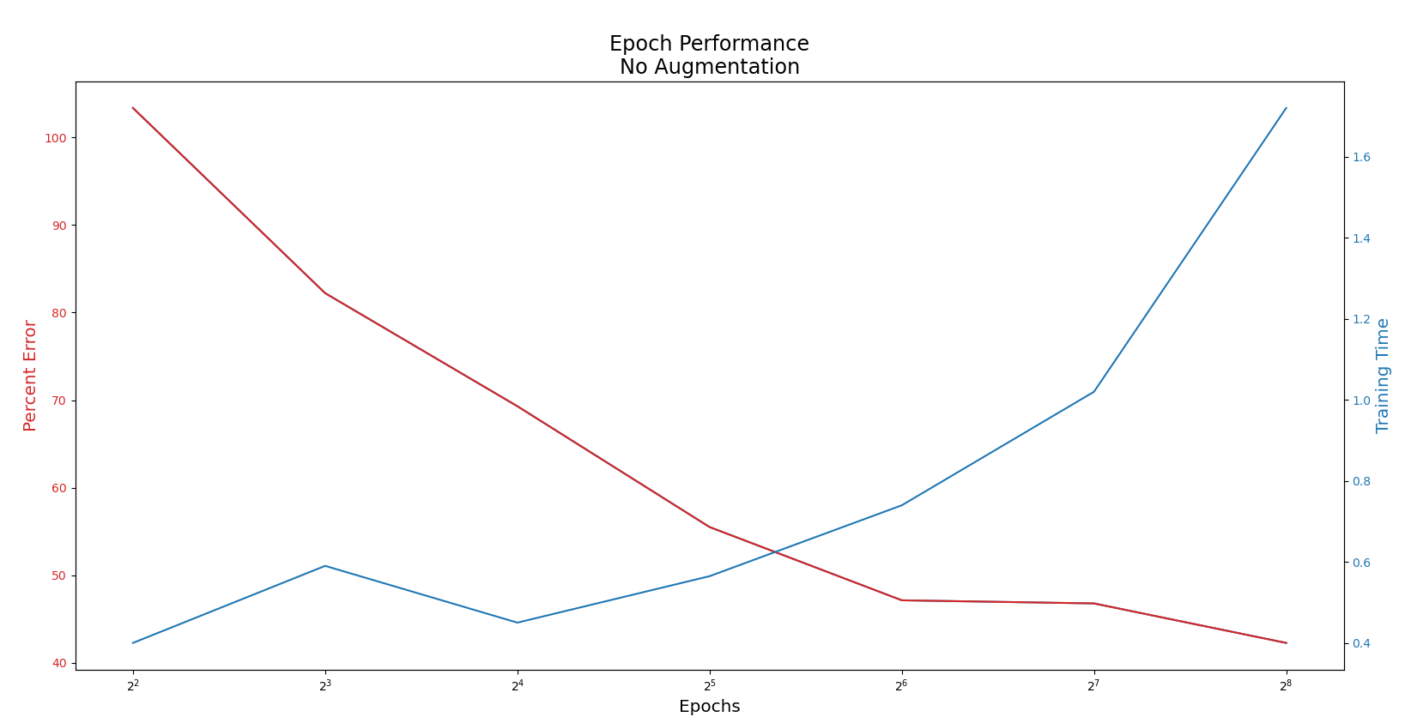
Results
Epoch quantity sensitivity in the un-augmented dataset
Best epoch: 2⁶ = 64

