Slide 2
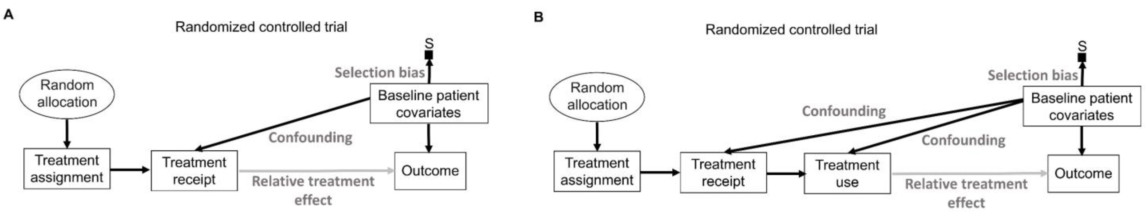

Slide 4
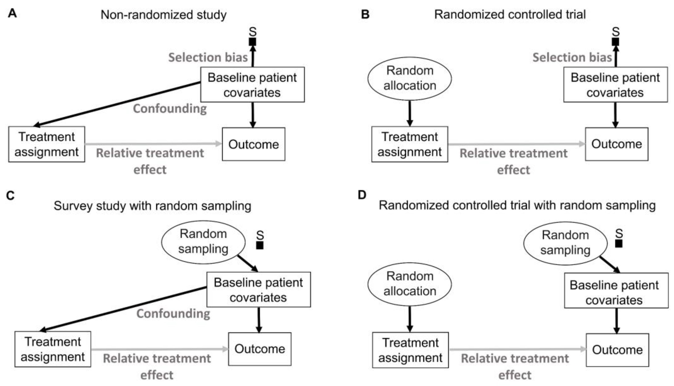

Slide 5
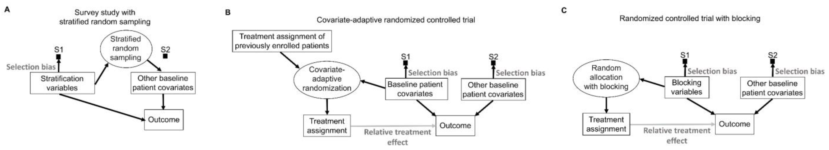
Potential
Potential

Slide 6
Potential
Potential

Slide 7
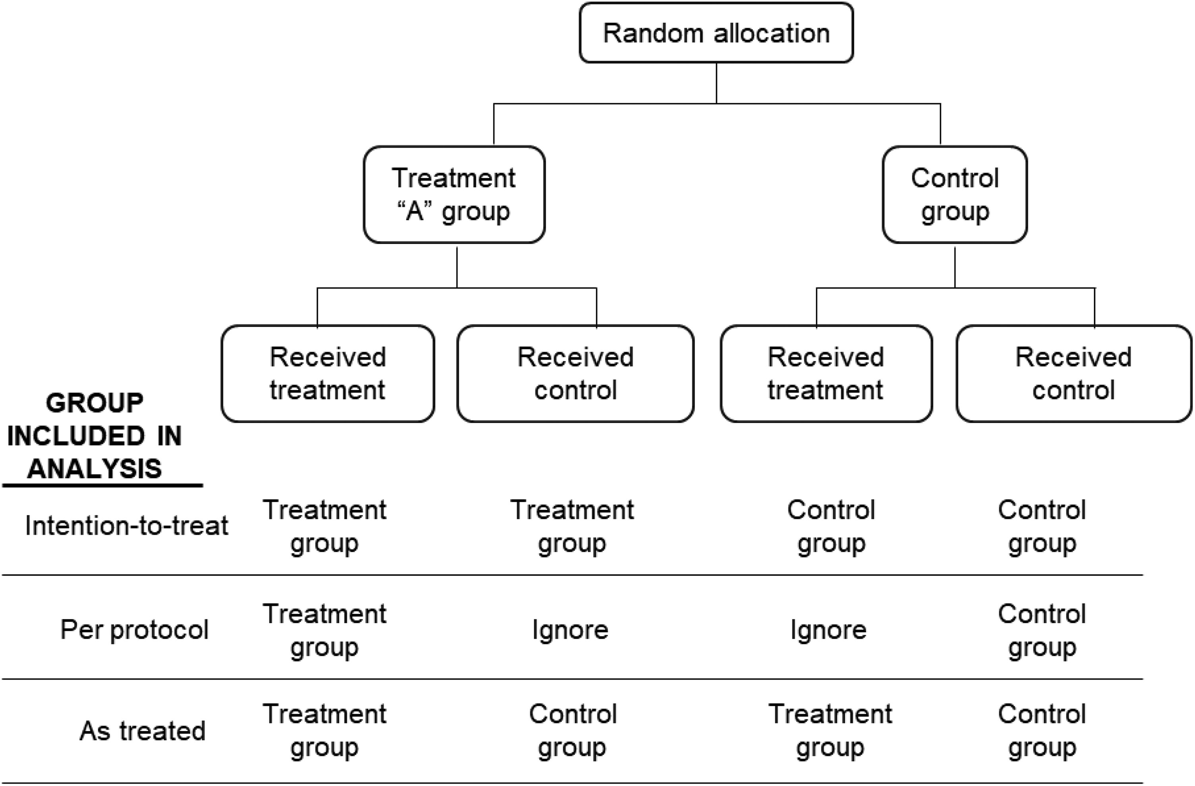

Slide 11
Randomization
Group Assignment
Time
Concealment allocation
Blinding & Follow-up

Slide 12
Randomization
Group Assignment
Confounding
Time
Concealment allocation
Blinding & Follow-Up
Selection Bias
Performance Bias
Measurement Bias
Selection Bias

