Slide 1
Does a higher population lead to higher Gross Domestic Product(GDP)? What country has the highest Per Capita GDP? By Jhony Ortiz

Slide 2
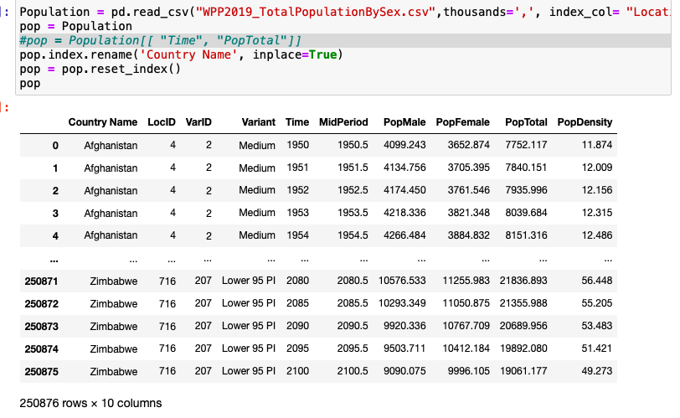

Loading Data
WPP2019 Total Population
GDP 2011-2019

Slide 3

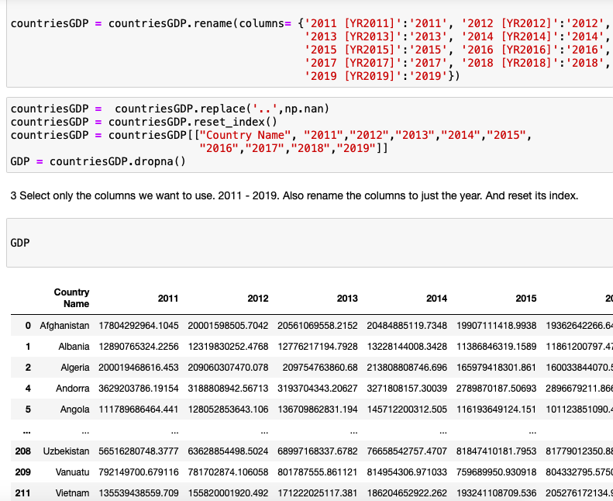
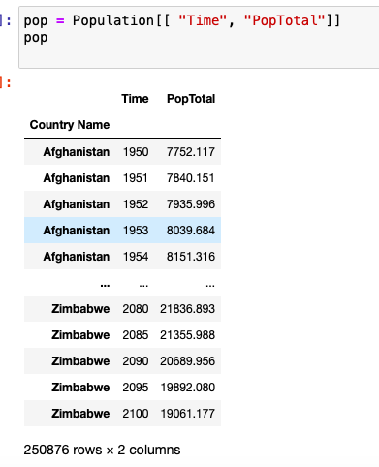
Clean Up Data
Change some of the country names
Select certain columns
Rename columns
Replace values of ‘…’ with NaN

Slide 4

Preparing to Merge the Tables
Melt the GDP table
Convert some of the values into numeric data

Slide 5
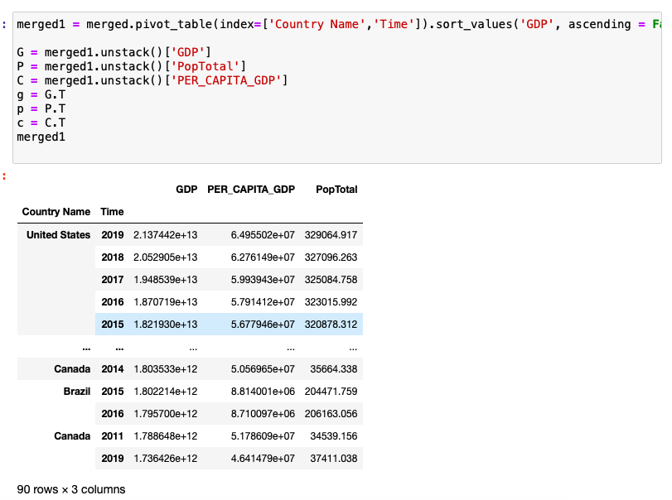
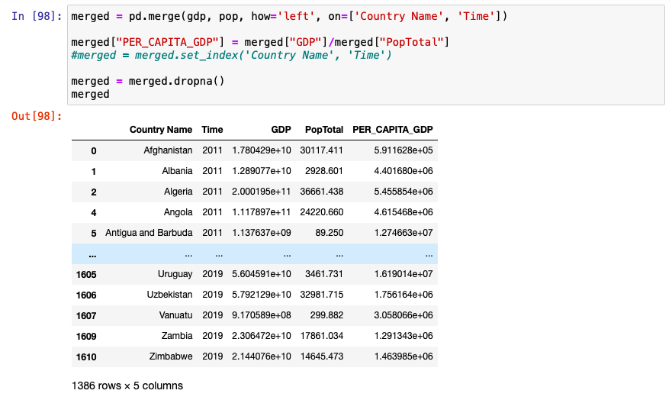
Merging Tables
Pivot table
And indexed it using Country Name and Time
Merge both tables using left table to join the data.
Add Column with the Per Capita Data

Slide 6
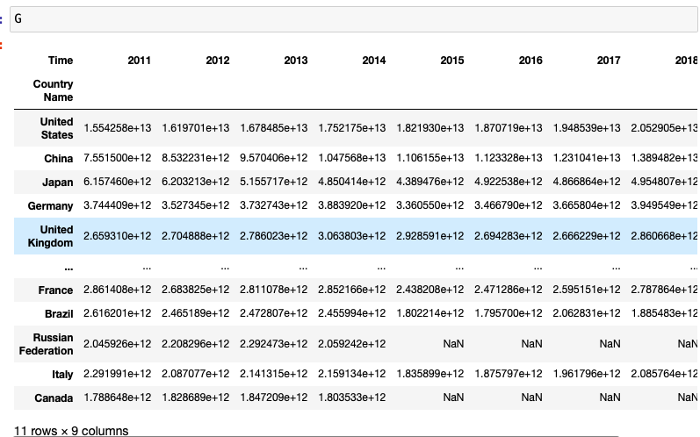
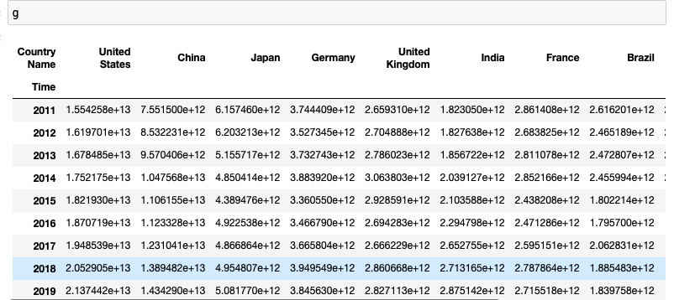
Setting up for visualization
Unstack data
Transpose data

Slide 7
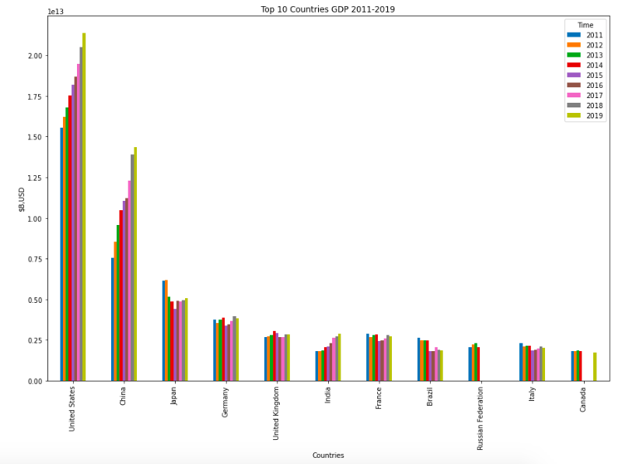
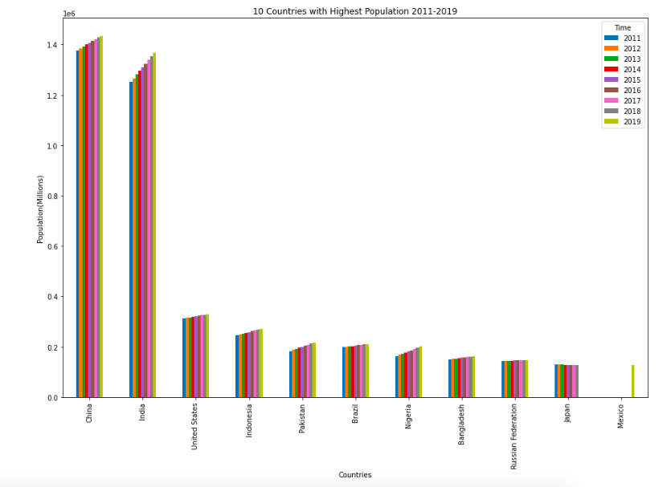
GDP and Population from 2011-2019
Top 10 Countries with Highest GDP
Top 10 Countries with Highest Populations

Slide 8
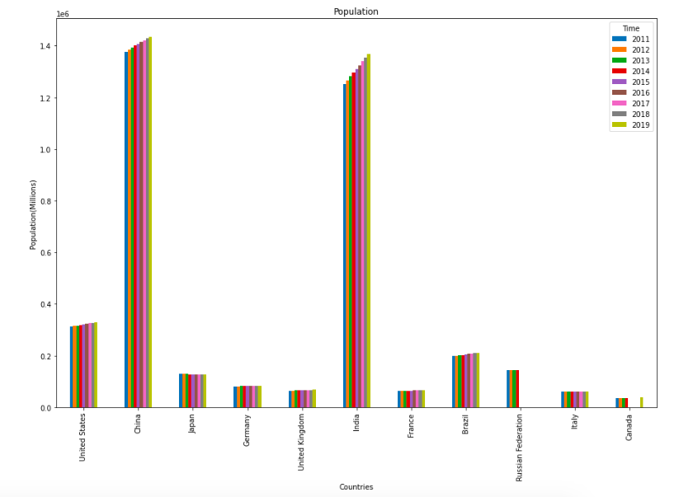
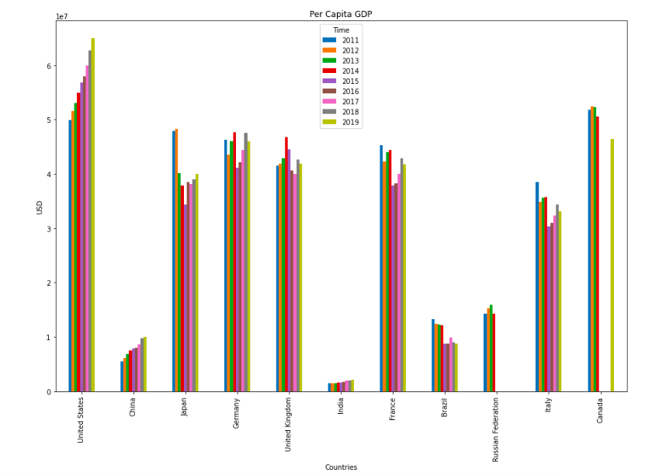
Population of the top 10 countries with highest GDP and Per Capita GDP
Population
Per Capita GDP

Slide 9
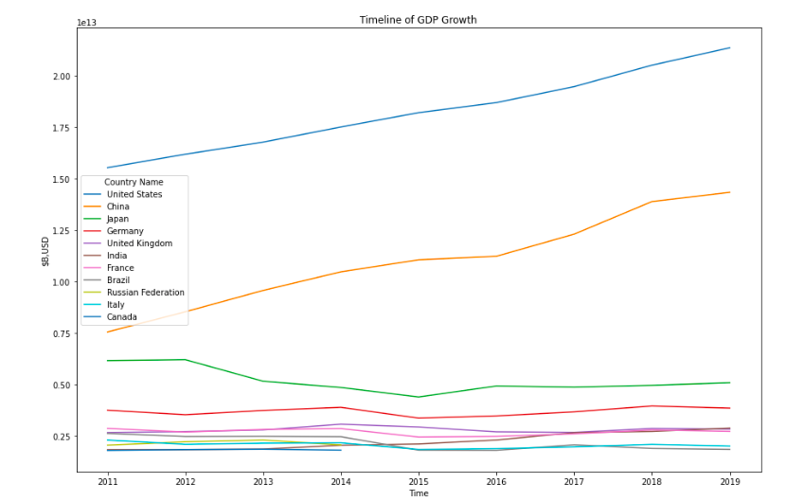
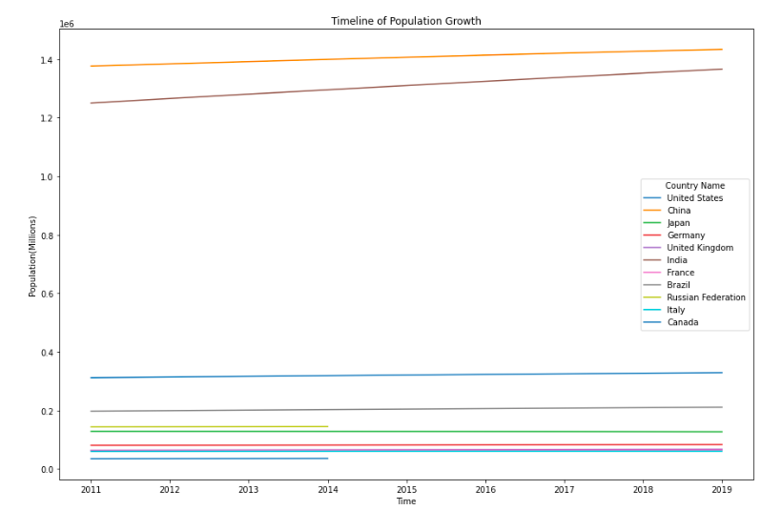
GDP and Population Growth of Top 10 Countries with Highest GDP
GDP over 9 years
Population over 9 years

Slide 10
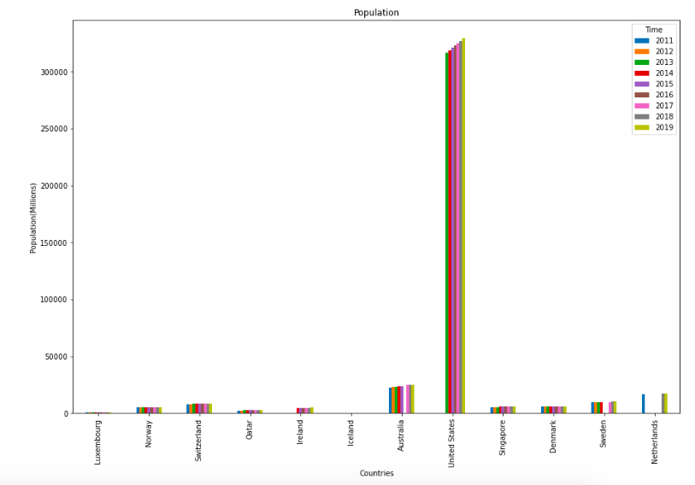
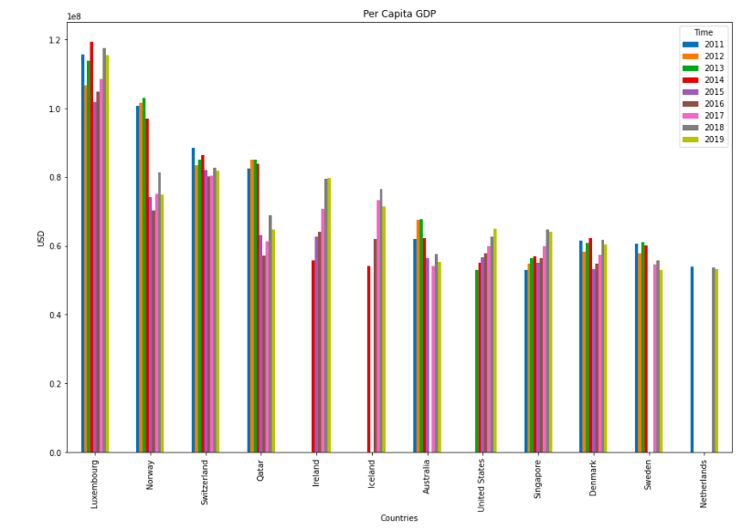
Countries with the highest Per Capita GDP and Population
Population
Per Capita GDP

Slide 11
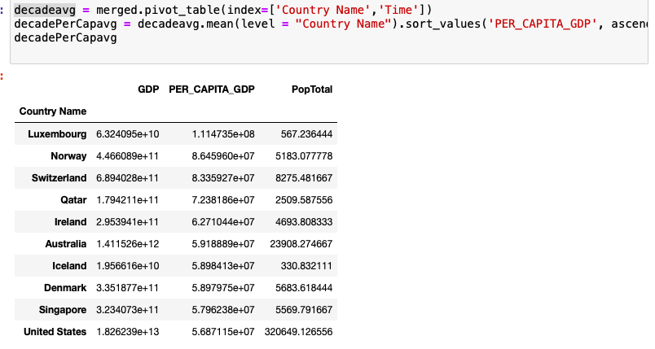
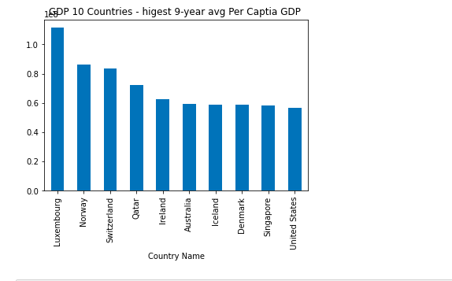
Avg. Highest Per Capita GDP for the 9- year period
Per Capita GDP
Easier way to look at it

Slide 12
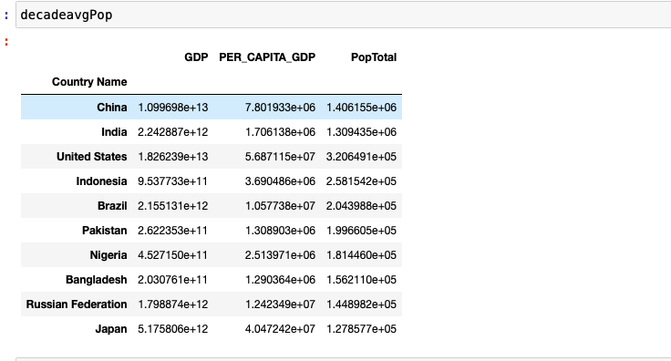
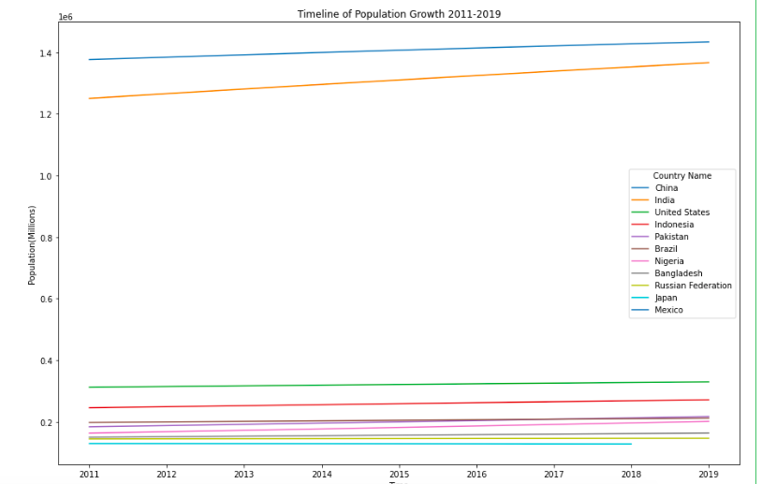
Top 10 Countries with the highest Population Average
List of Top 10
Population GDP Growth

Slide 13
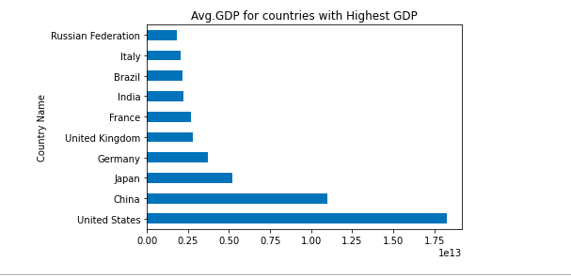
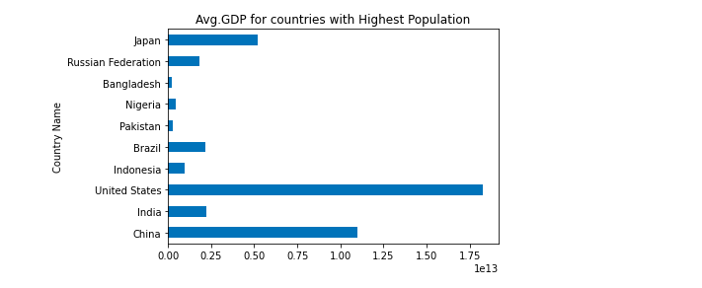
Higher Populations Lead to Higher GDP
List of countries with the highest Avg. GDP
Avg. GDP of the countries with highest Populations

Slide 14
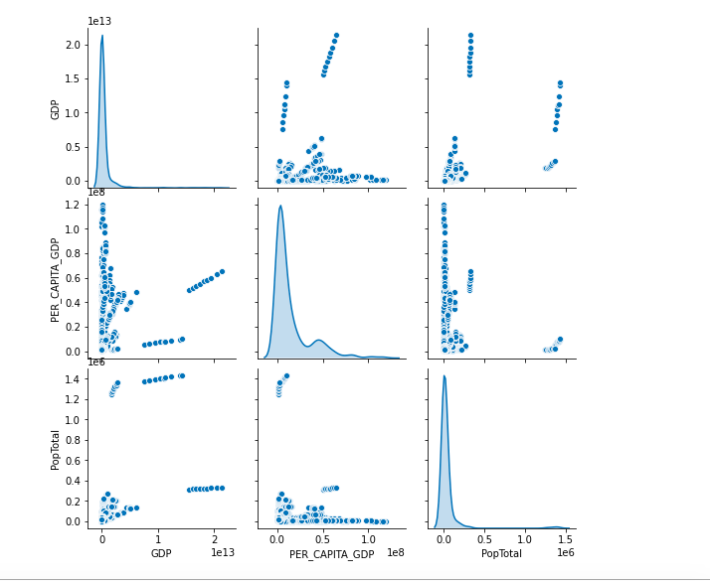
Conclusion
Country with Highest GDP: United States
Country with Highest Population: China
Country with Highest Per Capita GDP: Luxemburg
Higher Population does not mean higher GDP or Per Capita GDP.
Smaller Populations can lead to higher Per Capita GDP.

